Slide 1
Nutrition Cart
2020-1 SOFTWARE ENGINEERING TEAM5
김승윤 김선지 이민호 김주환 이민영 ChrisChross

Slide 2
Background
#01

Slide 3


  SOFTWARE ENGINEERING TEAM5
People can’t go outside
Strict Social distancing
People don’t go out to prevent the worldwide disease. People don’t use offline market, but rely on online shopping nowadays.

Slide 4
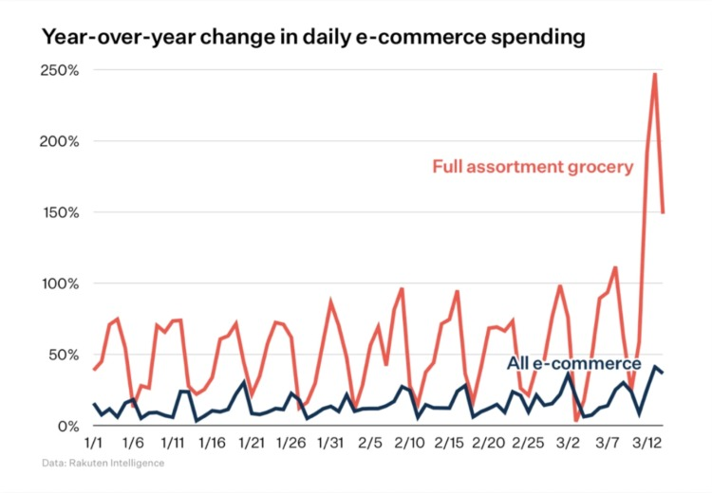
  SOFTWARE ENGINEERING TEAM5
Increasing rate of online shopping
E-commerce is growing
Because of
Effects of pandemic disease
Convenience of delivery
Commerce of social media
Improvement of mobile device
Are there any application for groceries?

Slide 5
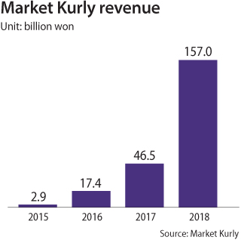

  SOFTWARE ENGINEERING TEAM5
Case study: Market Kurly
Fresh ingredient market
Its revenue is
increasing amazingly
year after year

Slide 6
Project Overview
#02

Slide 7


  SOFTWARE ENGINEERING TEAM5
Goals
Based on
Ingredient suggestion
Ingredients in cart
user’s health condition
user’s previous selection
Menu suggestion
Nutrition factor in Cart

Slide 8
Design Concept
#03

Slide 9
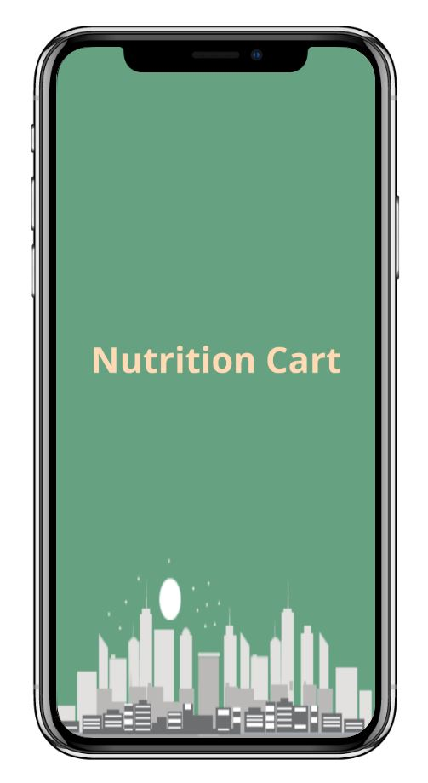
  SOFTWARE ENGINEERING TEAM5
  SOFTWARE ENGINEERING TEAM5
Overall Design Concept
Click it! →
Frontend

Slide 10
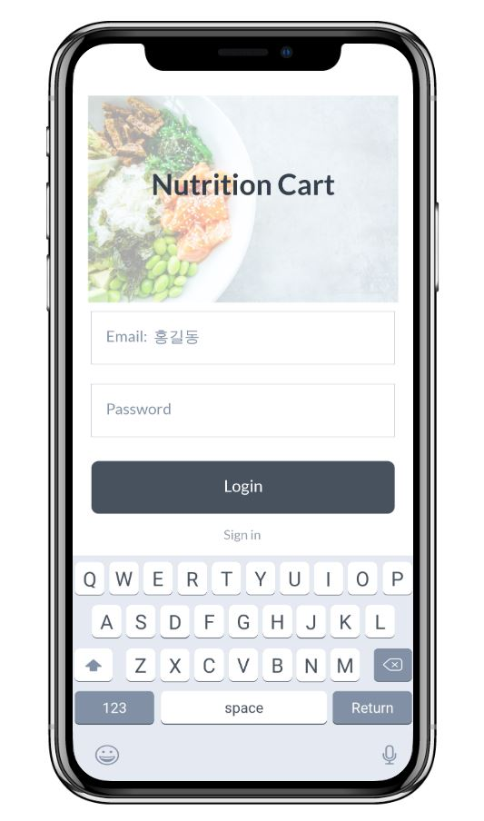
  SOFTWARE ENGINEERING TEAM5
  SOFTWARE ENGINEERING TEAM5
Login
Frontend

Slide 11
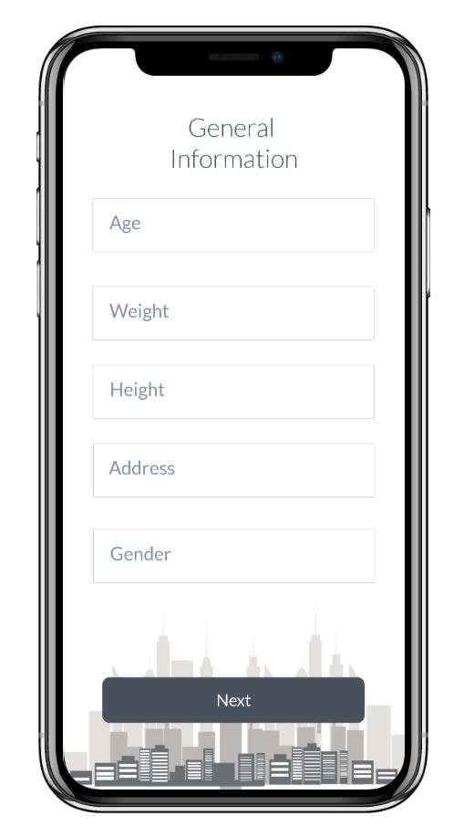
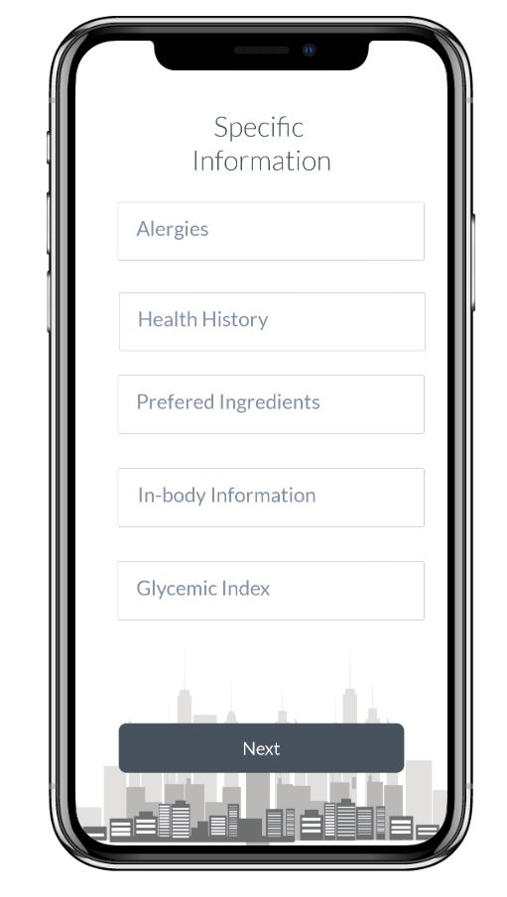
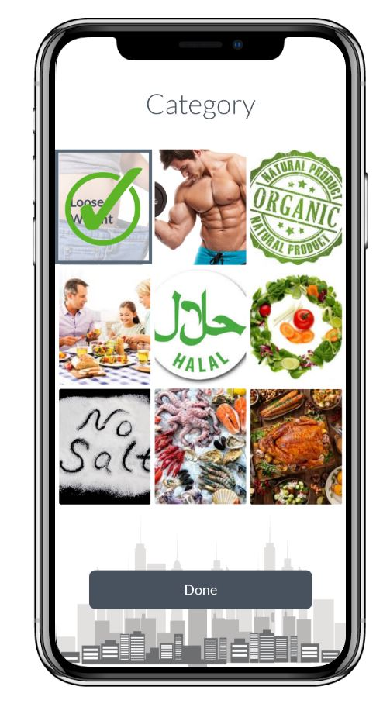
  SOFTWARE ENGINEERING TEAM5
  SOFTWARE ENGINEERING TEAM5
User Information
Through these processes,
we find out the user's information and preferences.

Slide 12
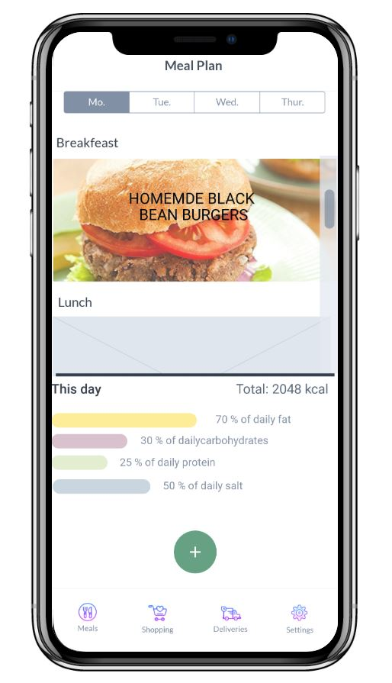
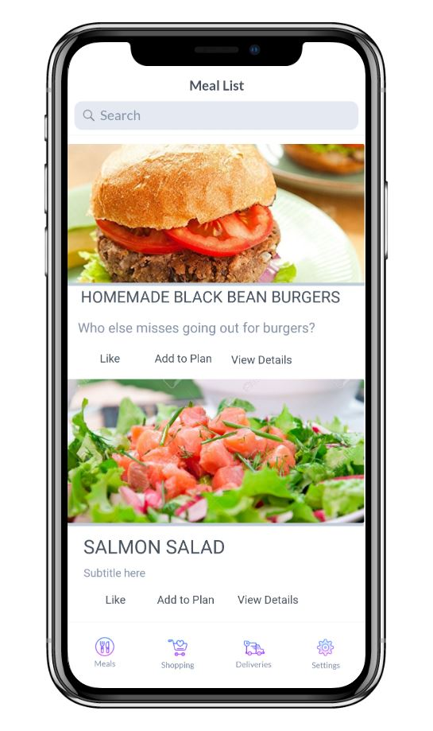
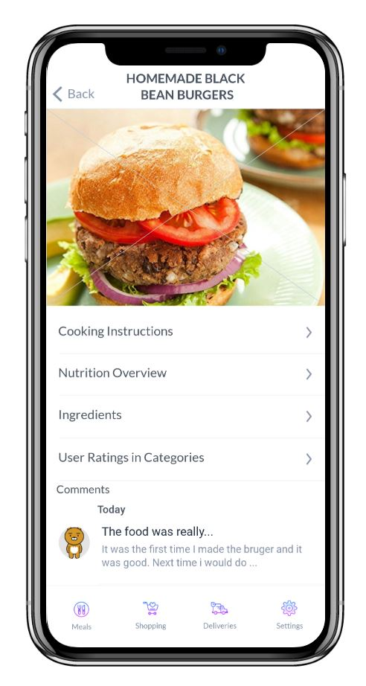
  SOFTWARE ENGINEERING TEAM5
  SOFTWARE ENGINEERING TEAM5
Recommendation
From the user's information obtained above
(for diet purposes,
preferred food, etc.)
various menus are recommended for each day of the week.
you can see the daily calories.

Slide 13
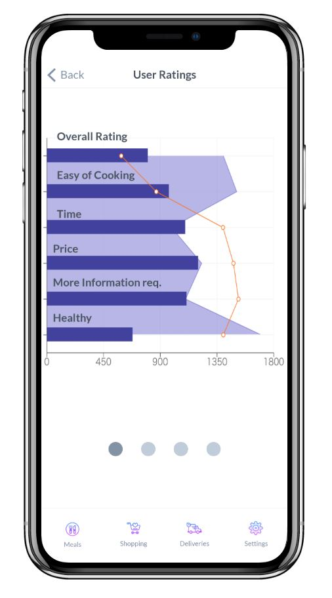
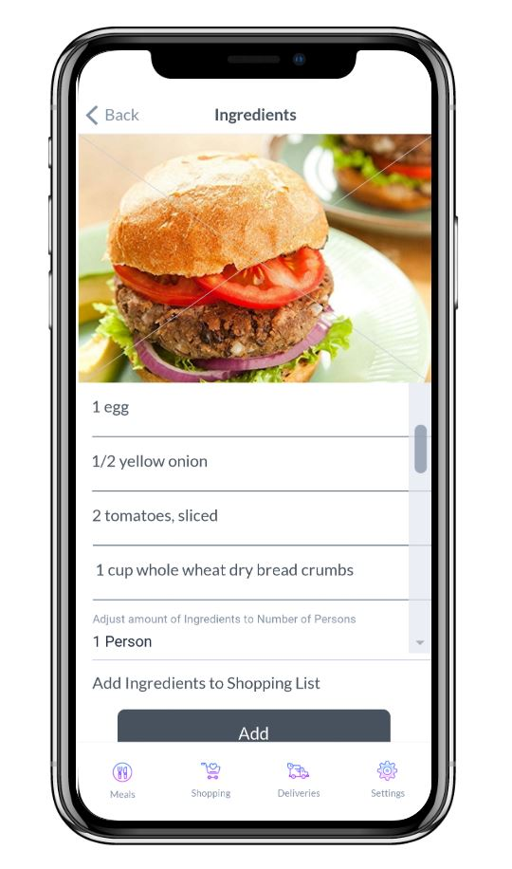
  SOFTWARE ENGINEERING TEAM5
  SOFTWARE ENGINEERING TEAM5
Details
You can see the ingredients and user rating of the selected menu.

Slide 14
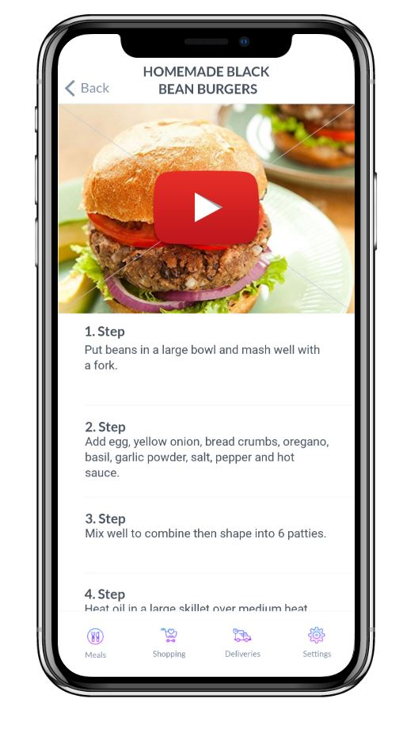
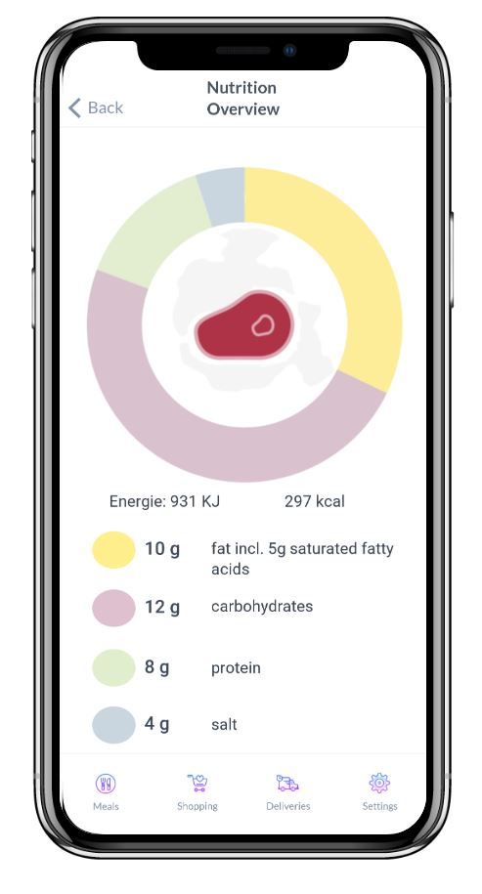
  SOFTWARE ENGINEERING TEAM5
  SOFTWARE ENGINEERING TEAM5
Details
Frontend
You can even see the recipes and nutrients in each ingredient of the menu.

Slide 15
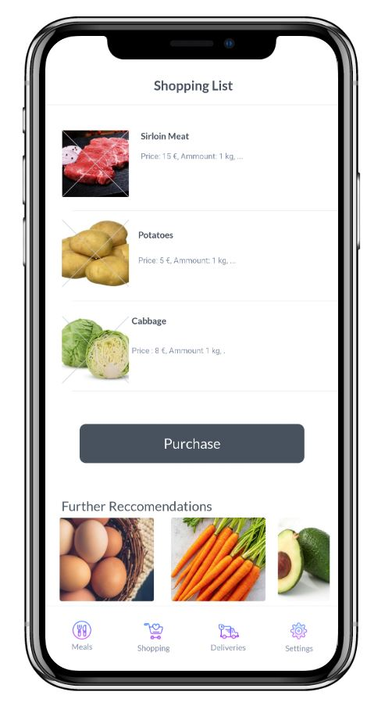
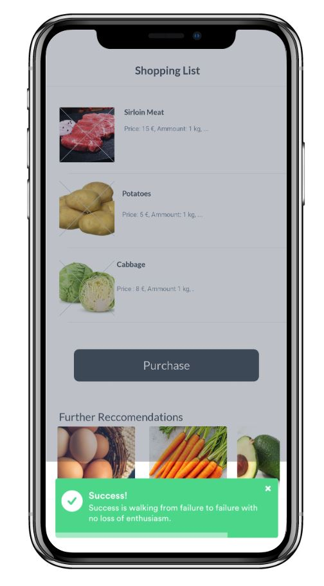
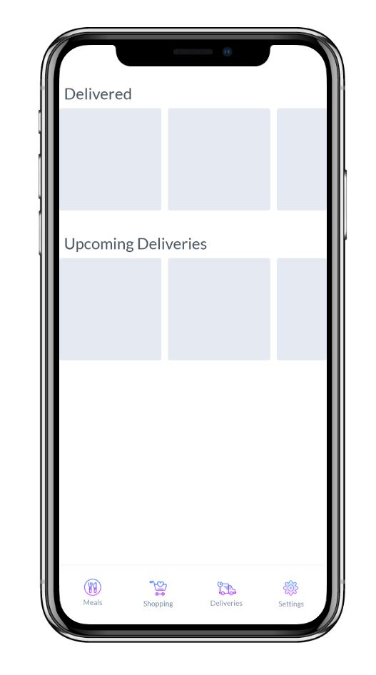



  SOFTWARE ENGINEERING TEAM5
  SOFTWARE ENGINEERING TEAM5
Shopping List & Delivery
In this page, you can see all foods you put the cart, and delivery status.

Slide 16
Development
#04

Slide 17
  SOFTWARE ENGINEERING TEAM5
  SOFTWARE ENGINEERING TEAM5
System Structure
System
Backend
Frontend
Web
Server
Recommendation
system
Database

Slide 18


  SOFTWARE ENGINEERING TEAM5
  SOFTWARE ENGINEERING TEAM5
Frontend
Ionic framework
Bootstrap
ionic framework 설명 추가
설명 추가
Open source UI toolkit for building performant, high-quality hybrid app
HTML, CSS, JS
Framework for developing responsive and mobile-first web projects
HTML, CSS, JS
System
Backend
Frontend
Web
Server
Recommendation
system
Database

Slide 19

  SOFTWARE ENGINEERING TEAM5
  SOFTWARE ENGINEERING TEAM5
System
Backend
NIGNX
Web Server
Web Server
Event-based web server software with faster performance with fewer resources
C
Recommendation
system
System
Backend
Frontend
Web
Server
Recommendation
system
Database

Slide 20

  SOFTWARE ENGINEERING TEAM5
  SOFTWARE ENGINEERING TEAM5
System
Backend
MySQL
Database
Web Server
The world's most popular open source RDBMS, including Facebook, Google and Adobe
C, C++
System
Backend
Frontend
Web
Server
Recommendation
system
Database

Slide 21



  SOFTWARE ENGINEERING TEAM5
  SOFTWARE ENGINEERING TEAM5
Collaborative Filtering
Technology that predicting itself based on the users’ information of what they prefer.
Backend
similar users
Recommendation
System
Web Server
System
Backend
Frontend
Web
Server
Recommendation
system
Database

Slide 22


  SOFTWARE ENGINEERING TEAM5
  SOFTWARE ENGINEERING TEAM5
Contents-Based Filtering
Technology that predicting itself based on the descriptions of each item using user’s previous experience of items.
Backend
Recommendation
System
Web Server
choose
similar items
System
Backend
recommended
Frontend
Web
Server
Recommendation
system
Database

Slide 23
Effects and Benefits
#05

Slide 24

  SOFTWARE ENGINEERING TEAM5
  SOFTWARE ENGINEERING TEAM5
Healthy Meal Plan
Based on
Recipe recommendation
Analyzing
User’s information
Inbody & Nutritions

Slide 25

  SOFTWARE ENGINEERING TEAM5
  SOFTWARE ENGINEERING TEAM5
Not Overbuying
By buying only ingredients
included in recipes,
Can provide economic saving.

Slide 26
Thank you
Q&A

