Slide 1
CONNECT-U
Workforce Brokerage Platform

Slide 2

PREVIEW
1
TEAM 11
TOPIC
CONTENTS OF
CONNECT-U
2
TEAM&PLAN
3
EFFECT
4

Slide 3
1.
PREVIEW

Slide 4
PREVIEW
PREVIEW
Background
Tony, I'll gonna contact professor A to let me in his lab.
Case 01
There is not enough information about lab
e.g. remaining seats, recruitment of this semester, project, pay, etc
I'm interested in his research topic.
Oh, really?
But, as far as I know, he doesn’t recruit research student anymore.
Probably because there are already too many students.
😧
How did you know that?

Slide 5

PREVIEW
PREVIEW
Background
Case 02
It is hard to look for people to work with
e.g. project, programming study

Slide 6
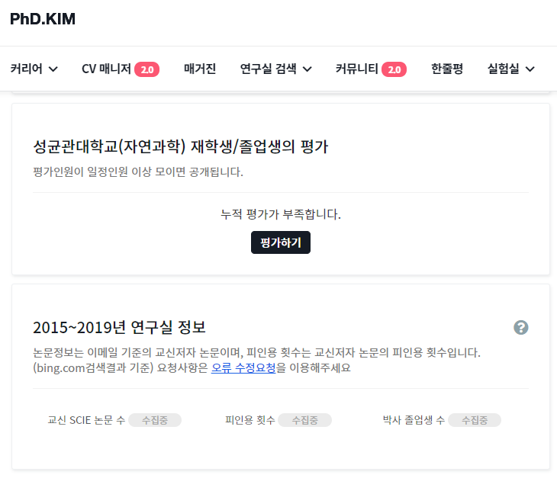
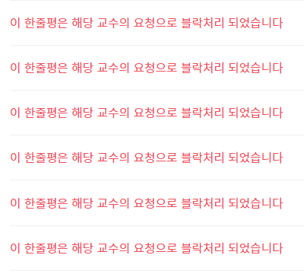
PREVIEW
Status quo.
Case1: Ph.D KIM net
Students just know fragmentary information from “Ph.D Kim.net”
Even “Ph.D Kim.net” lacks information or the information is blocked
Only provide web service, not application service.

Slide 7
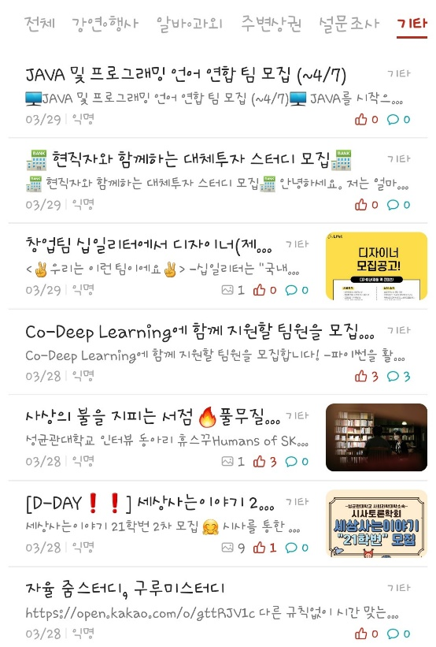
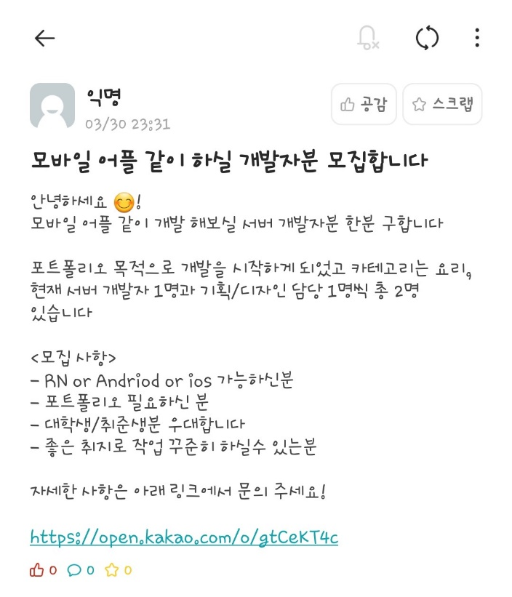
PREVIEW
Status quo.
Case2: Everytime
Contains various types of advertising articles. Difficult to find the desired study or project job postings.
No fixed template for the recruitment article. Ambiguous conditions.
(e.g. duration, career, ability, etc)

Slide 8
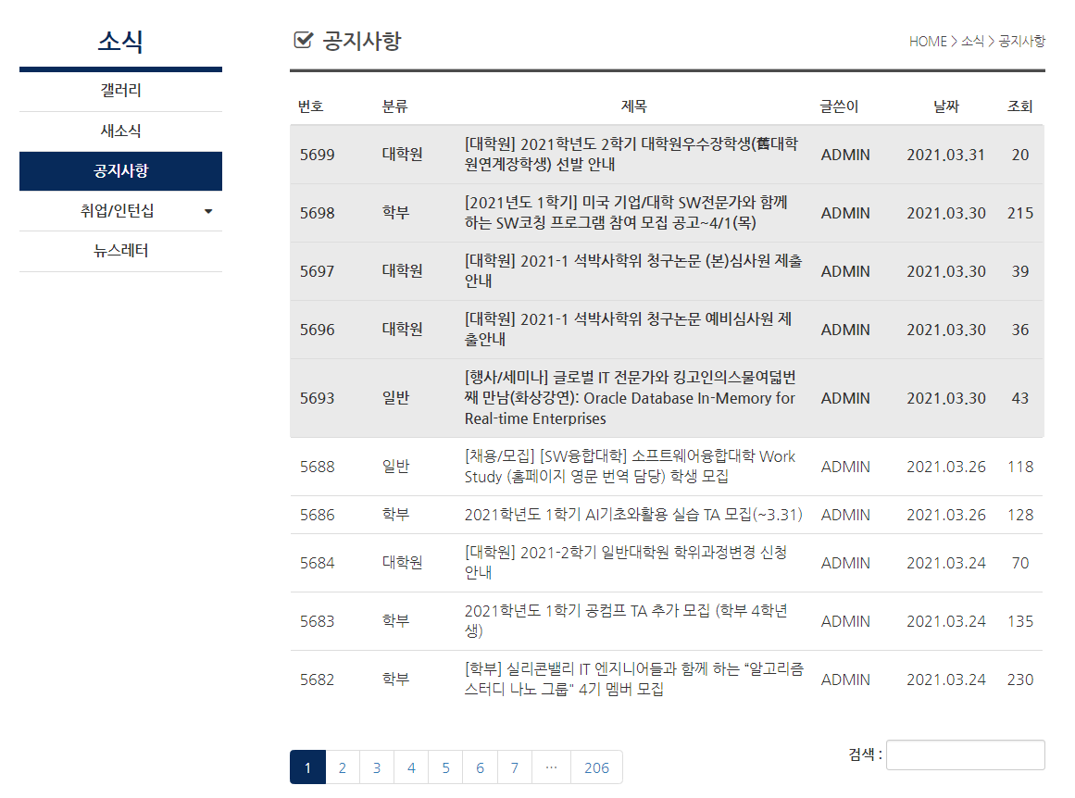
PREVIEW
Status quo.
Case3: cs.skku.edu
No sorting function by category. Difficult to find the desired job posting.

Slide 9
2.
TOPIC

Slide 10



PREVIEW
TOPIC
Target
Professors who find Undergraduate / Master / Doctoral Researchers or experiment participants.
“Connect requester and requestees.”
Students who want some pay, work or anything that may improve career.

Slide 11




PREVIEW
TOPIC
Feature
Increasing readability and accessability by providing fixed template while register process
Every Request can be sorted by Pay / Subject / Worktime / Requirements
Provide “rating” system to Requesters and Requestees to evaluate each other
and enabling users access to opponents’ rating
Collecting lab’s information by project or experiment’s review

Slide 12
PREVIEW
TOPIC
System Design
0
Whole system of “Connect-U”
Front-end
Back-end
Photoshop
Zeplin
APIs
Firebase
Android Studio & XCode (iOS)
Easy Features
Record Career
Analyzing Report / Review
Friendly UI/UX
Objectification(객관화)
Review / Report
Recommendation by interest area

Slide 13
PREVIEW
TOPIC
System Flow
Feature
System
Register
Requirements
Pay, Workload
Performance
Verifying
Sorting
Pay, Workload, Rating, etc…
Only Fitted things
Interest
Recommend
Career
Preference
Review
Rating for several standards
Comment
Report
Kinds
Analyze Report
Decision Punishment

Slide 14



PREVIEW
TOPIC
Frontend tools
Zeplin
For hand-off UI/UX
Photoshop
For design
Android Studio
For developing app

Slide 15



PREVIEW
TOPIC
Backend tools
Firebase
For Server&DB
Github
For open development
Android Studio
For developing app

Slide 16
3.
TEAM&PLAN

Slide 17
PREVIEW
TEAM&PLAN
Team Formation
Team 11
Designer
Developer
Android & iOS
Developer
Server & Database
Developer
UX/UI Designer
Insu Lee
Gwangho Lee
Dohyun Kim
Yeonjae Kim
Yongwoo Choi

Slide 18




PREVIEW
TEAM&PLAN
Team Formation
Design
App develop
Server & DB
Insu Lee
Gwangho Lee
Yeonjae Kim
Design UX/UI
Importing design to application
Develop application
Connect with other parts
Develop and Manage server & DB
Connect application and server
Dohyun Kim
Yongwoo Choi
Develop application
Team leader
Develop and Manage server & DB
Server optimization

Slide 19
PREVIEW
TEAM&PLAN
Plan
 | 4/5~4/11 | 4/12~4/18 | 4/19~4/25 | 4/26~5/2 | 5/3~5/9 | 5/10~5/16 | 5/17~5/23 | 5/24~5/30 | 5/31~
Requirement Specification
Design UI/Structure
Implement Component
Integration
Code Review
Testing
Launch

Slide 20
PREVIEW
TEAM&PLAN
Test Process
Unit Test
Test each Android and iOS apps
Integration Test
Import design to apps
Connect and integrate server & DB
System Test
Test of the system as a whole
Acceptance Test
Distribute and test to SKKU student

Slide 21
4.
EFFECT

Slide 22


PREVIEW
EFFECT
Goals
Easy, Fast, and Efficient
Workforce Brokerage
Easily recruit people you want
Easily find the projects, labs, jobs, etc. what you want

Slide 23



PREVIEW
EFFECT
Effect
PROFESSOR
It may be used to recruit suitable persons for his laboratory.
Able to find project participants, undergraduate researchers, master's degree students, teaching assistant, etc at one platform
SCHOOL STAFF
It may be used to recruit administrative office assistance, library work, etc.
Conduct surveys more easily
STUDENT
It is easy to find and participate in projects they want, research they want to participate in, part-time jobs in the school, etc.

Slide 24

PREVIEW
EFFECT
Benefit
Able to work with certified person by rating system
Reducing effort to find specified project or person
Easily find the information about the laboratory

Slide 25
Thank You

