Slide 1
start lecture
open bookmark tab
create bookmark
Consult professor’s bookmark
delete bookmark
change bookmark
write memo
change memo
save data
c

Slide 2


bookmark
consult professor’s bookmark
<include>
create professor’s bookmark
create student’s bookmark
<extend>
add memo
student
edit bookmark
change memo
professor
<extend>
delete bookmark
change bookmark

Slide 3
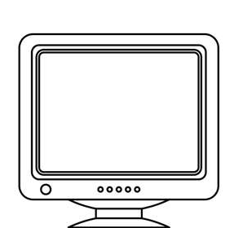
student
professor
Show bookmark
open own bookmark table
Open instructor’s bookmark table
Make bookmark
Edit bookmark
Delete bookmark
Jump to bookmark
Add note
Edit bookmark
system

Slide 4
start lecture
Close instructor’s bookmark table
Close own bookmark table
Close sign
Close sign
Jump to bookmark
Click sign
Jump to bookmark
Click sign
Make bookmark
Open instructor’s bookmark table
Make sign
Delete sign
Open sign
Open own bookmark table
Edit sign
Edit bookmark
Add note
Open sign (ins)
Delete sign
Finish sign
Finish sign
Delete bookmark
Finish sign
Finish edit
Finish delete bookmark
Send bookmark data
Send bookmark_id
save data
c

Slide 5
Lecture Management
System
User-Info Management
System
I-Campus Lecture
Sub-System
Bookmark Management
System
Note management
System

Slide 6
bookmark
consult professor’s bookmark
<include>
create professor’s bookmark
create student’s bookmark
<extend>
add memo
student
edit bookmark
change memo
professor
<extend>
delete bookmark
change bookmark

Slide 7
Open Instructor’s Bookmark
Jump to Bookmark
2
Instructor
Open Own Bookmark
Jump to Bookmark
2
Instructor
Make
Bookmark
Add to
Database
2
Edit
Bookmark
Delete
Bookmark

Slide 8
server
User DB
Open bookmark
Request data
Show data
Send data
If Show
successfully
Add bookmark
Create bookmark data
Show data
Send data
Finish edit bookmark
Update bookmark data
Show data
Send data
Finish delete bookmark
Remove bookmark data
Show data
Send data

