Slide 1
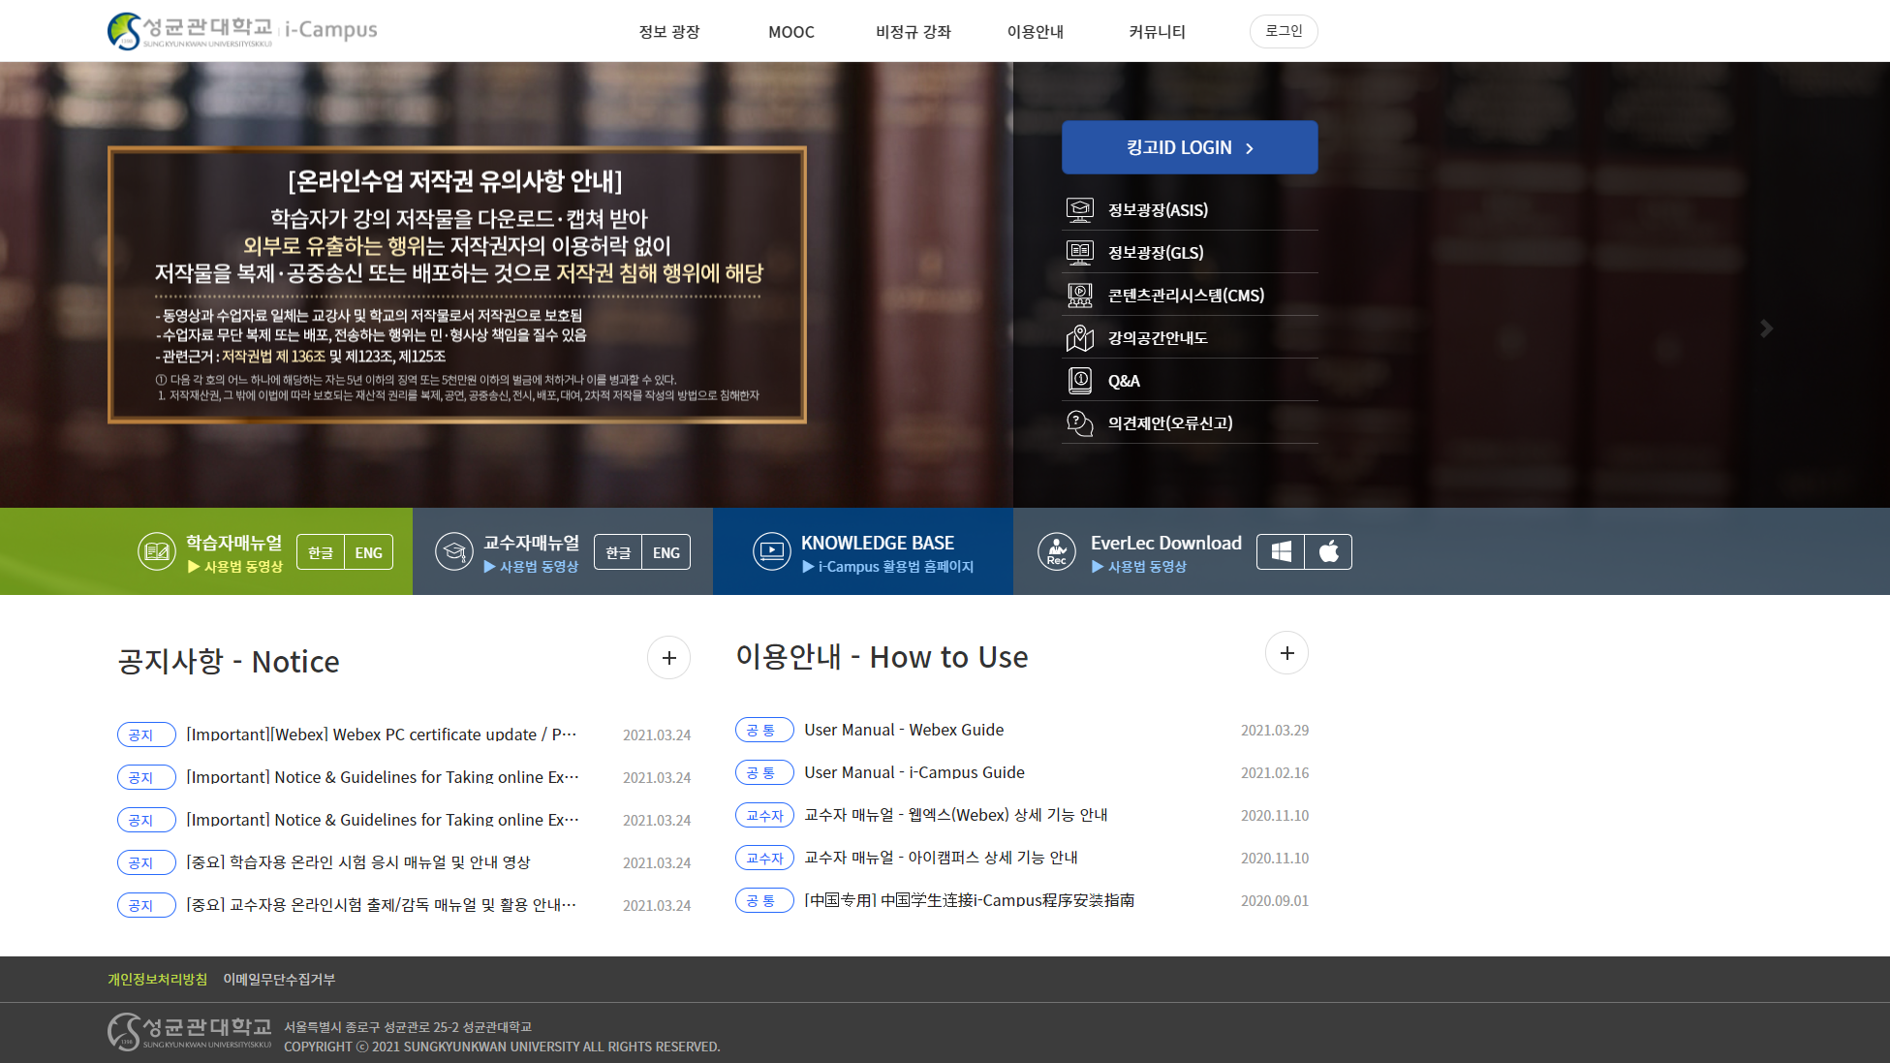
Team 4
I-Campus lecture Sub System
Team 4
2021.04.04
Copyrightⓒ. Saebyeol Yu. All Rights Reserved.

Slide 2

CONTENTS
001
Overview
Background
Market Status
002
Goals & Methods
Goals
Method
003
Team & Strategy
Team
Planning Strategy
004
Benefits
Copyrightⓒ. Saebyeol Yu. All Rights Reserved.

Slide 3
Part 1.
Overview
Overview
Copyrightⓒ. Saebyeol Yu. All Rights Reserved.

Slide 4
I-Campus lecture Sub System
1
Background
About I-Campus use
Have you ever used new I-Campus?
How are your classes conducted?
Most students have used the new i-Campus,
and many lectures are being conducted Online

Slide 5
I-Campus lecture Sub System
1
Background
Satisfaction with new I-Campus
Average satisfaction rating of 64.125

Slide 6
I-Campus lecture Sub System
1
Background
Preference about adding new functions (Bookmark & Notepad)
With the exception of 21.6 percent of people who chose "I don't know,"
About 80% of survey participants responded positively
to the idea of adding a notebook and bookmarking feature.

Slide 7
I-Campus lecture Sub System
1
Background
Another function to add
1. Capture the ppt screen during the professor's lecture and convert it into a textbook.
(If you press a specific button in the middle of the lecture,
the screens are made of pages in the pdf.) 2. In addition to letting students bookmark videos, the professor can also bookmark sections to highlight important information for students.
Add another bookmark for professor

Slide 8
I-Campus lecture Sub System
1
Background
Opinions about new functions
- I can't remember what they said/where they said it - I think it'll be easy to find and listen to the parts I need. - I don't want to pull up a seperate window
- I want to be able to do all of my work in one place - It's hard to keep going back and forth.

Slide 9
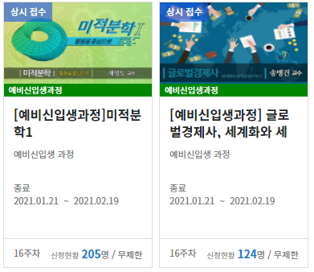
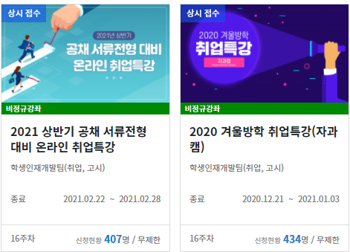
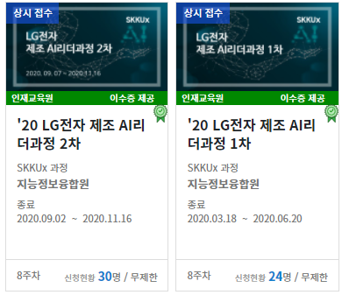
I-Campus lecture Sub System
2
User Status
Who is user
Our target demographic is students using I-Campus.
Many classes are being held on i-Campus, and students seem to want this feature.
It can also be helpful to freshman, graduates, outsider.

Slide 10
Part 2.
Goals & Methods
Goals & Methods
Copyrightⓒ. Saebyeol Yu. All Rights Reserved.

Slide 11
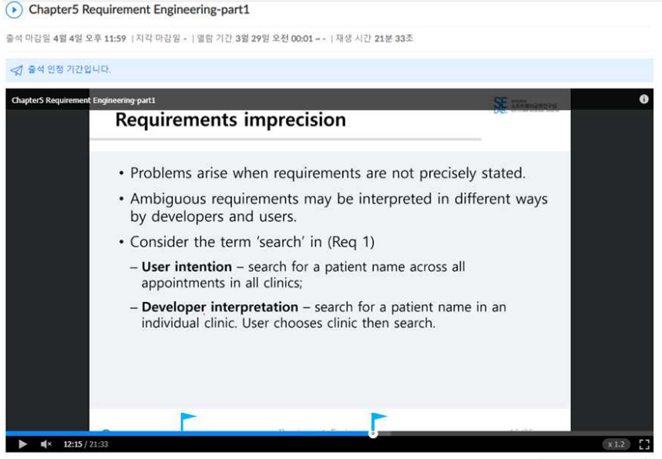
I-Campus lecture Sub System
1
Goals
Bookmark
Users can create bookmarks
Chapter5. Requirement Engineering-part 1
1 | 5:58
Write somethind...
2 | 12:15
Bookmark
MEMO
They can see and revise contents.
MEMO

Slide 12
I-Campus lecture Sub System
1
Goals
Notepad function
Chapter5. Requirement Engineering-part 1
1 | 5:58
Write somethind...
2 | 12:15
Bookmark
MEMO
Users can label their bookmarks
MEMO

Slide 13
I-Campus lecture Sub System
1
Goals
Professor bookmark function
Chapter5. Requirement Engineering-part 1
Bookmark
Pf. Chapter5. Requirement Engineering-part 1
1 | 3:32
2 | 18:58
Bookmark
Students are able to see the
Professor's bookmarks

Slide 14
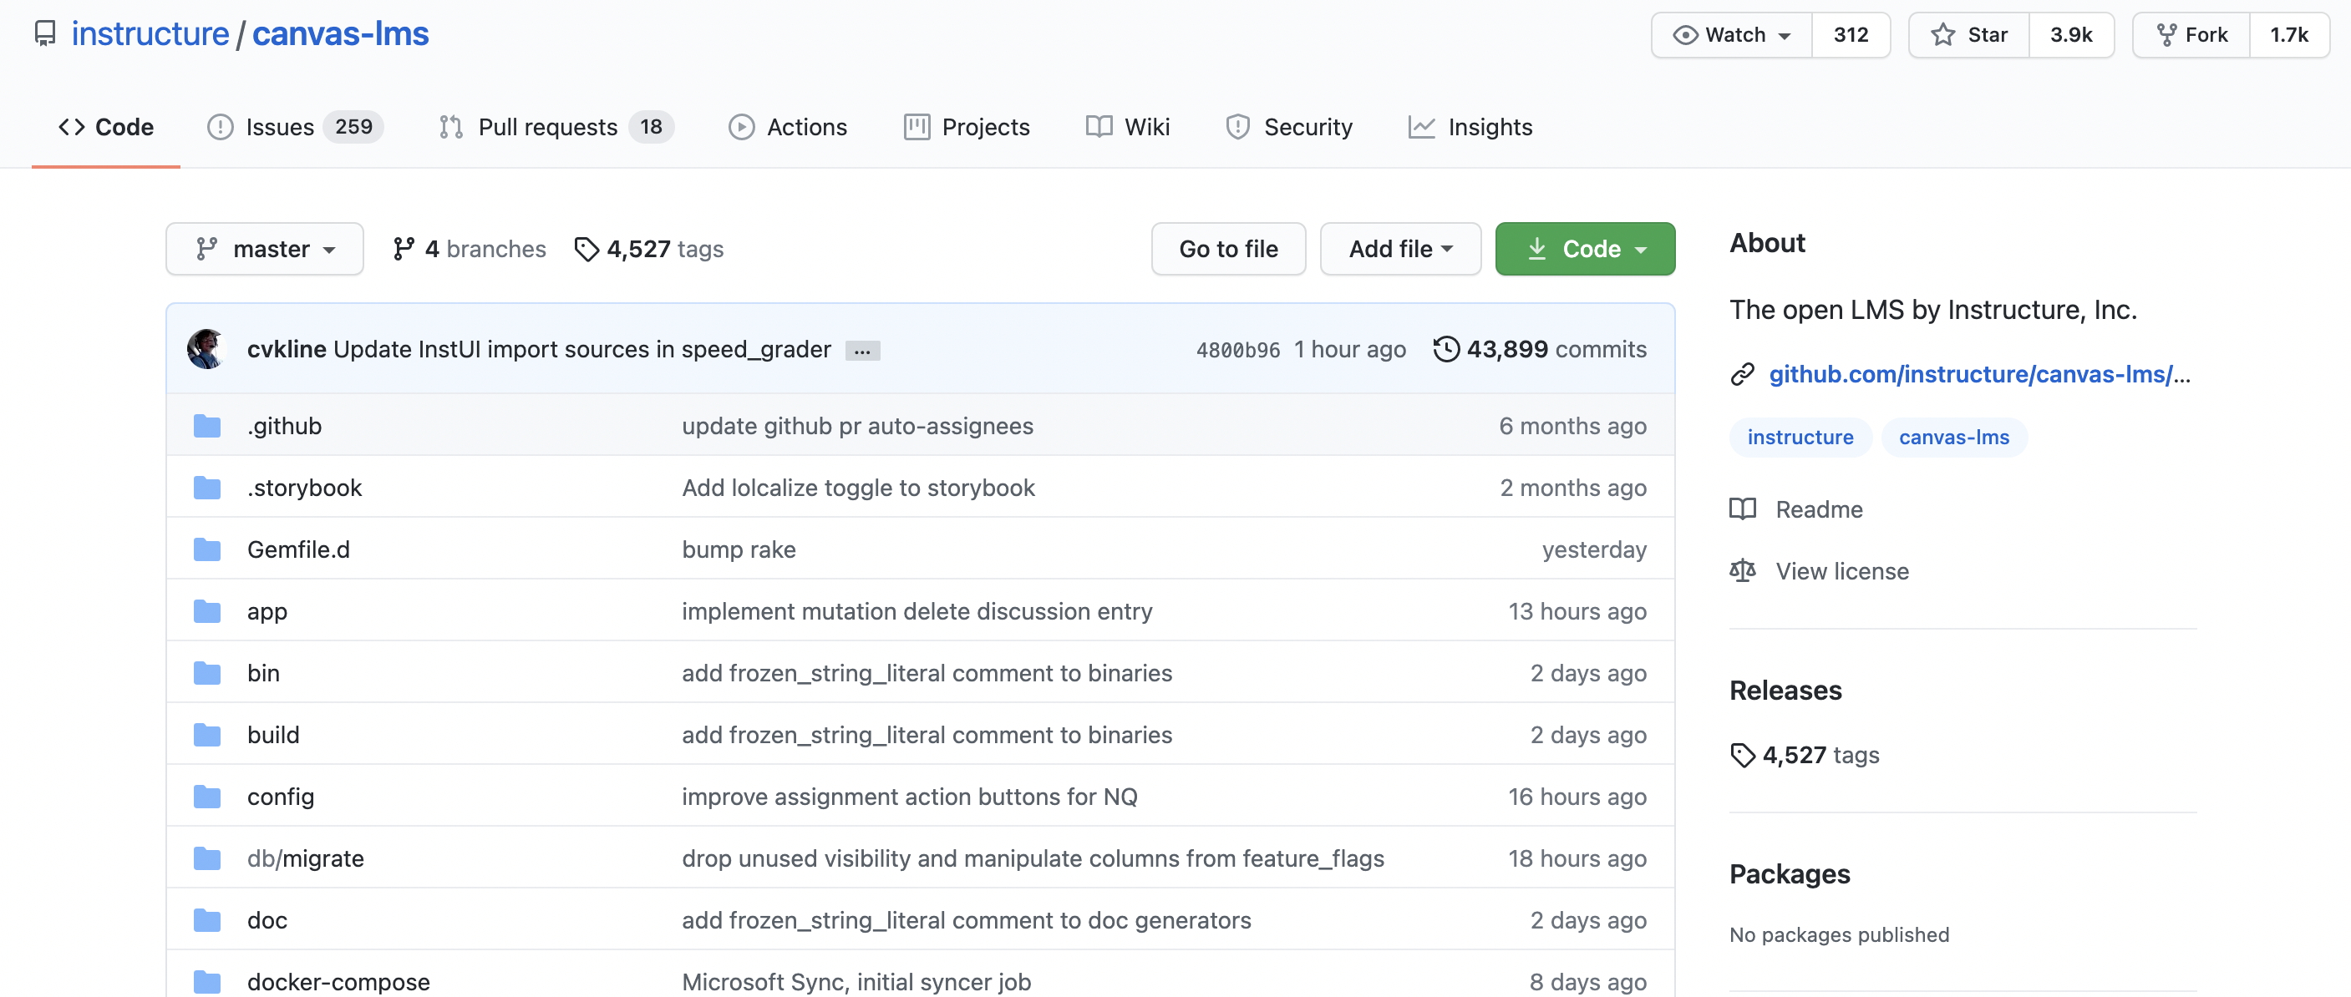
I-Campus lecture Sub System
2
Methods
About I-campus
I-Campus is implemented by customizing an open source-based infrastructure called canvas-lms.
https://github.com/instructure/canvas-lms

Slide 15



I-Campus lecture Sub System
2
Methods
About I-campus
Backend Server
canvas-lms
Frontend
Test

Slide 16
I-Campus lecture Sub System
2
Methods
Implemetation process
Write about API Logic
Write about UI/UX flow
Write about Backend Logic
Implement frontend view
Implementation DB
Begin unit testing

Slide 17
Part 3.
Team & Strategy
Team & Strategy
Copyrightⓒ. Saebyeol Yu. All Rights Reserved.

Slide 18
I-Campus lecture Sub System
1
Team
About I-campus
Backend Server
Kang Deokjae
Lee Chihyun
Project
Frontend
Test
Lee Dongjun
Lee Jisun
Krogfoss Ryan
Kim Seongwoo

Slide 19
I-Campus lecture Sub System
2
Strategy
Schedule
# | Contents | Timeline
 |  | 3/14 | 3/21 | 3/28 | 4/4 | 4/11 | 4/18 | 4/25 | 5/2 | 5/9 | 5/16 | 5/23 | 5/30
1 | Subject Select
2 | Application proposal
3 | Requirements specification
4 | Design specification
5 | Test specification

Slide 20
I-Campus lecture Sub System
2
Strategy
Development Schedule
# | Contents |  | Timeline
 |  |  | 5/30 | 6/6 | 6/13 | 6/20 | 6/27 | 7/4 | 7/11 | 7/18 | 7/25 | 8/1 | 8/8
6 | Backend Server | Architecture
 |  | Define Class
7 | Frontend | Design
 |  | Connection
8 | Code review
9 | Testing

Slide 21
Part 4.
Benefits
Benefits
Copyrightⓒ. Saebyeol Yu. All Rights Reserved.

Slide 22

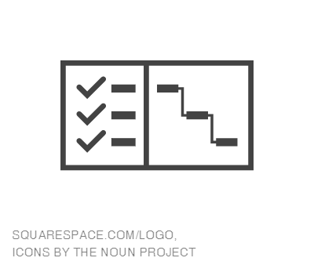

I-Campus lecture Sub System
1
Benfits
Record
Convenience
Search

Slide 23
Thank you
Team 4
Copyrightⓒ. Saebyeol Yu. All Rights Reserved.

