Slide 1


Balanced ONE
Team1
너드르 김두원 모하메드 이재현 조원이 김윤재

Slide 2
Contents
Our Idea
Function & Design
User & Market
Development

Slide 3
1. Our idea

Slide 4
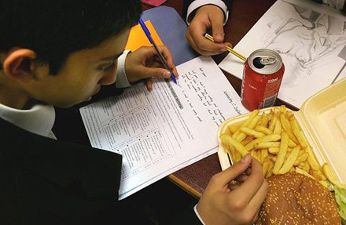
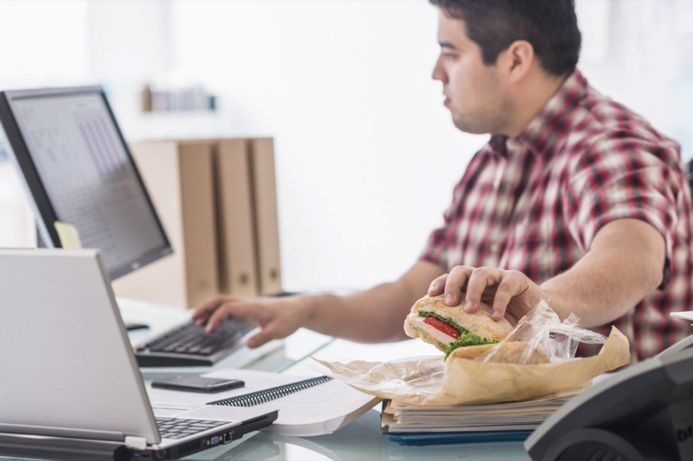
Poor Diet of Student and Office Workers
Students Office workers

Slide 5
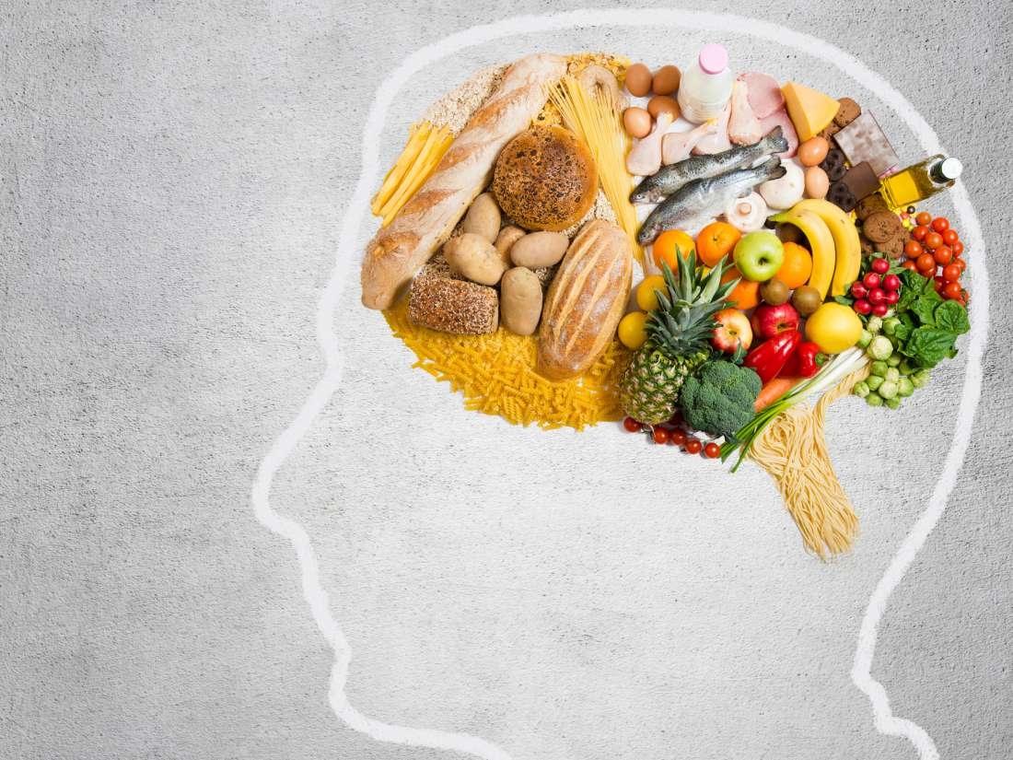
Brain Development Healthy Lifestyle
Brain Development and Healthy Lifestyle

Slide 6
2. Function & Design

Slide 7
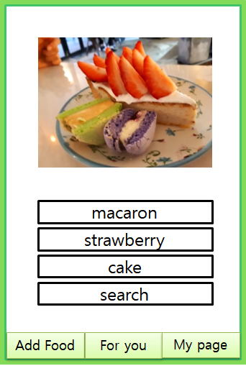
Add Food - Add food going to eat.
Camera : Just take a photo! AI recognition will find several candidates of the food.
Candidate button : Choose the correct food going to eat. The nutrition information what you eat will be automatedly updated to the data base.

Slide 8
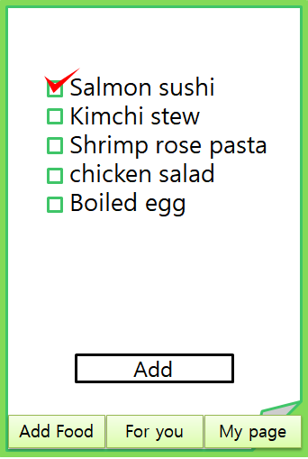
For you – Find the best food for your body.
Food check list : Several food are listed as candidates by the nutrition information of your body. It will be perfect for your body.
Add button : Add the food you choose.

Slide 9
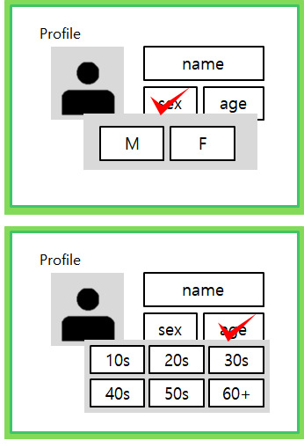
My page
Profile box : You can change your personal information. This info will be applied to food select algorithm.

Slide 10
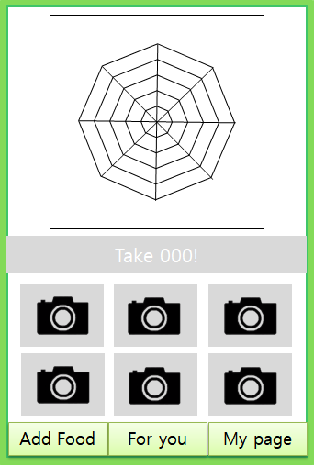
Main page – Overall information of your body
Nutrition graph : A graph notating the nutrition state of your body.
Nutrition proposed : indicate the nutrition what your body need.
Photos of previously eaten.

Slide 11
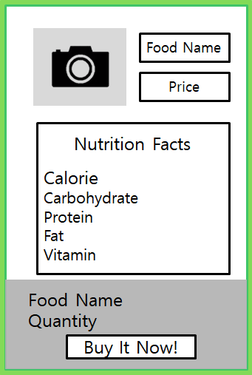
Order menu – quickly order the food you need
Food info
Nutrition Facts
One-click order button

Slide 12
3. User & Market

Slide 13
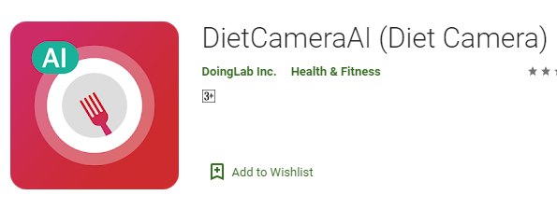
First application – DietCameraAI
The first app is similar to our project in terms of
Use image processing
Use artificial intelligence
Cares about food health

Slide 14
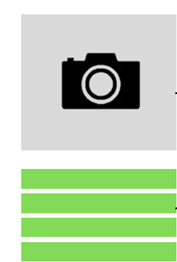
DietCameraAI – Difference
There are some differences between him and our project .
in our project we use camera

Slide 15
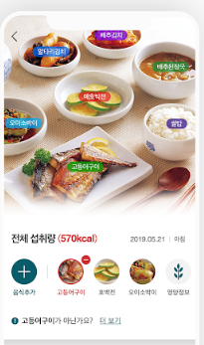
DietCameraAI – Difference
But in DietCameraAI we cant use camera but we can just take picture of food from studio

Slide 16
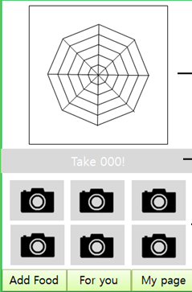
DietCameraAI – Difference
In our application the ratio of vitamins is calculated to follow the person nutritional health .

Slide 17
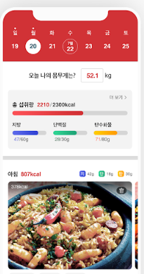
DietCameraAI – Difference
Btu in DietCameraAI Calories are calculated so as to follow the diet that the person follows.
and in our project vitamins, calories and other things are calculated.

Slide 18
The second application – Caloriemama
Caloriemama application
Simply snap a food photo and get the nutritional information of your meal.
Calorie Mama App is powered by our Food AI API. Food AI API is based on the latest innovations in deep learning and image classification technology to quickly and accurately identify food items.

Slide 19
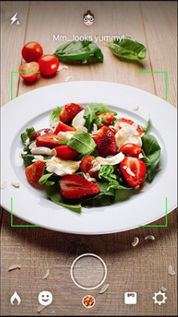
The second application – Caloriemama
Look at the app

Slide 20
The second application – Caloriemama
The app looks like our project at
Use image processing
Use artificial intelligence
Use deep learn
Depends on food photography

Slide 21
Caloriemama – Difference
The output
The resulting vitamin will be calculated .
But in a project no matter what vitamin is calories and other information about food

Slide 22
Person Information
Caloriemama – Difference
In our project there is a special page for the person to register their data like his age and gender .

Slide 23
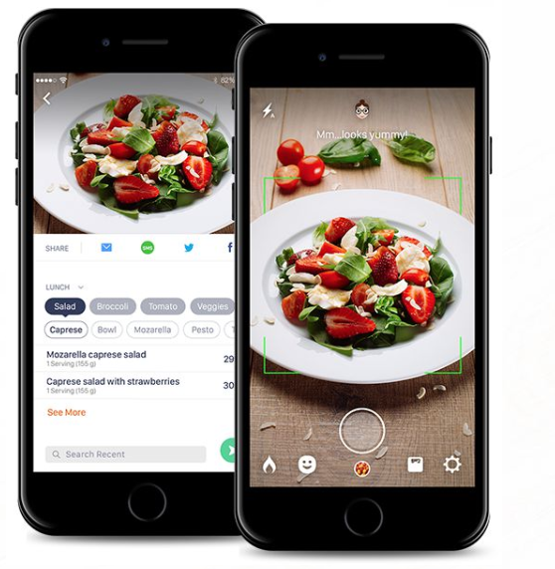
Caloriemama – Difference
But in the application Mama information appears to everyone without the need for a profile .
This is an overview of the application

Slide 24
Third application – FoodTracker
A research team at McGill University in Canada has developed a mobile application that can recognize food items inside an overall meal in real-time, providing useful nutrition-related information. The team outlined the new mobile application, called FoodTracker .

Slide 25
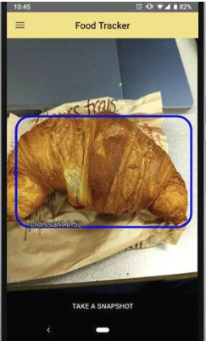
Third application – FoodTracker
Image of the application
FoodTracker, the mobile app developed by the researchers, is very easy to use. When a user points his smartphone camera to a plate containing his/her meal, the app rapidly recognizes its different ingredients.

Slide 26
Third application – FoodTracker
Looks like an application at
using artificial intelligence
Different from it in
No profile
Provides more food information

Slide 27
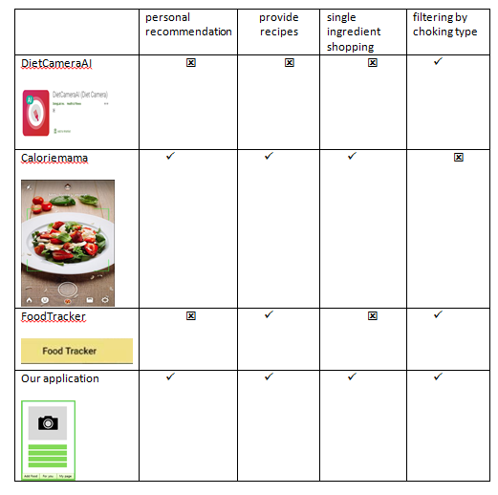
Function comparison

Slide 28
4. Develop

Slide 29
System Structure
System
Frontend
Backend
Android
Native
Application
Rest API
Database
Image Recognition
Blockchain
Flask
MySQL
Google
Vision
Node.js
Klaytn
Notes:
This is our system structure.
Under the whole system, we will use that programs and frameworks for implementation of frontend and backend.

Slide 30


Used Technology – Frontend
Android
React
Mobile Operating System
User Interface Library
Notes:
For frontend, we will use Android and React native. React is an user interface library.

Slide 31

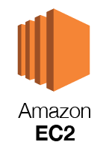

Used Technology – Backend
AWS
Cloud Hosting Service
EC2
RDS
Cloud Computing Hosting
Database Hosting
Notes:
For backend, as a server hosting service, we will use amazon web service. We will use Amazon EC2 for cloud computing and RDS for database hosting.

Slide 32

Used Technology – Backend
MySQL
Database Management System
Notes:
For database, we will use MySQL.

Slide 33


Used Technology – Backend
Node.js
Javascript Server Framework
Klaytn
Blockchain platform
Notes:
For server, we will construct two servers. First, node.js server. It is used only for Klaytn Blockchain server. Blockchain will be used for our point system.

Slide 34


Used Technology – Backend
Flask
Python Server Framework
Google Vision
Google Cloud API for vision ML
API Call
Notes:
Second, Flask server. Flask is a server framework for python. On this server, we will operate REST API server for application and this server will call google vision API for Image processing.

Slide 35
Used Technology – Backend
API Call
Use separate server for load balancing
Notes:
We use these two separate server for load balancing. Blockchain server needs heavy network and computing power.

Slide 36
Q & A

