Slide 1
Networking module 5a
Network management: SDN and SNMP
Link layer part 1 - ARP
1
1

Slide 2
Agenda
Repeat DNS
Routing (algorithms and protocols)
This module
SNMP
Software Defined Networking (SDN)
ARP

Slide 3
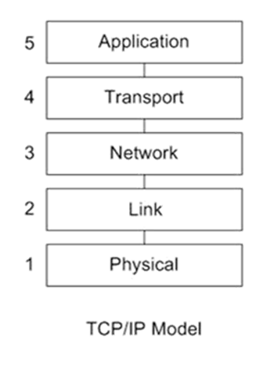
Vorige week: DNS
Reminder: DNS
DNS security risks:
Use of DNS servers in DDOS attacks
DNS hijacking
Possible solutions:
DNS over HTTPS
DNSSec
Figure 1
3

Slide 4
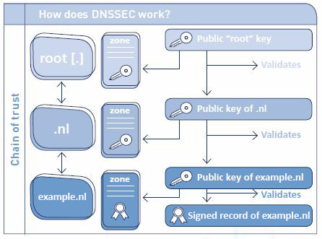
Vorige week: DNSSec
DNSSec signs DNS records, using public/private key cryptography
This provides authentication (but not confidentiality)
Similar to website certificates
Figure 19
4

Slide 5
Vorige week: Routing
Reminder: routing & forwarding
Routing algorithms
Link State – all nodes have complete view of network
Distance Vector – node talks only to neighbours
Routing and Autonomous Systems
Routing Protocols
Intra-AS Routing: OSPF (Link State)
Inter-AS Routing: BGP (Distance Vector)
BGP hijacking
Figure 1
5

Slide 6
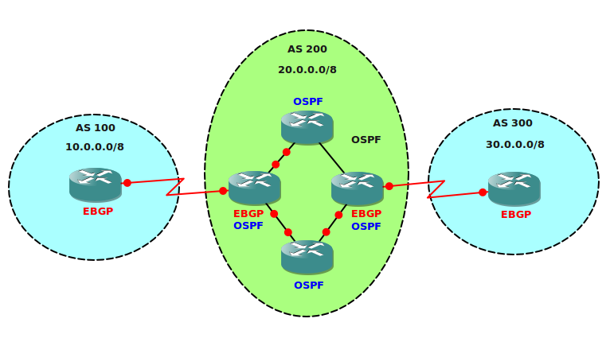
Vorige week: Autonomous Systems
Autonomous Systems:
A group of routers under the same control
Belong to (for example) a single company or ISP
Figure 9
Intra-AS routing: routing within AS (i.e. OSPF)
Inter-AS routing: routing between AS’s (i.e. BGP)
6

Slide 7
Intra-AS routing: OSPF (Open Shortest Path First)
OSPF - router advertisements flooded to entire AS
InteR-AS routing: BGP (border gateway protocol): the de facto inter-domain routing protocol --> “glue that holds the Internet together”

Slide 8
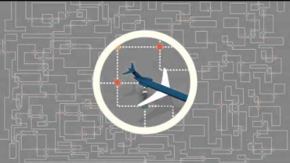
Border Gateway Patrol Hijacking

Slide 9
Path attributes and BGP routes
advertised network prefix includes BGP attributes:
AS-PATH: list of AS-es through which prefix advertisement has passed
NEXT-HOP: indicates specific internal-AS router to next-hop AS
Policy-based routing:
Policies determine whether a path is advertised and whether an advertised path will be accepted (e.g., never route through AS Y).
Route selection:
router may learn about more than one route to destination AS, selects route based on:
local preference value attribute: policy decision
shortest AS-PATH
closest NEXT-HOP router: hot potato routing
additional criteria
9

Slide 10
Will a BGP router always choose the route with the shortest AS_PATH length?
Yes, this is the actual purpose of the design
No, it chooses the path with the least next-hops
No, it uses policies. E.g. for political or economic reasons it might choose a different path
No, the BGP router always selects the loop-free route

Slide 11
Network management
SNMP
Software Defined Networking
SDN principles
Match & Action
SDN architecture
Figure 1
11

Slide 12


SNMP: infrastructure for network management
definitions:
managing entity
agent
data
managing
entity
managed devices contain managed objects whose data is gathered into a Management Information Base (MIB)
data
managed device
network
management
protocol
agent
data
managed device
agent
data
managed device
agent
data
agent
data
managed device
managed device
12
Figure 9
Notes:
12

Slide 13
SNMP protocol
Two ways to convey MIB info, commands:
managing
entity
managing
entity
request
trap msg
response
agent
data
agent
data
managed device
managed device
request/response mode
trap mode
13
Figure 10
Notes:
13

Slide 14
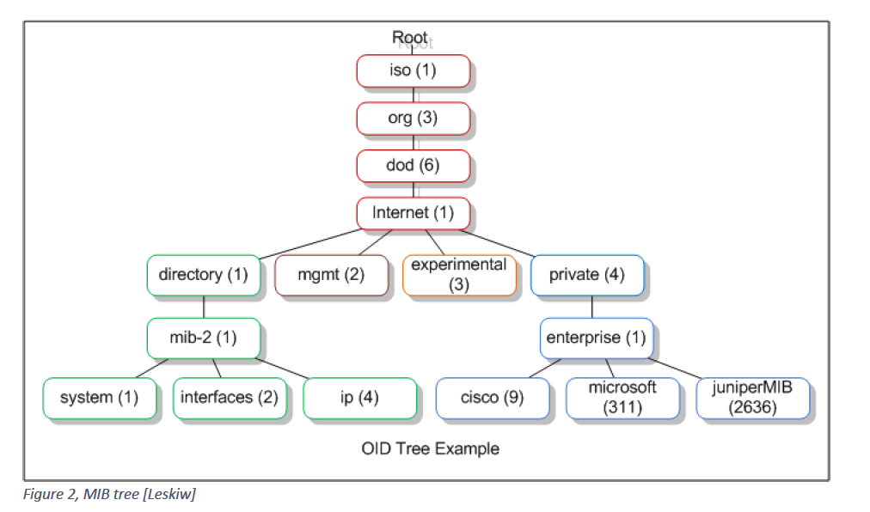
SNMP Example

Slide 15
Een 'managing server' wil weten hoe lang een bepaald 'managed device' (oftewel een agent) al online is. Hoe kan de managing server SNMP gebruiken om deze informatie te achterhalen?
Het MIB proces vraagt aan de agent hoe lang deze online is. De agent stuurt een reply met de waarde.
De informatie wordt uit de MIB gehaald op de managing server. Is deze informatie niet aanwezig dan stuurt de managing server een request naar de agent.
De MIB wordt via een gedistribueerd proces gesynchroniseerd tussen managing server en agent.
De gewenste informatie is opgeslagen in de MIB op het managed device. De server stuurt een SNMP request naar de agent om de info op te vragen. De agent stuurt een reply met de waarde van het opgevraagde object.

Slide 16
Network Layer
The Network Layer can be divided into two parts:
Data plane – per router functions that determine how datagram is arriving and forwarded .
Control plane – Network wide logic that controls how datagram is routed (e.g. OSPF and BGP)
Figure 1
16

Slide 17
traditionally dataplane and control plane have been implemented together in within router.
2005: renewed interest in rethinking network control plane → Software Defined Networking
logically-centralized routing controller
control plane
data plane
local flow table
headers counters actions
1
0100 1101
3
2
values in arriving
packet’s header
17
Figure 2

Slide 18
Software defined networking (SDN)
Why a logically centralized control plane?
easier network management: avoid router misconfigurations, greater flexibility of traffic flows
table-based forwarding allows “programming” routers
centralized “programming”: easier: compute tables centrally and distribute
distributed “programming”: more difficult: compute tables as result of distributed algorithm (protocol) implemented in each and every router
open (non-proprietary) implementation of control plane
18

Slide 19
Generalized Forwarding and SDN
Each router contains a flow table that is computed and distributed by a logically centralized routing controller
logically-centralized routing controller
control plane
data plane
local flow table
headers counters actions
1
0100 1101
3
2
values in arriving
packet’s header
19
Figure 2

Slide 20
Openflow data plane abstraction
flow: defined by header fields
generalized forwarding: simple packet-handling rules
Pattern: match values in packet header fields
Actions: for matched packet: drop, forward, modify matched packet or send matched packet to controller
Priority: disambiguate overlapping patterns
Counters: #bytes and #packets
Flow table in a router (computed and distributed by controller) define router’s match+action rules
src=1.2.*.*, dest=3.4.5.* → drop
src = *.*.*.*, dest=3.4.*.* → forward(2)
3. src=10.1.2.3, dest=*.*.*.* → send to controller
* : wildcard
20
Figure 3

Slide 21
Examples
Destination-based forwarding:
Switch
Port
MAC
src
MAC
dst
Eth
type
VLAN
ID
IP
Src
IP
Dst
IP
Prot
TCP
sport
TCP
dport
Action
*
*
*
*
*
*
51.6.0.8
*
*
*
port6
IP datagrams destined to IP 51.6.0.8 should be forwarded to router output port 6
Firewall:
Switch
Port
MAC
src
MAC
dst
Eth
type
VLAN
ID
IP
Src
IP
Dst
IP
Prot
TCP
sport
TCP
dport
Forward
*
*
*
*
*
*
*
*
*
22
drop
do not forward (block) all datagrams destined to TCP port 22
Destination-based layer 2 (switch) forwarding:
Switch
Port
MAC
src
MAC
dst
Eth
type
VLAN
ID
IP
Src
IP
Dst
IP
Prot
TCP
sport
TCP
dport
Action
*
22:A7:23:
11:E1:02
*
*
*
*
*
*
*
*
port3
layer 2 frames from MAC 22:A7:23:11:E1:02 should be forwarded to output port 3
21
Notes:
21

Slide 22
Openflow abstraction
match+action: unifies different kinds of devices
Router
match: longest destination IP prefix
action: forward out a link
Switch
match: destination MAC address
action: forward or flood
Firewall
match: IP addresses and TCP/UDP port numbers
action: permit or deny
NAT
match: IP address and port
action: rewrite address and port
22

Slide 23
SDN: data plane switches
Data plane switches
fast, simple, commodity switches implementing generalized data-plane forwarding in hardware
switch flow table computed, installed by controller
API for table-based switch control (e.g., OpenFlow)
defines what is controllable and what is not
protocol for communicating with controller (e.g., OpenFlow)
network-control applications
…
routing
access
control
load
balance
control
plane
northbound API
SDN Controller
(network operating system)
southbound API
data
plane
23
SDN-controlled switches
Figure 4

Slide 24
SDN controller
SDN controller (network OS):
maintain network state information
interacts with network control applications “above” via northbound API
interacts with network switches “below” via southbound API
implemented as distributed system for performance, scalability, fault-tolerance, robustness
network-control applications
…
routing
access
control
load
balance
control
plane
northbound API
SDN Controller
(network operating system)
southbound API
data
plane
24
SDN-controlled switches
Figure 5

Slide 25
SDN: control applications
network-control apps:
“brains” of control: implement control functions using lower-level services, API provided by SDN controller
unbundled: can be provided by 3rd party: distinct from routing vendor, or SDN controller
network-control applications
…
routing
access
control
load
balance
control
plane
northbound API
SDN Controller
(network operating system)
southbound API
data
plane
25
SDN-controlled switches
Figure 6

Slide 26
Components of SDN controller
routing
access
control
load
balance
Interface layer to network control apps: abstractions API
Interface, abstractions for network control apps
…
network graph
RESTful
API
intent
Network-wide state management layer: state of networks links, switches, services: a distributed database
…
statistics
flow tables
SDN
controller
Network-wide distributed, robust state management
…
Link-state info
host info
switch info
…
communication layer: communicate between SDN controller and controlled switches
OpenFlow
SNMP
Communication to/from controlled devices
26
Figure 7

Slide 27
SDN: control/data plane interaction
Dijkstra’s link-state
Routing
1
S1, experiencing link failure using OpenFlow port status message to notify controller
4
5
…
network graph
RESTful
API
intent
2
SDN controller receives OpenFlow message, updates link status info
3
…
statistics
flow tables
…
3
Dijkstra’s routing algorithm application has previously registered to be called when ever link status changes. It is called.
Link-state info
host info
switch info
2
…
OpenFlow
SNMP
6
4
Dijkstra’s routing algorithm access network graph info, link state info in controller, computes new routes
1
s2
s1
s4
s3
27
Figure 8

Slide 28
SDN: control/data plane interaction
Dijkstra’s link-state
Routing
4
5
…
network graph
RESTful
API
intent
5
link state routing app interacts with flow-table-computation component in SDN controller, which computes new flow tables needed
3
…
statistics
flow tables
…
Link-state info
host info
switch info
2
…
6
Controller uses OpenFlow to install new tables in switches that need updating
OpenFlow
SNMP
6
1
s2
s1
s4
s3
28
Figure 8

Slide 29
Software Defined Networking
Een netwerk bestaat uit een aantal met elkaar verbonden routers. Eén van deze routers stelt vast dat een bepaalde verbinding offline is gegaan.
Vroeger zou deze router de andere routers hierover informeren met behulp van een routing protocol. Elke router zou vervolgens voor zichzelf de eigen routing table opnieuw berekenen,.
Leg uit, hoe SDN (Software Defined Networking) hier mee omgaat. Welke verschillende stappen worden gezet, om te zorgen dat de routing tables van alle routers geupdate worden.
Zet antwoord in chat

Slide 30
The router will notify the central SDN controller about the link failure.
The SDN controller will invoke a network control application that will calculate new routing information.
Finally, the SDN controller will push the new routing tables to all routers (or packet switches).
Notice how the routers don't communicate directly with one another: the new routing information is calculated centrally and then distributed to the routers.

Slide 31

Break
31

Slide 32
Link layer
MAC addresses
Looking up MAC addresses: ARP
MAC addresses vs IP addresses, a routing example
Figure 1
32

Slide 33

















Link layer: reminder
terminology:
hosts and routers: nodes
communication channels that connect adjacent nodes along communication path: links
wired links
wireless links
LANs
layer-2 packet: frame, encapsulates datagram
data-link layer has responsibility of
transferring datagram from one node
to physically adjacent node over a link
Figure 9
33
Notes:
33

Slide 34
MAC addresses
32-bit IP address:
network-layer address for interface
used for layer 3 (network layer) forwarding
MAC (or LAN or physical or Ethernet) address:
function: used ‘locally” to get frame from one interface to another physically-connected interface (same network, in IP-addressing sense)
48 bit MAC address burned in NIC ROM
e.g.: 1A-2F-BB-76-09-AD
hexadecimal (base 16) notation
(each “number” represents 4 bits)
34
Notes:
34

Slide 35
MAC addresses (more)
each adapter on LAN has unique MAC address
MAC address allocation administered by IEEE
manufacturer buys portion of MAC address space (to assure uniqueness)
analogy:
MAC address: like Social Security Number
IP address: like postal address
MAC flat address ➜ portability
can move LAN card from one LAN to another
IP hierarchical address not portable
address depends on IP subnet to which node is attached
That’s why you can recognise your Raspberry Pi by its MAC address
35
Notes:
35

Slide 36



ARP: address resolution protocol
Question: how to determine
interface’s MAC address, knowing its IP address?
ARP table: each IP node (host, router) on LAN has table
IP/MAC address mappings for some LAN nodes:
< IP address; MAC address; TTL>
TTL (Time To Live): time after which address mapping will be forgotten (typically 20 min)
137.196.7.78
1A-2F-BB-76-09-AD
137.196.7.23
137.196.7.14
LAN
71-65-F7-2B-08-53
58-23-D7-FA-20-B0
0C-C4-11-6F-E3-98
137.196.7.88
36
Figure 10
Notes:
36

Slide 37
ARP protocol: same LAN
A wants to send datagram to B
B’s MAC address not in A’s ARP table.
A broadcasts ARP query packet, containing B's IP address
destination MAC address = FF-FF-FF-FF-FF-FF
all nodes on LAN receive ARP query
B receives ARP packet, replies to A with its (B's) MAC address
frame sent to A’s MAC address (unicast)
A caches (saves) IP-to-MAC address pair in its ARP table until information becomes old (times out)
soft state: information that times out (goes away) unless refreshed
ARP is “plug-and-play”:
nodes create their ARP tables without intervention from net administrator
37
Notes:
37

Slide 38
Leg uit welke functie het TTL veld heeft in een ARP tabel.
Door een Time To Live in te stellen wordt voorkomen dat de ARP tabel te groot wordt.
Time To Live zorgt er voor dat de verstuurde data onbruikbaar wordt voor de ontvanger na een bepaalde periode. Hiermee wordt de ontvanger gedwongen opnieuw een request te doen.
Als de Time To Live van een entry verloopt, dan wordt de entry verwijderd uit de ARP tabel. Door verouderde entries te verwijderen, wordt de informatie in de tabel up to date gehouden.
De Time To Live zorgt er voor dat een tabel maar een bepaalde tijd te bezoeken is. Hierdoor wordt een DDOS aanval op ARP voorkomen.

Slide 39
Addressing: routing to another LAN
walkthrough: send datagram from A to B via R
focus on addressing – at IP (datagram) and MAC layer (frame)
assume A knows B’s IP address
assume A knows IP address of first hop router, R (how?)
assume A knows R’s MAC address (how?)
A
B
R
111.111.111.111
222.222.222.222
74-29-9C-E8-FF-55
49-BD-D2-C7-56-2A
222.222.222.220
1A-23-F9-CD-06-9B
111.111.111.112
111.111.111.110
222.222.222.221
CC-49-DE-D0-AB-7D
E6-E9-00-17-BB-4B
88-B2-2F-54-1A-0F
39
Figure 11
Notes:
39

Slide 40
Addressing: routing to another LAN
A creates IP datagram with IP source A, destination B
A creates link-layer frame with R's MAC address as dest, frame contains A-to-B IP datagram
MAC src: 74-29-9C-E8-FF-55
MAC dest: E6-E9-00-17-BB-4B
IP
Eth
Phy
IP src: 111.111.111.111
IP dest: 222.222.222.222
A
B
R
111.111.111.111
222.222.222.222
74-29-9C-E8-FF-55
49-BD-D2-C7-56-2A
222.222.222.220
1A-23-F9-CD-06-9B
111.111.111.112
111.111.111.110
222.222.222.221
CC-49-DE-D0-AB-7D
E6-E9-00-17-BB-4B
88-B2-2F-54-1A-0F
40
Figure 12
Notes:
40

Slide 41
Addressing: routing to another LAN
frame sent from A to R
frame received at R, datagram removed, passed up to IP
MAC src: 74-29-9C-E8-FF-55
MAC dest: E6-E9-00-17-BB-4B
IP src: 111.111.111.111
IP dest: 222.222.222.222
IP
Eth
Phy
IP src: 111.111.111.111
IP dest: 222.222.222.222
IP
Eth
Phy
A
B
R
111.111.111.111
222.222.222.222
74-29-9C-E8-FF-55
49-BD-D2-C7-56-2A
222.222.222.220
1A-23-F9-CD-06-9B
111.111.111.112
111.111.111.110
222.222.222.221
CC-49-DE-D0-AB-7D
E6-E9-00-17-BB-4B
88-B2-2F-54-1A-0F
41
Figure 13
Notes:
41

Slide 42
Addressing: routing to another LAN
R forwards datagram with IP source A, destination B
R creates link-layer frame with B's MAC address as dest, frame contains A-to-B IP datagram
MAC src: 1A-23-F9-CD-06-9B
MAC dest: 49-BD-D2-C7-56-2A
IP
Eth
Phy
IP
Eth
Phy
IP src: 111.111.111.111
IP dest: 222.222.222.222
A
B
R
111.111.111.111
222.222.222.222
74-29-9C-E8-FF-55
49-BD-D2-C7-56-2A
222.222.222.220
1A-23-F9-CD-06-9B
111.111.111.112
111.111.111.110
222.222.222.221
CC-49-DE-D0-AB-7D
E6-E9-00-17-BB-4B
88-B2-2F-54-1A-0F
42
Figure 14
Notes:
42

Slide 43
Addressing: routing to another LAN
R forwards datagram with IP source A, destination B
R creates link-layer frame with B's MAC address as dest, frame contains A-to-B IP datagram
MAC src: 1A-23-F9-CD-06-9B
MAC dest: 49-BD-D2-C7-56-2A
IP
Eth
Phy
IP
Eth
Phy
IP src: 111.111.111.111
IP dest: 222.222.222.222
A
B
R
111.111.111.111
222.222.222.222
74-29-9C-E8-FF-55
49-BD-D2-C7-56-2A
222.222.222.220
1A-23-F9-CD-06-9B
111.111.111.112
111.111.111.110
222.222.222.221
CC-49-DE-D0-AB-7D
E6-E9-00-17-BB-4B
88-B2-2F-54-1A-0F
43
Figure 15
Notes:
43

Slide 44
Addressing: routing to another LAN
R forwards datagram with IP source A, destination B
R creates link-layer frame with B's MAC address as dest, frame contains A-to-B IP datagram
MAC src: 1A-23-F9-CD-06-9B
MAC dest: 49-BD-D2-C7-56-2A
IP src: 111.111.111.111
IP dest: 222.222.222.222
IP
Eth
Phy
A
B
R
111.111.111.111
222.222.222.222
74-29-9C-E8-FF-55
49-BD-D2-C7-56-2A
222.222.222.220
1A-23-F9-CD-06-9B
111.111.111.112
111.111.111.110
222.222.222.221
CC-49-DE-D0-AB-7D
E6-E9-00-17-BB-4B
88-B2-2F-54-1A-0F
44
Figure 16
Notes:
44

Slide 45
Network management
Software Defined Networking
SDN principles
Match & Action
SDN architecture
Figure 1
45

Slide 46
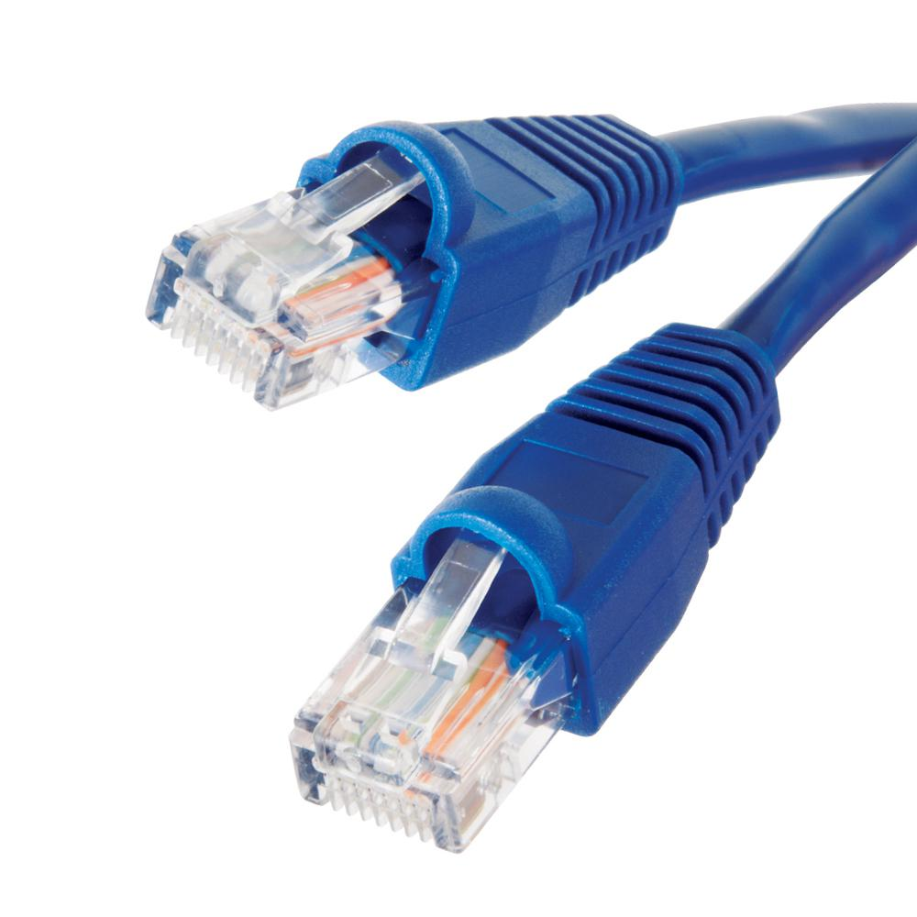
Ethernet
Ethernet
“dominant” wired LAN technology
simple, cheap
kept up with speed race: 10 Mbps – 10 Gbps
Ethernet frame
Preamble: fixed pattern used to synchronise sender, receiver clocks
Source and Destination MAC address
Type: usually IP
Data: contains IP datagram
CRC: cyclic redundancy check code to detect errors (corrupt frames are dropped)
Figure 17
type
preamble
dest.
address
source
address
data (payload)
CRC
Figure 18
Notes:
46

Slide 47
Ethernet and switches
Collision domains
One host can send at the same time, hosts need to wait when line is busy
When two hosts start sending at the same time, data collides and becomes corrupted.
All of this decreases performance
Bus topology: popular through mid 90s
all nodes in same collision domain
Star topology: prevails today
active switch in center
each “spoke” runs a (separate) Ethernet (nodes do not collide with each other)
switch
star
bus
Figure 19
Notes:
47

Slide 48
Switch: multiple simultaneous transmissions
A
hosts have dedicated, direct connection to switch
switches buffer packets
Ethernet protocol used on each incoming link, but no collisions; full duplex
each link is its own collision domain
switching: A-to-A’ and B-to-B’ can transmit simultaneously, without collisions
C’
B
6
1
2
5
4
3
B’
C
A’
switch with six interfaces
(1,2,3,4,5,6)
Figure 20
48
Notes:
48

Slide 49
Switch forwarding table
A
Q: how does switch know A’ reachable via interface 4, B’ reachable via interface 5?
C’
B
6
1
2
A: each switch has a switch table, each entry:
(MAC address of host, interface to reach host, time stamp)
looks like a routing table!
5
4
3
B’
C
A’
switch with six interfaces
(1,2,3,4,5,6)
Q: how are entries created, maintained in switch table?
Figure 21
49
Notes:
49

Slide 50
Switch: self-learning
Figure 22
Source: A
Dest: A’
switch learns which hosts can be reached through which interfaces
when frame received, switch “learns” location of sender
records sender/location pair in switch table
switches do NOT use ARP
A
A A’
C’
B
6
1
2
A A’
A A’
A A’
A A’
A A’
5
4
3
B’
C
frame destination, A’, location unknown:
A’ A
flood
A’
destination A location known:
selectively send on just one link
MAC addr interface TTL
A
1
60
A’
4
60
50
switch table - initially empty
Notes:
50

Slide 51
Switches vs. Routers
application
transport
network
link
physical
datagram
both are store-and-forward:
routers: network-layer devices - examine network-layer headers - connect different subnets
switches: link-layer devices - examine link-layer headers - connect devices on same subnet
both have forwarding tables:
routers: compute tables using routing algorithms, IP addresses
switches: learn forwarding table using MAC addresses
frame
link
physical
frame
switch
network
link
physical
datagram
frame
application
transport
network
link
physical
51
Figure 23
Notes:
51

Slide 52
For next module…
Next module lecture: Wireless networks
Homework - before the next lecture:
study the materials as described in the study guide on DLO
make practice test #4
finish this modules labs and hand in your results on DLO
52

Slide 53
For next module…
Next modules lecture: Link layer (pt. 2) & Wireless networks
To prepare for next mosules practical lab: read chapter 5.7 on SNMP in Kurose & Ross!!!
53

Slide 54
Sources
Figure 1-23: Kurose and K.W. Ross, Computer Networking, A Top-Down Approach, Pearson Education, 2016
54

Slide 55
Sources
Figure 1,2,3,4,5,6,8,10,11,12,13,14,15,16: Kurose and K.W. Ross, Computer Networking, A Top-Down Approach, Pearson Education, 2016
55

