Slide 1
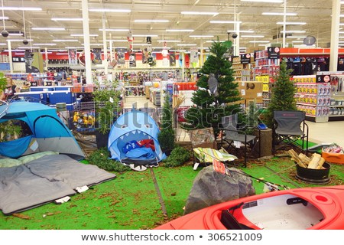
Sales Products Analysis
By
Susanta Kumar Labala
CDF Term-3 Project Report
on
Sales Products Analysis
27/01/2019

Slide 2
Sales Analysis of Out Door Products 2012 to 2014
1. Revenue Performance
2. Sales Type Performance
3. Products Sales Highlights
4. Sales Margin Growth
5. Conclusion

Slide 3
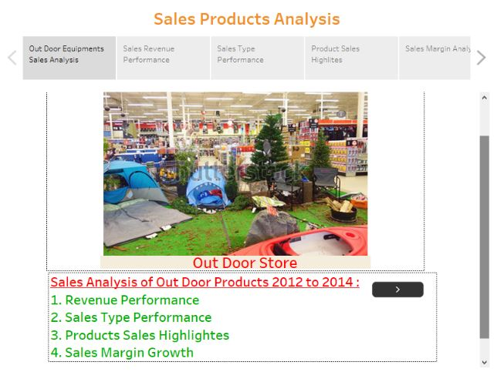

Slide 4
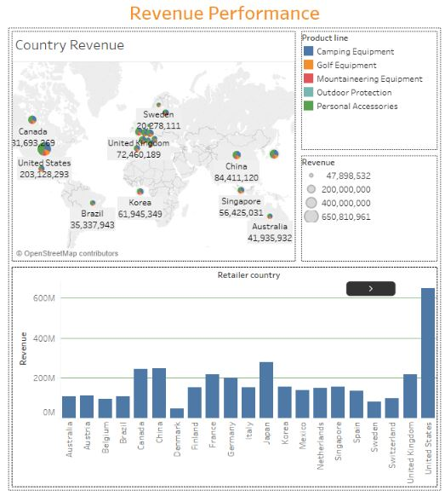
1. Revenue Performance
Observed highest Sales Revenue from “United Sates”

Slide 5
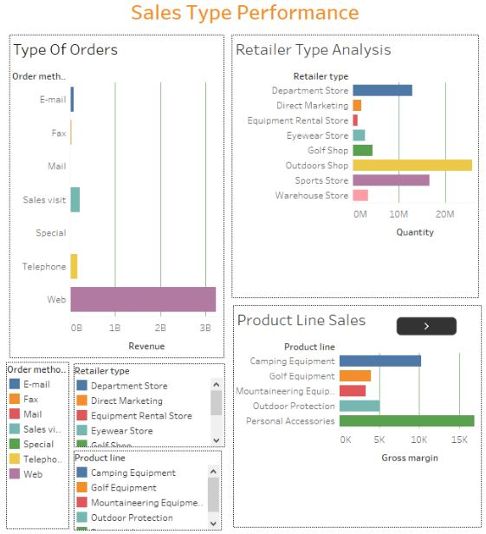
2. Sales Type Performance
Observed “Personal Accessories” sold more from “Outdoors Shop” and the orders type was “Web”

Slide 6
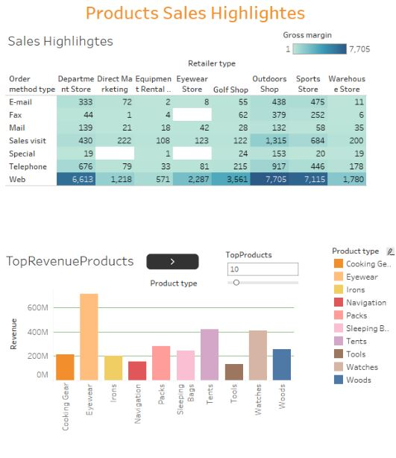
3.Products Sales Highlights
Observed “Eyeweare” was the Top Revenue Products

Slide 7
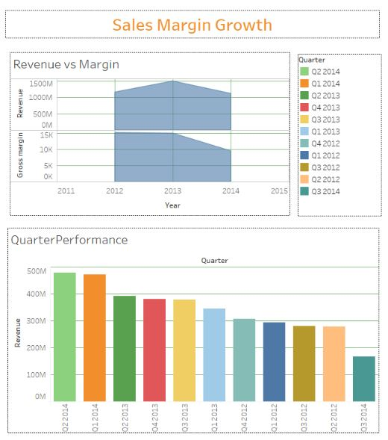
4.Sales Margin Growth
Sales Revenue was good on Q2 2014 and Q1 2014

Slide 8
5. Conclusion
More sales revenue generated from “United States”
Observed “Personal Accessories” sold more from “Outdoor Shop” and the orders placed through “Web”
Observed “Eyeweare” was the Top Revenue Products
Sales Revenue was good on Q2 2014 and Q1 2014
Public Tableau link : https://public.tableau.com/profile/susanta4413#!/vizhome/CountryRevenue/SalesProductsAnalysis?publish=yes

