Slide 1
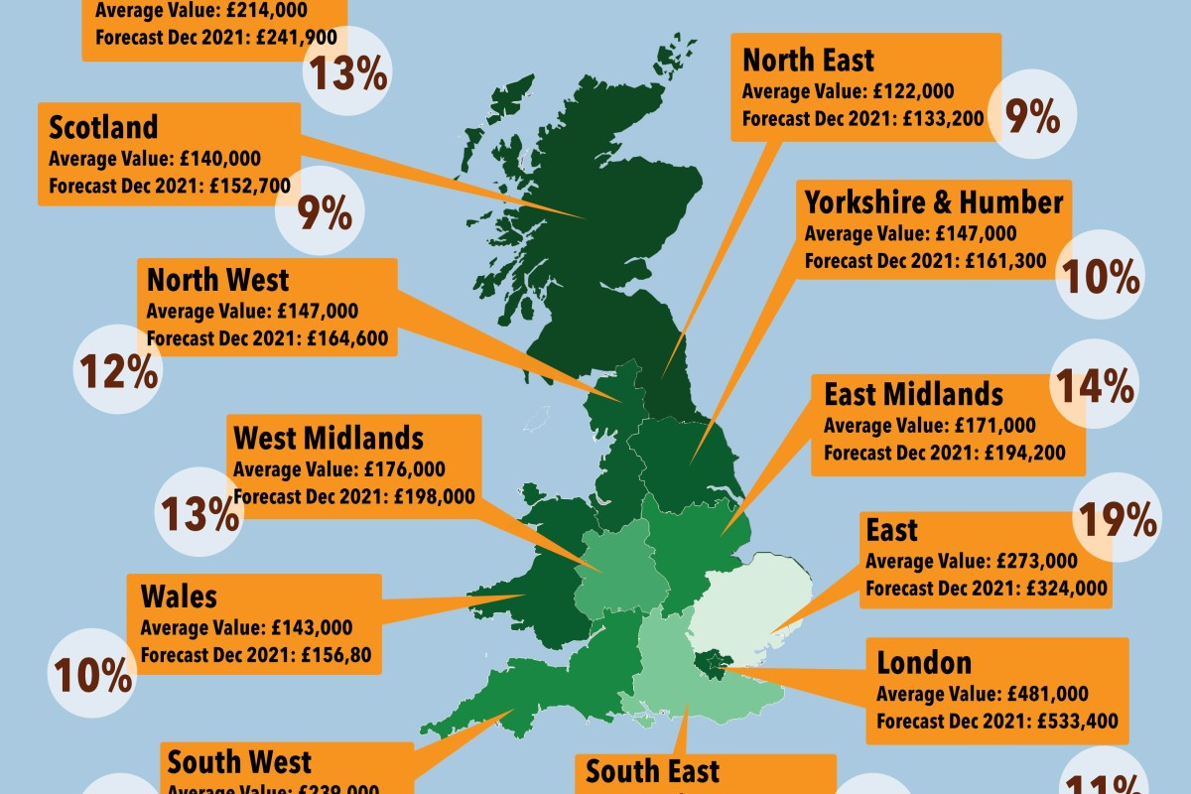
House Price Prediction
By
Susanta Kumar Labala
CDF Term-2 Project Report
on
House Price Prediction
15/12/2018

Slide 2
Heading
A house value is simply more than location and square footage. Like the features that make up a person, an educated party would want to know all aspects that give a house its value.
House dataset containing house information such as size, location, condition, etc. Here, we see that training set contains 81 columns. The first 80 of these also appear in the test set: these will be the features on which we will base our predictions. The final column, SalePrice, is our target variable.

Slide 3
Problem statement
Given the dataset containing house information such as size, location, condition, etc. Will make a model to predict the sales price for each house. For each Id in the test set, must predict the value of the SalePrice variable.

Slide 4
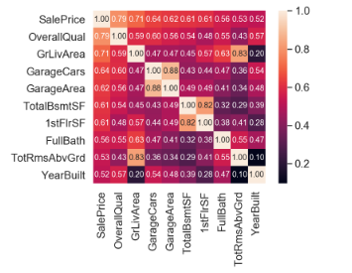
10 features most related to Sale Price

Slide 5
Most correlated features to sale price
OverallQual: Rates the overall material and finish of the house (1 = Very Poor, 10 = Very Excellent)
GrLivArea: Above grade (ground) living area square feet
GarageCars: Size of garage in car capacity
GarageArea: Size of garage in square feet
TotalBsmtSF: Total square feet of basement area
1stFlrSF: First Floor square feet
FullBath: Full bathrooms above grade
TotRmsAbvGrd: Total rooms above grade (does not include bathrooms)
YearBuilt: Original construction date

Slide 6
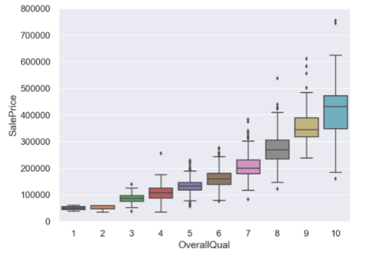
Overall Quality vs Sale Price
People pay more for better quality.

Slide 7
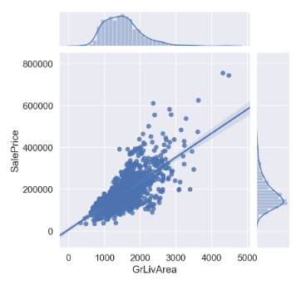
Living Area vs Sale Price
People would pay for the more living area.

Slide 8
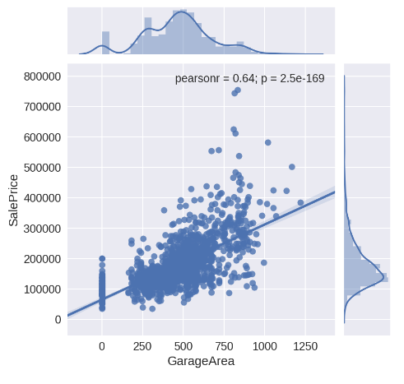
Garage Area vs Sale Price
That looks much better.

Slide 9
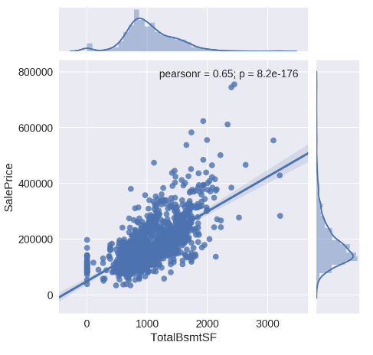
Basement Area vs Sale Price
Everything looks fine here.

Slide 10
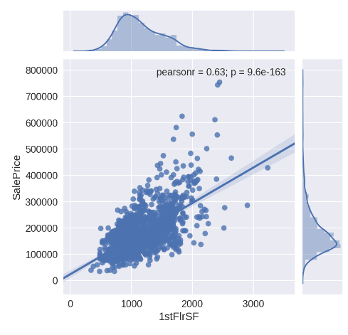
First Floor Area vs Sale Price
Looks good.

Slide 11
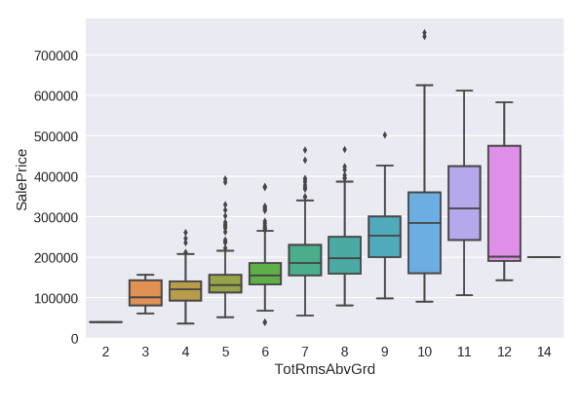
Total Rooms vs Sale Price
It seems like houses with more than 11 rooms come with a $100k off coupon.

Slide 12
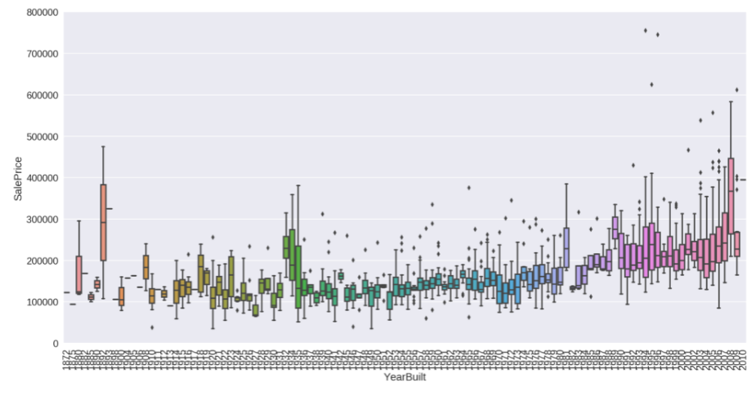
Year Built vs Sale Price
Although it seems like house prices decrease with age, we can't be entirely sure. Is it because of inflation or stock market crashes?

Slide 13
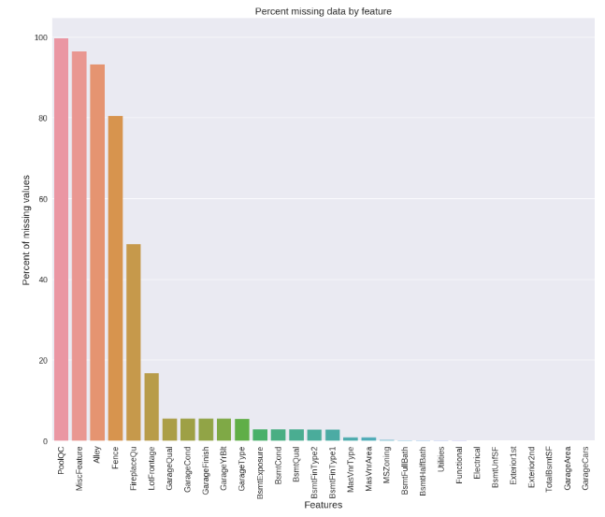
% Missing data by feature
Imputed Missing Values

Slide 14
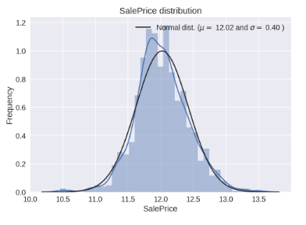
Sale Price Normal Distribution
skewness looks good.

Slide 15
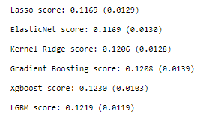
Checking performance of base models by evaluating the cross-validation RMSLE error

Slide 16
RMSLE score on train data: 0.06084748057627577

Slide 17
Conclusion
Please refer “submission.csv” for the predicted sale price of the house

