Slide 1

What Properties are Associated with Successful Movies Proposal
By
Susanta Kumar Labala
CDF Term-1 Project Report
on
1000 Movie Dataset
08/10/2018

Slide 2
Heading
We always define a successful movie based on it’s revenue, reviews, popularity, etc. But what’s the factor associated with a successful movie?
We know that movies hitting the box office are not always with high rating, or high rating movies are always not in trend. But how about popularity v.s. revenue?
It seems like when a film raises a burst of upsurge, no matter what the reviews rating bad or not, people are still willing to pay for a popular movie. For this point, let’s use the dataset to find the answer!

Slide 3
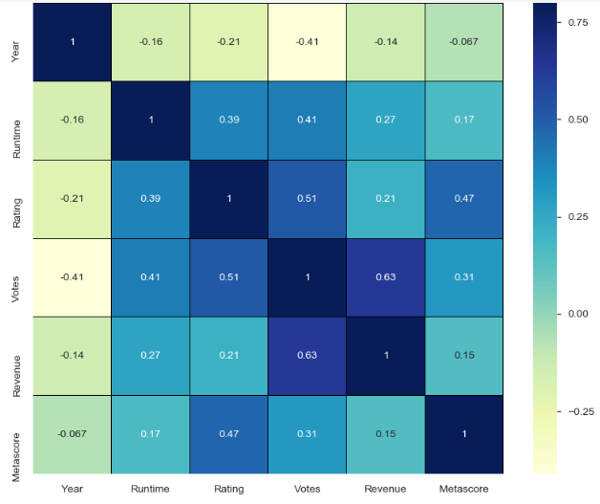
Properties are Associated with Successful Movies
Data in depth

Slide 4
Properties are Associated with Successful Movies
Problem statement
General Explore :
1: Popularity Over Years
2: The distribution of revenue in different popularity levels in recent five years.
3: The distribution of revenue in different score rating levels in recent five years.

Slide 5
Properties are Associated with Successful Movies
Findings :
1: What kinds of properties are associated with movies that have high popularity?
2: What kinds of properties are associated with movies that have high voting score?

Slide 6
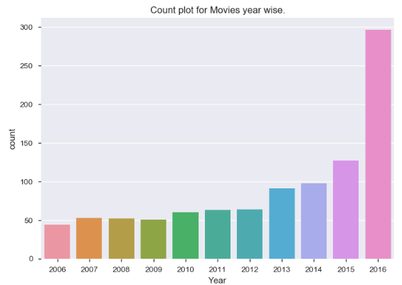
How Movies Popularity Over Years ?
From the figure above, we can see that the trend of popularity is upward year to year, and the peak is in the 2016. We still can conclude that popularity over years is going up in recent years

Slide 7
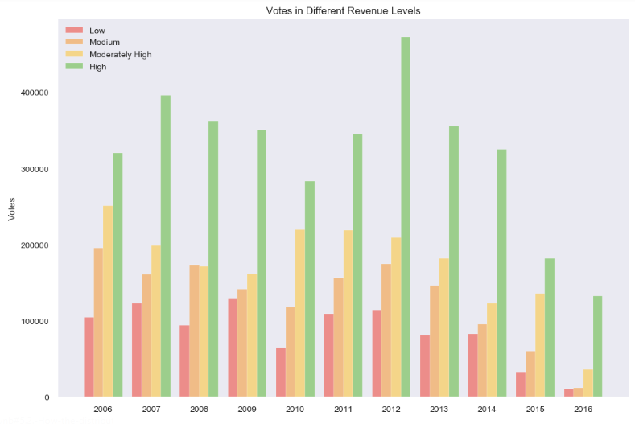
How the distribution of Votes in different revenue levels ?
We can see that movies with higher revenue level are with higher Votes .

Slide 8
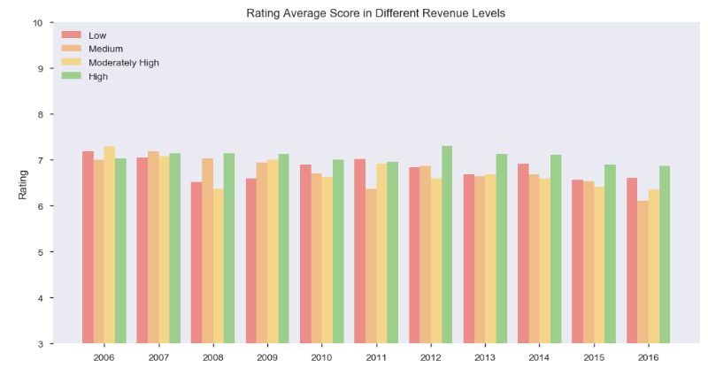
How the distribution of revenue in different score rating levels ?
From the chart above, we can see that there is no big difference of movie rating
between each revenue level. So it can be concluded that the high revenue movies
don't have the significant high score rating.

Slide 9
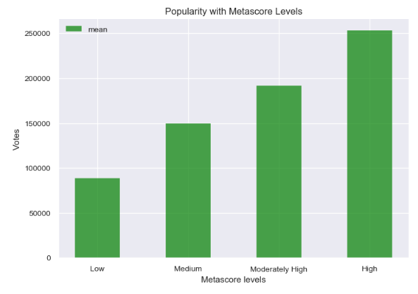
What's the Metascore level movie are associated with movies that have high popularity?
We can see that the higher popularity movies has Metascore

Slide 10
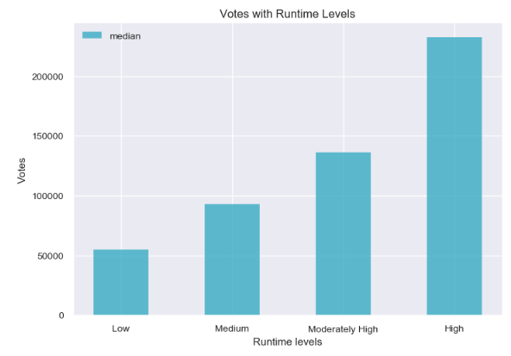
What's the runtime level are associated with movies that have high popularity on average ?
We can see that the higher popularity movies has longer run time

Slide 11
Conclusion
The properties that are associated with high popularity movies were with high Metascore (From: Section 6.1.1) levels and Longer Run Time (From: Section 6.1.2) and high Voting Score(From: Section 5.2).

