Slide 1
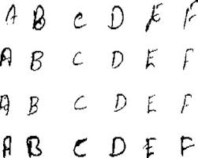
Letter Recognition Model
By
Susanta Kumar Labala
GCD Term-5 Project Report 05/05/2019

Slide 2
Introduction
From the given dataset, the alphabetic letter category has to be predicted based on its attributes which comes under classification type.

Slide 3
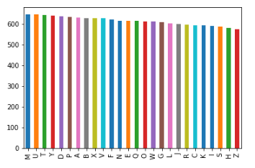
Distribution of Letters
Plotting "letter" column to know the "frequency of each letter" in train dataset

Slide 4
Data fields
1. lettr capital letter (26 values from A to Z) 2. x-box horizontal position of box (integer) 3. y-box vertical position of box (integer) 4. width width of box (integer) 5. high height of box (integer) 6. onpix total # on pixels (integer) 7. x-bar mean x of on pixels in box (integer) 8. y-bar mean y of on pixels in box (integer) 9. x2bar mean x variance (integer) 10. y2bar mean y variance (integer) 11. xybar mean x y correlation (integer) 12. x2ybr mean of x * x * y (integer) 13. xy2br mean of x * y * y (integer) 14. x-ege mean edge count left to right (integer) 15. xegvy correlation of x-ege with y (integer) 16. y-ege mean edge count bottom to top (integer) 17. yegvx correlation of y-ege with x (integer)

Slide 5
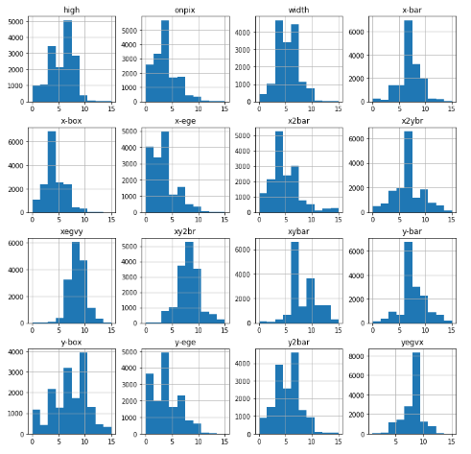
various attributes distribution

Slide 6
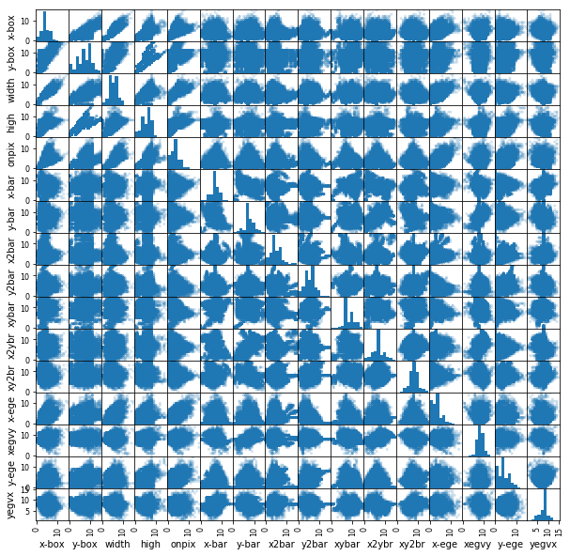
Scatter and density
visualize a bivariate distribution

Slide 7
Pre-processing to improve the analytics data.
Removing the unnecessary independent variables ‘Id”

Slide 8
Model Selection
SVM is supervised binary classifiers which are very effective when you have higher number of features. The goal of SVM is to separate some subset of training data from rest called the support vectors (boundary of separating hyper-plane). The decision function of SVM model that predicts the class of the test data is based on support vectors and makes use of a kernel trick.

Slide 9
Model Prediction Accuracy Result
# | Algorithms Used | Accuracy
1 | Random Forest | 96.21875
2 | KNN | 94.5625
3 | XGBoost | 83.97
4 | SVC | 97.28

Slide 10
CONCLUSION
From above all, as SVC algorithm gave good accuracy, it is considered and used for predicting test dataset.
Final result is in "submissionsvm.csv" file.

