Slide 1

CAR SALES PRICE ANALYSIS
By
Susanta Kumar Labala
GCD Term-6 Project Report 21/07/2019

Slide 2
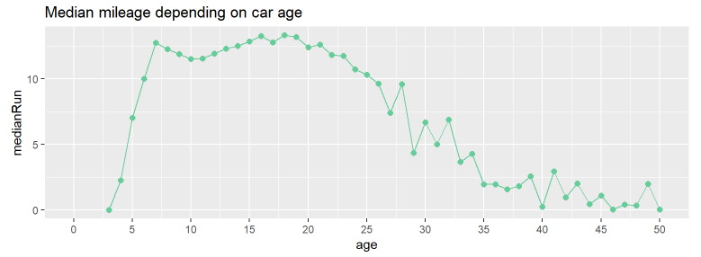
Which car has the biggest average annual mileage? And what about average age?
There is a wide “plateau” for 7-18 years old cars at the level of 16’000 km per year. Than the level goes down.

Slide 3
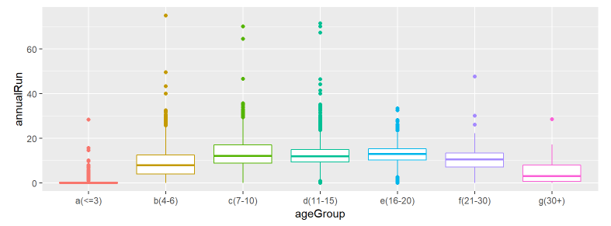
check the mileage variance for age groups
As we see average values of mileage for VAZ are lower than 2nd quartile for all cars of this age. In this cars it is easy to "adjust" speedometer readings. And assumed that we got evidence of such massive manipulations.

Slide 4
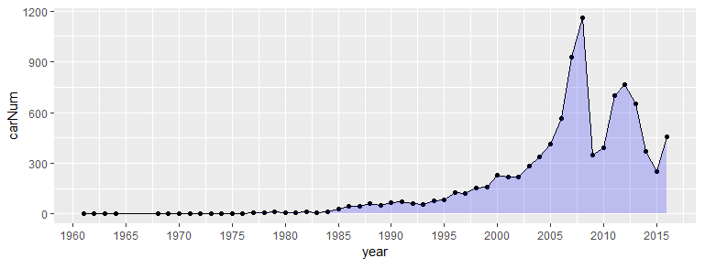
What is the distribution of year of production?
There are two clear groups. The first one is relevant to post Soviet period growth with a burst after 2000. The second one is short recovery after 2008 crisis.
It is interesting what are the oldest cars at the market.

Slide 5
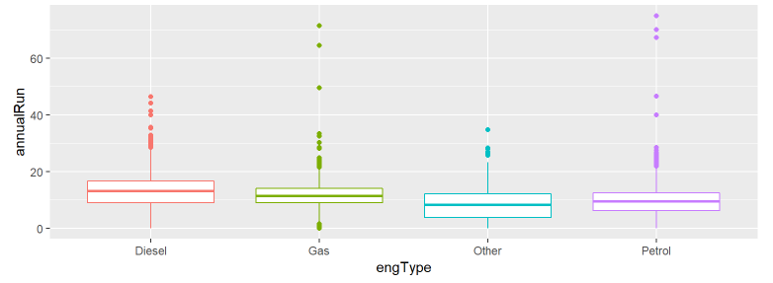
Diesel engines have consistently bigger annual mileage
it looks like Diesel drivers are indeed tend to drive more

Slide 6
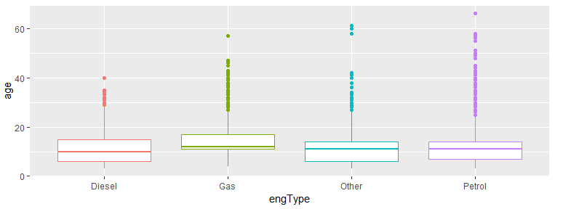
What about petrol and body type? Do they influence drivers mileage?
Also we can see that the cars which use gas as a fuel are mainly old ones.

Slide 7
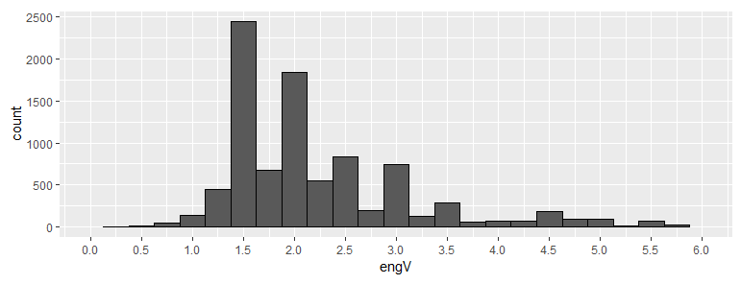
What is the distribution of engine volume?
Main engine volumes are clear to understand, the most popular one is 1.5-1.6 litres.

Slide 8
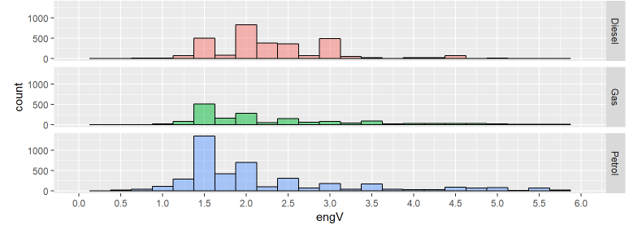
What is the distribution across different engine types?
Indeed main part of diesel engines has 2l volume, while petrol as usual is just 1.5l. Gas engines have the same pattern as petrol because again they are just reworked petrol ones.

Slide 9
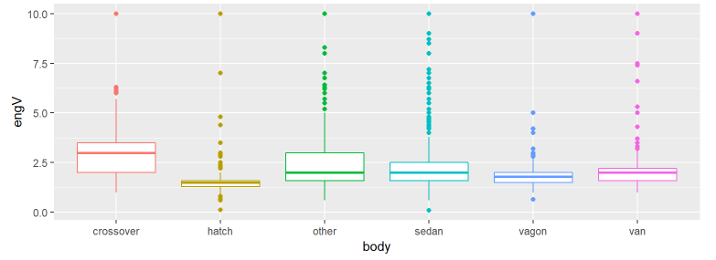
Body type and Engine volume relation
Hatchbacks almost don’t have variance - their engines gathered in 1.4-1.6 litters zone. Almost the same with vagon which often have 2l volume. While crossover engine volume can vary significantly.

Slide 10
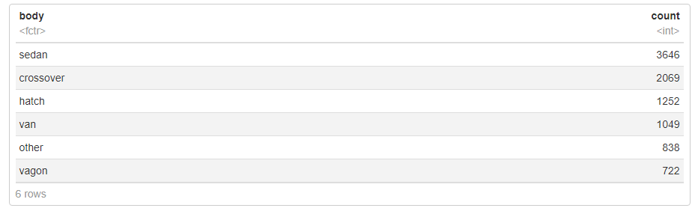
Let’s glance at the number of offers by body type
Found sedan is the most popular..

Slide 11
CONCLUSION
Above analysis shows that the prices of car strongly depend on mileage, year of manufacturing and engine volume.
The sales analysis also showed that people preferred a sedan with petrol engine.
This shows that the company should produce petrol sedan to increase their chances of making profit.

