Slide 1

EMAIL FILTERING MODEL
By
Susanta Kumar Labala
GCD Term-4 Project Report 17/03/2019

Slide 2
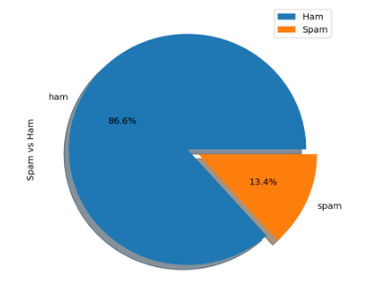
Distribution of Ham/Spam Emails
13.4 % of Emails are Spam needs to be classified using ML models.

Slide 3
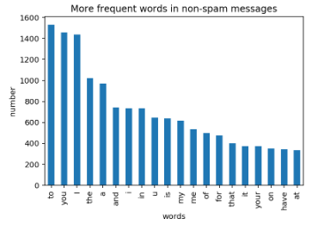
Most frequent words in ham messages
The frequent words of the messages will be model features

Slide 4
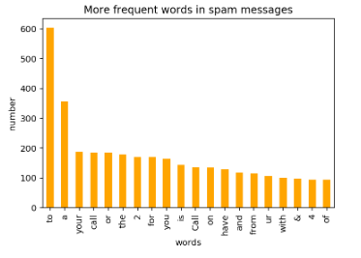
Most frequent words in spam messages
The majority of frequent words in both classes are stop words such as 'to', 'a', 'or' and so on. Which are common words in a language, there is no single universal list of stop words.

Slide 5
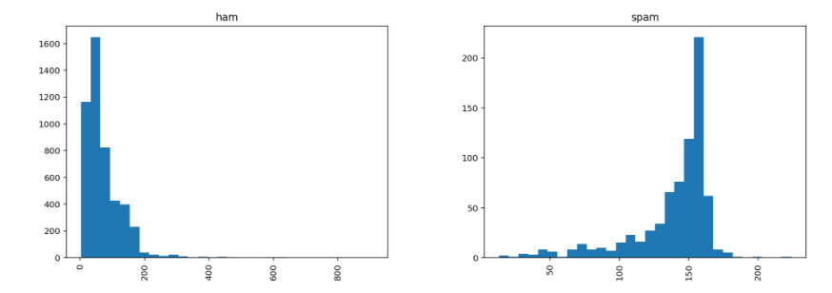
length of ham and spam messages
From this plot we can say that spam messages are much more long than ham messages on an average

Slide 6
Pre-processing to improve the analytics data.
For text classification, removing stop words (words that don't provide useful meaning, i.e. "and" "or").
Also the characters are converted to a single case
Stems each word (i.e it replaces a word with the root of that word, for example "tasted" or "tasting" would become "taste").
Processing TFIDF (term frequency - inverse document frequency) statistical method to tell how important a word is to a particular document by increasing the numerical value for an occurrence in the specific document but decreasing relative to number of occurrences in the entire corpus.

Slide 7
Model Selection
Naive Bayes classifier is a conventional and very popular method for document classification problem. It is a supervised probabilistic classifier based on Bayes theorem assuming independence between every pair of features.
SVM is supervised binary classifiers which are very effective when you have higher number of features. The goal of SVM is to separate some subset of training data from rest called the support vectors (boundary of separating hyper-plane). The decision function of SVM model that predicts the class of the test data is based on support vectors and makes use of a kernel trick.

Slide 8
Model Prediction Accuracy Result
Multinomial Naive Bayes Model : 0.9850478468899522
SVM model : 0.9784688995215312

Slide 9
CONCLUSION
Multinomial Naive Bayes Model provided a slightly more accurate result than the SVM model so should therefore be used. There are many other models that may be more suitable for this dataset, however both of these model produce sufficient results.

