Slide 1
Introduction & Course Overview CS 194H – User Experience Design Project
January 5, 2016

Slide 2
Outline
Who are we?
Course overview & schedule
Introductions
Teams

Slide 3


Who are We?

Slide 4
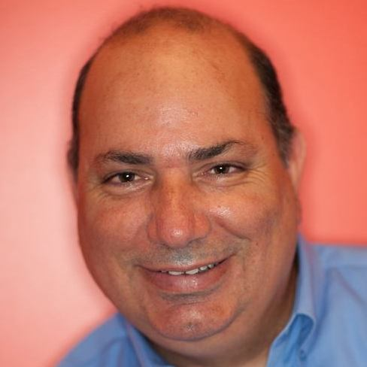
James Landay
Professor in Computer Science at Stanford
formerly professor in Information Science at Cornell Tech, CSE at the University of Washington & EECS at UC Berkeley
spent 3 years as Director of Intel Labs Seattle
Dec 2011 finished 2.5 year sabbatical at Microsoft Research Asia
PhD in CS from Carnegie Mellon ’96
HCI w/ focus on informal input (pens, speech, etc.), crowdwork, web design (tools, patterns, etc.) & ubiquitous computing (Ubicomp)
Office hours
Mon. 2:00 PM – 3:00 PM, Gates 390
Wed. 10:00 AM – 11:00 AM, Gates 390

Slide 5
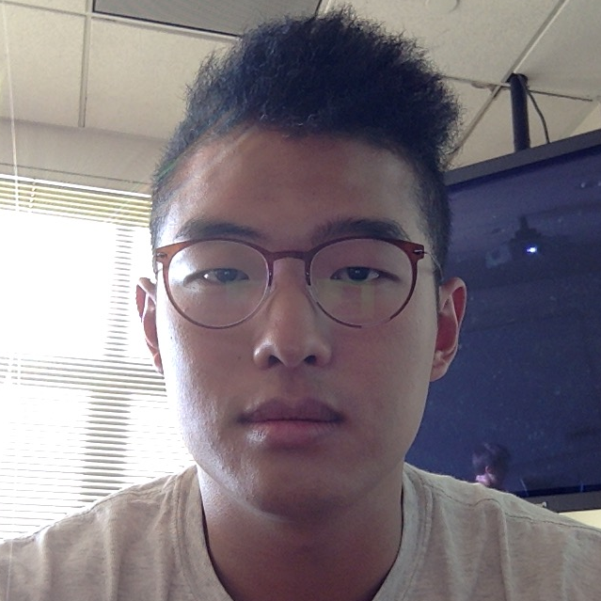
Chris Min
BA Economics, MS CS
Need finding, rapid design iteration, healthcare tech
I like traveling, biking, and traveling by bike
Office hours
Mon. 1:00 PM – 2:00 PM, Huang Basement
Wed. 1:00 PM – 2:00 PM, Huang Basement

Slide 6
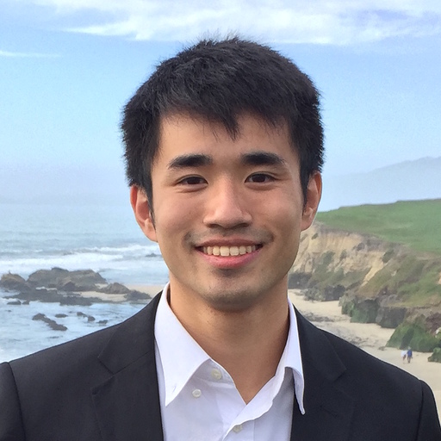
Sherman Leung
BS CS (HCI), MS CS (HCI)
entrepreneurship, edtech & mobile health
enjoys piano, ping pong & basketball
office hours
Tue./Thur. 10:30 AM – 11:30 AM, Tressider

Slide 7
How to Design and Build UIs
UI Development process
Usability goals
User-centered design
Need finding, task analysis & contextual inquiry
Rapid prototyping
Evaluation
Programming

Slide 8
Iteration
At every stage!
Design
Prototype
Evaluate

Slide 9
Goals of the Course
Learn to prototype, evaluate, & build UIs
the needs & tasks of prospective users
cognitive/perceptual constraints that affect design
technology & techniques used to prototype UIs
techniques for evaluating a user interface design
importance of iterative design for usability
how to work together on a team project
communicate your results to a group
key to your future success
Understand where technology is going & what UIs of the future might be like

Slide 10
Course Format
Quarter long project & individual homework
Interactive lectures / Project presentations (usually on Tuesdays)
Studio design critiques on Thursday (usually)
Readings (small number & short)
All material is (will be) online
slides, exercises, readings, schedule
http://hci.stanford.edu/courses/cs194h/
Have fun & participate!

Slide 11
Project Description
We will continue work on projects from CS 147
existing groups will stay intact
we will assign “new” students to teams
Groups
4 students to a group ➔ 10-15 groups
groups meet with teaching staff every 2 weeks
often in class, but also regularly scheduled outside
Cumulative
apply several HCI methods to a single interface

Slide 12
Project Process Overview
Project Recap (next Tue)
Web Site
Lab Usability Study
Hi-Fi Prototype #2
Field Usability Test
Hi-Fi Prototype #3
Hi-Fi Video Prototype
Final posters/presentations & project fair with industry guests

Slide 13
Schedule
http://hci.stanford.edu/courses/cs194h/2016/wi/calendar.html

Slide 14
Administrivia
James’ contact info
email: landay@[usual stanford email domain] for appointments at times outside of office hours
Chris & Sherman’s contact info on web site

Slide 15
Books
Universal Principles of Design by Lidwell, Holden & Butler
“handout” ~8 chapters we will use
We will also hand out other papers, give you web links & refer to slides
Other recommended refs on web page

Slide 16
Assignments
Individual
5 short studio tasks + one individual talk
Team
8 team assignments including web site
5 team presentation/demos + with 1 write-up
video
poster
team web site graded
all work handed in online
team work on team web site
individual work TBD

Slide 17
Grading
No exams
Individual assignments (30%)
Group project (60%)
demos/presentation (team component)
project write-up
team web site
ratings given by other team members & class
In class participation (10%)

Slide 18
Tidbits
Late Policy
no lates on team assignments
individual assignments lose one letter grade/day
Cheating policy
Stanford honor code

Slide 19
Teams
Which 147 teams are represented?
How many team members?

Slide 20
Survey
http://goo.gl/forms/Ig5kltfG7k

Slide 21
Summary
Thursday
Studio assignment #1 – Hierarchy & Tagging
Read How to Survive a Critique by Karen Cheng
Read Hierarchy from Universal Principles of Design
Share with Chris so we can access during class

