Slide 1
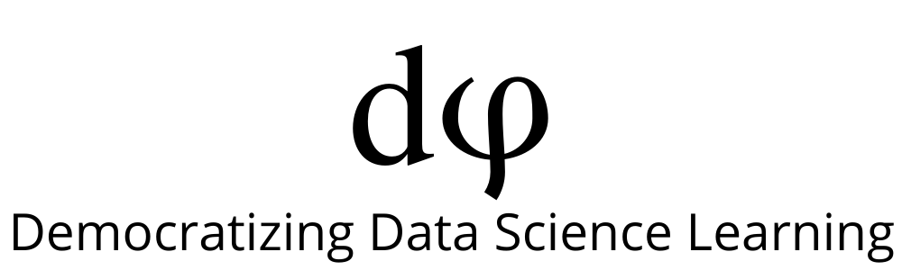
Welcome to Data Science Online Bootcamp
Day 0

Slide 2

Learning Objectives
1. Adding comments in Python
2. Variables and Operators
3. Input and Output in Python
4. Data Types
5. Numeric and String Data Types

Slide 3
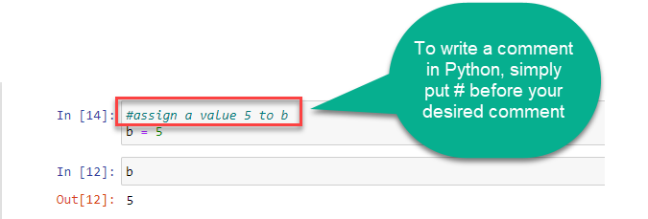
Comments in Python
When writing code in Python, it’s important to make sure that your code can be easily understood by others, say by your friend who wants to see your code.
Python ignores everything after the hash mark and up to the end of the line. You can insert them anywhere in your code!
A shortcut for adding comments is by using CTRL + /

Slide 4
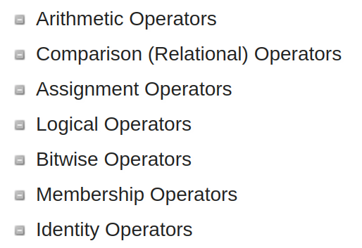
Operators
Operators are used to perform operations on variables and values.
Python supports the following types of operators:
Let’s look at the commonly used types for now.

Slide 5
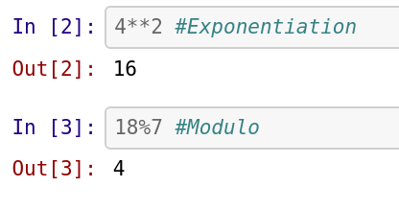
Operators
Arithmetic Operator
Used with numeric values to perform common mathematical operations
The addition and subtraction operations that you performed yesterday come under this category
Example:
x =2
y=3
x + y # Addition
x * y # Multiplication

Slide 6
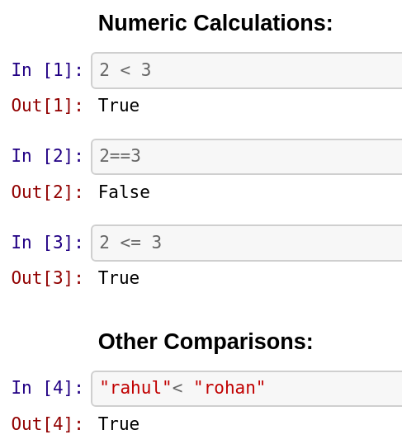
Operators
Comparison Operator
Used to compare two values
Gives a boolean result
(True/False)

Slide 7
Operators
To learn more about operators, visit: https://www.w3schools.com/python/python_operators.asp
Cheat Sheet: https://www.codecademy.com/learn/learn-python-3/modules/learn-python3-syntax/cheatsheet
Tip: If you are unable to follow, try running the code and make out the difference

Slide 8
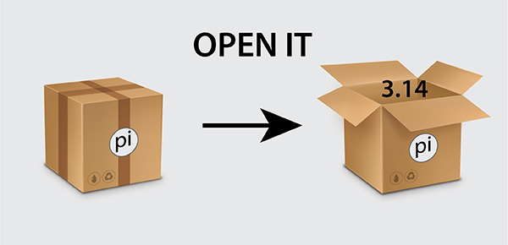
Variables
A variable can be considered a storage container for data.
Every variable will have a name.
It is a good way to store information while making it easy to refer to that information in our code later.
For instance, instead of working with the number 3.14, we can assign it to a variable pi and use it as many times as we want later.

Slide 9
Variables
The equal sign (=) is used to assign values to variables.
The syntax for assigning values to a variable is as follows:
Variable name = value or information
Example:
x = 5
y = "John"

Slide 10
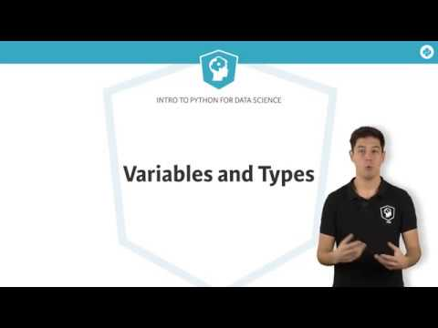
Variables and Types

Slide 11
Data Types in Python
Before we proceed to discuss what data types in Python are, there are some basic questions that we would discuss. What is data?
Let’s say you are going to meet a friend at her office. When you go to visit her office, the guard asks you to make an entry in the register before you enter the office. A typical entry register asks for the following information –
The above information that you just provided is data.
Visitor’s name | Visitor’s phone number | Visitor’s address | Entry time
Karen | 32 000 000 | Leuven | 8:30 am

Slide 12
Data Types in Python
We see that the data entry in the previous slide has different varieties:
some are english letters,
some are numerical digits, and
there are some special characters, dash (-) and colon ( : ).
In this example, our data is divided into 4 categories – name, phone number, address, and time.
This categorisation of data, based on their characteristic & our need, is called data types.

Slide 13
Data Types in Python
Some of the data types in python include:
Integer: whole numbers, positive or negative numbers. Eg: 100
Float: Floating-point numbers are real numbers, rational or irrational. In most cases, this means numbers with decimal fractions. Example: 123.45
String: Strings are sequences of characters, or text, enclosed in quotes. Example: "any text", “karen”

Slide 14
Data Types in Python
For further reading about operators and data types, visit: https://www.dummies.com/programming/python/python-all-in-one-for-dummies-cheat-sheet/
For practice and different data type examples, visit: https://www.w3schools.com/python/python_datatypes.asp

Slide 15
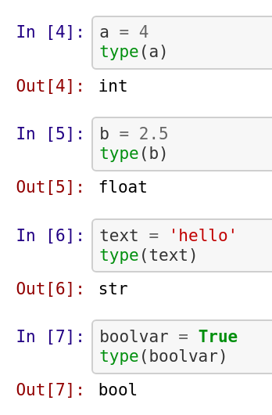
Getting the Data Type
You can get the data type of any object by using the type( ) function:

Slide 16
Python Strings
Strings are sequence of characters.
Let us see some examples of String: My name is Rahul, Rahul, Go home. All these are examples of String.
In Python, Strings are called str.
There is a specific way of defining String in Python – it is defined within single quote (‘) or double quotes (“).

Slide 17
Accessing String Elements
Square brackets can be used to access elements of the string.
Remember that the first character has index 0.
Example:
a = "Hello, World!"
print(a[1])
Will give an output e. Can you understand why?
Index refers to position of a character in a string. In python index number starts from 0.

Slide 18
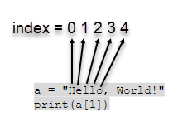
Accessing String Elements
Hope you got the answer to the previous question now!

Slide 19

String Slicing
We can also call out a range of characters from the string using string slicing.
Specify the start index and the end index, separated by a colon, to return a part of the string. Note that the character of the end index is not included.
Suppose we want to print World from the string “Hello World”. We can do so as below:

Slide 20
Negative Indexing
If we have a long string and we want to pinpoint an item towards the end, we can also count backwards from the end of the string, starting at the index number -1
Printing ‘r’ from the string :
a = "Hello, World!"
print(a[-4])
Get the characters from position 5 to position 1, starting the count from the end of the string:
print(a[-5:-2])
Will give an output :
orl

Slide 21
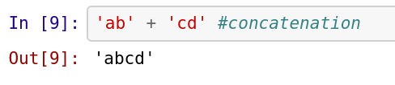
String Concatenation
String concatenation means adding strings together.
Use the + character to add a variable to another variable:
Example:
1.
2. x = "Python is "
y = "awesome"
z = x + y
print(z)
OUTPUT
Python is awesome

Slide 22
String Length
To get the length of a string, use the len( ) function.
Getting length of the string a :
a = "Hello, World!"
print(len(a))
OUTPUT:
13

Slide 23
String Methods
Python has a set of built-in methods that you can use on strings.
Must learn: Learn about important string methods from the below cheatsheet:
https://www.codecademy.com/learn/learn-python-3/modules/learn-python3-strings/cheatsheet
Tip: If you are unable to follow, run the code and make out the difference

Slide 24
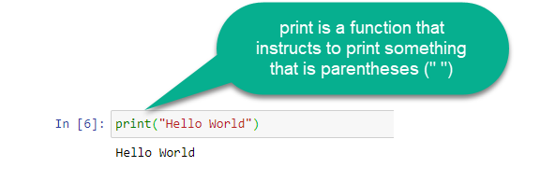
Input and Output in Python
Print Function
You’ve already worked with the print function in your first Python program to print “Hello World”
Example:
print(“This is a print statement”)
print(2)

Slide 25
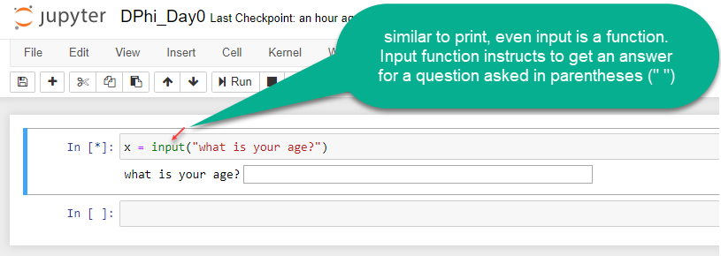
Input and Output in Python
Input Function

Slide 26
Let’s Practice!
Write a program to take a number from the user using a prompt “Enter a number : “.
Print the number taken by the user in the previous question. Hint: assign your program to a variable in question 1
Print the square of that number.
Create a string with value “Program” and print ‘o’ from it. Hint: recall indexing
Print the last 4 characters of the above string.
Check if the string contains all lowercase letters.
Print the type of the string

Slide 27
Let’s Practice!
8. Take in first name and last name as input and store it in the
variables firstname and lastname
Suppose
firstname = “abc”
lastname = “xyz”,
Your task is to print the following:
Hello abc xyz! You just delved into python.
Hint: Google how to print multiple arguments/variables in python

Slide 28
That’s it for the day. Thank you!
Feel free to post any queries in the #help channel on Slack

