Slide 1
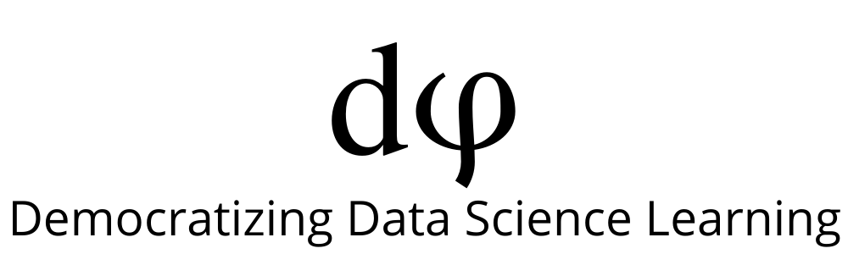
Welcome to Data Science Online Bootcamp
Day 1

Slide 2

Learning Objectives
Data Structures
Sequence Types
List
Tuple

Slide 3
Data Structures and Data Types
If you’re learning Python from multiple sources, you might encounter the terms data structures and data types being used interchangeably.
Definition: Data structure is a general computer science concept. Its definition reads as follows on Wikipedia: Data structure is a data organization, management, and storage format that enables efficient access and modification. More precisely, a data structure is a collection of data values, the relationships among them, and the functions or operations that can be applied to the data.

Slide 4
Data Structures and Data Types
Whereas Data type is a concept specific to a programming language. In a way, it is a concrete implementation of a data structure in a particular programming language (be it python or any other language).
The actual definition of what constitutes a "type" varies among programming languages. Talking about Python, there are basic data types like int, float, char etc. You can use the built-in types like list, set etc. which we will be covering in this session.
Calling these data types as data structures won’t be wrong because there is no major difference between the two in Python. Now let’s get started with learning the new data structures/types such: Sequence types, Lists and Tuples.

Slide 5
Sequence Types
Sequences allow you to store multiple values in an organized and efficient way.
There are seven sequence types: strings, Unicode strings, lists, tuples, bytearrays, buffers, and xrange objects.
We’ll discuss list and tuples in the following slides.
Nothing to worry looking at this long list, you will get to know it gradually

Slide 6
List
As the name suggests, List is an ordered sequence of data. In real life, if you could make a list of things that come to your mind (or event for any specific purpose), it could be something like this –
Brush
Leuven
48851964400
3.14
Mom
Well, this is my list. You could make your own list & include whatever you want in it. So, in my list, I have included what I do early in the morning, the city I live in, my mobile number, the value of pi to two digits, and mom. It has different types of data – strings, float, and integer.

Slide 7
List
Well, this is the kind of flexibility Python List provides. It can hold different types of data types. Declaring a List is fairly straightforward. You use square bracket ([]) and separate the items by a comma. Let me write an example -
A = ["Brush", "Leuven", 48851964400, 3.14, "Mom"]
Lists are mutable. Say if you want to change some item on a List, you can do that. For example, if I don’t like ‘Brush’’, and want to replace this with ‘Morning Walk’, I can do it –
A = ["Morning Walk", "Leuven", 48851964400, 3.14, "Mom"]
Some essential features of Python lists are:
Collection of values
Can be of any data type
Can be a combination of different types

Slide 8
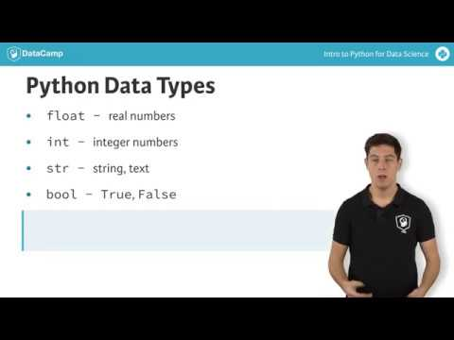
List

Slide 9
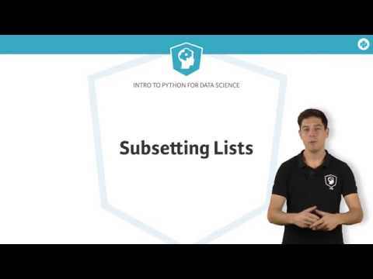
Accessing List Elements

Slide 10
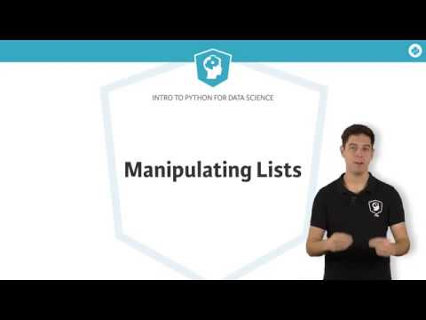
List Manipulation

Slide 11
List Methods
Python has a set of built-in methods that you can use on lists.
Must learn: Learn about important list methods from the below cheatsheet:
https://www.codecademy.com/learn/learn-python-3/modules/learn-python3-lists/cheatsheet
Tip: If you are unable to follow, run the code and make out the difference

Slide 12
Interested to learn more about Lists?
To learn more about lists, visit: https://www.w3schools.com/python/python_lists.asp

Slide 13
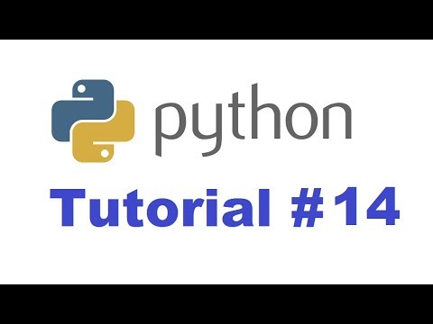
Tuples
Note: The tutor in this video used python console. Nothing to worry here, you can use the same code and run it on jupyter notebook too

Slide 14
Tuples
Tuple is also an ordered sequence of items as List. Tuple also holds multiple data types.
The only difference in Tuple & List is that Tuple is immutable; once created it cannot be changed.
Creating a tuple is as simple as putting different comma-separated values within round brackets.
Example: A = (‘Brush’, ‘Leuven’, 48851964400, 3.14, ‘Mom’)

Slide 15
Interested to learn more about Tuples?
To learn more about Tuples, visit: https://www.w3schools.com/python/python_tuples.asp

Slide 16
Let’s Practice!
Write a program to store the names of your following members of family: john, chan, yuen, matt Put them in a list named list1.
Print the list.
Grab the 2nd element of the list and print it. ( Remember that the indexing starts from 0)
Change the 2nd element to the name of your friend and print the list again.
Now, try to create a list of list named list2 with each element as [name, age] of the family members.

Slide 17
Let’s Practice!
6. Add item 7000 after 6000 in the following Python List
list1 = [10, 20, [300, 400, [5000, 6000], 500], 30, 40] Final output should look like this:
list1 = [10, 20, [300, 400, [5000, 6000, 7000], 500], 30, 40]
7. Given a Python list, find value 20 in the list, and if it is present,
replace it with 200. Only update the first occurrence of a value.
list1 = [5, 10, 15, 20, 25, 50, 20]
Expected output:
list1 = [5, 10, 15, 200, 25, 50, 20]
8. Create a tuple of 5 colours.
9. Unpack the following tuple into 4 variables
aTuple = (10, 20, 30, 40)

Slide 18
That’s it for the day. Thank you!
Feel free to post any queries in the #help channel on Slack

