Slide 1

Welcome to Data Science Online Bootcamp
Day 2
Notes:
Communication for the course:
- Communication about programming language
We don't want to give you a shock by dumping too many things
We will go gradually and make it a smooth learning exp

Slide 2

Learning Objectives
While loop
For loop
Enumerate
Range

Slide 3
Loops
A loop is a sequence of instructions that is continuously repeated until a certain condition is reached.
Think about a teacher taking attendance. The teacher calls out a name, and the student responds present.
The teacher is going through the list of students one by one and calling a name to get “present” if the student is present, or “<<silence>>” if they are absent.
This process will only end when the whole list of students are completed. This will be the condition that will break out of the loop.
Let’s have a look at the types of loops present in Python!

Slide 4
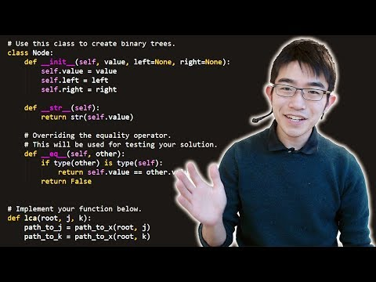
For Loop

Slide 5
For Loop
“For loop” is used for iterating over a sequence (that can be any data structure - list/tuples or even a string)
Iteration means performing an action repeatedly
Syntax:
for variable in sequence:
expression
Which means " for each variable in sequence, execute the expression"

Slide 6
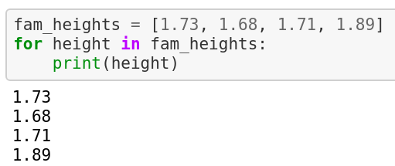
Looping through a List
Example:
Let’s say we wish to store the heights of our family members in a list and print them one by one.
Internal Working:
First, we store all the heights in a list named fam_heights
Now, we’ll go to each element and print it
This action will continue until all the elements of the list are printed in order.

Slide 7
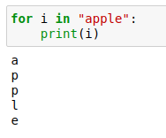
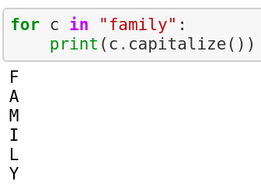
Looping through a String
Even strings are iterable objects, they contain a sequence of characters:
As you can see, each character of the string is printed in a separate line.
We can even apply string methods in the for loop.

Slide 8
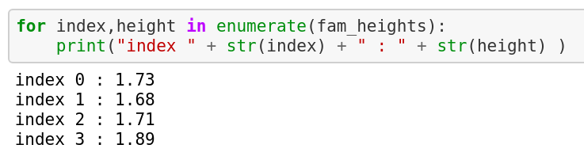
Enumerate
With the for loop, you were able to print the heights of your family members.
But what if you want to access the index of each element of the list as well? Here is where the enumerate function comes into play.
The enumerate function iterates over the elements of a list and associates an index with them. You need to use 2 variables (index and height in this case) to store the values given by enumerate.

Slide 9
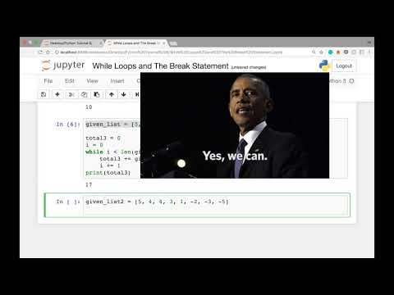
While Loop

Slide 10
While Loop
With the while loop we can execute a set of statements repeatedly as long as a condition is true.
Syntax:
while condition:
statement(s)
All the statements indented by the same number of character spaces after a while condition are considered to be part of a single block of code. Python uses indentation as its method of grouping statements.

Slide 11
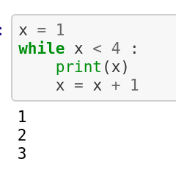
While Loop
For example:
Let us understand what is happening in the above program.
Value of x is assigned as 1
The while loop starts with a condition that x must be less than 4
The next 2 statements have the same indentation and will be considered a part of while loop
The value of x is printed. Initially, x=1
The value of x is then increased by 1. So now, x=2
Control goes back to the condition line, x is less than 4 (2<4). This means that the following statements will be executed again
This continues until x is assigned a value of 4. Then, the condition fails as x is not less than 4
The next 2 statements will not be executed and the while loop will end.

Slide 12
Range
range() allows user to generate a series of numbers within a given range.
The user can decide where that series of numbers will begin and end as well as how big the difference will be between one number and the next.
range() takes mainly three arguments:
A start argument is a starting number of the sequence. i.e., lower limit. By default, it starts with 0 if not specified.
A stop argument is an upper limit. i.e., generate numbers up to this number, The range() doesn’t include this number in the result.
The step is a difference between each number in the result. The default value of the step is 1 if not specified.
range() only works with the integers. You can not use float number or any other type in a start, stop and step argument of a range().

Slide 13
Range
You can call range function in three ways:
range(stop) takes one argument.
range(start, stop) takes two arguments.
range(start, stop, step) takes three arguments.

Slide 14
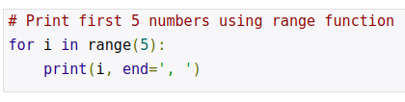
Range
Example 1: Using only one argument
Output:
0, 1, 2, 3, 4,
Only a stop argument is passed to range() . So by default, it takes start = 0 and step = 1.
By default, print statement prints in different lines. If you want to print output in the same line, you can use the end argument.
‘,’ specifies that each output will be separated by a comma.

Slide 15

Range
Example 2: Using two arguments (i.e., start and stop)
Output:
5, 6, 7, 8, 9,
By default, it took step value as 1.

Slide 16
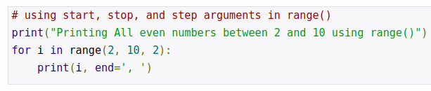
Range
Example 3: Using all three arguments
Output:
Printing All even numbers between and 10 using range()
2, 4, 6, 8,
All three arguments are specified i.e., start = 2, stop = 10, step = 2. The step value is 2 so the difference between each number is 2.

Slide 17
Additional Reading
A few more concepts like break, continue and nested loops are commonly used in Python.
Must learn: Learn about important these concepts from the below cheatsheet:
https://www.codecademy.com/learn/learn-python-3/modules/learn-python3-loops/cheatsheet
Tip: If you are unable to follow, run the code and make out the difference
Find out how the range function works with strings and list.
Hint: You’ll use their lengths instead

Slide 18
Let’s Practice!
Print First 10 natural numbers using while loop.
Iterate over the following list and print the elements:
list1 = [12, 15, 32, 42, 55, 75, 122, 132, 150, 180, 200]
3. Accept a number n from user and print its multiplication table
4. Use the enumerate function to print the elements of this list along
with the indices:
grocery = ['bread', 'milk', 'butter']
5. Write a program to input number from user and find sum of all numbers
between 1 to n.

Slide 19
Let’s Practice!
6. Create a sequence of numbers from 3 to 5, and print each item in the
sequence.
7. Create a sequence of numbers from 3 to 19, but increment by 2
instead of 1.
8. Print the letters of the string “Python” in the same line:
Using a simple for loop
Using the range function
The above questions are for self-practice and ungraded, you don’t need to upload them on Learning Platform.

Slide 20
You can attempt the quiz after this!
That’s it for the day. Thank you!
Feel free to post any queries in the #help channel on Slack

