Slide 1

Welcome to Data Science Online Bootcamp
Day 3
Notes:
Communication for the course:
- Communication about programming language
We don't want to give you a shock by dumping too many things
We will go gradually and make it a smooth learning exp

Slide 2

Learning Objectives
Conditional Statement
Dictionary

Slide 3
Conditional Statement: if-else-elif
In the real world, we commonly evaluate information around us and then choose one course of action or another based on what we observe:
If the weather is nice, then I’ll go for a walk. (It’s implied that if the weather isn’t nice, then I won’t go for a walk.)
In a Python program, the if statement is how you perform this sort of decision-making. It allows for conditional execution of a statement or group of statements based on the value of an expression.

Slide 4
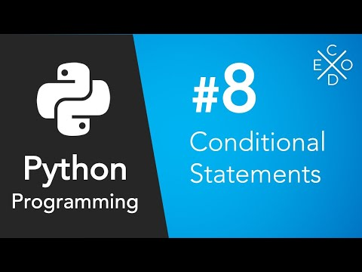
Tutorial on Conditional Statements

Slide 5
If
Syntax (how to write If statement in python?)-
if test expression/condition:
statement(s)
Here, the program evaluates the test expression and will execute statement(s) only if the text expression is True.
If the text expression is False, the statement(s) is not executed.
In Python, the body of the if statement is indicated by the indentation. Body starts with an indentation and the first unindented line marks the end.
Python interprets non-zero values as True (even negative values). None and 0 are interpreted as False.

Slide 6
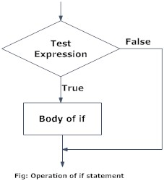
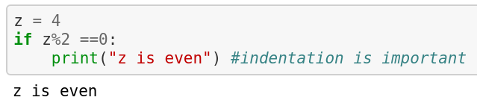
If
Flowchart:
Example: Python program to detect if a number is even. (sign % tells us the remainder of an expression. Any number that has a remainder 0 after dividing by 2 must be even.)

Slide 7
If - else
Syntax-
if test expression:
Body of if
else:
Body of else
The if..else statement evaluates test expression and will execute the body of if only when the test condition is True.
If the condition is False, the body of else is executed. Indentation is used to separate the blocks.

Slide 8
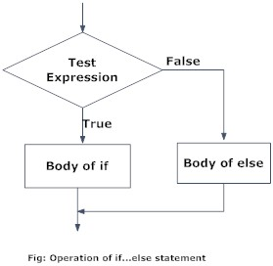
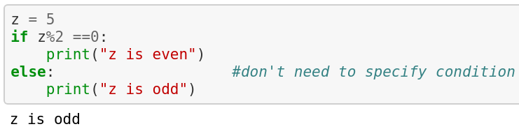
If-else
Flowchart:
Example:

Slide 9
If - elif - else
Syntax-
if test expression:
Body of if
elif test expression:
Body of elif
else:
Body of else
The elif is short for else if. It allows us to check for multiple expressions.
If the condition for if is False, it checks the condition of the next elif block and so on.
If all the conditions are False, the body of else is executed.
Only one block among the several if...elif...else blocks is executed according to the condition.
The if block can have only one else block. But it can have multiple elif blocks.

Slide 10
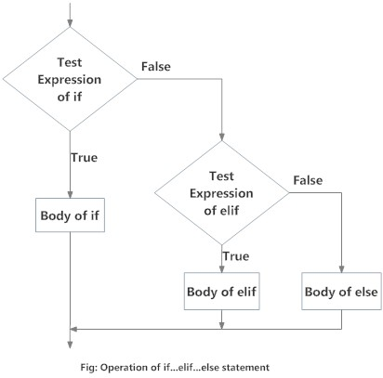
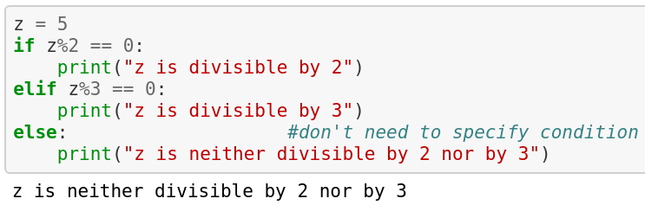
If-elif -else
Flowchart:
Example:

Slide 11
If-elif -else
Now let’s try to understand the given example.
We first assigned the value 5 to x
The control shifts to the next line where x%2 is checked. 5 is not divisible by 5 and so the control doesn’t shift to the body of if.
Then, the elif statement: x%3 is executed. Since 5 is not divisible by 3, the body of elif is not executed.
Finally, the else statement is executed and the control shifts to the body of the control statement. The print statement (“z is neither divisible by 2 nor by 3” is executed.
Point to be noted: The conditions are checked in a top to bottom order. If any of the above if or elif condition is True, it’ll be executed and no further conditions will be checked.
Can you figure out what will z=6 print in the given example?

Slide 12
Dictionary
Dictionary is unordered collection of key-value pairs.
Real word dictionaries are a good analogy to understand them: they contain a list of items(words), each item has a key(the word) and a value(the word’s meaning).
It generally is used when we have a huge amount of data.
It is defined within braces with each item being in the form of key: value pair. Syntax –
my_dict = {
"key1":"value1",
"key2":"value2",
}

Slide 13
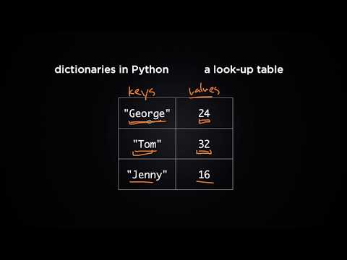
Tutorial on Dictionaries

Slide 14
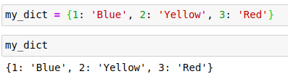
Dictionary
The keys in a dictionary must always be unique and immutable. This is the reason dictionary keys can be String but not List.
On the other hand, Values in a dictionary can be of any datatype and can be duplicated
Dictionary keys are case sensitive, same name but different cases of Key will be treated distinctly.
Example:

Slide 15
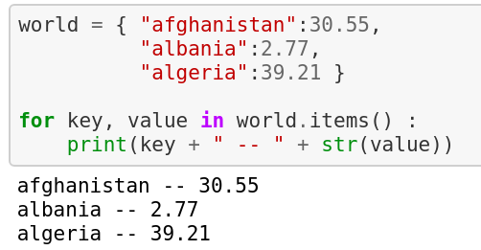
Looping over Dictionary
Let’s say we have a dictionary containing countries as keys and their populations as values.
For looping through a dictionary, we use a method called items( ). Similar to enumerate, it gives us both the keys and values of a dictionary.

Slide 16
Interested to learn more about Dictionaries?
For additional practice on dictionaries, visit: https://www.w3schools.com/python/python_dictionaries.asp

Slide 17
Let’s Practice!
Take values of length and breadth of a rectangle from user and check if it is square or not.
Take two int values from user and print greatest among them.
Write a program to read the age of a candidate and determine whether it is eligible for casting his/her own vote.
Write a Python program to add a key to a dictionary.
Sample Dictionary : {0: 10, 1: 20}
Expected Result : {0: 10, 1: 20, 2: 30}
Below are the two lists, convert it into a dictionary.
keys = ['Ten', 'Twenty', 'Thirty']
values = [10, 20, 30]
Expected output:
{'Ten': 10, 'Twenty': 20, 'Thirty': 30}

Slide 18
Let’s Practice!
6. Access the value of key ‘history’
sampleDict = {
"class":{
"student":{
"name":"Mike",
"marks":{
"physics":70,
"history":80
}
}
}
}
Expected output:
80

Slide 19
Let’s Practice!
7. Given the following dictionary:
inventory = {
'gold' : 500,
'pouch' : ['flint', 'twine', 'gemstone'],
'backpack' : ['xylophone','dagger', 'bedroll','bread loaf']
}
Try to do the following:
Add a key to inventory called 'pocket'.
Set the value of 'pocket' to be a list consisting of the strings 'seashell', 'strange berry', and 'lint'.
.sort()the items in the list stored under the 'backpack' key.
Then .remove('dagger') from the list of items stored under the 'backpack' key.
Add 50 to the number stored under the 'gold' key.

Slide 20
Submitting your quiz answer
Learners who enrolled for the bootcamp can access DPhi Learning Platform to submit their day-wise module quizzes.
Link to learning platform: https://learn.dphi.tech/

Slide 21
That’s it for the day. Thank you!
Feel free to post any queries in the #help channel on Slack

