Slide 1

Welcome to Data Science Online Bootcamp
Day 5 - Pre-Session Preparation

Slide 2

Learning Objectives
1. Arrays
2. Vector
3. Matrix

Slide 3
Arrays
What?
Similar to a list, an array is also a data structure which can hold more than one value at a time.
It can only hold a collection or ordered series of elements of the same type.
Why?
A combination of Arrays, together with Python could save you a lot of time. Arrays help reduce the overall size of your code.
List vs Array
A list can store any type of values such as intergers, strings, etc. Whereas an arrays, stores only single data type values, i.e you can only have an array of integers, an array of strings, etc.

Slide 4
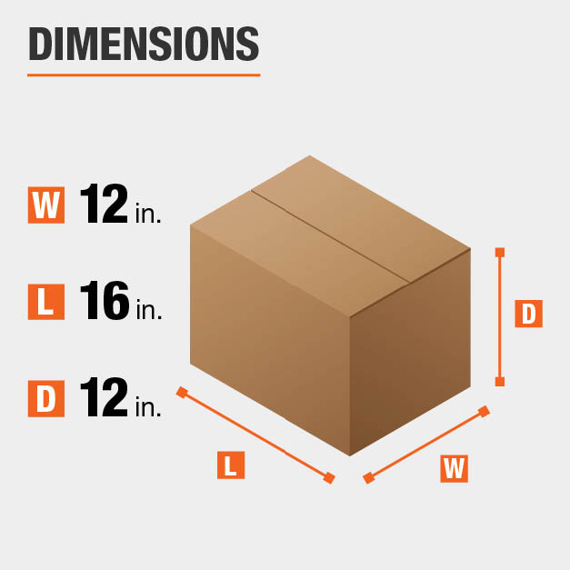
Vector
A vector, in programming, is a type of array that is one dimensional.
Now, what are dimensions? - Let’s take an example of box to explain this. A box has three dimensions width, length and depth (or height). Similarly, in data science we working “N” dimensional datasets. “N” could be any number.

Slide 5
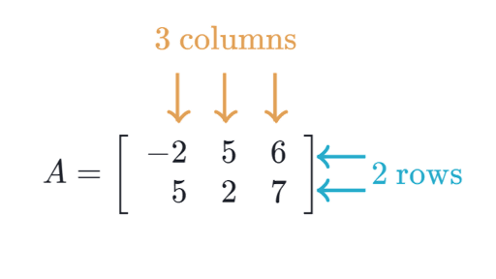
Matrix
Matrix is an arrangement of numbers into rows and columns
You may go through this simple explainer on Khan Academy: https://www.khanacademy.org/math/precalculus/x9e81a4f98389efdf:matrices/x9e81a4f98389efdf:mat-intro/a/intro-to-matrices

Slide 6
Session Details
Tutor: Sai Gayatri (Data Scientist at Tetrasoft Inc and Machine Learning/Data Science Instructor).
Topic: Session on NumPy Library
Date & time: 24th May, at 8:30 pm IST (5:00 pm CET, please locate your time in your timezone here).
Youtube live link: https://www.youtube.com/watch?v=lYcz4eCZTvE
Notebook that would be used during session: https://bit.ly/NumPy_Colab_DPhi (If you are using it Google Colab, just go to file → click “save a copy in drive” to run the notebook)

Slide 7
See you at the session. Thank you!
Remember Google is your friend in need! And ofcourse #help channel and coaches on slack!

