Slide 1

Welcome to Data Science Online Bootcamp
Day 7

Slide 2

Learning Objectives
1. Enjoying or tired of coding?
2. Let’s look at the solutions for practice exercises

Slide 3
What to do next?
Try solving the practice exercises yourself (that were given during Day 0 to Day 5)
If you are stuck then refer the solutions given in next page

Slide 4
Solutions for Day#0 to Day #4
Read through next set of slides to know how to access the notebooks
Practice Exercises for Day #0
Practice Exercises for Day #1
Practice Exercises for Day #2
Practice Exercises for Day #3
Practice Exercises for Day #4

Slide 5
How to access Solution Notebooks?
Option 1: (If you are using it in Google Colab, just go to File → click “save a copy in drive” to start working on the notebook)
Option 2: If you want to use Jupyter notebook. Click “File” → “Download .ipynb file”

Slide 6
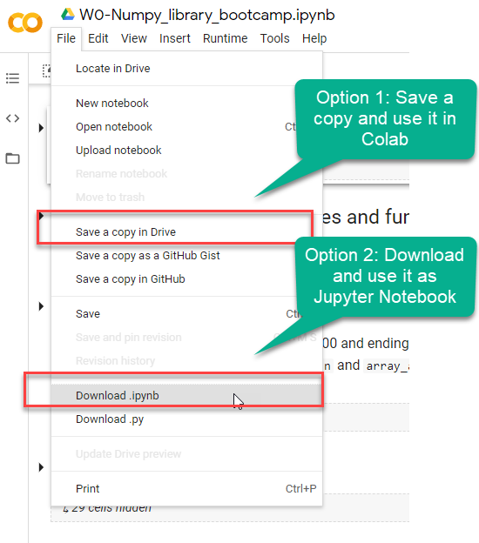
How to use it? (If you are logged with Gmail)

Slide 7
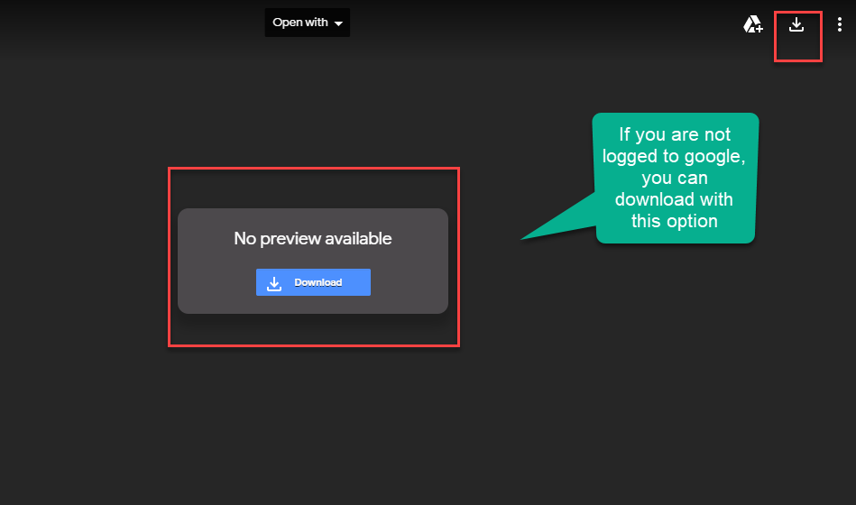
Not logged with Gmail

Slide 8
Some tips!
Things are going great and you are learning great deal? - That’s nice, just try reading up additional material and talk to your coaches and be engaged.
Finding things difficult? Don’t worry, we will get used all of it overtime. Drop us a message on #help channel on Slack, we will help you or you can get in touch with your personal assigned coaches.
Sessions are overwhelming? - Yes, it could be. When we are doing something new there will be a friction, so please take it easy. With time things will be fine, our desire to learn data science should be stronger to overcome these challenges mid way!

Slide 9
That’s it for the day. Thank you!
Remember Google is your friend in need! And ofcourse #help channel and coaches on slack!

