Slide 1
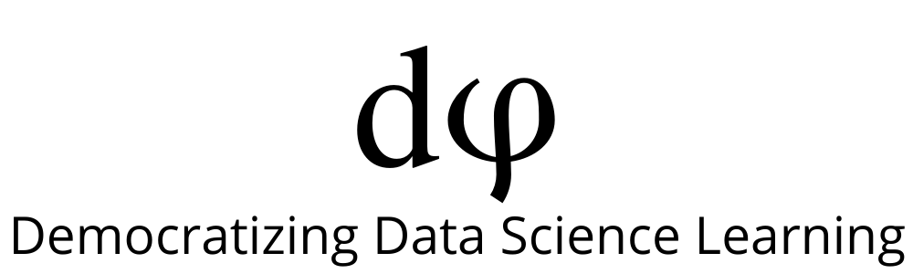
Welcome to Data Science Online Bootcamp
Week 1
Day 1 : Pre-Session Preparation

Slide 2

Learning Objectives
Data Analytics
Pandas

Slide 3
Data Analytics: An Analogy
You are An Apple Farmer
You own an apple farm and you want to know the number of apples you grow but you are too busy with the farm so you hire someone to count them. You sell your apples too, and you get your apple counter to keep a record of the number of apples you have in the beginning and at the end of the day, every day. Many days and months pass and you put sheet after sheet of the apple count together and you discover patterns and trends in the purchasing behaviour of your customers.
The trends and patterns help you realise that during the colder season, your output of apples are the same but people buy less than during the summer. You then set out to dig deeper into this trend, and find ways to keep the sales of apples consistent throughout the year, beating your competitors at the game and becoming an apple farm tycoon.

Slide 4
Data Analytics: An Analogy
Apples are your data, tracking them is important, analysis is key
Apples are your products/assets, knowing their movement is important. For starters, you will know if your supply of apples matches the market’s demand, as well as the consistency of the ratio of demand to supply throughout the year. Pegging the price to each apple and drawing the cost down gives you your profit. When you have enough data, you will find trends and patterns in your production. These trends can help you understand your own organisation better, help you reduce inefficiency and therefore reduce costs.

Slide 5
Data Analytics
In simple words, data analysis is the process of collecting and organizing data in order to draw helpful conclusions from it. The process of data analysis uses analytical and logical reasoning to gain information from the data.
The main purpose of data analysis is to find meaning in data so that the derived knowledge can be used to make informed decisions.

Slide 6
Real-life Examples
Economics
Analyzing data to form patterns and understanding trends about how the economy in various sectors is growing, is something very essential for economists. Therefore, a lot of economists have started using Python and Pandas to analyze huge datasets.
Recommendation Systems
We all have used Spotify or Netflix and been appalled at the brilliant recommendations provided by these sites. The recommendation system is possible only by learning and handling huge masses of data.
Stock Prediction
The stock market is extremely volatile. However, that doesn’t mean that it cannot be predicted. With the help of Pandas and a few other libraries like NumPy and matplotlib, we can easily make models which can predict how the stock markets turn out.

Slide 7
Why Pandas?
In real-life, as a Data Scientist, we need to play with data and pandas essentially helps us to give a head start with it.
Be it reading the data, analyzing /cleaning /changing / transforming. Pandas has a solution for all of it.
It even helps in calculating basic statistics. If we go on there will be number of use-cases, we have summarized a few of them in the next slide.
Pandas help in analyzing large volumes of data with ease.

Slide 8
Specific-Use Cases
Creating a data: You can create your own dataset using pandas.
Reading data: Often we get data in various formats such as csv, excel, in sql database, json etc. Pandas have some simple functions to perform this task
Analyzing data: With the help of other libraries like matplotlib, it helps in statistical analysis and visualize data with plots such as histograms, scatter plots etc
Cleaning data and handling missingness: Often Data Scientists get unclean data with a lot missing values and we need to have a solution to deal with it. Pandas facilitate in handling this issue.

Slide 9

Pandas Objects
At the core of the pandas library there are two fundamental data structures/objects:
Series
Data Frames
Series: stores single column data along with an index. An index is just a way to "number" the Series object.

Slide 10
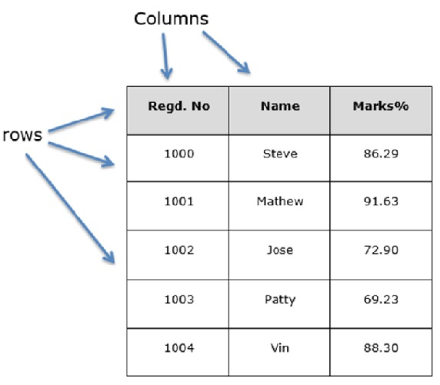
Pandas Objects
DataFrame: is a two-dimensional tabular data structure with labeled axes (rows and columns). It is conceptually useful to think of a DataFrame object as a collection of Series objects.

Slide 11
Reading Material
Here is an exhaustive tutorial on pandas with clear use-cases:
https://www.learndatasci.com/tutorials/python-pandas-tutorial-complete-introduction-for-beginners/

Slide 12
Notebook for Session
Link to the Notebook: https://bit.ly/Pandas_Notebook
Note: There is a lot of hard work that went into creating this notebook. We would like to thank Coach Julian Miranda for enriching the notebook that would help learners to read through and self-learn. And, thanks to Coach Manish KC for coming up with nice gradient of exercises that would learners to implement things. We hope you will enjoy reading/learning from it!

Slide 13
How to access Notebook?
Option 1: (If you are using it in Google Colab, just go to File → click “save a copy in drive” to start working on the notebook)
Option 2: If you want to use Jupyter notebook. Click “File” → “Download .ipynb file”

Slide 14
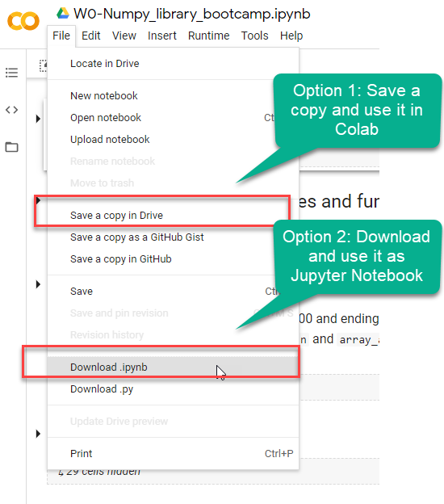
How to use it? (If you are logged with Gmail)

Slide 15
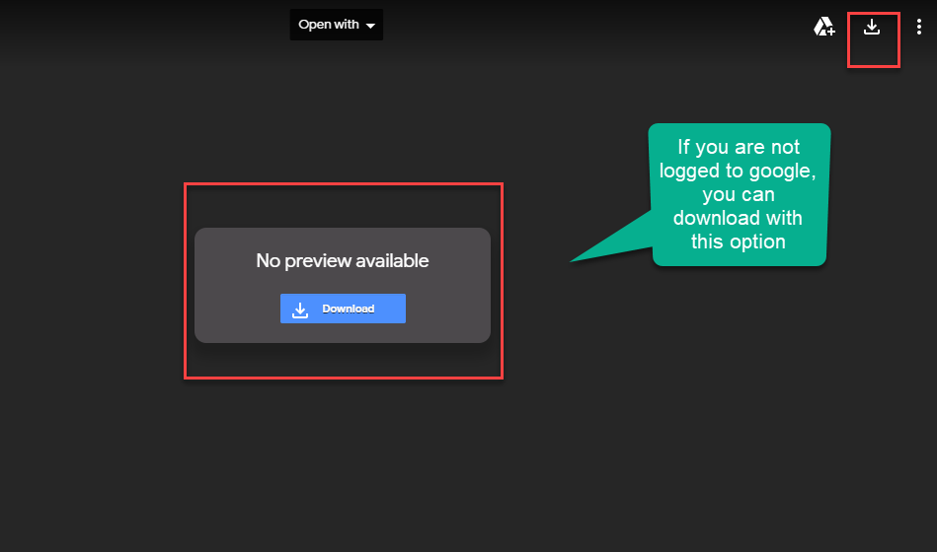
Not logged with Gmail

Slide 16
Session Details & Notebook
Tutor: Saravanan JaiChandaran
Topic: Deep Dive into Pandas
Date & time: 27th May, at 9 pm IST (please locate your time in your timezone here).
Youtube live link: https://youtu.be/FsKHdcDUFTE

Slide 17
That’s it for the day. Thank you!
Feel free to post any queries in the #help channel on Slack

