Slide 1

Welcome to Data Science Online Bootcamp
Week 1
Day 2-3 : Pandas Recap & Working with CSV Files

Slide 2

Learning Objectives
Pandas Recap
2. Working with CSV files

Slide 3
Pandas Session Recap
What we learnt so far?
Pandas Objects/Data Structures (refer pre-session slides for clear explanation)
Series
Dataframe
Data indexing and selection
Use case: Helps fetch a data record when we are dealing with large volumes of data. For ex: If you have a data with 10 million records, you can easily fetch information of a particular serial no/index no with pandas. This operation may not be feasible with MS Excel while dealing with such large volumes

Slide 4
Pandas Session Recap
Data Wrangling & Handling Missing Values - read the notebook.
Use case: Often Data Scientists get unclean data with a lot missing values and we need to have a solution to deal with it. Pandas facilitate in handling this issue
Pandas String Operations
Use case: Helps in Handling Missing Values

Slide 5
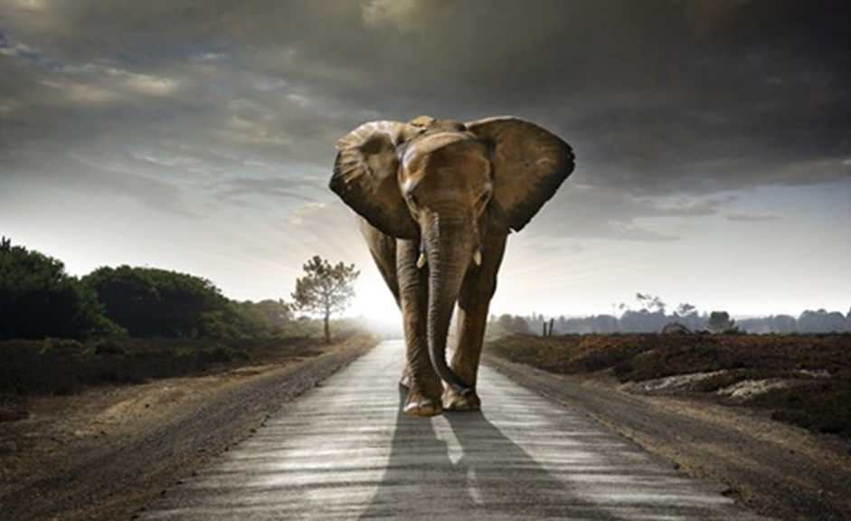
Next steps: Pandas Session Recap
How would you eat an elephant?
… one bite at a time!
Disclaimer: The writer is a vegetarian by no means the visual is meant to hurt animals, it is just given as an analogy.

Slide 6
Next steps: Pandas Session Recap
Similar to the analogy given in previous slide. Let’s attack one concept at a time in Pandas.
Day 2: We can learn about Pandas Objects and Index. Alongside, we can try solving some exercises given in the notebook. You can target to solve Exercises 1-3
Day 3: We can learn about handling missing data and solving exercises from 4-6.
This can be stretched till Day 4 too. Overall this could be a little hectic but with our strong desire to learn data science, we can overcome the hurdles that come midway! Happy learning :)

Slide 7
Working with CSVs

Slide 8
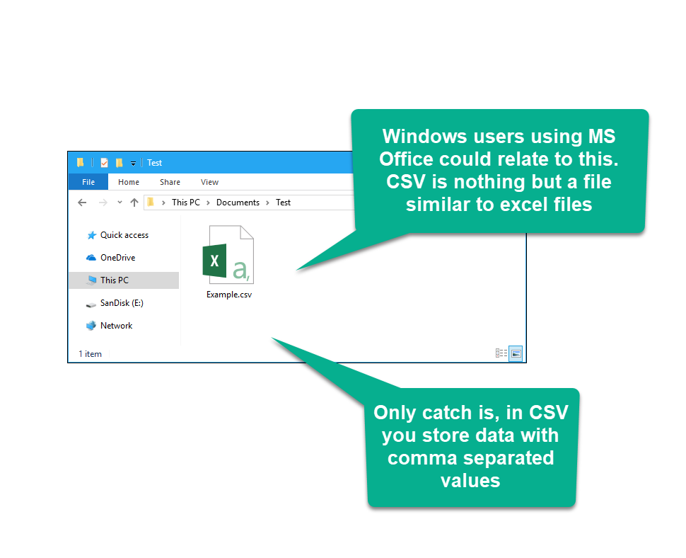
What is a CSV file?

Slide 9
What is a CSV ?
CSV files are normally created by programs that handle large amounts of data. They are a convenient way to export data from spreadsheets and databases as well as import or use it in other programs.
CSV (Comma Separated Values) is a simple file format used to store tabular data, such as a spreadsheet or database.
A CSV file stores tabular data (numbers and text) in plain text.
Each line of the file is a data record.
Each record consists of one or more fields, separated by commas.
The use of the comma as a field separator is the source of the name for this file format.

Slide 10
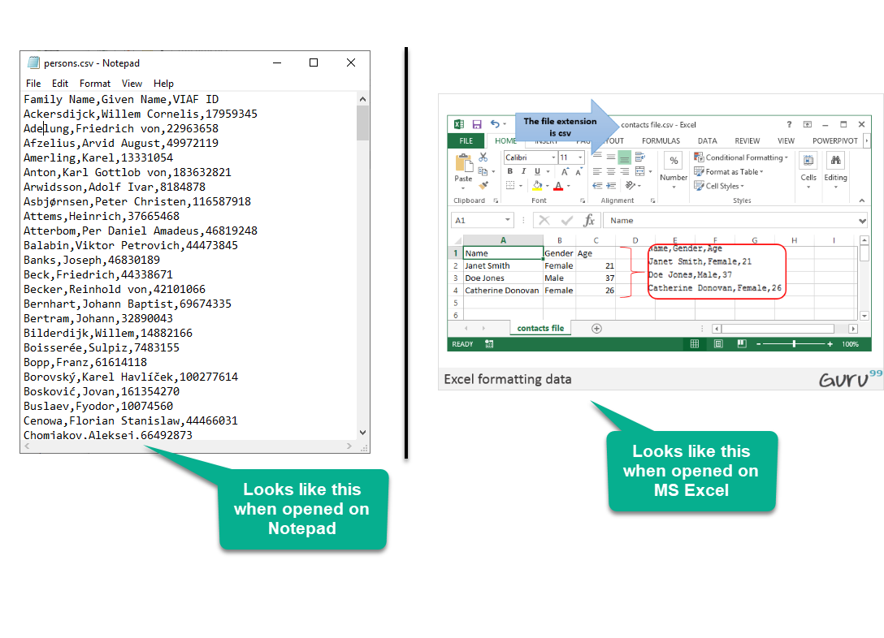
How does it look like?

Slide 11
Working with CSV files in Python
For working CSV files in python, there is an inbuilt module named csv.
However, a common method for working with CSV files is using Pandas. It makes importing and analyzing data much easier.
One crucial feature of Pandas is its ability to write and read Excel, CSV, and many other types of files.

Slide 12
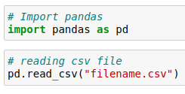
Pandas read_csv
Functions like the Pandas read_csv() method enable you to work with files effectively.
The read_csv() function reads the CSV file into a DataFrame object.
A CSV file is similar to a two-dimensional table and the DataFrame object represents two dimensional tabular view.
The most basic way to read a csv file in Pandas:
Read the next slide to understand how to provide filename

Slide 13
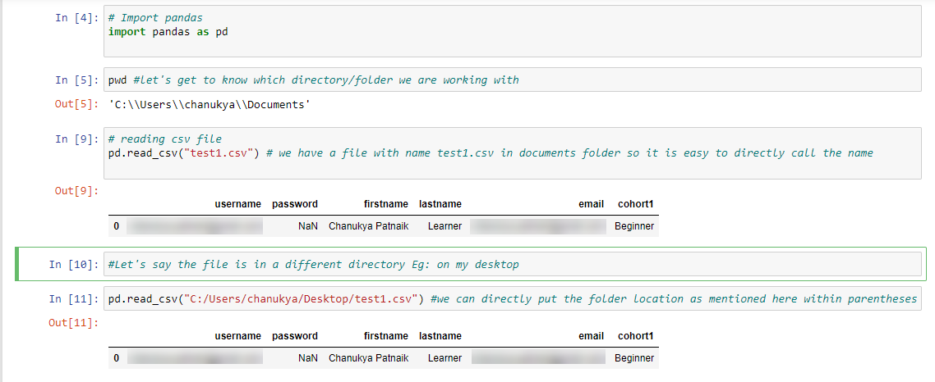
Pandas read_csv

Slide 14
Pandas read_csv
There are many other things one can do through this function only to change the returned object completely.
For instance, one can read a csv file not only locally, but from a URL through read_csv or one can choose what columns needed to export so that we don’t have to edit the array later.
These modifications can be done by the various arguments it takes.
We don’t need to memorise all the arguments though, let’s have a look at few important ones in the next two slides.

Slide 15


Pandas to_csv
The easiest way to write DataFrames to CSV files is using the Pandas to_csv function
Syntax:
Where df is the name of your DataFrame
If you want to export without the index, simply add index=False

Slide 16
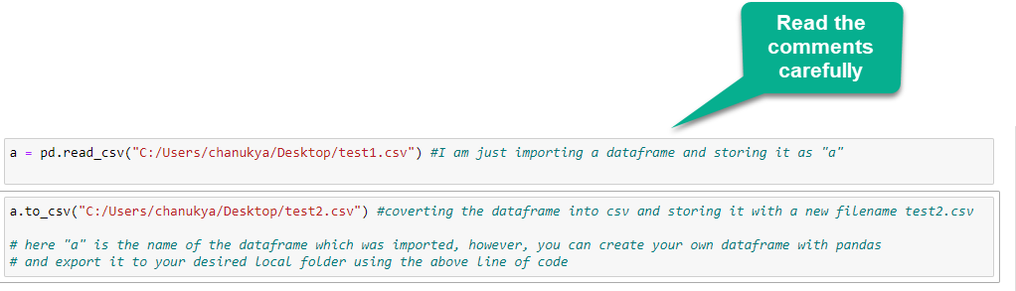
Pandas to_csv with example

Slide 17
Comprehensive Tutorial
Must read-
A comprehensive tutorial on pandas for beginners.
https://www.learndatasci.com/tutorials/python-pandas-tutorial-complete-introduction-for-beginners/

Slide 18
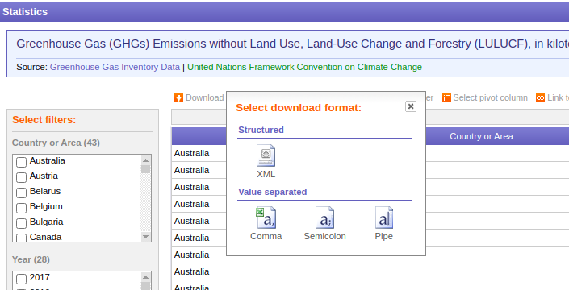
Let’s Practice!
Now let’s practice what we’ve learnt on a real dataset
The dataset can be downloaded from
https://data.un.org/Data.aspx?q=greenhouse+gas+co2+emissions&d=GHG&f=seriesID%3aGHG
Click on Comma to download a comma separated file

Slide 19
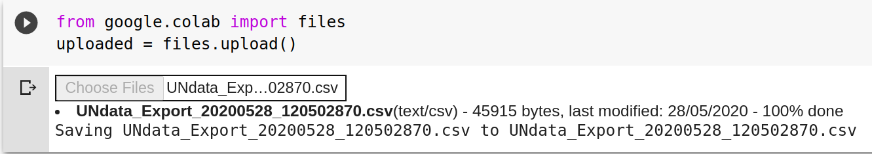
Let’s Practice!
Extract the zip file.
For Jupyter Notebook users:
Place the CSV file that you just extracted in the same folder you’re running your Jupyter Notebook from or just copy the folder path and paste it as given in the examples in previous slides.
For Google Colab users:
To upload from your local drive, start with the following code:
from google.colab import files
uploaded = files.upload()
It will prompt you to select a file. Click on “Choose Files” then select and upload the file. Wait for the file to be 100% uploaded. You should see the name of the file once Colab has uploaded it.
Read this article here for more help

Slide 20
Let’s Practice!
Load the CSV file into a variable - greenhouse_data
Use the description function to understand how the data looks like
Print its first 10 rows using head()
Print its last 10 rows using tail()
Check if there are any null values
Store the DataFrame to a CSV file named ‘file2.csv’

Slide 21
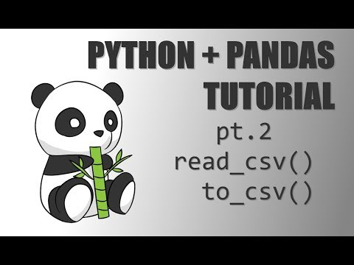
Optional Video Tutorial (Beginners can skip this)
Ignore matplotlib library for the moment and you may follow the rest

Slide 22
That’s it for the day. Thank you!
Feel free to post any queries in the #help channel on Slack

