Slide 1

Welcome to Data Science Online Bootcamp
Week 1
Day 4 : Pre-Session Preparation

Slide 2

Learning Objectives
Scatter Plot
Correlation in Data Science

Slide 3
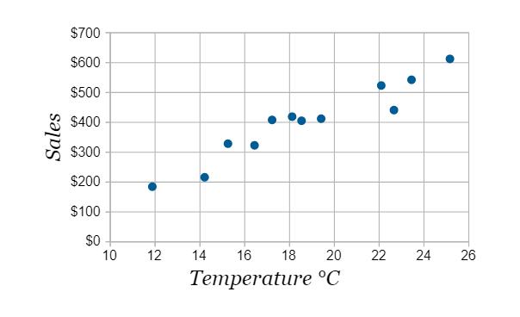
Scatter Plot
Scatter plots are used for interpreting trends in data. Below is an example of a scatter plot between temperature and ice cream sales in dollars. What is the trend in this scatter plot? Roughly we can say that as temperature increases ice cream sales increases.

Slide 4
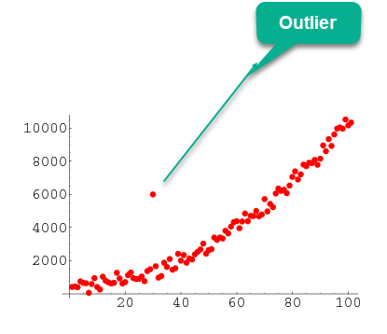
Outlier
In statistics, an outlier is a data point that differs significantly from other observations.

Slide 5
Correlation
Correlation is a statistical measure.
It is a measure of the strength of a linear relationship between two quantitative variables
Now you may ask what is a variable? - If we go back to scatter plot example: temperature and ice-cream sales are variables. Variable is often interchangeable used as features too. Target variable - In data science, The “target variable” is the variable whose values are to be modeled and predicted by other variables in the dataset.

Slide 6
Importance of Correlation
Every single successful data science project revolves around finding accurate correlations between the input and target variables. However more than often, we oversee how crucial correlation analysis is.
It is recommended to perform correlation analysis before and after data gathering and transformation phases of a data science project.

Slide 7
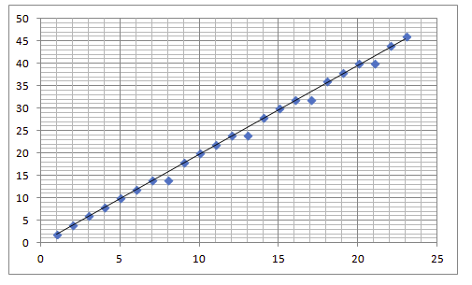
Positive Correlation
Two features (variables) can be positively correlated with each other. It means that when the value of one variable increases then the value of the other variable(s) also increases (also decreases when the other decreases).
Strong Positive Correlation: Real life examples:
The more time you spend running on a treadmill, the more calories you will burn.
As the temperature goes up, ice cream sales also go up.
As the level of water lowers in a fish tank, the volume of the habitat for the fish decreases.

Slide 8
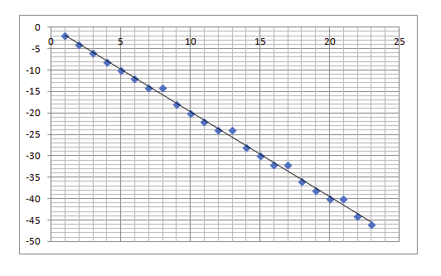
Negative Correlation
Two features (variables) can be negatively correlated with each other. This occurs when the value of one variable increases and the value of other variable(s) decreases (inversely proportional).
Strong Negative Correlation: Real life examples:
As the weather gets colder, air conditioning costs decrease.
The more vitamins one takes, the less likely one is to have a deficiency.
The more one works, the less free time one has.

Slide 9
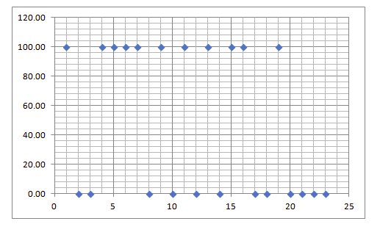
Zero/No Correlation
Two features might not have any relationship with each other. This happens when the value of a variable is changed then the value of the other variable is not impacted.
No Correlation: Real life examples:
There is no relationship between the amount of tea drunk and level of intelligence.
It was raining this morning and the grocery store was out of bananas.
The temperature in Mars and the stock market have an almost zero correlation because the price of the stock market will not depend on the temperature in Mars.

Slide 10
Session Details
Tutor: Gunnika Batra
Topic: Data Visualization
Date & time: 30th May, at 8:30 pm IST (please locate your time in your timezone here ).
Youtube live link: https://www.youtube.com/watch?v=fgysRlKaYbM

Slide 11
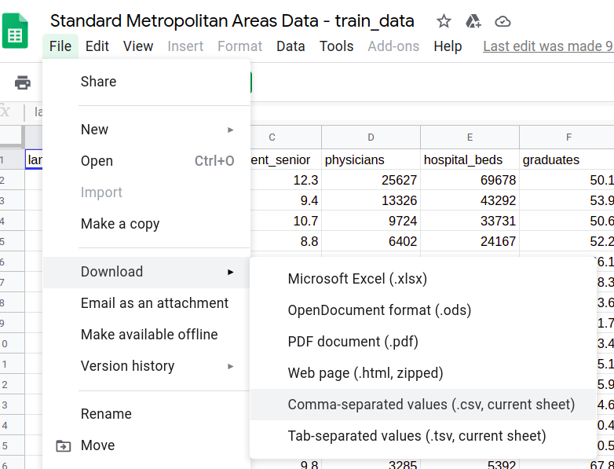
Notebook and Dataset
Link to the Notebook: https://bit.ly/DPi_DV_Notebook
Link to the Dataset: https://bit.ly/SMA_Dataset
Download the dataset as a CSV file.
Go through the dataset and try to understand what the columns represent.

Slide 12
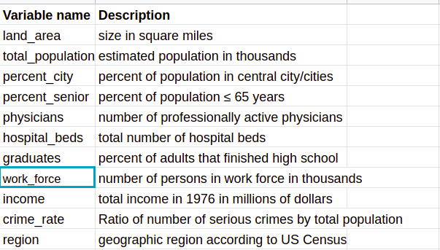
Dataset Description
It contains data of 99 standard metropolitan areas in the US. The data set provides information on 11 variables for each area for the period 1976-1977. The areas have been divided into 4 geographic regions: 1=North-East, 2=North-Central, 3=South, 4=West. The variables provided are listed in the table below:

Slide 13
How to access Notebook?
Option 1: (If you are using it in Google Colab, just go to File → click “save a copy in drive” to start working on the notebook)
Option 2: If you want to use Jupyter notebook. Click “File” → “Download .ipynb file”
Please keep this notebook open in another tab while watching the live session.

Slide 14
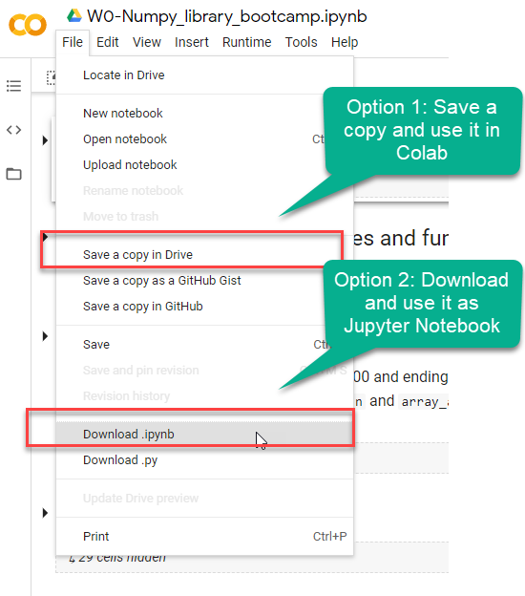
How to use it? (If you are logged with Gmail)

Slide 15
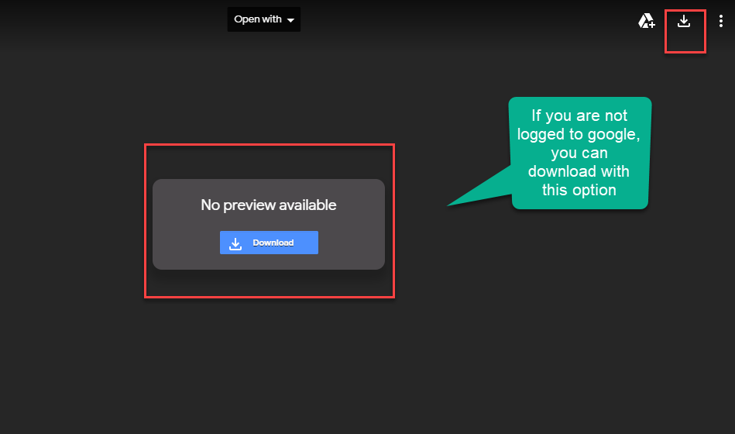
Not logged with Gmail

Slide 16
That’s it for the day. Thank you!
Feel free to post any queries in the #help channel on Slack.
See you in the live session!

