Slide 1
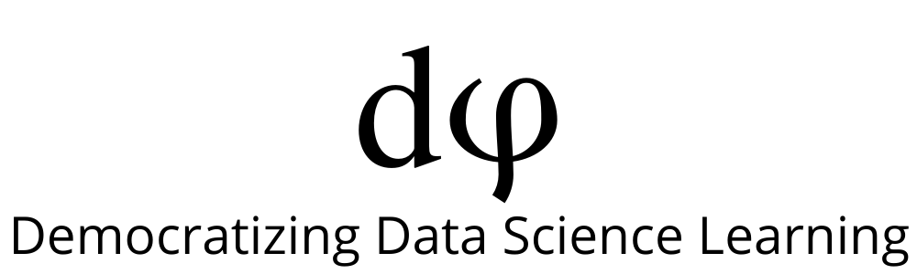
Welcome to Data Science Online Bootcamp
Week#2 - Day 1

Slide 2

Learning Objectives
Measures of Dispersion
Transformations
EDA with Seaborn
Additional Python Topics

Slide 3
Measures of Dispersion
Range: It is the difference between highest value and the lowest value in the data set.
For a given list of numbers: 10, 20, 40, 10, 70 the range is 70 - 10 = 60.
Variance: The average of the squared differences from the mean.
Steps to calculate variance:
- Calculate mean (mean is nothing but average)
- Find difference of each data from mean
- Square all the differences
- Take the average of the squares.
Standard Deviation: It shows you how much your data is spread out around the mean. Its symbol is 𝛔 (the greek letter sigma). It is the square root of the variance.

Slide 4
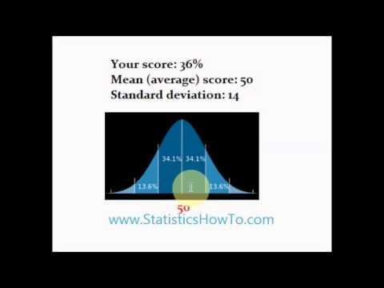
Standard Deviation

Slide 5
Calculating Variance
Steps to calculate variance:
Calculate mean
Find difference of each data from mean
Square all the differences
Take the average of the squares.
Consider the list of numbers: 10, 20, 40, 10, 70.
Mean of the number is 30.
Difference of each data from the mean: -20, -10, 10, -20, 40.
Square of all the differences: 400, 100, 100, 400, 1600
Take the average of the squares:
(400 + 100 + 100 + 400 + 1600) / 5 = 2600 / 5 = 520

Slide 6
Standardization/normalization:
Often variables in a real dataset come with a wide range of data values.
For example let’s look at the wine dataset given in next slide, the fixed.acidity variable has values ranging from 3.8 to 14.2. Similarly, if we look at volatile.acidity, it has values ranging from 0.08 to 1.10. Basically, they are not on a common scale. Now what is common scale? - let’s take an example of grades in an examination. If maximum grade is 100 for all the subjects, we know that students would get marks anywhere between 0 to 100 only. Now how does standardization/normalization help?
Performing standardization/normalization would bring all the variables in a dataset to a common scale so that it could further help in implementing various machine learning models (where standardization/normalization is a pre-requisite to apply such models). Again, don’t take this for granted, there are some smart algorithms which doesn’t need this.

Slide 7
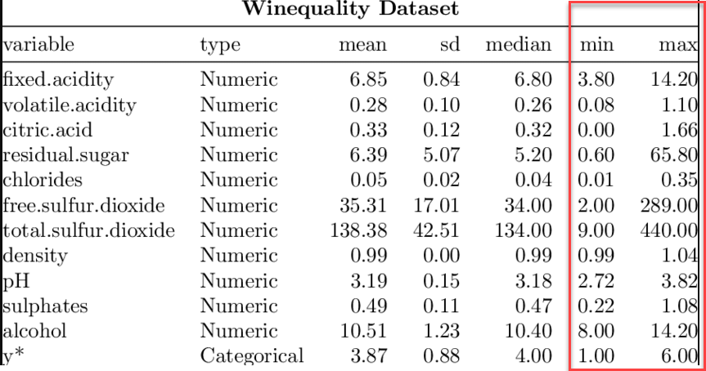
Standardization/normalization:

Slide 8
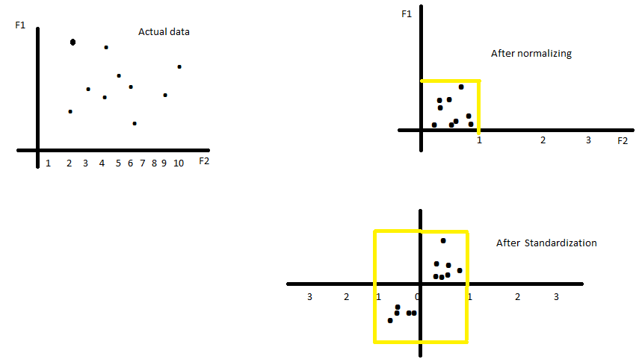
Standardization vs Normalization
Look at the above graphs.
The actual data is scattered across a wide range.
Normalisation helps in bringing the whole data within a particular range.
Standardisation distributes the data in a manner such that it now has a mean of 0 and standard deviation of 1.

Slide 9
Transformation
Some machine learning algorithms are quite sensitive to the scale of the numeric values provided.
Consequently, in order for the algorithm to converge faster or to provide a more exact solution, rescaling the distribution is necessary. Rescaling mutates the range of the values of the features and can affect variance, too. You can perform features rescaling in two ways:
Using statistical standardization (z-score normalization)
Standardization typically means rescaling data to have a mean of 0 and a standard deviation of 1 (unit variance).
Using the min-max transformation (or normalization) Normalization typically means rescaling the values into a range of [0,1].

Slide 10
EDA with Seaborn
In today’s session, we’ll be performing EDA by visualising data with Seaborn (specifically with scatterplot, countplot, distplot, boxplot and heatmap).
Please go through the following material to understand these different plots:
https://towardsdatascience.com/how-to-perform-exploratory-data-analysis-with-seaborn-97e3413e841d
https://towardsdatascience.com/analyze-the-data-through-data-visualization-using-seaborn-255e1cd3948e

Slide 11
Additional Python Topics (This is for self-learning for today’s session and may not be required in near time)

Slide 12

Python Lambda Function
A lambda function is a small anonymous function.
A lambda function can take any number of arguments, but can only have one expression.
Syntax:
lambda arguments : expression
Example:
A lambda function that adds 10 to the number passed in as an argument, and prints the result:
Here’s a short article about lambda function and its applications:
https://www.programiz.com/python-programming/anonymous-function

Slide 13
Python List Comprehension
One of the Python’s most distinctive features is the list comprehension, which you can use to create powerful functionality within a single line of code.
List comprehension is generally more compact and faster than normal functions and loops for creating list.
MUST READ: Learn about list comprehension from here:
https://www.programiz.com/python-programming/list-comprehension

Slide 14
Python Regular Expression
A regular expression is a special sequence of characters that helps you match or find other strings or sets of strings, using a specialized syntax held in a pattern.
Must Read: Go through the following link to get an overview of how regular expression are used in Python:
https://www.tutorialspoint.com/python/python_reg_expressions.htm
It is usually a confusing topic for most programmers. So don’t worry if you’re not able to fully understand it.

Slide 15
Session Details
Tutor: Joinal Ahmed
Topic: Introduction to descriptive statistics and exploratory data analysis
Notebooks link: https://github.com/dphi-official/Exploratory-Data-Analysis
Date & time: 3rd June, at 8:30 pm IST (please locate your time in your timezone here).
Youtube live link: https://youtu.be/5CoETeAdi9A

Slide 16
That’s it for the day. Thank you!
Feel free to post any queries in the #help channel on Slack

