Slide 1
Project TRINITY
India's Sovereign AI Infrastructure Company | SIA / Mandal Holdings | August 2026

Slide 2
The Thesis
• India needs its own complete AI stack — compute, data, models, agents, applications — not dependence on foreign cloud
• TRINITY builds all five layers; SIA is the AI operating system delivered on every device (Nano → Cloud)
• One profitable app funds all R&D — sell outcomes, not tokens (Pillar 1 rule)
• Phase-gated funding: MVP ₹2–10 Cr → Global ₹2,000 Cr+; registered Bengaluru, Karnataka

Slide 3
The Problem
• Limited sovereign AI infrastructure; dependence on foreign foundation models
• 900M+ Indians lack reliable connectivity — cloud AI is unusable offline
• DPDP 2023: data leaving devices is a compliance risk — on-device is the answer
• High compute costs, fragmented tooling, no credible Indian full-stack player

Slide 4
The Solution — SIA, an AI Operating System
• Family of models on ONE shared stack: tokenizer, architecture, tool-calling, memory format, runtime
• SIA Nano 0.5–1B (wearables/IoT) · SIA Edge 2–4B (phones) · SIA Pro 8–14B (workstations) · SIA Cloud 70B+ (data centers)
• Private by design: on-device inference keeps data in India
• Multimodal: text, audio, vision, code — audio listen/generate live; VAE image decode working

Slide 5
India's Five-Layer AI Prize
The stack
Why it matters
• 1. Compute — GPU cloud, chips (GPU/TPU/NPU/photonic)
• Each layer earns its own margin
• 2. Data — Indian languages, synthetic, SIA Memory
• Sovereign moat — replacing foreign dependency
• 3. Models — SIA family + services
• Jobs, IP, chips, energy stay in India
• 4. Agents & OS — AI runtime, SIA Studio/SDK
• Government is both customer and mandate
• 5. Applications — health/edu/agri/defence/gov

Slide 6
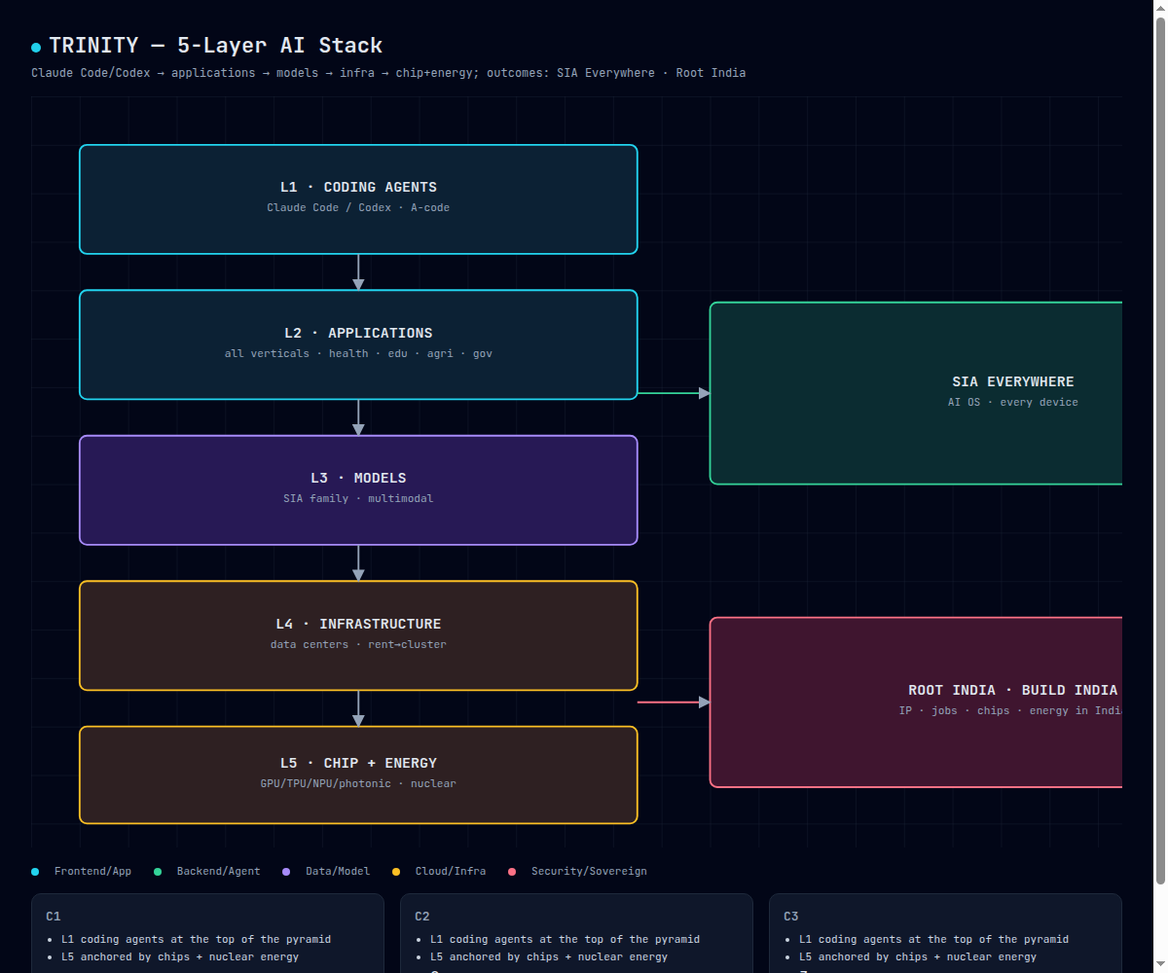
The 5-Layer AI Stack
L1 coding agents → L5 chip+energy; outcomes: SIA Everywhere · Root India / Build India

Slide 7
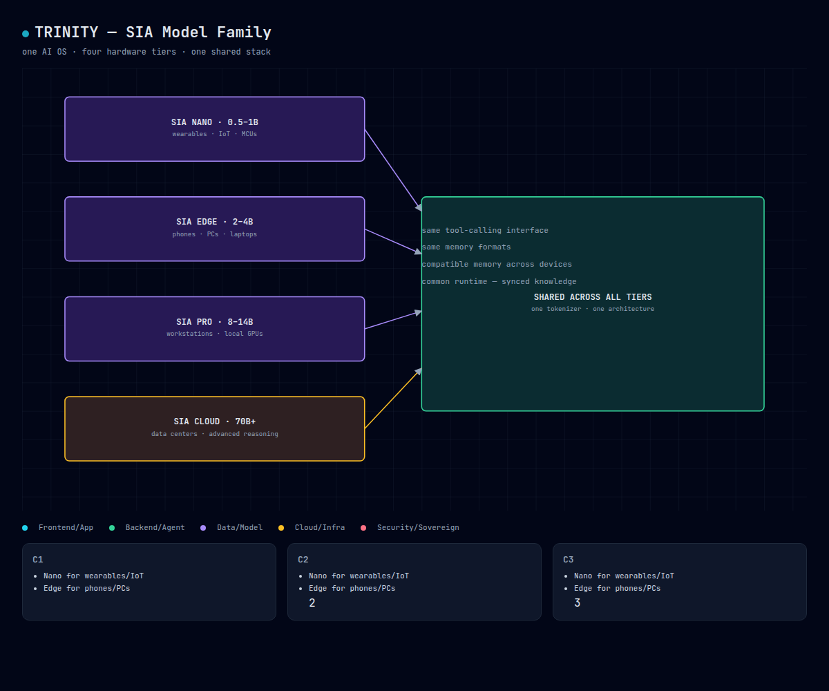
SIA Model Family — One OS, Four Tiers
Nano→Cloud share tokenizer, architecture, tool interface, memory formats, common runtime

Slide 8
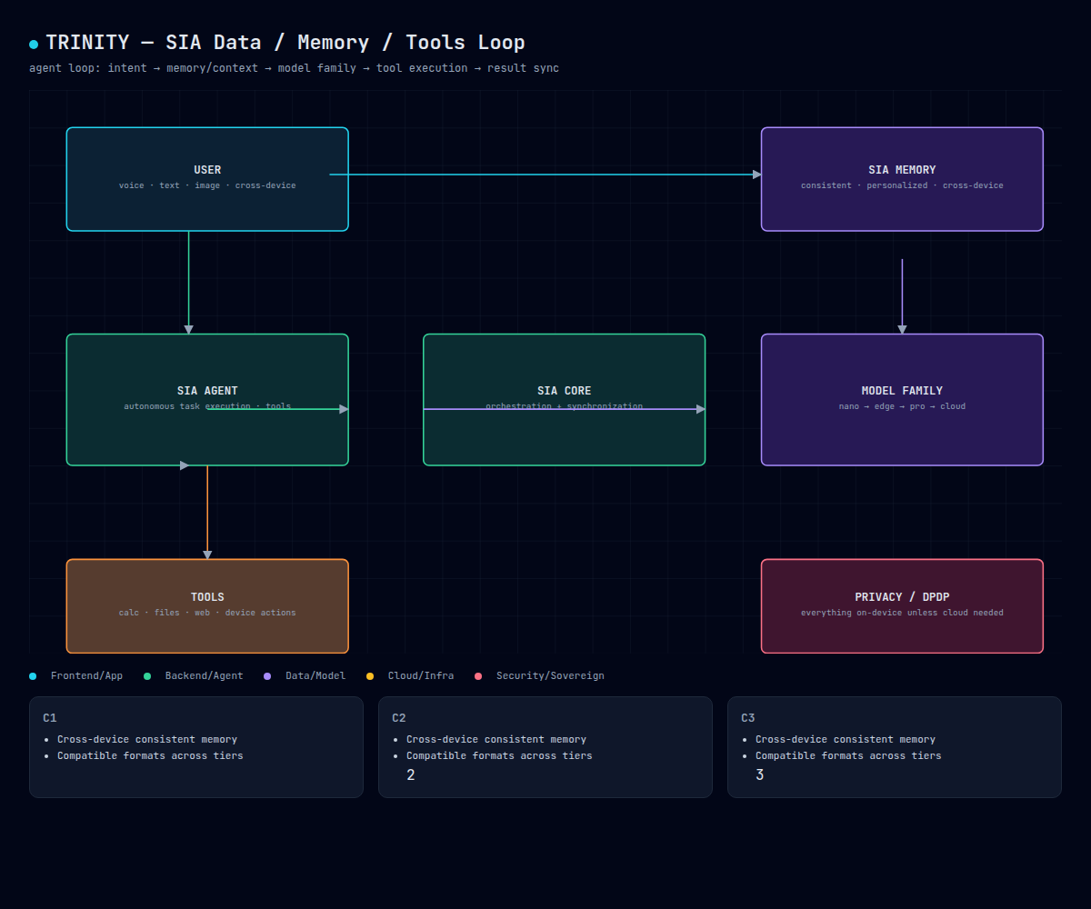
The Agent & Memory Loop
User → Agent → Tools → Core → Model Family → Memory · DPDP privacy boundary

Slide 9
Market — TAM/SAM/SOM
• TAM: India AI spend $12–15B (2026E) → $25–40B (2030E); global AI $800B+ by 2030
• SAM: ~$4–6B by 2028 — enterprise AI + on-device Indic + SDK/embedded
• SOM: 1% by Y5 ≈ $40–60M ARR (≈₹330–500 Cr)
• First-mover: no credible full-stack sovereign Indian AI company today

Slide 10
Business Model & Financial Profile
• Revenue: API · enterprise subscriptions · GPU cloud · licenses · managed services
• Indicative build: ₹0 → ~₹11 Cr (Y3) → ~₹68 Cr (Y5) → ~₹460 Cr (Y10)
• Gross margin 70–85%; LTV/CAC target >3 (4–6×); enterprise churn <5%
• Phase-gated raises: MVP ₹2–10 Cr → Growth ₹25–100 Cr → Scale ₹100–500 Cr → National ₹500–2,000 Cr

Slide 11
Competitive Landscape — We Own the Gap
• Frontier labs (OpenAI/Anthropic/Google): cloud-first, English-first, no sovereign-India
• Meta/OSS: strong weights, foreign lineage
• India labs: fragmented, not full-stack
• TRINITY: from-scratch IP, on-device privacy, Indic-first, sovereign-government alignment — the only full-stack play

Slide 12
Why India, Why Now
• IndiaAI Mission: 34,000+ GPUs, 367+ datasets, 20 sovereign models already funded [VERIFIED]
• DPDP 2023 makes on-device privacy a regulatory advantage
• Dholera 28nm fab + DLI/PLI → silicon roadmap is real
• 1.4B people; 900M+ offline — on-device is the only deliverable path to them

Slide 13
Roadmap (2026–2035)
• Phase 1 (26–27): MVP — SIA Edge companion + 5 pilots
• Phase 2 (27–29): Foundation models — Nano/Edge trained, Pro LoRA
• Phase 3 (29–31): Enterprise platform — agents, SDK, memory
• Phase 4 (31–35): National infra — private cluster → hyperscale campus
• Phase 5 (35+): Global expansion

Slide 14
Traction — Working Proof
• From-scratch nano transformer trained on CPU — 9/9 demos pass (text, code, vision, audio-listen, audio-gen, image, video, tools, quantize)
• Audio→language loop live; VAE decoder gives real 256×256 images
• LoRA fine-tune pipeline ready (Gemma 3 1B, Colab T4)
• Full investor doc set: master report, A/B/C appendices, TAM, financials, competitive, GTM, hiring, valuation

Slide 15
The Ask — ₹2–10 Cr MVP
• Use of funds: team ~30%, compute ~35%, data/fine-tuning ~20%, legal/SDK ~15%
• Targets: live flagship demo + 3–5 enterprise/government pilots + DPIIT/Startup India registration
• Milestones unlock Growth round ₹25–100 Cr for foundation models
• Government path: TIDE 2.0, SISFS, IndiaAI, SAMRIDH + Karnataka state schemes

Slide 16
Join the Sovereign AI Builder
SIA — Your private intelligence, on your device. India is the root.

