Slide 1

Introductory meeting
Sep 11th 2023

Slide 2

Bible verse of the day
You, O God, do see trouble and grief; you consider it to take it in hand. The victim commits himself to you; you are the helper of the fatherless. —Psalm 10:14

Slide 3
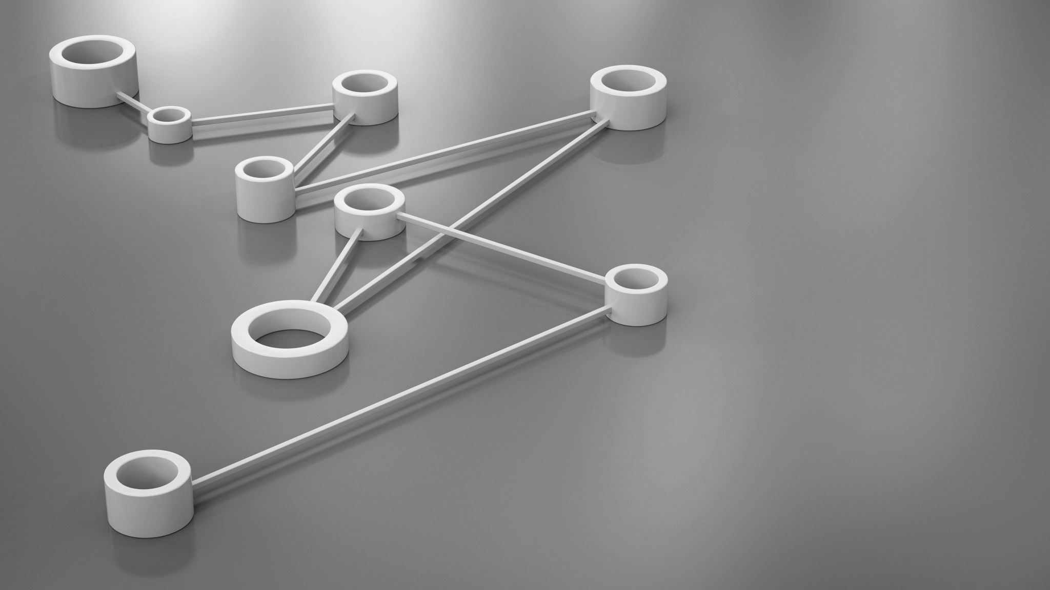
Introduction for HPC concepts
Hardware
OS
Software
Networking

Slide 4

What is an HPC?
High Performance Computing
Primarily associated with fast computers
Differences occur in multi threaded vs single threaded calculations

Slide 5
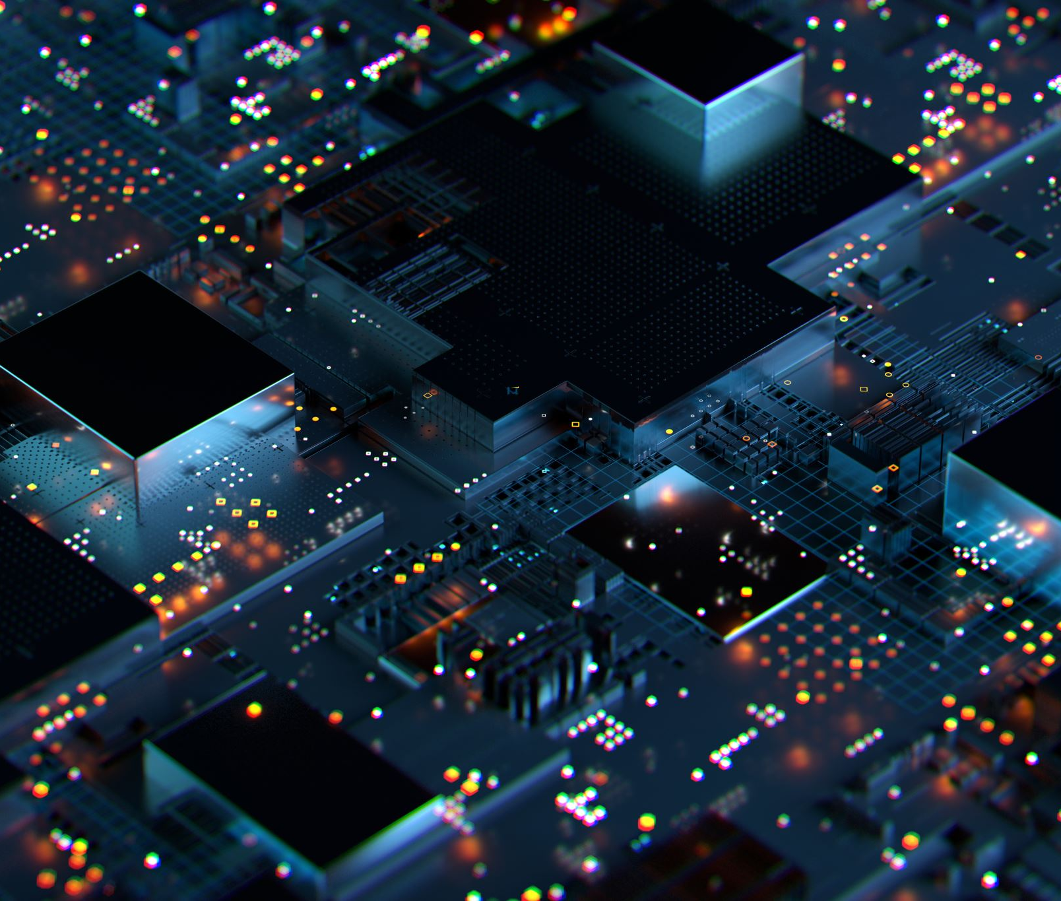
History of HPC ~A rough overview 80s-2ks
Cray Super Computers
  Primarily focused on really fast single threaded computers
90’s led to Beowulf clusters
  Cheap consumer hardware networked together
  Tasks at this point were becoming very multi-threaded
2000’s-present
  The majority of super computers have both a gpu and cpu presence
  Multicore processors led to a huge increase in performance

Slide 6

What is a computer cluster?
Two or more computers networked together to achieve some task
  At its simplest form a LAN with two computers can be considered a cluster

Slide 7

Multi-threaded vs Single-threaded
If the process can use more than one core it is multi-threaded
As we have encountered a blockage in recent history preventing cpus from massively gaining single threaded speed to gain more performance software relies on being programmed to utilize more than one core

Slide 8
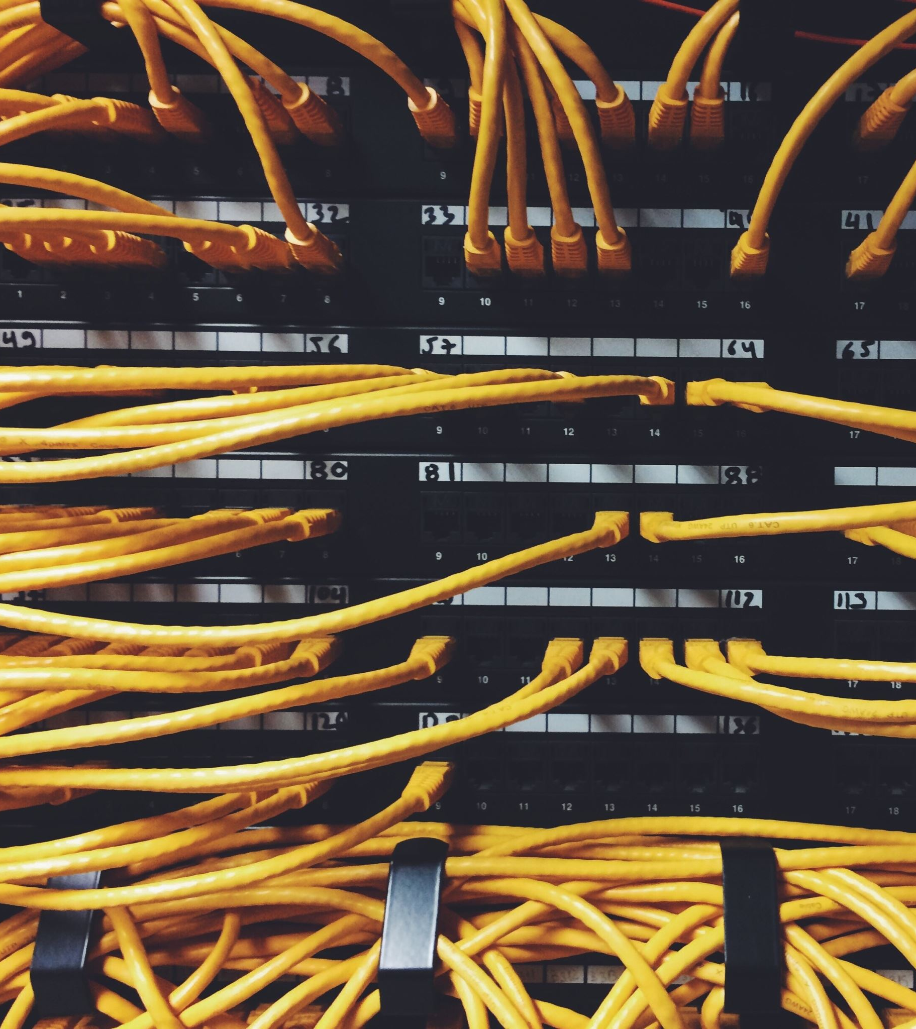
How to get more cores?
Beowulf clusters
  Take a bunch of cheap consumer computers and network them together
  A lot of research was done on this in the 90’s

Slide 9

Different methods of achieving multi core over a network
MPI
  Openmpi
  Mpicc
Mosix
  Not free
kerrighed
  Not supported

Slide 10

We primarily use MPI
MPI is easy to setup
There is much support for it
You build your program with MPI support

Slide 11
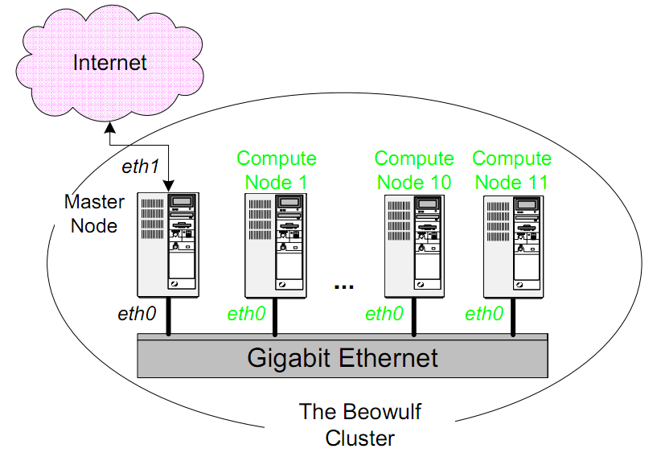
Beowulf cluster network diagram

Slide 12

Back to the building blocks part 1
Hardware
OS
Software
Networking

Slide 13

Back to the building blocks part 2
Hardware (cheap computers with cpu cores)
OS
Software
Networking

Slide 14
Back to the building blocks part 3
Hardware (cheap computers with cpu cores)
OS (rocky linux, although can be any operating system)
Software
Networking

Slide 15
Back to the building blocks part 4
Hardware (cheap computers with cpu cores)
OS (rocky linux, although can be any operating system)
Software (MPI, openMPI)
Networking

Slide 16

Back to the building blocks part 5
Hardware (cheap computers with cpu cores)
OS (rocky linux, although can be any operating system)
Software (MPI, openMPI)
Networking (Ethernet switches, high end uses infiniband)

Slide 17
Now that you know what we deal with, let’s go over what is outside of this club’s budget
GPU based clusters
RDMA supported clusters, cause infiniband

Slide 18

What are GPU Clusters
What we have covered so far has been CPU based, but GPU has same concept
Instead of maxing out number of cores you maximize number of GPUS

Slide 19
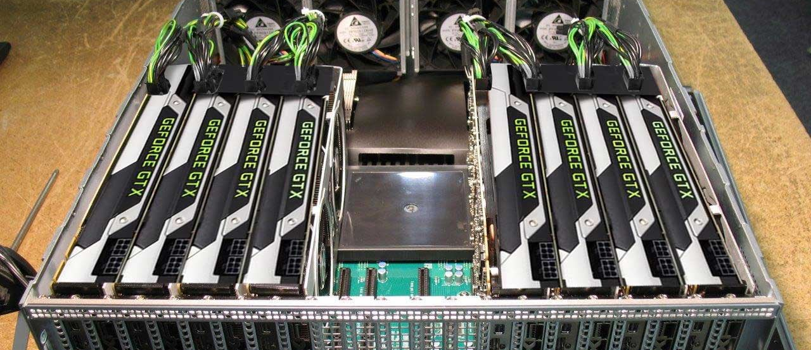
Example photo of a node in a GPU cluster

Slide 20

GPU more $$ than CPU clusters
Researchers discovered in the early 2010’s that if the problem they are trying to solve can be reduced to matrix math a GPU can perform it faster than a CPU for the same $$
This led to researchers building heavy GPU based clusters, and the rise of NVIDIA in that sector
AI is heavily matrix math based, QED

Slide 21
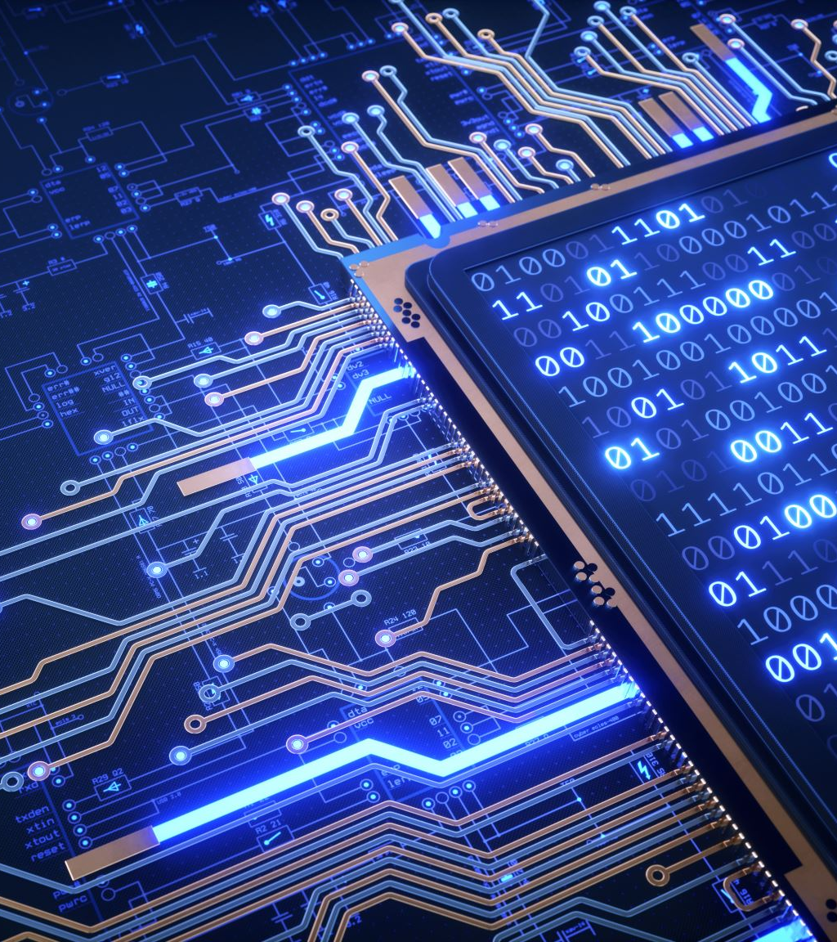
What about problems that are not matrix math based?
These, assuming they can be made to support multiple cores, are the reason CPU clusters are still used
Not all problems can run on GPUs and not all can benefit from GPUs and this all has to do with instruction sets and the problem itself.
A lot of High end computer clusters that deal with CPU’s are ARM based rather than x86 based because of energy efficiency

Slide 22




ARM vs X86 rough overview
ARM think apple silicon
X86 think intel
That’s all you really need from an overview stand point

Slide 23



Other things that are also ARM
Raspberry pi
Majority of all smartphones android and ios
Most chromebooks

Slide 24
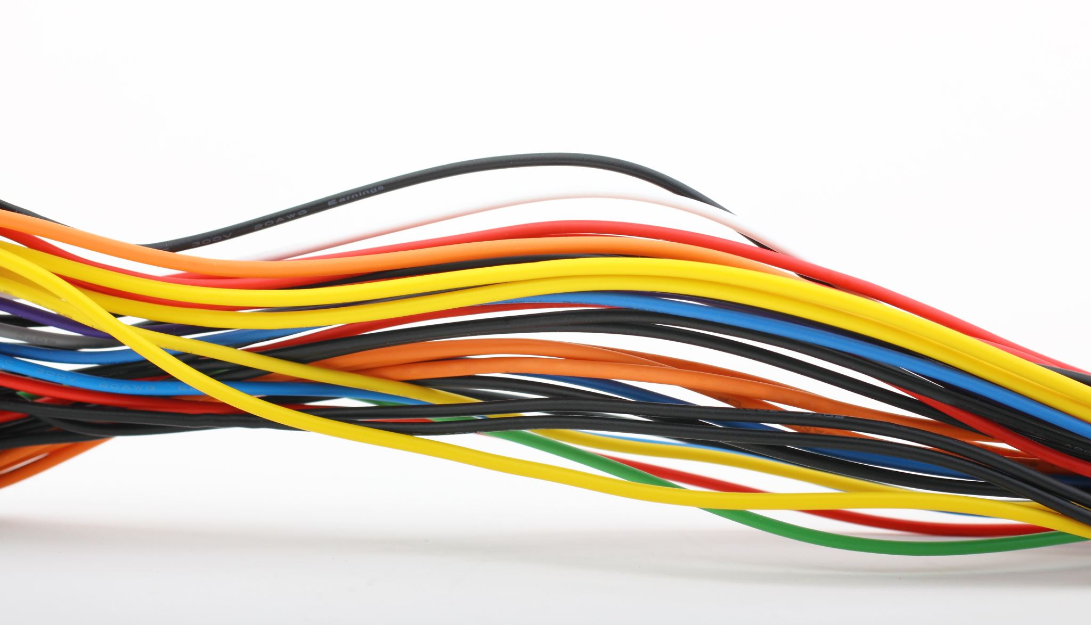
Networking, What is infiniband?
Instead of using copper wires, InfiniBand uses lasers through a tube
This has much lower latency and a larger bandwidth than ethernet
New IB is expensive tho

Slide 25
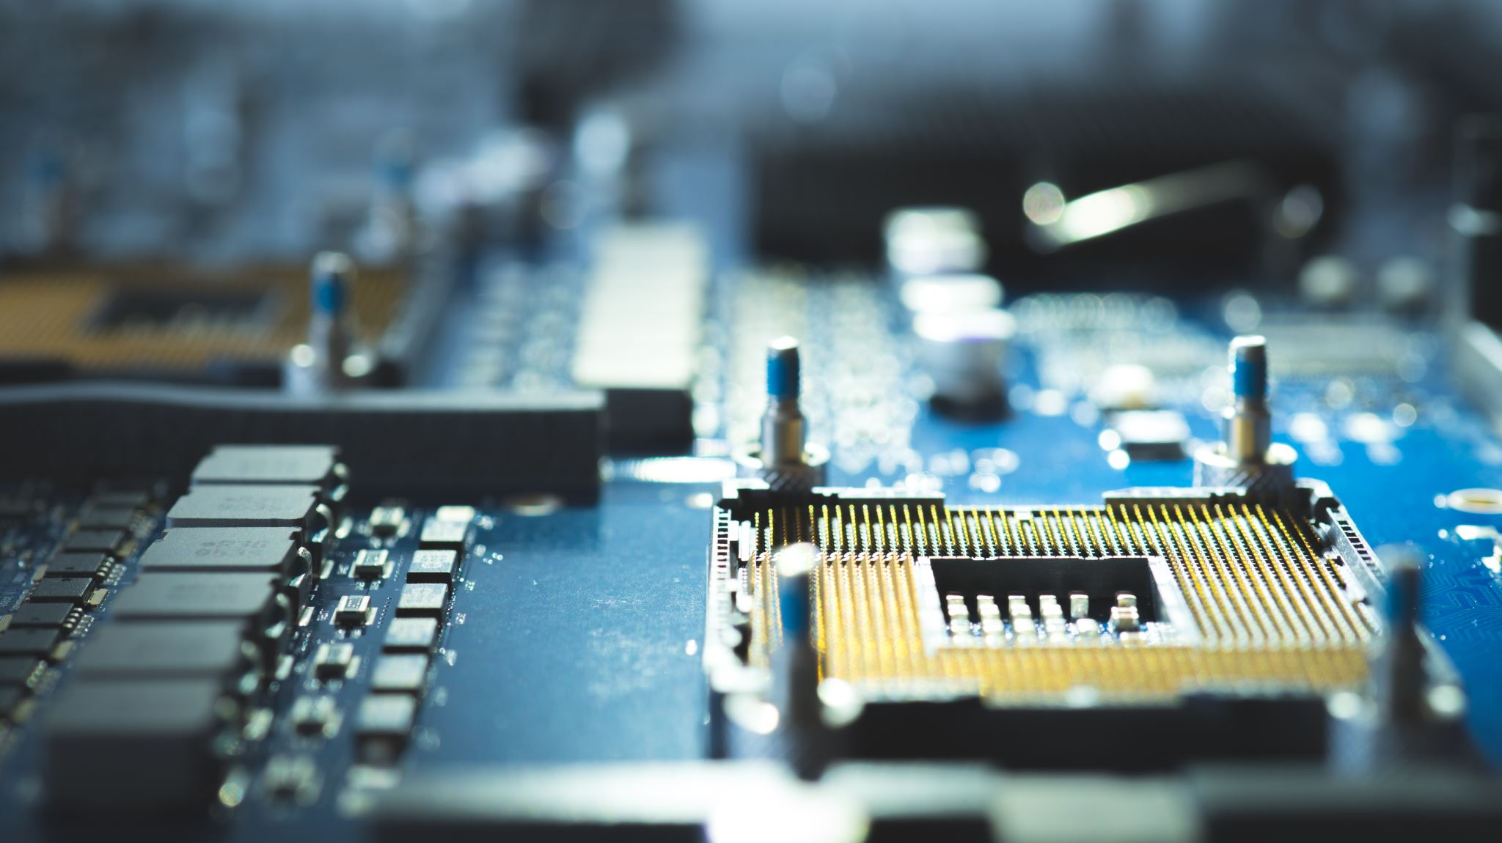
What can you do with IB?
RDMA (Remote Direct Memory Access)
Allows for a computer on the network to directly access the RAM or VRAM of a secondary computer without going through that computers CPU
This speeds up multi core and multi GPU operations

Slide 26



In conclusion
High performance computing is basically taking a bunch of smaller things and making a bigger thing
Many different ways to achieve it and the computer should be built around the task that is needed to be completed

Slide 27

Questions?

