Slide 1

Linux as an Operating System
Jamison Kagey

Slide 2

Verse of the Day
1 Peter 3:18
18 For Christ also suffered once for sins, the just for the unjust, that He might bring us to God, being put to death in the flesh but made alive by the Spirit,

Slide 3
Overview
The boot process of Linux
Different components of a working Linux install
Build an Arch ISO
Install an Arch ISO in VMWare Player

Slide 4


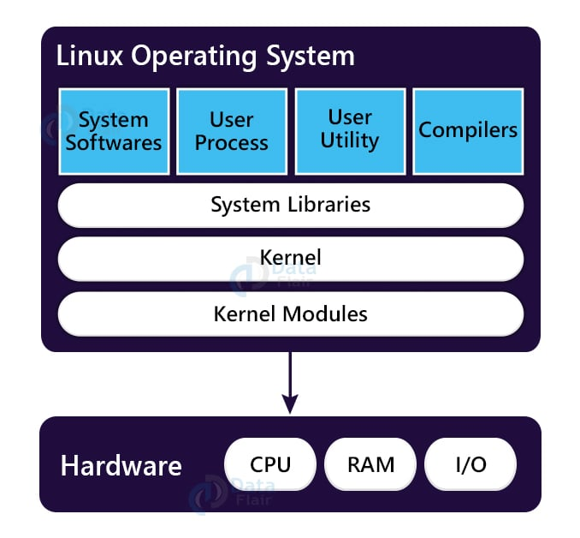
So, what is Linux anyways?
In short, Linux by itself is just a kernel
Normally when people talk about Linux, they mean GNU/Linux, the OS

Slide 5
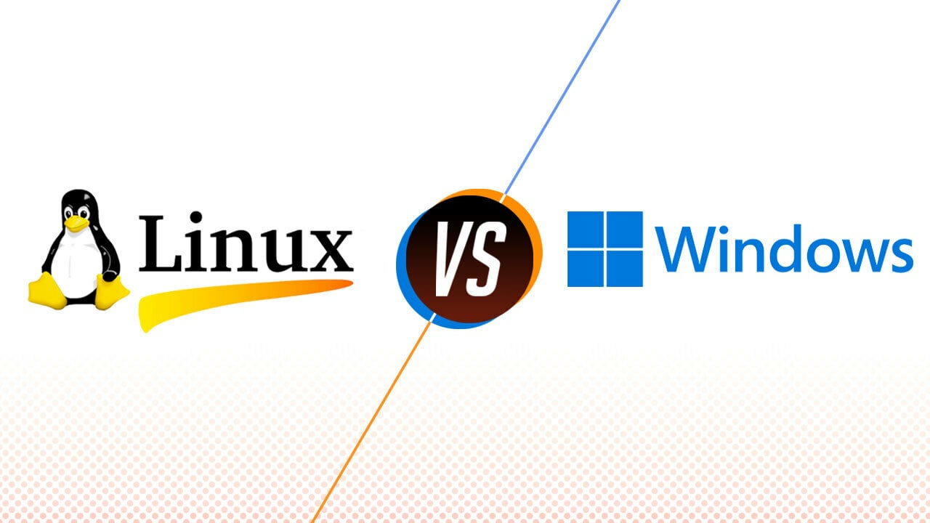
GNU Linux vs. Windows
Linux
Windows
Linux is Free Open-Source Software (FOSS)
Like a manual car
Wide hardware support
Extremely stable
Secure/stable for servers
Customizable to any extent
Proprietary software made by Microsoft
Automatic
Wide software support
Graphics support (Games, 3D Modelling, Adobe etc.)
Generally easy to use

Slide 6
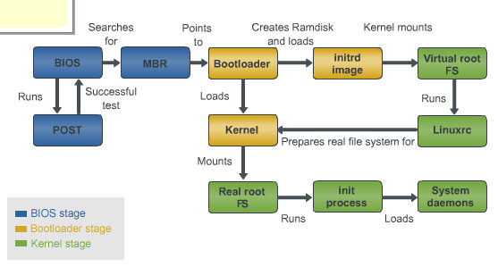
GNU Linux Boot Process (POST)
Post aka Power On Self Test
Tests to see what hardware is connected and if it is working properly
Initializes firmware
Verifies firmware

Slide 7
GNU Linux Boot Process (BIOS and MBR)
Old Legacy standard (last used in 2007)
Often still used in VMs because it is easy to implement
Load and execute a specific part of a disk with an MBR partition
Starts a legacy bootloader to get to an OS

Slide 8
GNU Linux Boot Process (UEFI and GPT)
Completely different from legacy booting
Can use CSM to boot like a legacy system if needed
Has many more components and can ‘understand’ the bootloaders, partition tables, and operating systems on a device

Slide 9
GNU Linux Boot Process (UEFI and GPT) cont..
Executes EFI (extensible firmware interface) on a FAT partition or dedicated EFI partition
Much easier to use because it uses standard partitions (GPT disk)
UEFI can be accessed from the OS, in Linux the efibootmgr tool
Lists recognized bootable devices with /EFI folder

Slide 10
GNU Linux Boot Process (Bootloader)
Typically GRUB 2.0 (GRand Universal Bootloader)
Other options are Syslinux and LILO
Can boot to the Linux kernel which loads OS
GRUB can also boot to Windows

Slide 11
GNU Linux Boot Process (initrd filesystem)
Initial RAM disk
Loads RAM disk as root and mounts it
Moves root filesystem to disk and mounts it
Removes itself from RAM

Slide 12
GNU Linux Boot Process (initrd filesystem)
Initial RAM disk
Done in read only mode
Loads RAM disk as root and mounts it
Mounts root filesystem to disk and moves to it
Loads system devices
Kernel is initialized
Removes itself from RAM

Slide 13
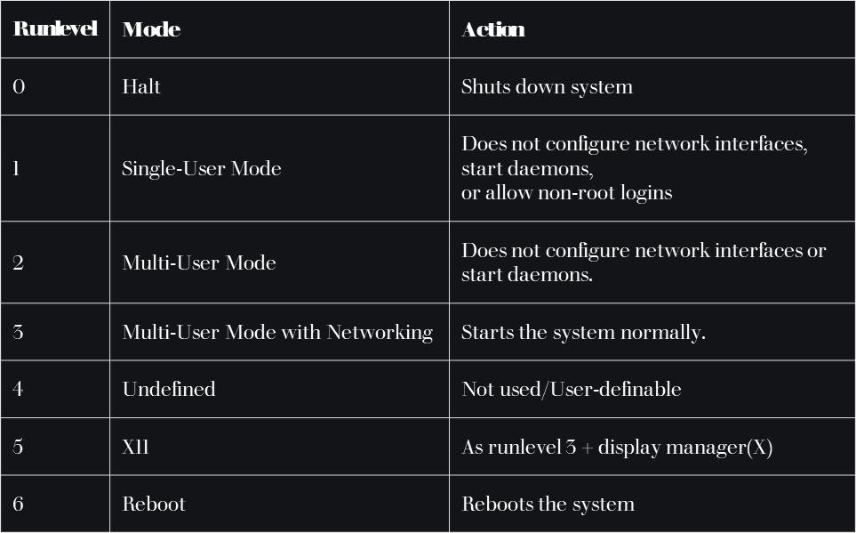
GNU Linux Boot Process (init)
Init (initialization) is run
Parent of all Linux processes with PID 1
Starts processes in /etc/inittab
Normally runs at Runlevel 5 for GUI (display manager) and Runlevel 3 for no GUI

Slide 14
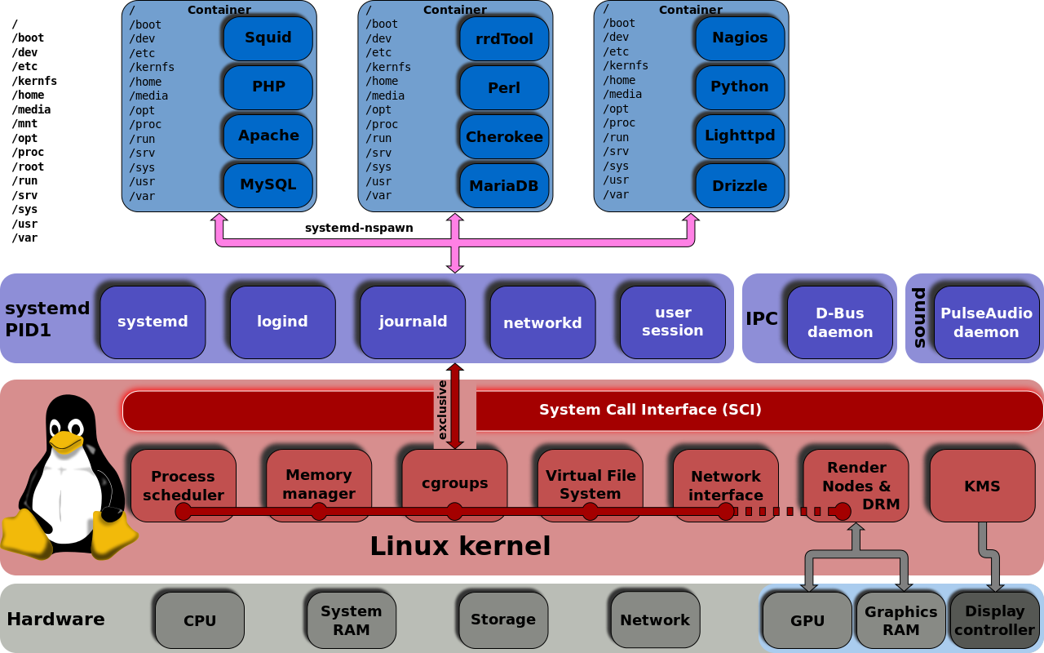
Systemd
The default init process for most Linux based Oses
Starts all daemons (background processes necessary to run)

Slide 15
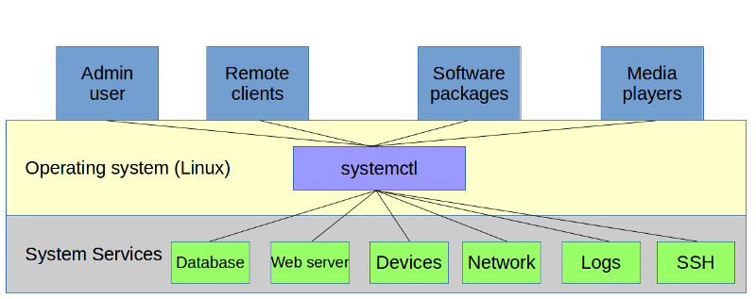
Systemd
Starts and stops system process services called units
systemctl can manage these units and view their status
Must be run as root user
systemctl list-units = lists all of the currently active units

Slide 16
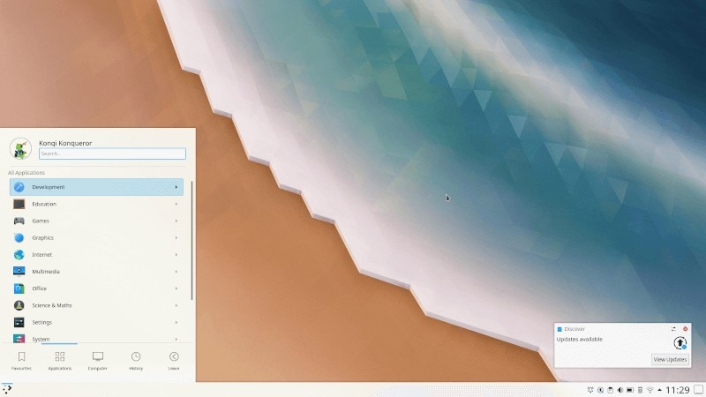
Desktop Environment
The GUI of an OS
Desktop Environments have their own navigation systems with their own look, feel, and performance
Popular Desktop Environments:
  KDE
  LXDE
  GNOME
  XFCE
  Cinnamon
  MATE
  LXQt

Slide 17



Package Managers
The easiest way to install programs and manage them
Solve most dependency issues
Update through repositories online
3 Most Popular Package Managers
  apt – Debian based
  pacman – Arch based
  dnf – Red Hat (improved version of yum)

Slide 18



Other Package Types
Snap – made for Ubuntu, sandboxed, includes all dependencies and libraries in one package
Flatpak – larger OS support, sandboxed, can share libraries and dependencies between packages
AppImage – run on all major OS, not sandboxed, contain all necessary libraries to run

Slide 19
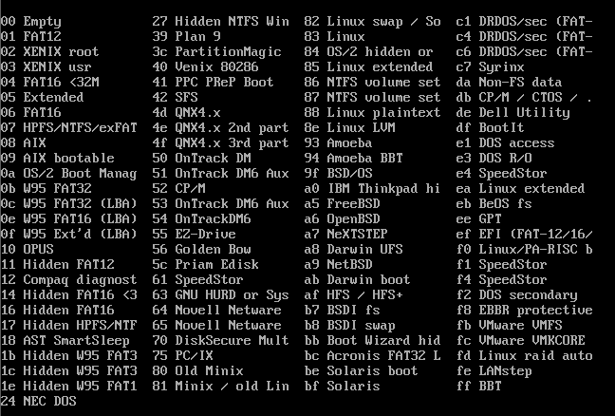
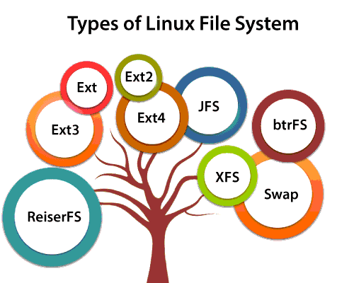
Filesystems
EXT (2/3/4) – typical Linux
FAT (12/16/32) – EFI
exFAT – flash drives
ZFS – used in Linux servers
Swap – RAM overflow
NTFS – Windows
APFS - Mac

Slide 20

Common Linux Commands (Files)
cd /directory/to/go/to
  ~ = home directory
  / = top directory
  .. = move up a directory
ls = lists contents of directory
mkdir [name] = makes a directory
touch [filename] = creates file
cp /file /destination = copy file or directory
rm = remove file
mv /file /destination = move file
pwd = displays present working directory

Slide 21

Common Linux Commands (Users)
sudo = proceeding command will run as root (important and dangerous)
whoami = displays which user you are currently using for shell
su = changes current user to root
su - = changes current user to login
su [user] = changes current user
exit = exits from current user
passwd [user] = changes password
useradd [user] = adds user
chmod = changes permission of files for execute permission, reads, and writes
chown = changes ownership of file or directory

Slide 22

Common Linux Commands (Internet)
wget [URL] = downloads recursively from website
curl [option] [URL]= used to transmit data between servers
ifconfig = displays info and configures network (depreciated)
ping [hostname] = checks connection to server

Slide 23
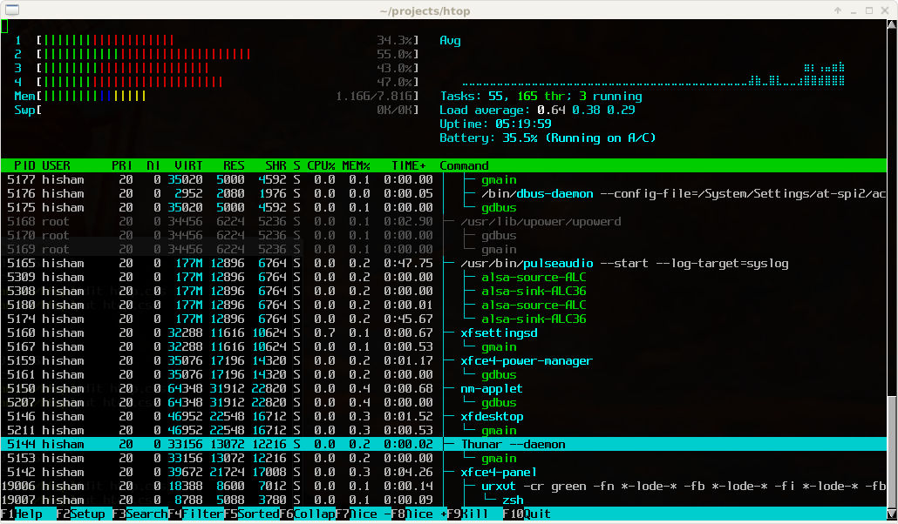
Common Linux Commands (Other Stuff)
systemctl = manages system processes (system control)
history = displays command history
top or htop = displays current system statistics
kill [PID] = kills running process
nano or vim for text editing

Slide 24
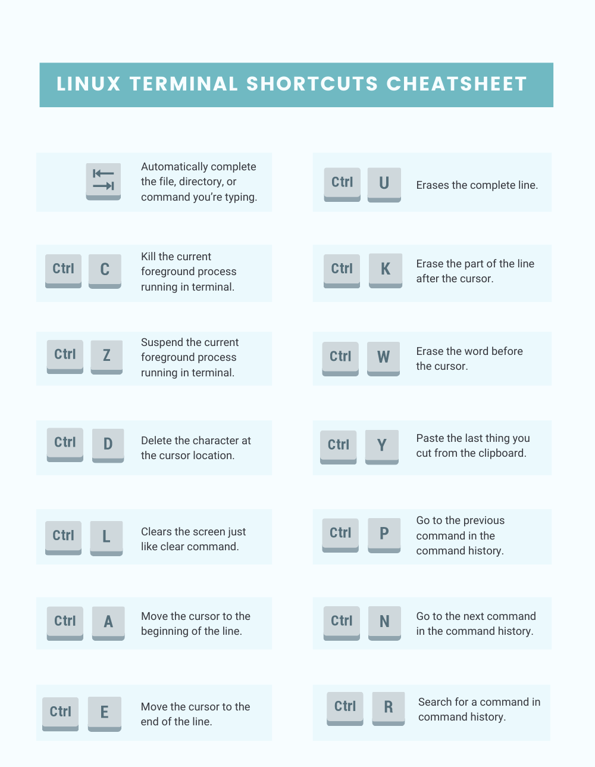
Helpful Keyboard Shortcuts
up arrow
Ctrl + C = kill current command
Ctrl + Z = suspend current command
Ctrl + Q = resume suspended command
Ctrl + A = move to start of command
Ctrl + E = move to end of command

Slide 25

Time to make an Arch ISO

Slide 26
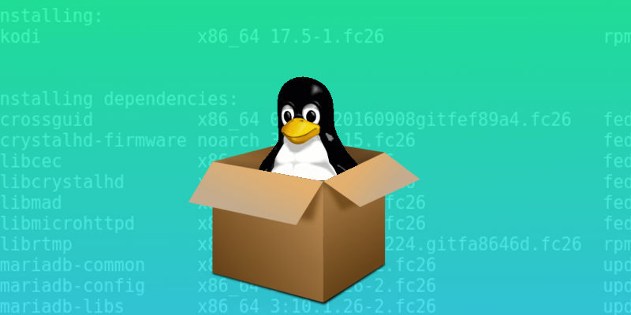
Use Archiso to Customize your ISO
Install on Arch
Use releng profile for default package config
Change to archlive directory
Edit packages.x86_64 (I added htop)
Copy any files you want included
Change kernel or bootloader if desired in packages.x86_64
pacman –S archiso
cp -r /usr/share/archiso/configs/releng/ archlive
cd archlive
nano packages.x86_64
cp –r /file/to/copy /airootfs/place/to/go

Slide 27
Use Archiso to Customize your ISO cont..
Find the system service to start for X
Start the X display manager at boot by linking it
ls -l /etc/systemd/system/display-manager.service
ln -s /usr/lib/systemd/system/lxdm.service archlive/airootfs/etc/systemd/system/display-manager.service

Slide 28
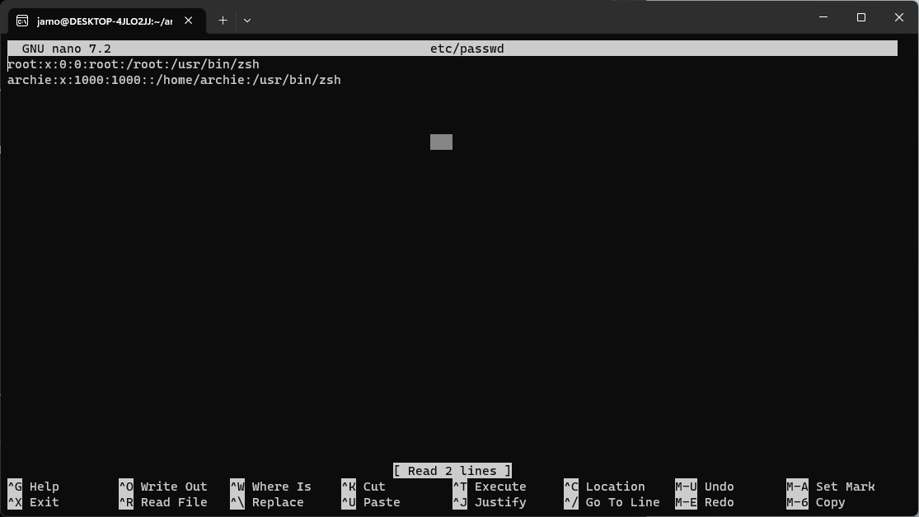
Use Archiso to Customize your ISO cont..
Add user to live environment, in this case ‘archie’
edit archlive/airootfs/etc/passwd

Slide 29
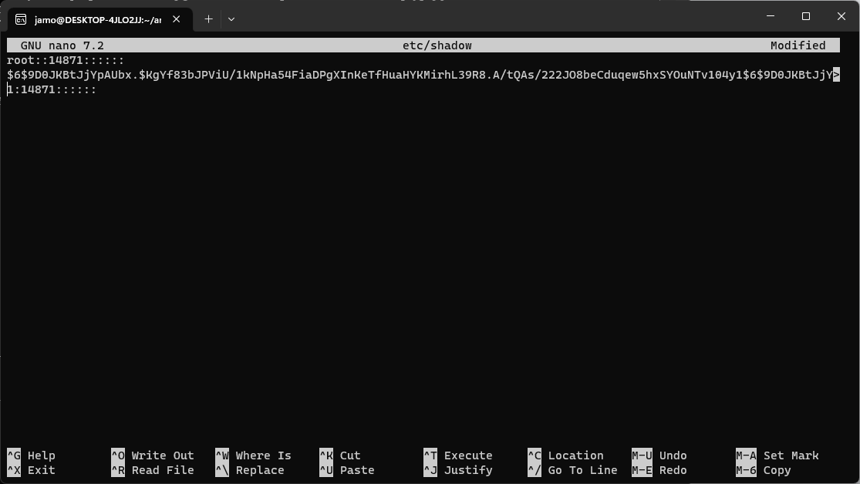
Use Archiso to Customize your ISO cont..
Generate password for user
Add generated hash to list
openssl passwd -6
edit archlive/airootfs/etc/shadow

Slide 30
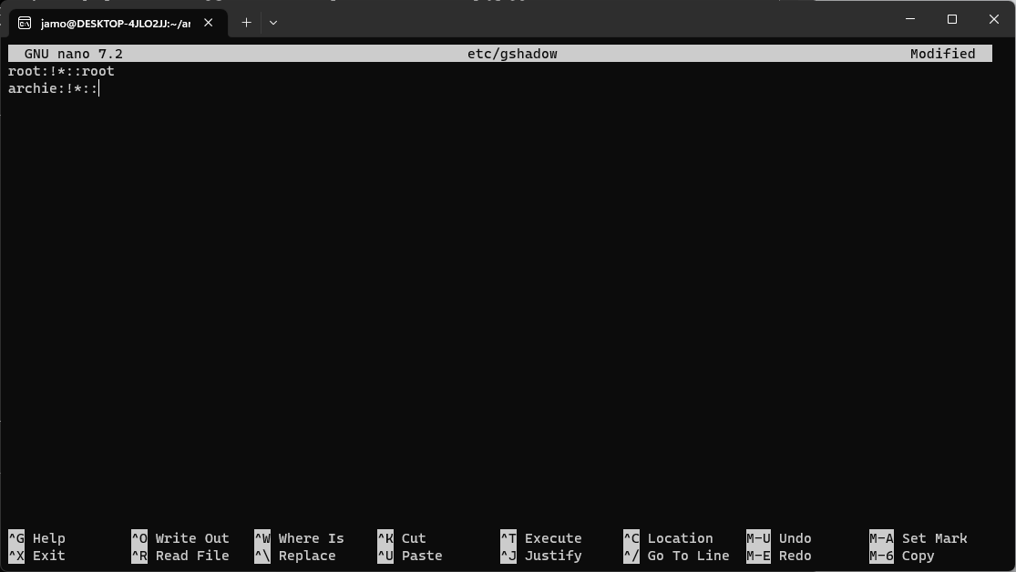
Use Archiso to Customize your ISO cont..
Add user to groups so they have permissions
edit archlive/airootfs/etc/gshadow

Slide 31
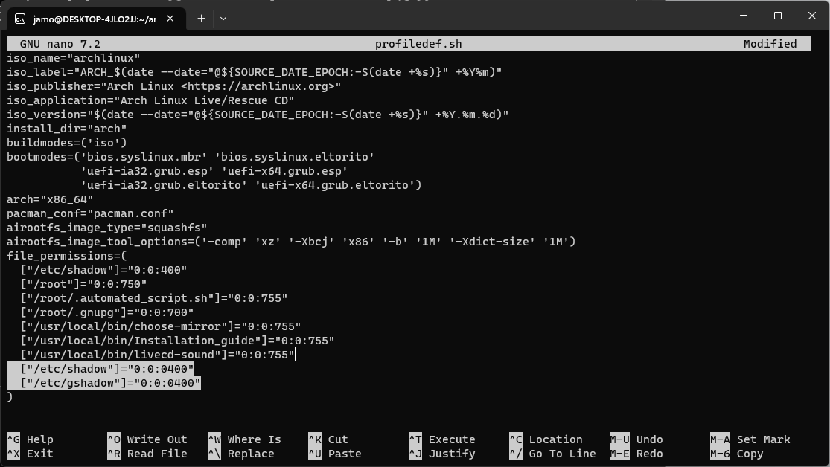
Use Archiso to Customize your ISO cont..
Give correct permissions to group
edit archlive/profiledef.sh

Slide 32
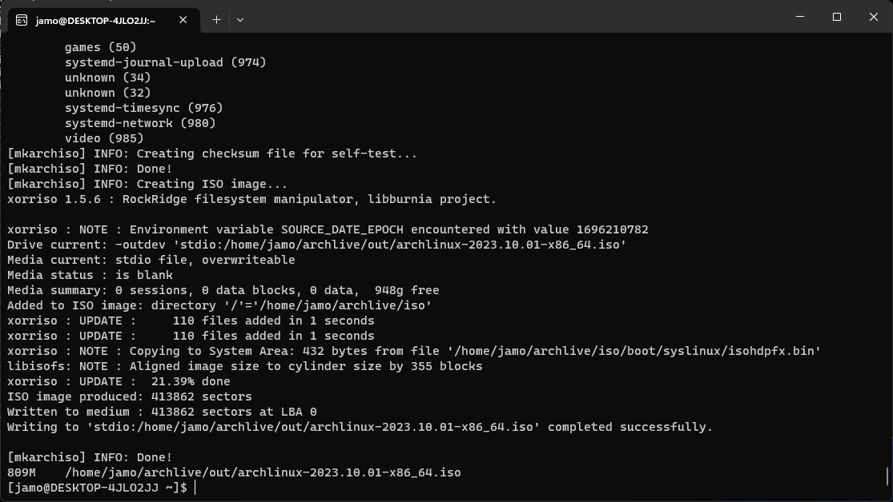
Use Archiso to Customize your ISO cont..
Build ISO!
mkarchiso -v -w /path/to/work_dir -o /path/to/out_dir /path/to/profile/

Slide 33
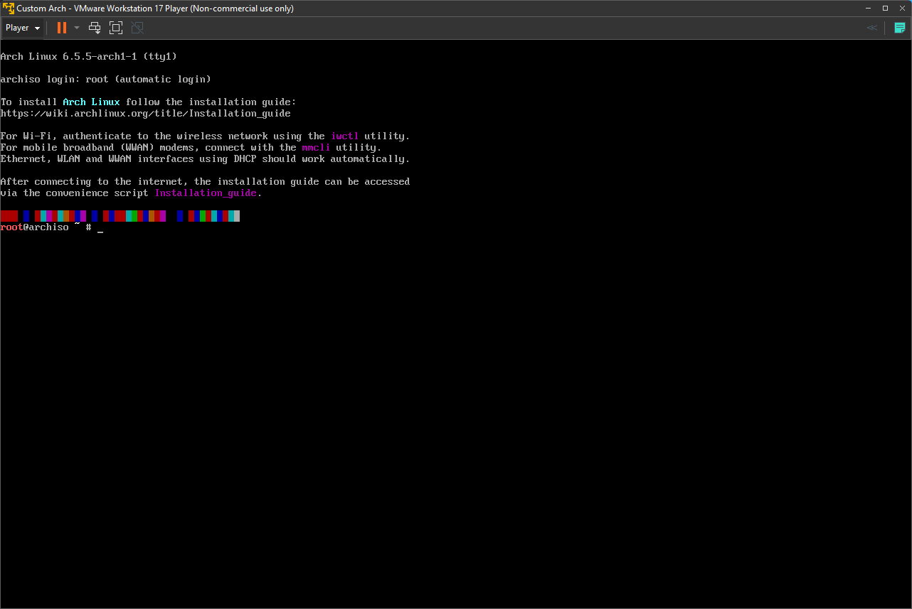
Use Archiso to Customize your ISO cont..
Boot Arch Linux setup!

Slide 34
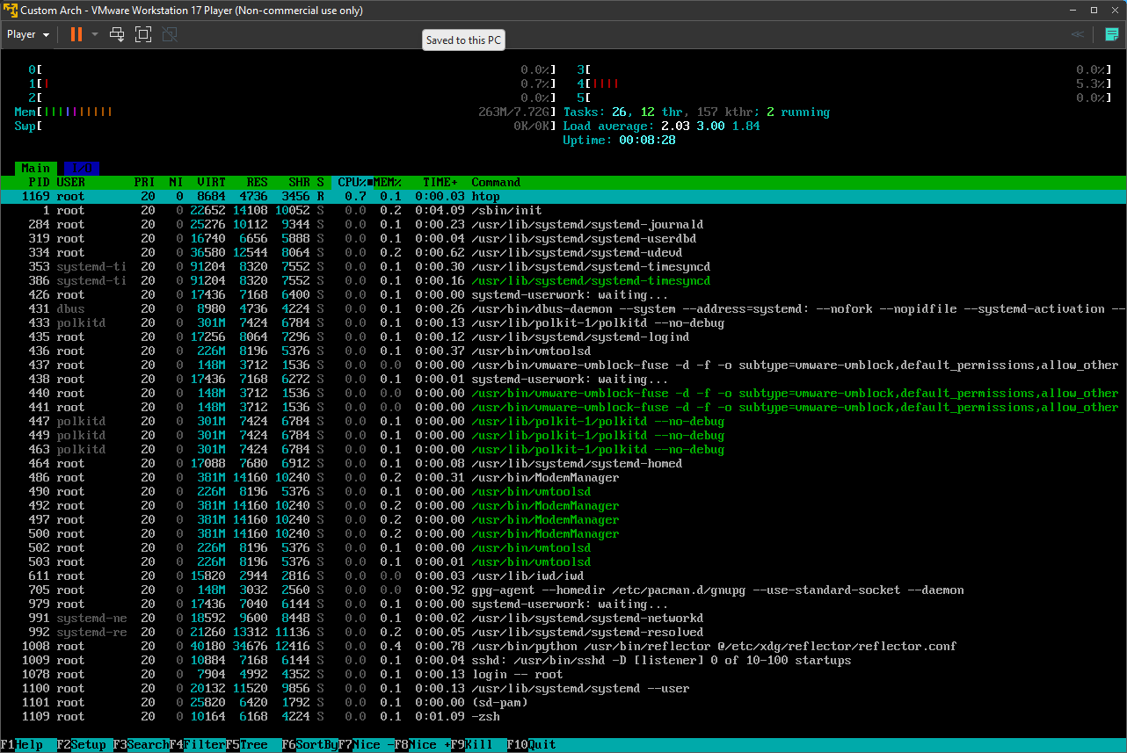
Use Archiso to Customize your ISO cont..
htop is installed

Slide 35
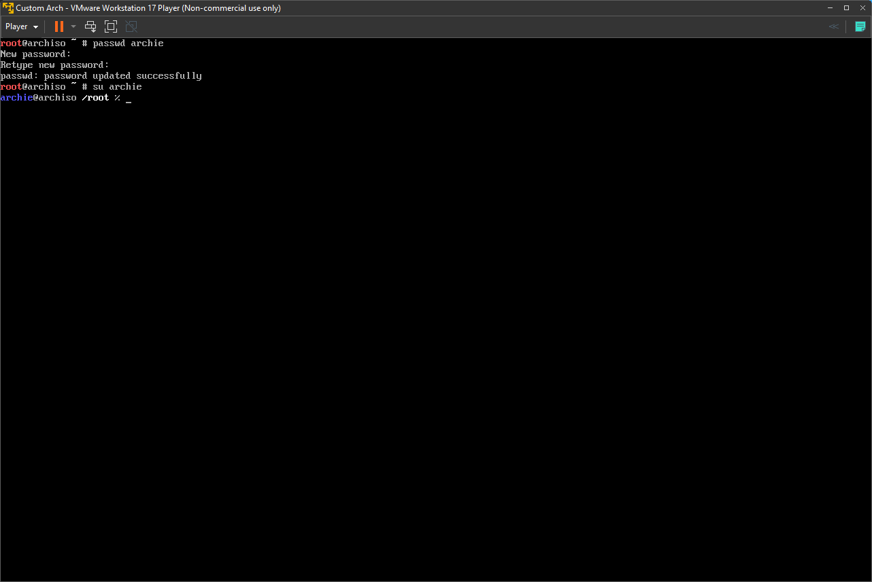
Use Archiso to Customize your ISO cont..
The user archie is present

Slide 36

Onto Installing Linux
Super basic, nothing extra, not even a user besides root

Slide 37
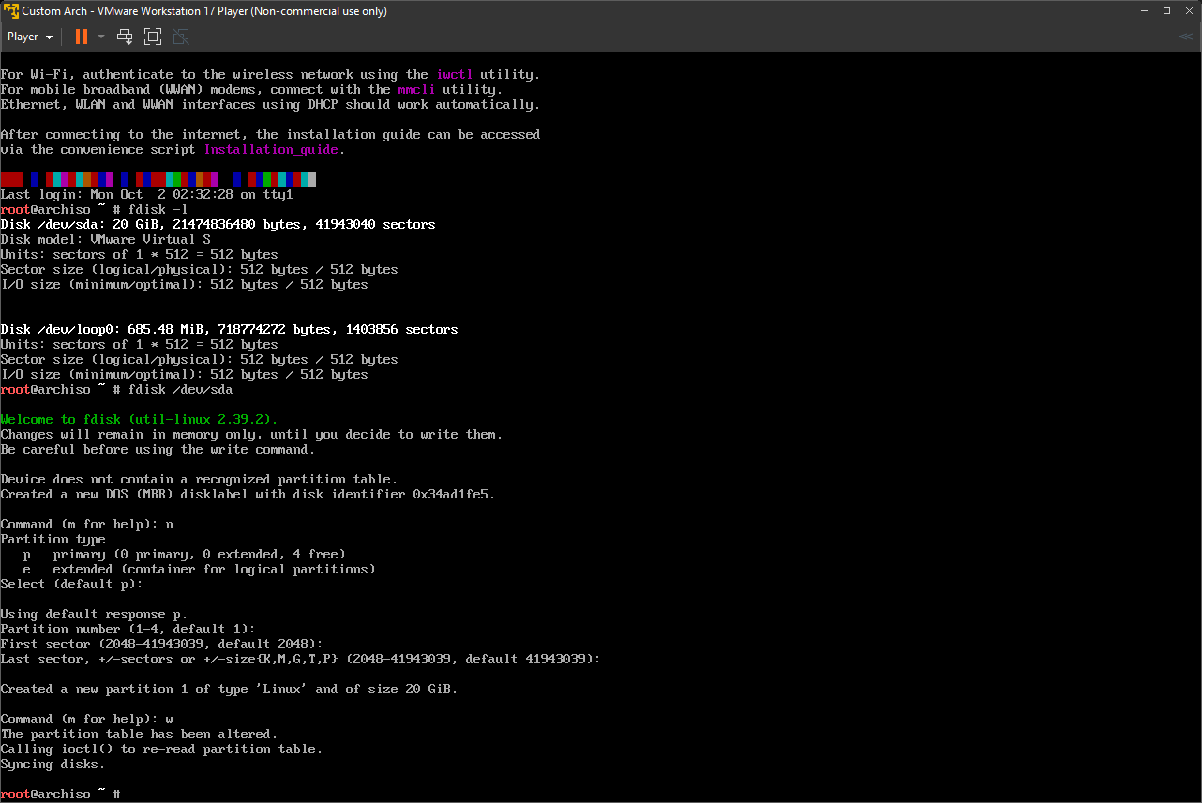
Install Arch
fdisk –l
  List available disks
fdisk /dev/sda
  Select disk to install to
We are legacy not UEFI so we do not need an EFI partition
n
  Create new partition
  Accept all defaults

Slide 38
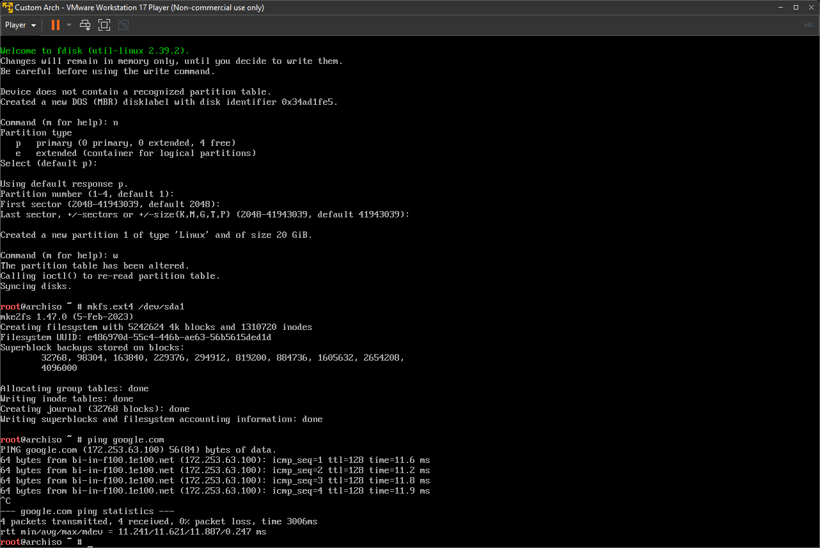
Install Arch cont..
mkfs.ext4 /dev/sda1
  Create an ext4 filesystem
ping google.com
  Check connection to internet

Slide 39
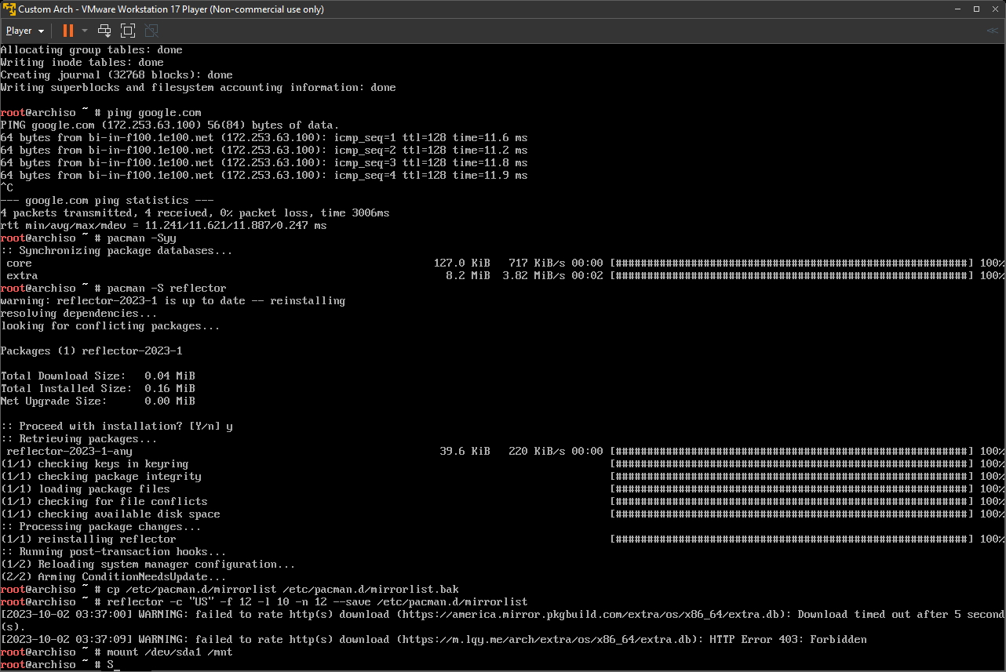
Install Arch cont..
pacman -Syy
  Sync package repository
pacman -S reflector
  Update mirrorlist for close servers
mount /dev/sda1
  Mount the root partition

Slide 40
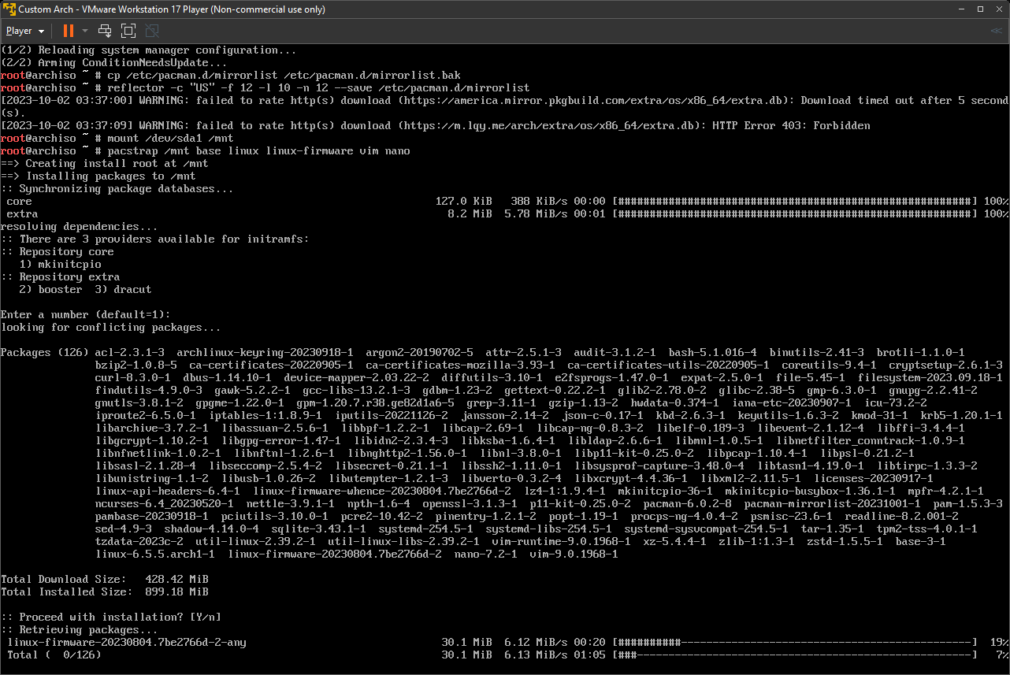
Install Arch cont..
pacstrap /mnt base linux linux-firmware vim nano
  Install necessary packages for linux install

Slide 41
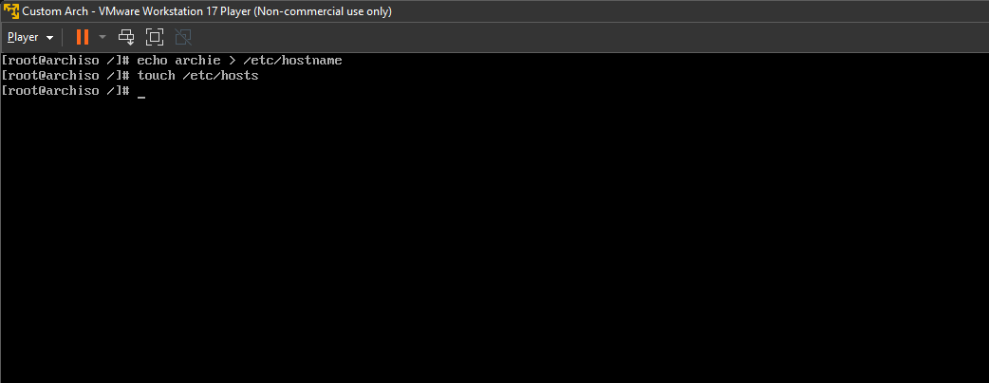
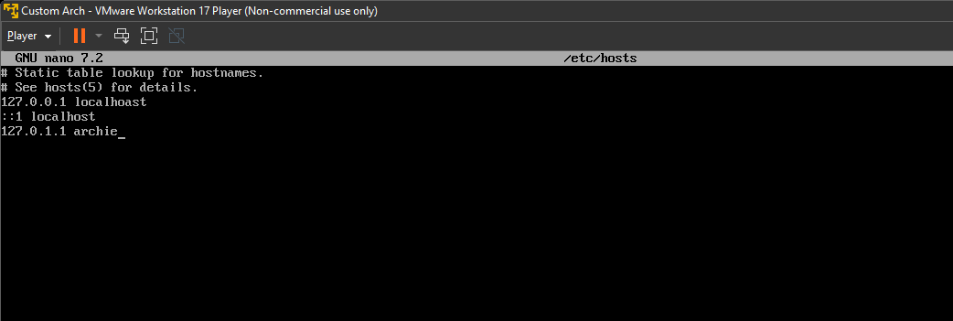
Install Arch cont..
echo archie > /etc/hostname
  Add archie to the network
touch /etc/hosts
  Create the hosts file and edit it to contain itself and archie

Slide 42
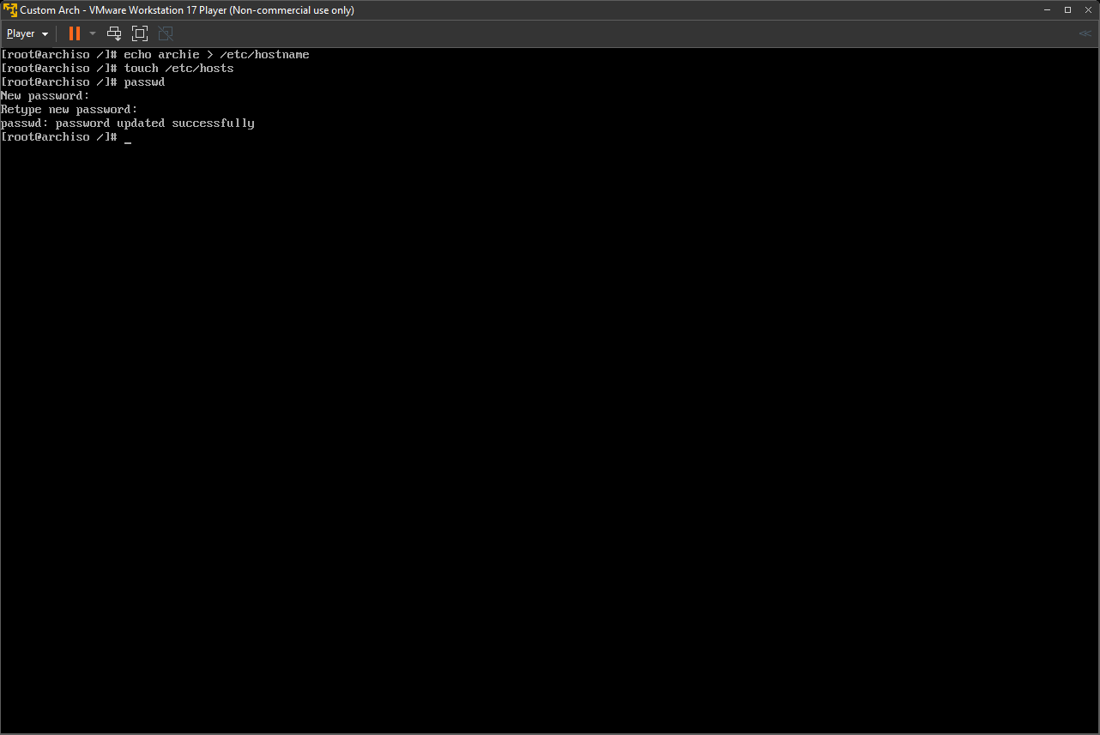
Install Arch cont..
passwd
  Set a password for the root user

Slide 43
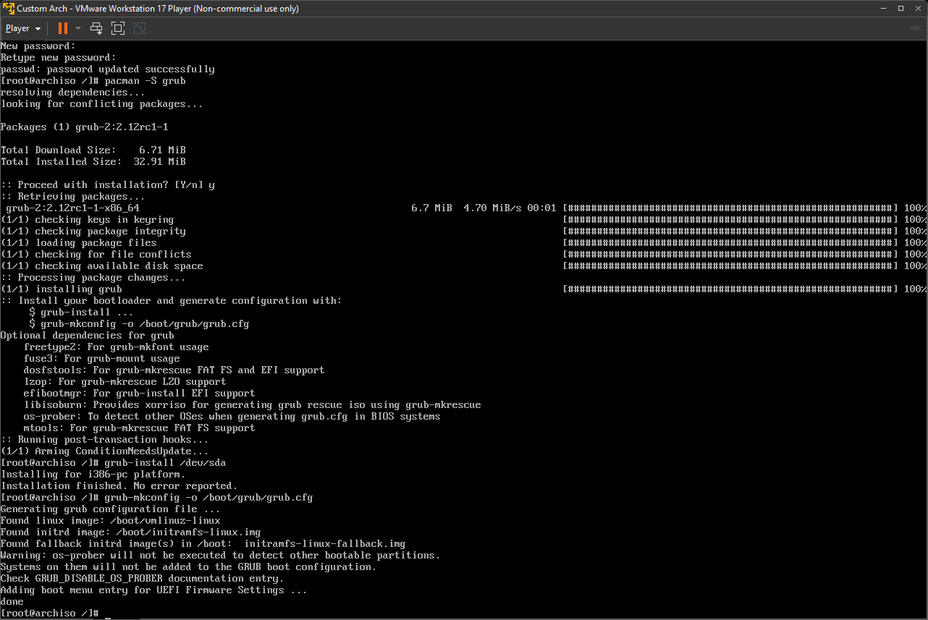
Install Arch cont..
pacman -S grub
  Install GRUB bootloader package
grub-install /dev/sda
  Install the bootloader
grub-mkconfig -o /boot/grub/grub.cfg
  Generate GRUB configuration

Slide 44
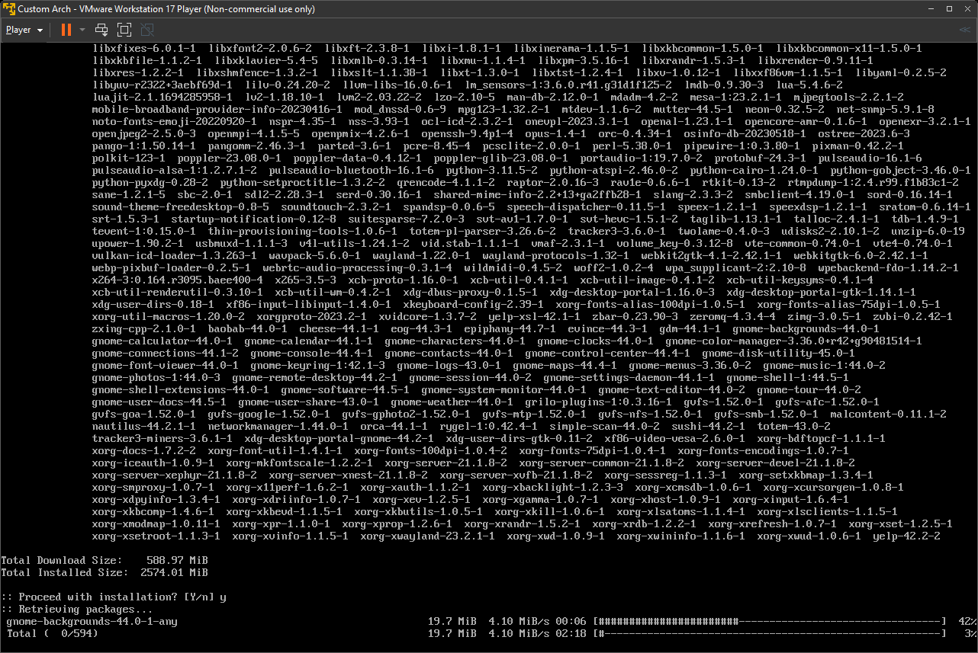
Install Arch cont..
pacman -S xorg networkmanager gnome
  Install GNOME desktop environment, display manager, and network manager

Slide 45
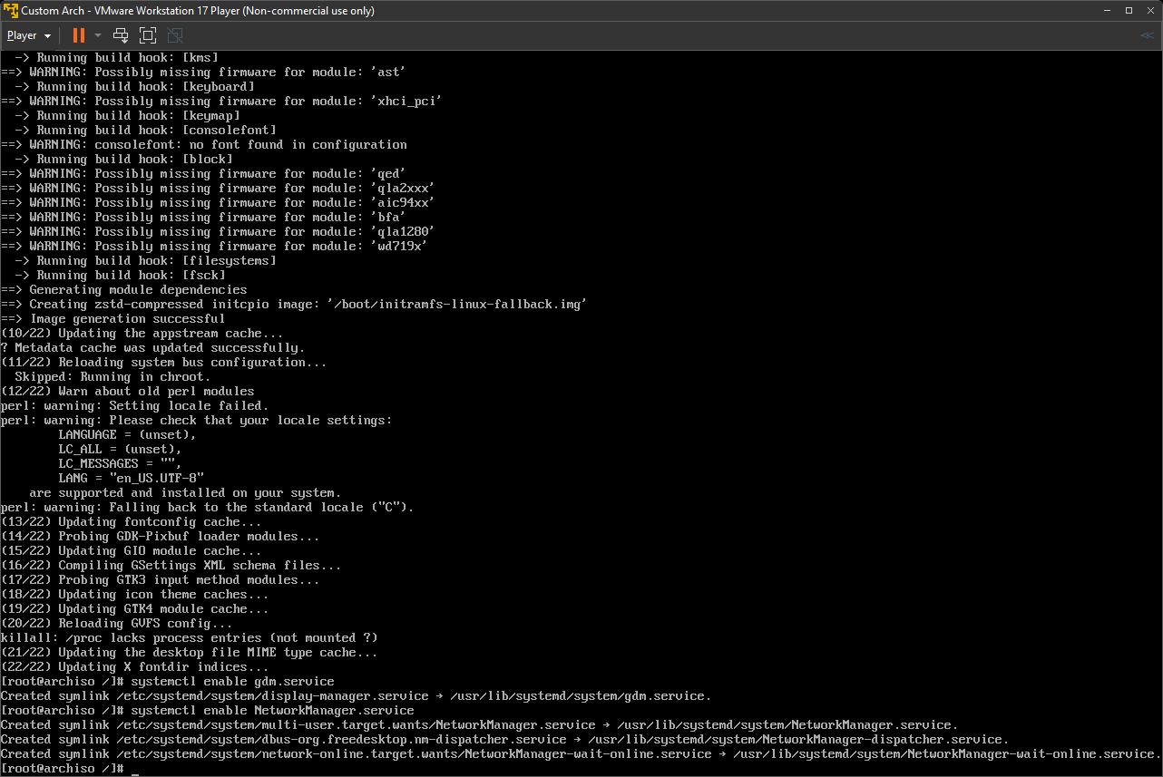
Install Arch cont..
systemctl enable gdm.service
  Enable display manager service
systemctl enable NetworkManager.service
  Enable network manager service

Slide 46
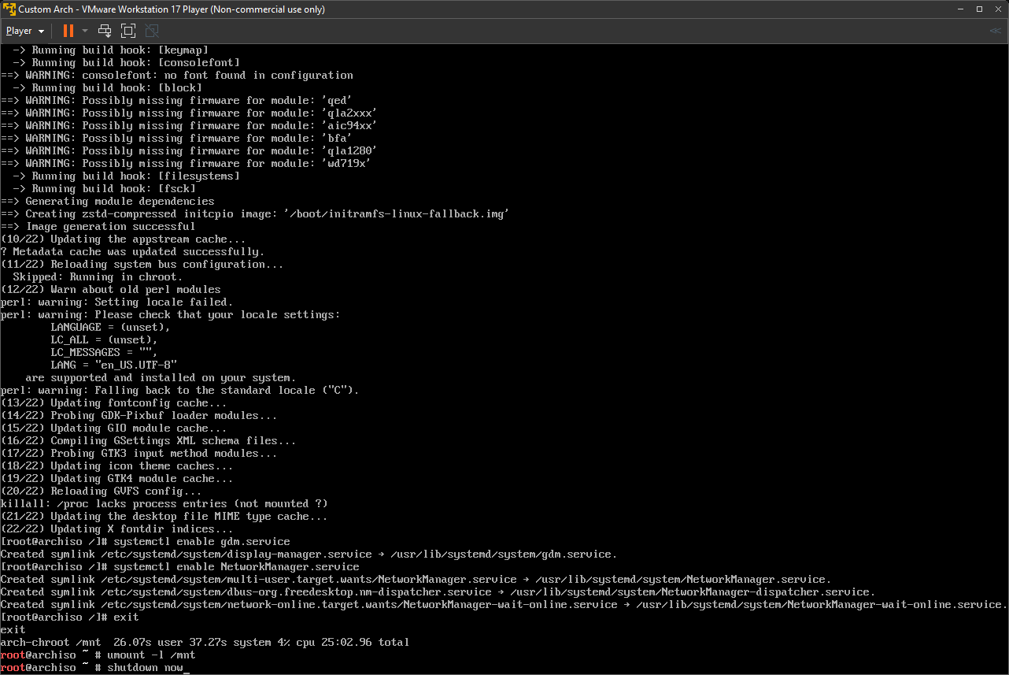
Install Arch cont..
exit
  Leave chroot
umount -R /mnt
  Unmount root partition
shutdown now
  Shutdown immediately

Slide 47
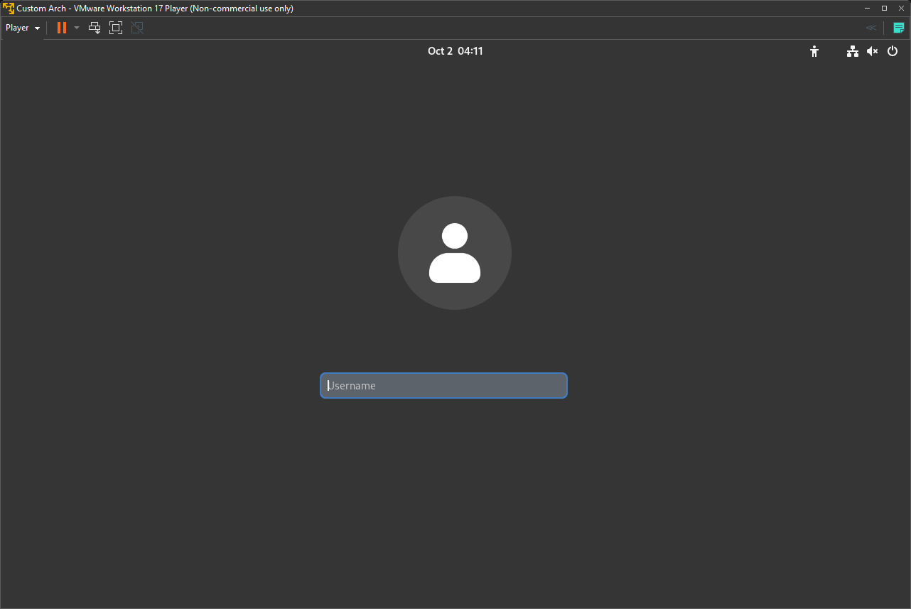
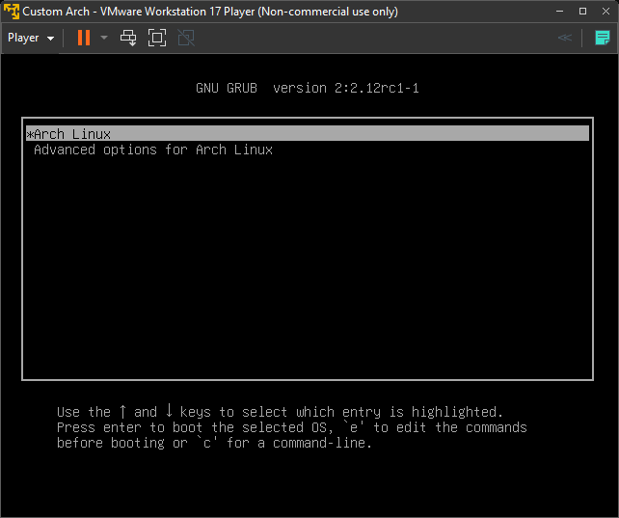
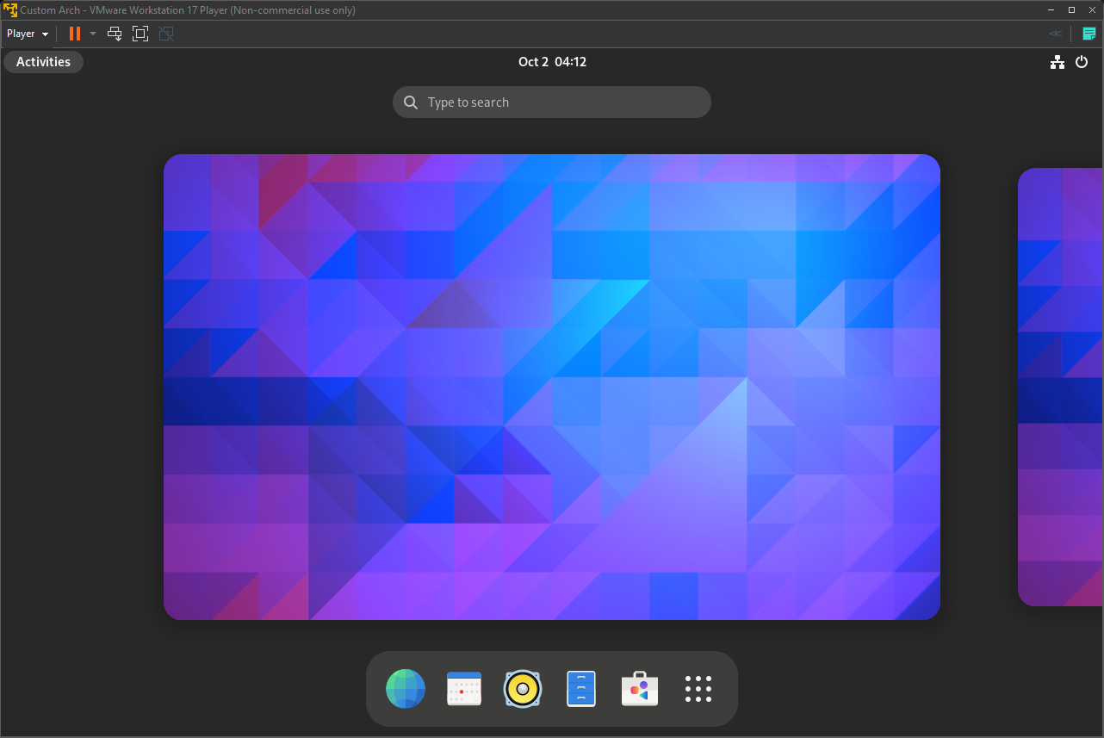
Install Complete

Slide 48

Review
Linux is just a kernel
Systemd – the default init process
Linux filesystems – ext4, swap, zfs, efi
Build your own Arch ISO with archiso
Install it in a VM

Slide 49


Questions???

