Slide 1

Raspberry Pi Clusters - Hands-On
HPCC Presentation 10-16-23
Sean Mapes

Slide 2
Overview
Ask any questions as you have them!
Pi OS Setup
Installing Packages
Master Setup
Nodes Setup

Slide 3
Pi OS Setup
Pi OS is Raspberry Pi’s official Debian distribution
  Made for Raspberry Pi, including a lot of helpful tools for deployments
To get it, we can use Raspberry Pi’s custom imaging utility from their website
  https://www.raspberrypi.com/software/

Slide 4
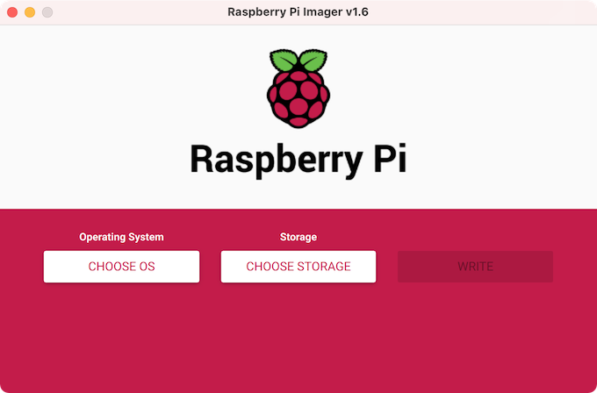
Pi OS Setup

Slide 5
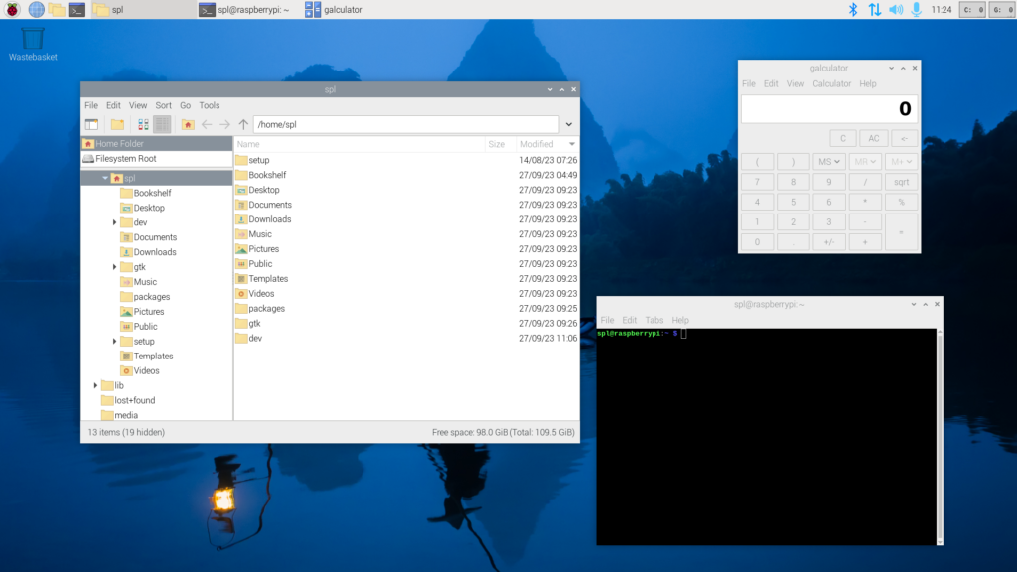
Pi OS Setup

Slide 6
Installing Packages
Python
  sudo apt install python-pip python-dev
MPI
  sudo apt install mpich
  sudo pip install mpi4py

Slide 7
Master Setup
DNS / DCHP
  sudo apt dnsmasq
  Static IP address
    Edit /etc/dhcpd.conf
      interface eth0
      static ip_address=192.168.0.10/24
      static routers=192.168.0.1
      static domain_name_servers=192.168.1.1 8.8.8.8
      Write down this IP adress for later
    Reboot

Slide 8
Master Setup
DNSMasq Configuration
  Add the following to /etc/dnsmasq.conf
    interface=eth0
    bind-dynamic
    domain-needed
    bogus-priv
    dhcp-range=192.168.1.100,192.168.1.200,255.255.255.0,1d
  Restart dnsmasq
    sudo service restart dnsmasq

Slide 9
Master Setup
SSH Key Generation
  ssh-keygen
    Default values are fine

Slide 10
Nodes Setup
Plug the master into the switch first
Plug all the nodes into the switch after the master has started up
  We need the nodes to use the master as it’s DCHP server

Slide 11
Nodes Setup
Python
  sudo apt install python-pip python-dev
MPI
  sudo apt install mpich
  sudo pip install mpi4py

Slide 12
Nodes Setup
Get the nodes IP addresses
  ip a
    Record the IP address and hostname
Test ping the master
  nmap -sP IP.*
  ping -c 3 MASTER_IP
    Where MASTER_IP is the IP address of the master

Slide 13
Nodes Setup
On the master:
  Make a file in /home/pi named HOSTFILE
  Edit /home/pi/HOSTFILE
    Write localhost, followed by a list the IP addresses of the nodes, separated by a new line
  Edit /etc/hosts (optional)
    At the end of the file, type the IP addresses of the nodes followed by an alias for them (hostname)

Slide 14
Nodes Setup
On the master:
  Test SSH to the nodes
    ssh pi@NODE_IP
      Where NODE_IP is the IP address of a node
  Copy over the SSH key over to each node
    ssh-copy-id -i .ssh/id_rsa.pub
  Edit ~/.bashrc (optional)
    Add alias HOSTNAME=’ssh pi@NODE_IP’ for each node

Slide 15
Testing
Test MPI without a script
  mpiexec -hostfile HOSTFILE hostname
    The hostfile option tells MPI where a hostfile is located, and within that file is a list of our IP address for MPI to execute off of
    Hostname is the command we are running, in this case it should identify the hostname of the system it is running on
    If successful, there should be 3 different hostnames present (master and two nodes)

Slide 16
Testing
Test MPI with a script
  ...for a later date

