Slide 1
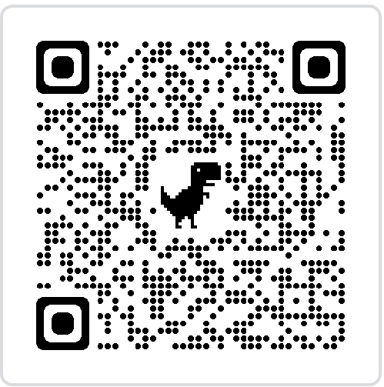
Do Attendance please. ☺

Slide 2

RAID and Local Cache Repository
By: Connor Anderson

Slide 3
Verse
Count it all joy, my brothers, when you meet trials of various kinds, for you know that the testing of your faith produces steadfastness.
James 1:2&3 (NIV)

Slide 4

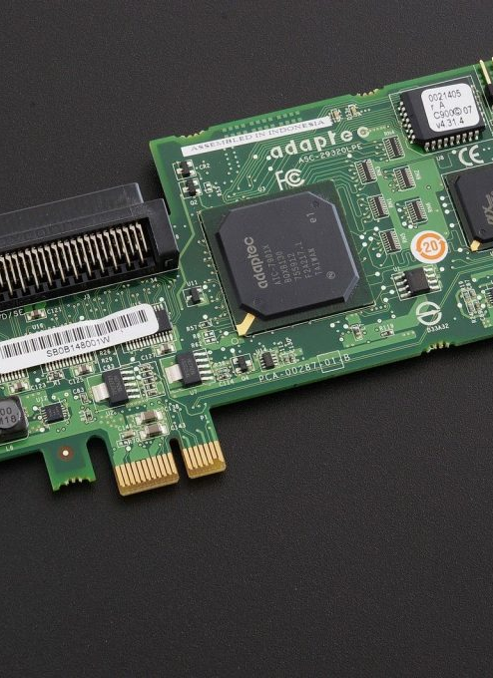
What is RAID
Stands for Redundant Array of Independent Disks
Takes multiple disks and makes them one unit
Used for increasing writing speed or information safety
Not a replacement for backups
Software and Hardware RAID

Slide 5

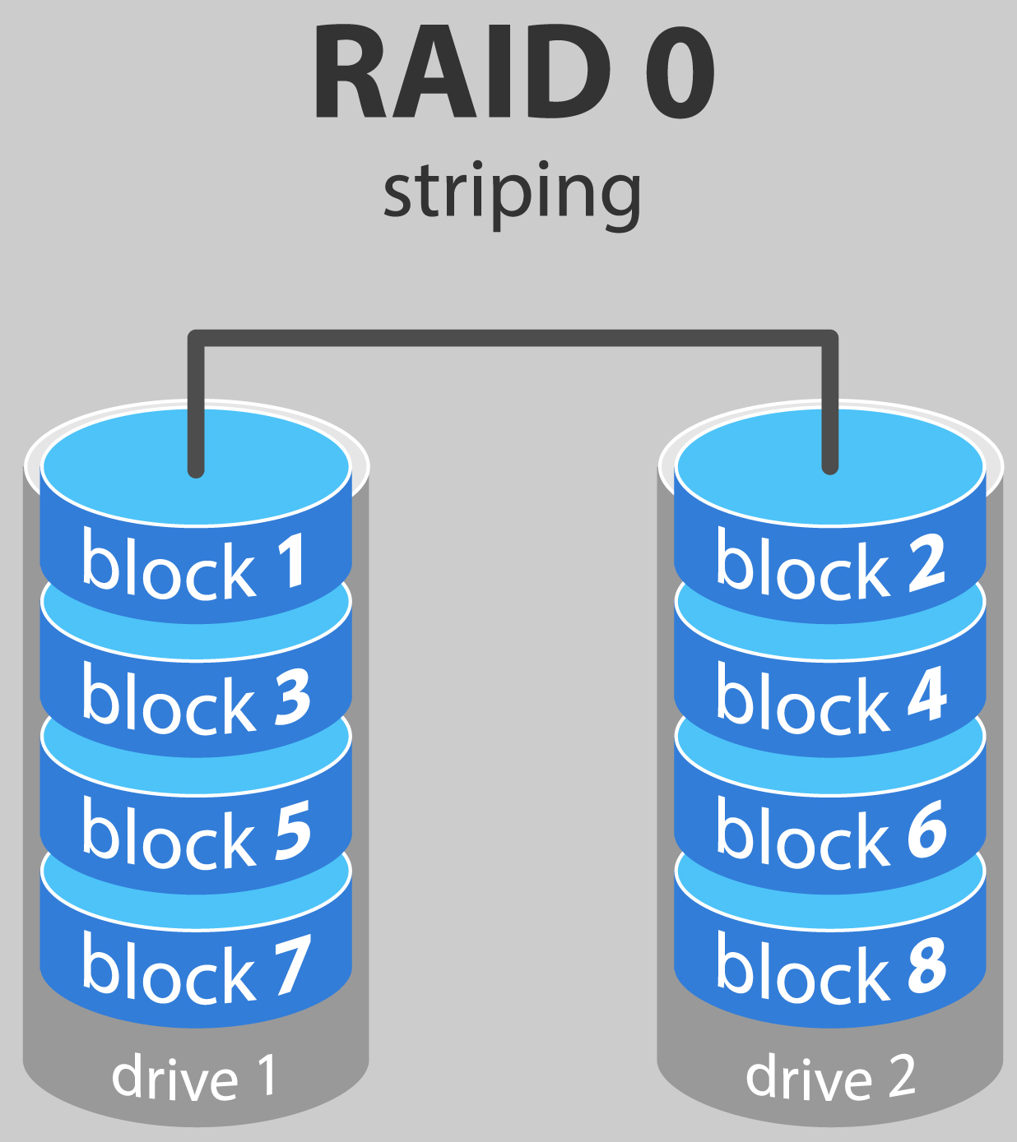



Raid 0
Striping
Faster writing speeds
Easier to lose data

Slide 6
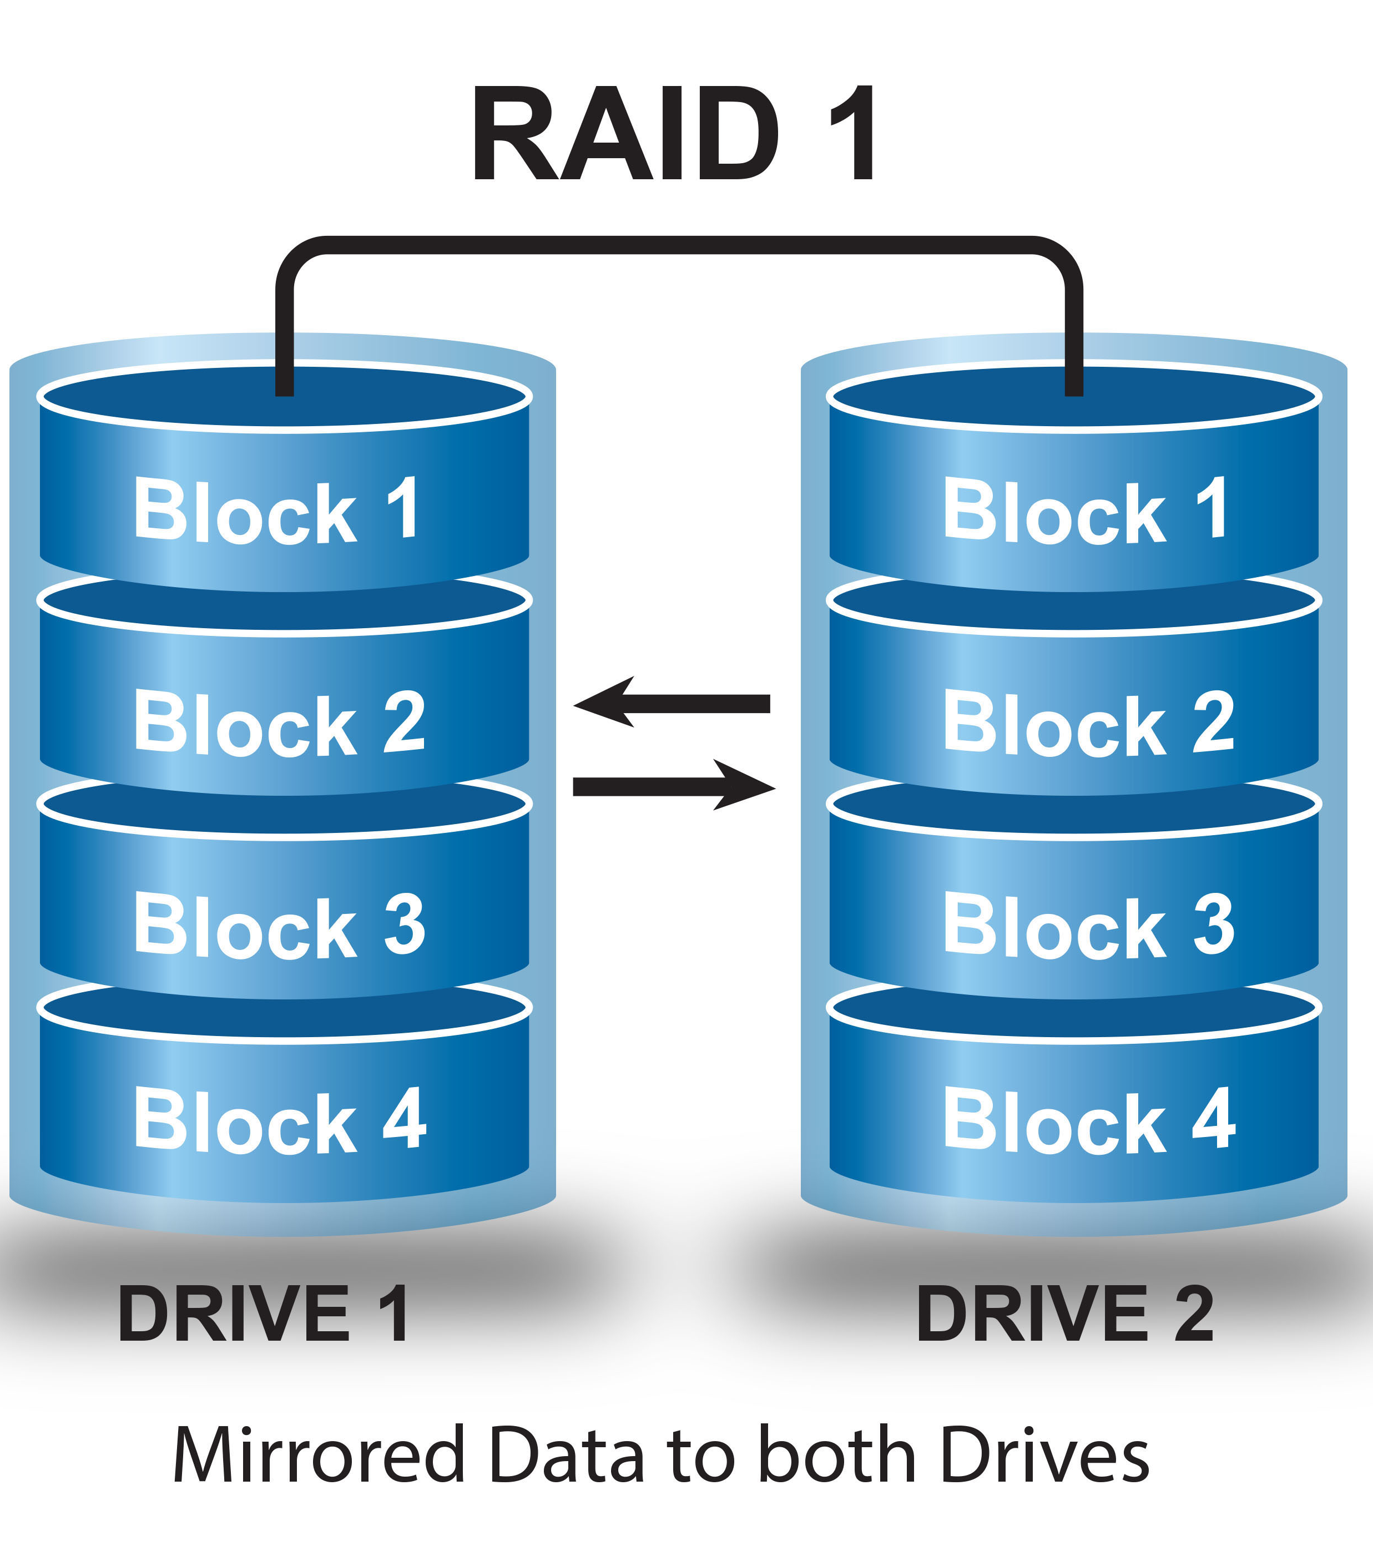
Raid 1
Mirroring
Slower writing speeds
More secure data

Slide 7
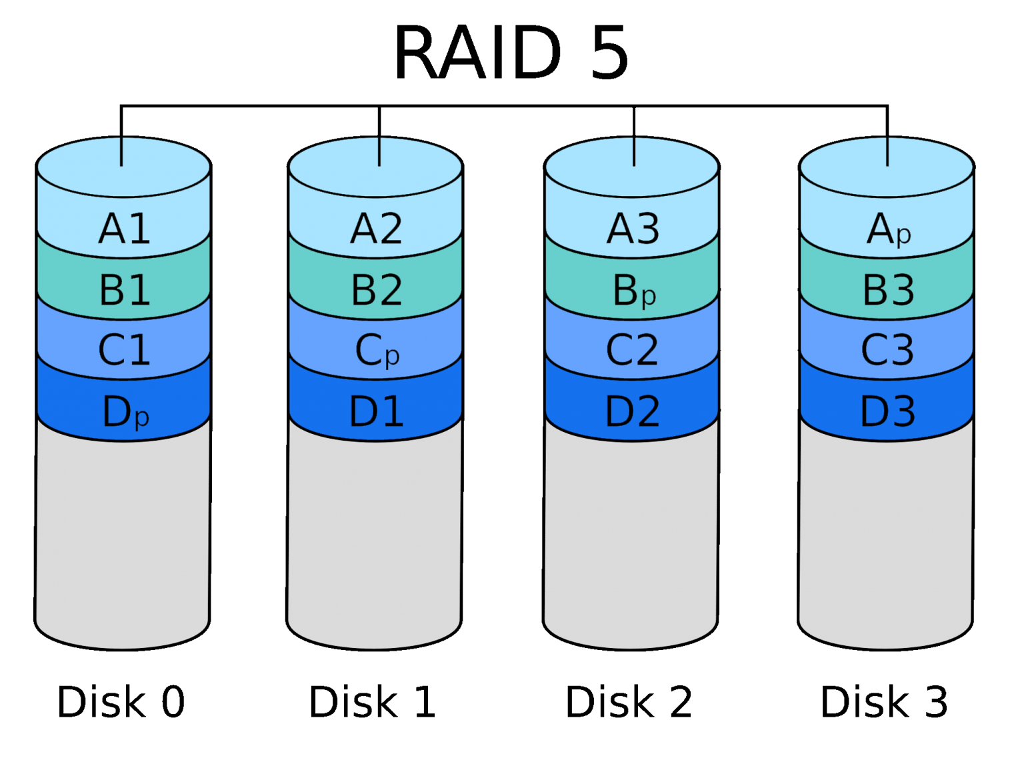
Raid 5
Striping with Parity
Loses an entire drive
Faster writing speeds
More secure
Needs a min of two drives

Slide 8
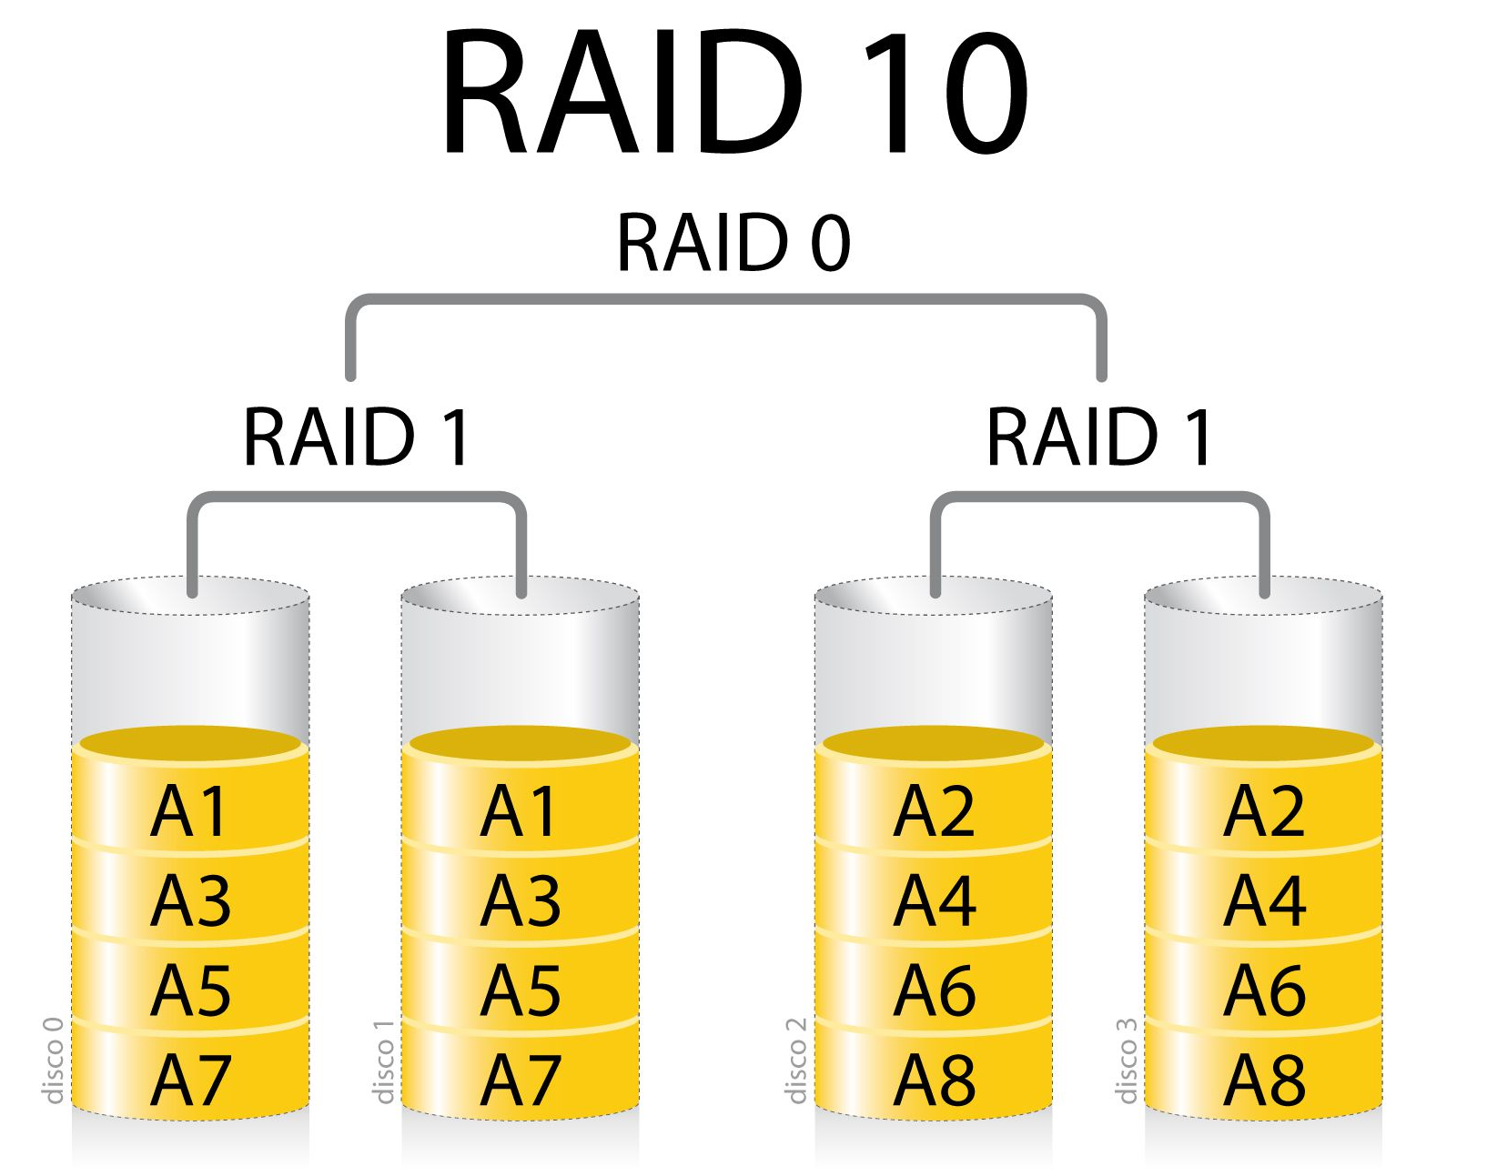
Raid 10
What is 1 + 0?
10
Combination of Raid 1 and 0
Faster writing speeds
Redundancy

Slide 9
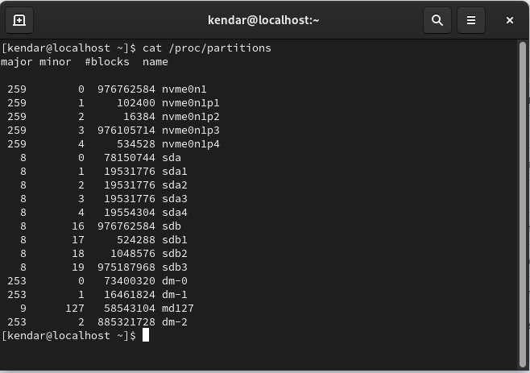
How to set up Raid
Start by partitioning the hard drives
This can be done in command line or “disks”
Here’s how to do it in command line:
  Cat /proc/partitions
  Fdisk “partition location”
  N (create a new partition)
  P (primary partition)
  1 (partition number)
  W (write out)

Slide 10
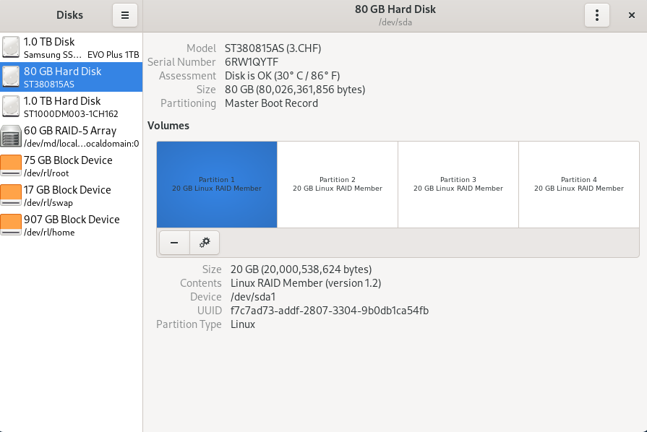
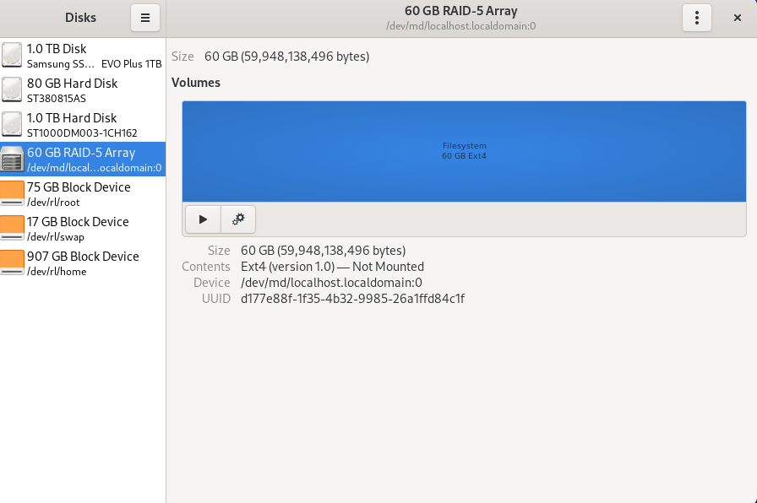
Using MDADM create the RAID array
Cat /proc/partitions
Sudo mdadm –create /dev/md0 –a yes –l 5 –n 4 /dev/sda1 /dev/sda2 /dev/sda3 /dev/sda4
Cat /proc/partitions
Mkfs.ext4 /dev/md0
Mount /dev/md0 /mnt

Slide 11

Repository
A local storage area for important files or data
Mirror’s specifically are a location to get updates for software

Slide 12

How to (hypothetically) set up a basic repository?
Yum install yum-utils createrepo
Reposync –gpcheck -1 –repoid=<rep-id>
Cd /var/www/html/<rep-id>
Createrepo –v /var/www/html/<rep_id>

Slide 13
Thank you!

