Slide 1
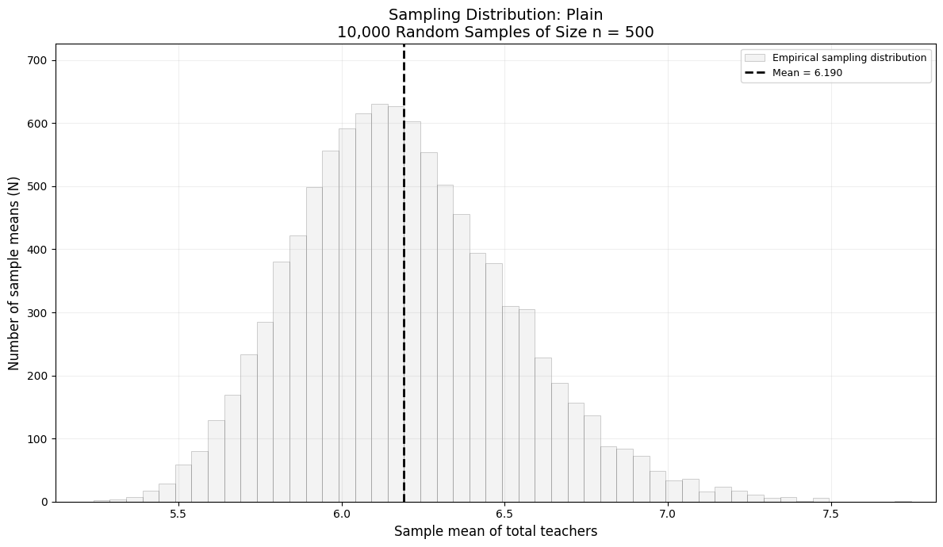

Slide 2
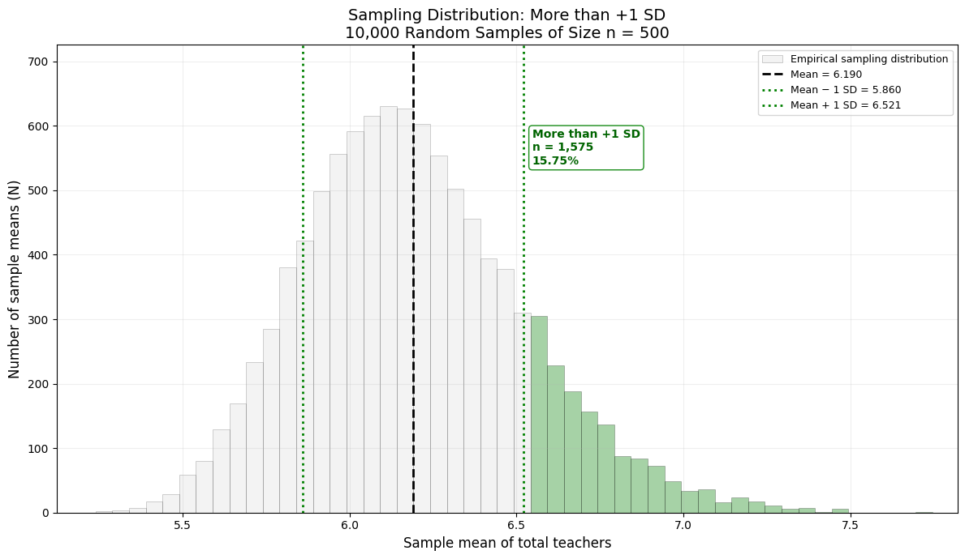

Slide 3
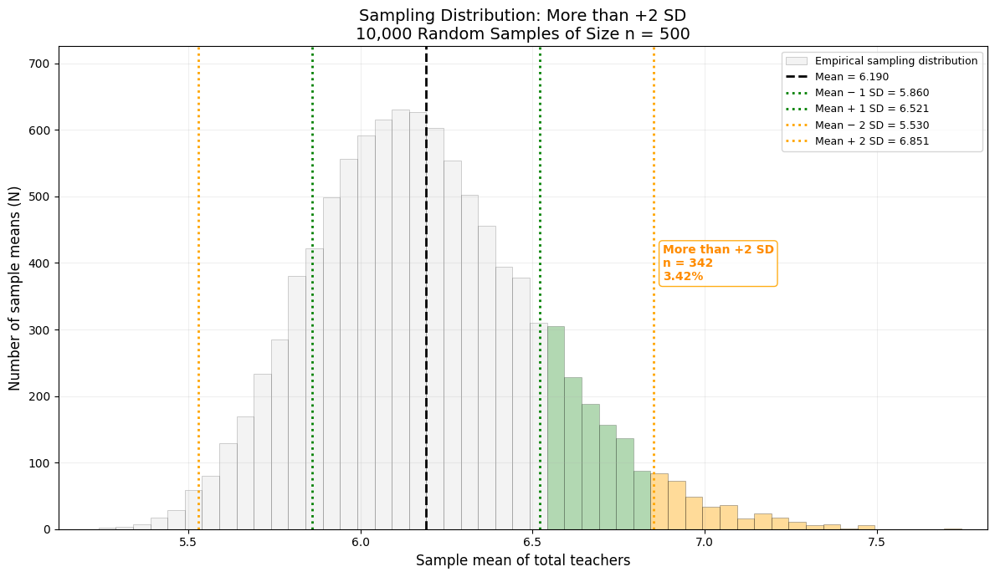

Slide 4
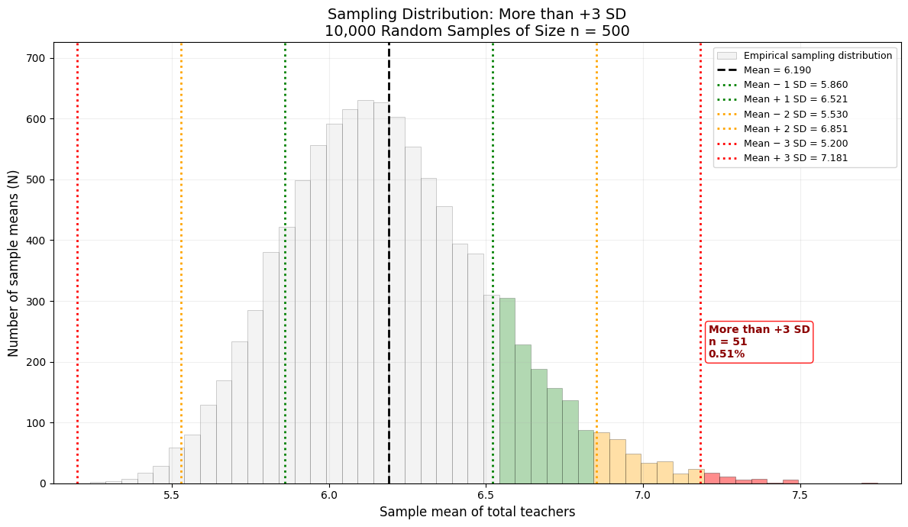

Slide 5
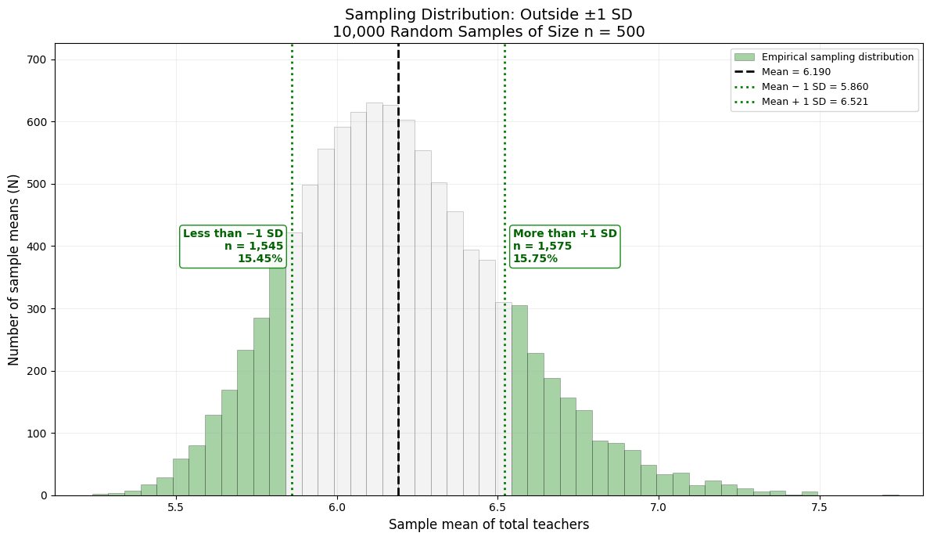
This green region is 31.2% approximately 32%, ie. 68% between -1 and 1 S.D.

Slide 6
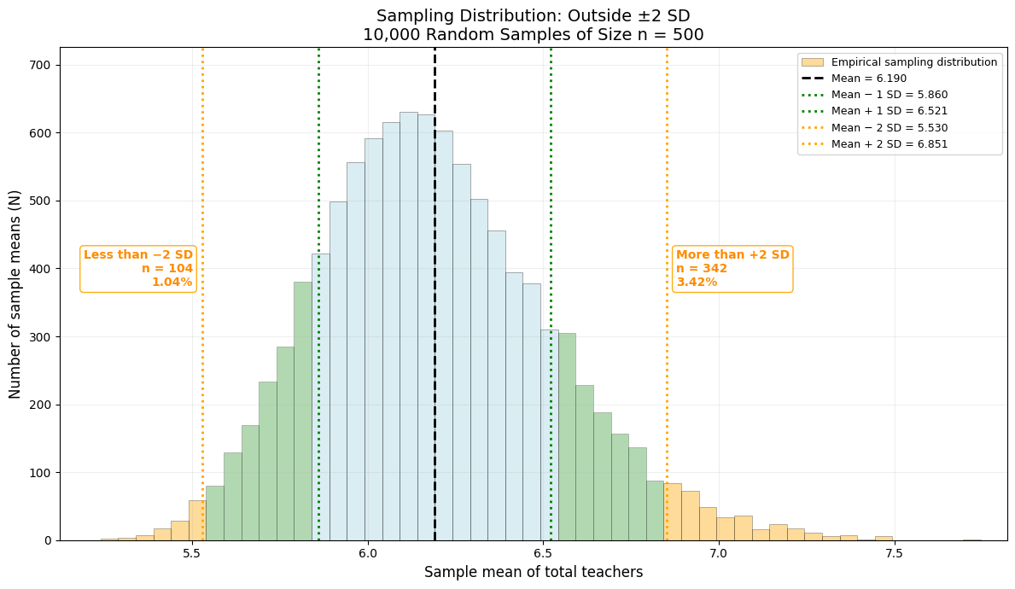
This yellow region to 4.46% approximately 5%
And between -2 and 2 S.D. is ~95%

Slide 7
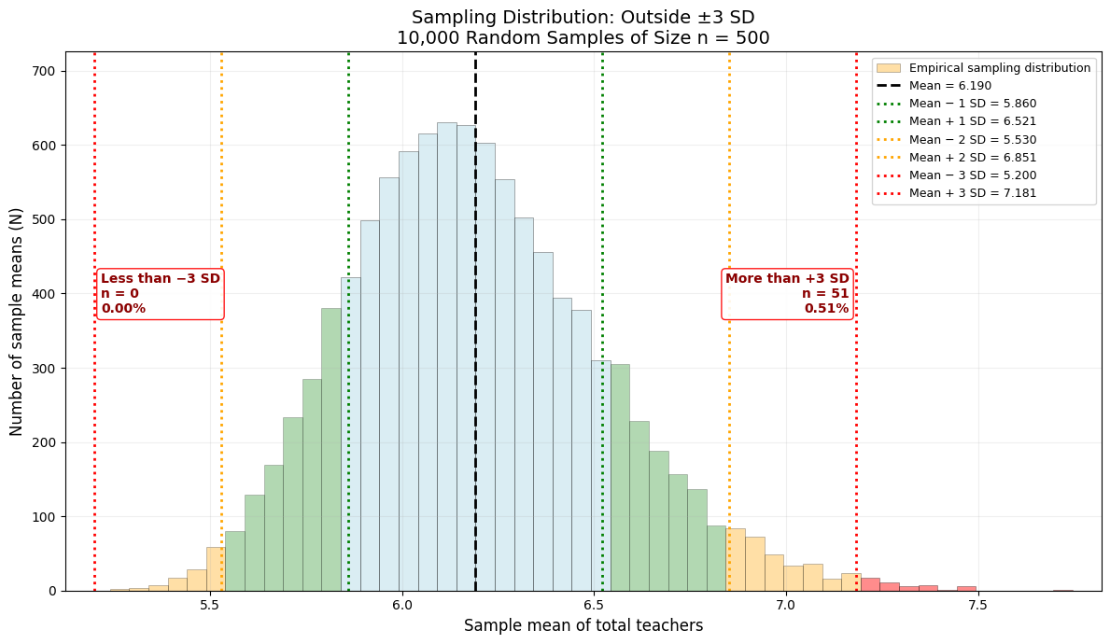
This red region to 0.51% approximately 0.3%
And between -3 and 3 S.D. is close to ~99.5%

Slide 8
