Slide 1
BCG
POWER CO PROJECT

Slide 2
BUSINESS PROBLEM:-
The main goal of this program challenge is to predict the probability of customers churn on one of BCG clients called PowerCo.
PowerCo is a company that focus on supplying gas and electricity for SME( Small Medium Enterprises) and residential customers.
They want to derive an effective decision to the declining customers lately by collaboration with BCG.
One hypothesis that likely to happen of the customers churn during period of January to March 2016 is the price sensitiviy and the issue of power-liberalization market in Europe.
We, as consultant want to understand the data better and derive actionable insights through the hypothesis whether we should consider marketing strategy that PowerCo is trying to do by offering 20% discount to the customers churn.
Is it an effective way to do or any other solutions that we can deliver to the client.
As this is a classification problem, we will be using one or more classification algorithms such as Logistic Regression, Decision tree and Random Forest by always checking a few importants parts such as overfitting or underfitting model.
We will analyze three datasets that we will believe can support the insights by following data :
1.Historical customer data: Customer data such as usage, sign up date, forecasted usage etc
2.Historical pricing data: variable and fixed pricing data etc
3.Churn indicator: whether each customer has churned or not

Slide 3
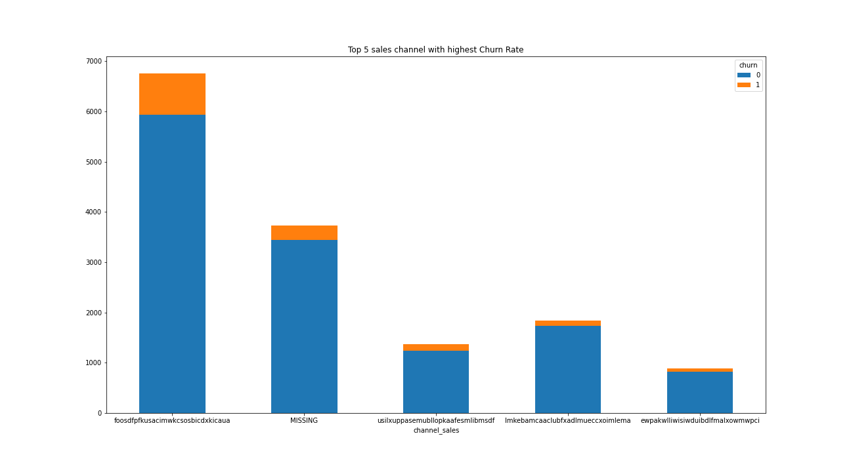
Exploratory Data Analysis:-
Loading the datasets (client_csv which contains 14606 rows & 26 columns and price_csv contains 193002 rows and 8 columns.
Performing descriptive statistics on both the dataset using pandas library to understand the average pricing in each period of time.
No missing values were found in both datasets as well as no duplicates were found in both data.
Using matplotlib library top 5 sales channel with highest Churn Rate is been detected and seen that (foosdfpfkusacimwkcsosbicdxkicaua) sales channel has the highest number of churn

Slide 4
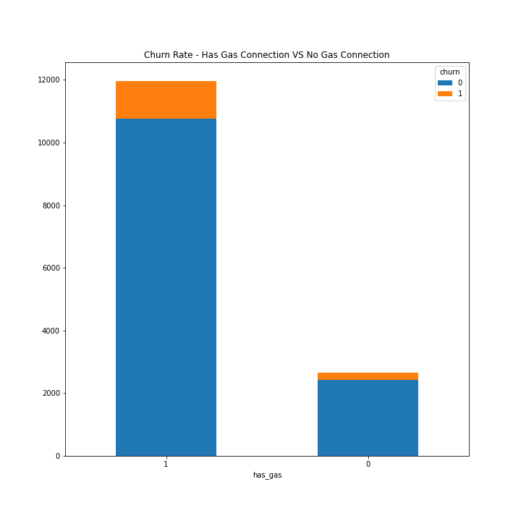
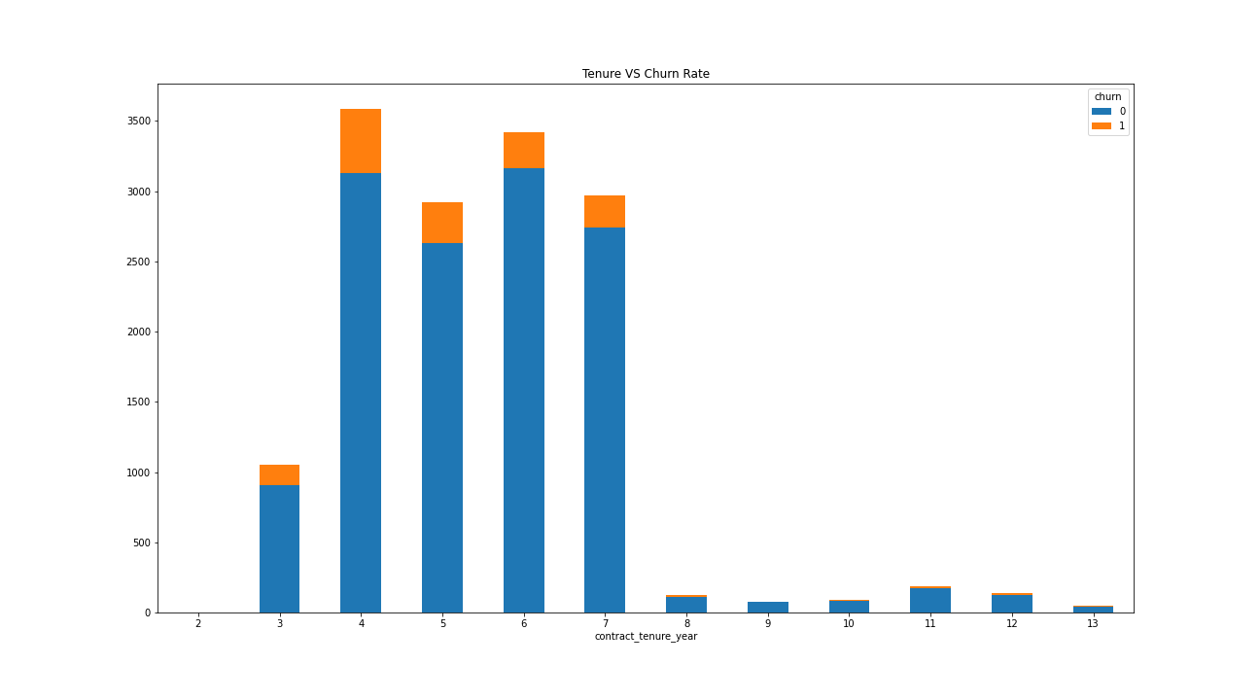
Grahps bas on Churn Rate - Has Gas Connection VS No Gas Connection
The graphs which shows Tensure Vs Churn
Churn is very low for companies which joined recently or that have made the contract a long time ago. With the higher number of churners within the 3-7 years of tenure.

Slide 5
Feature Engineering:-
Converting the categorical features into continous using pandas.
New features for pricing and droping out the unwanted features('price_date', 'price_off_peak_var','price_peak_var', 'price_mid_peak_var', 'price_off_peak_fix', 'price_peak_fix', 'price_mid_peak_fix‘)
Droping the features ('id','date_activ', 'date_end', 'date_modif_prod', 'date_renewal‘) from client dataset which can effect the model accuracy.

Slide 6
Sample Model:
Creating Sample model as the data is big analyizing on sample data can make it easier to detect the best classification model for the project.
Models like SVC,Random Forest,Decision Tree,XGBM,AdaBoost, GradientBoosting.
XGBM gives the best accuracy for the sample data so going with xgbm.

Slide 7
Model Building & Evaluation
Using XGBM for analyising the model using parameters n_estimators=100,max_depth=5,min_child_weight=1,gamma=0,learning_rate=0.01 to avoid overfitting and underfitting.
Using sklearn library for detecting the accuracy score and classification report which gives us and accuracy of 90.13 which is a good model and can predict the probability of customers churn in the company.

