Slide 1
AI-Based Flat Price Prediction System
Machine Learning Project
Presented by: SK Mosaraf

Slide 2
Introduction
Real-estate prices depend on multiple characteristics.
Machine Learning learns patterns from property data.
The system predicts an estimated selling price.

Slide 3
Problem Statement
Predict flat selling price using area, facing, floor, parking and bedrooms.
Provide a simple web-based interface.

Slide 4
Dataset
100 flat records
Area, Facing, Floor, Parking, Bedrooms, Price
Synthetic academic/demo data

Slide 5
Methodology
Dataset → Preprocessing → Train/Test Split → One-Hot Encoding → Random Forest → Evaluation → Web App

Slide 6
Machine Learning Model
Random Forest Regression
300 trees; maximum depth 8; random_state 42
Suitable for non-linear relationships

Slide 7
Evaluation Results
MAE=6.507
RMSE=7.752
R2=0.866
Test samples=20

Slide 8
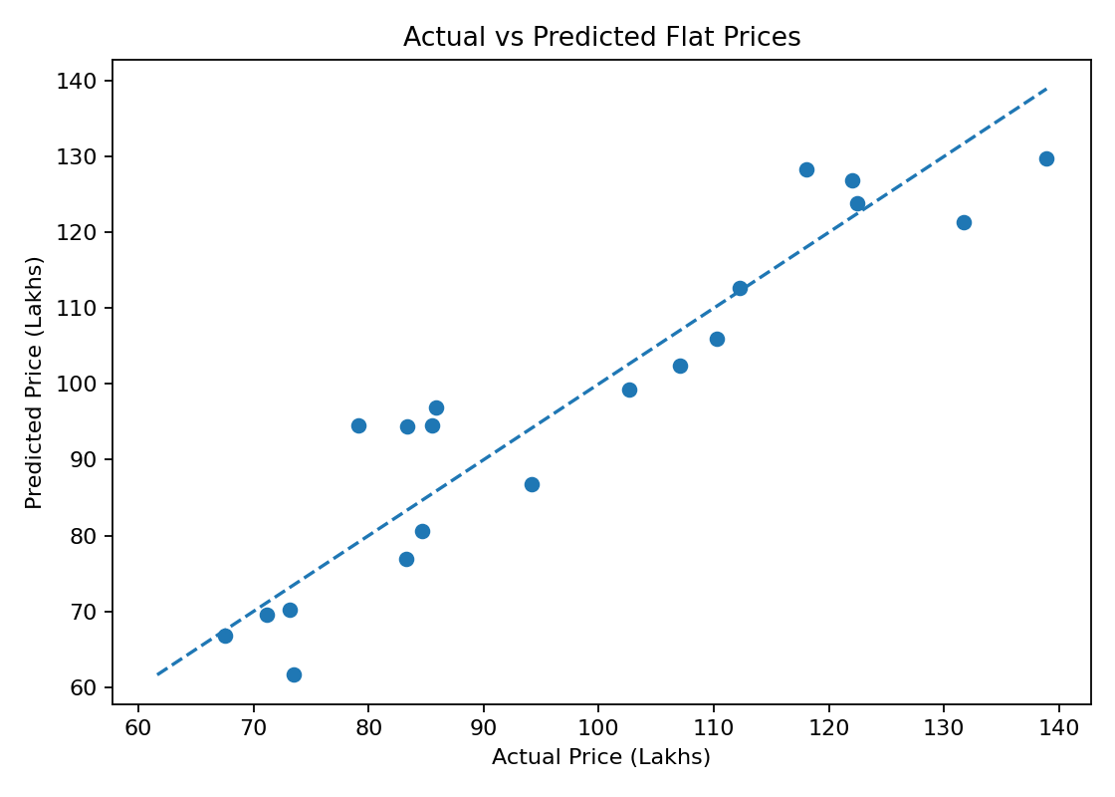
Actual vs Predicted Prices

Slide 9
Website
Responsive Flask web interface
Inputs: area, facing, floor, parking and bedrooms
Output: estimated price in lakhs

Slide 10
System Architecture
User → HTML/CSS → Flask Backend → Trained ML Model → Prediction → User

Slide 11
Advantages & Future Scope
Fast and simple estimation
Future: larger real dataset, location, amenities, property age and market trends

Slide 12
Conclusion
End-to-end AI/ML project
Combines data, model, evaluation and web deployment
Current dataset is for academic demonstration

Slide 13
Thank You
Questions?

