Slide 1
Implementing cpu with VHDL
tsc8: tiny soft core 8
Stefanos Kornilios Mitsis Piitidis
(aka drk||Raziel)

Slide 2
Soft core
Soft core cpus are the cpus that are implemented with VHDL/Verilog on programmable hardware
  Easy to add/modify
  … cost many LEs on FPGAs
    Many modern fpgas have a dedicated processor
  Perfect for cpu prototyping

Slide 3
About CPUs
A CPU has internal registers to temporary store operands and results from operations
  ex: ax, bx, etc
It reads opcodes from memory, decodes and executes operations between registers
  ex: add, sub, shift, etc
Special opcodes are used to read and write to memory
  Some designs allow instructions to directly use operands from memory, like 80x86

Slide 4
Project targets
At least 25.175 mhz operating clock so that a vga monitor can be driven with a single clock domain
The core must have at least an 8 bit wide data bus so that fairly complex programs are possible
  The classic game “brix” was implemented do demonstrate the core’s features and test the implementation
The core must fit on a FLEX 10K chip since that’s what’s used on the VHDL lab
Development of a software emulator/assembler for PC to ease development and facilitate debugging

Slide 5
Implementation summary
A simple architecture was designed
  3 Stage pipeline
  6 internal states
    sFetch, sFetch2, sExec, sVWAIT/0, sDRAW
256 byte Rom via lpm_rom
  THERE IS NO RAM !
64x32 1bit (black/white) vga driver
  VGA out with 8:1 zoom
2 push button inputs
The core and VGA controller are two different entities, connected using the schematic editor
For development QUARTUS II 9.1sp1 was used

Slide 6
Architecture
16 registers, r0 to r15
  r0 is the accumulator
  r6(rx), r7(ry): are the draw coordinates
pc register
  … Program Counter, points to the opcode to execute next
8bit rom, only for code. It’s not possible to read it with opcodes

Slide 7
Core opcodes
Data move
  Lir0
    r0=7 bit data
  mfr0 rs
    rs = r0
    The only command that writes to register rs
  mtr0 rs
    r0 = rs
ALU
  add rs
    r0 = r0 + rs
  neg rs
    r0 = -rs (2’s complement)

Slide 8
Core opcodes (2)
Branch
  jz rs
    if rs==0 pc=r0
  jgtz rs
    if rs>0 pc=r0 (2’s complement)
  Jr0
    pc = r0
i/o
  Vsync
    Wait for vsync
  draw rc
    Sets pixel (rx,ry) to the value of register rc
  getkey rd,key#
    Reads from pushbuttons (key0/key1)

Slide 9
Execution States
sFetch: Wait for ROM (starts rom read)
sFetch_2: Read from rom ROM, opcode decode & input mux
Exec: Opcode execution mux
3 cycles/opcode

Slide 10
Execution states (2)
sVWAIT: wait for vblank
  Entered via the vsync opcode
  Internally uses sVWAIT_0
  Effectively waits for the next frame
sDRAW: Draws a pixel on the screens
  Has to coordinate with the vga controller to do the operation

Slide 11
Decoding/Executing opcodes
Uses case ... is .. when … end case constuct
..
case idec(6 downto 4) is
when (op_mfr0) =>
reg(conv_integer(unsigned(idec(3 downto 0)))) <= reg(0);
when (op_mtr0) =>
reg(0) <= rp;
when (op_add) =>
reg(0) <= reg(0) + rp;
when (op_neg) =>
reg(0) <= unsigned(NOT std_logic_vector(rp)) + "1";
when (op_jz) =>
if (unsigned(rp)=0) then
pc<=std_logic_vector(reg(0));
end if;
….
end case

Slide 12
VGA Controller
Has 2 rams, 2048 bits each
  One for the ‘ramdac’
  One to write the next frame
    Copied for presentation during VBLANK
    If the core tries to write during the copy it stalls til the copy is finished
Magnifies the image 8:1 64x32 -> 512x256
Just barely fits on the FPGA due to the large ram requirements

Slide 13
Results
Maximum operating frequency: 32 mhz
  >8 MIPS usable processing power @ 25.175 mhz
~ 150 lines for the core
~ 240 for the vga controller

Slide 14
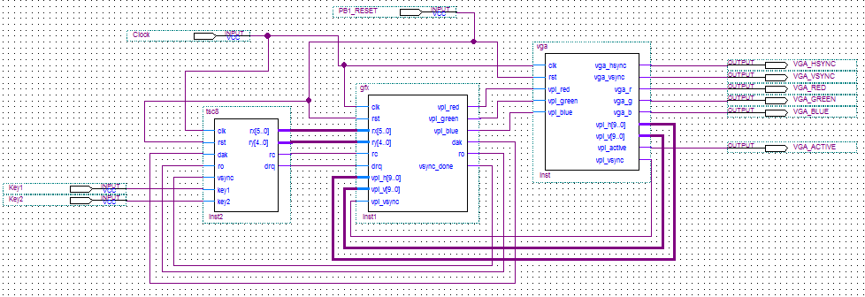

Slide 15
Software Emulator/Assembler
Required to develop programs
Assembler
  Converts from symbolic language to the binary opcodes that the core executes
    Supports composite instructions that are decomposed into many simpler ones
  Generates a .mif (memory initialization file) file for VHDL rom initialization
Emulator
  Functional level emulation of the core and vga controller so that software changes can be tested without requiring an FPGA reprogram

Slide 16
Assembler
10 opcodes
  mov rd,rs/imm { mtr0, mfr0 }
  add rd,rs/imm { mfr0, add }
  sub rd,rs/imm { mfr0, neg, add }
  neg rd,rs { mfr0, neg }
  jz rt,rs/label { mtr0, jz }
  jgtz rt,rs/label { mtr0, jgtz }
  jmp rs/label { mtr0, jr0 }
  vsync { vsync }
  draw rx,ry,rc { draw }
  getkey rd,key# { mfr0, getkey }

Slide 17
Assembler (2)
Comments begin with (;)
  ex:
    ;this is a comment
Supports labels
  ex:
    loop_solid:
    draw rx,ry,1
    add rx,1
    sub r2,1
    jgtz r2,loop_solid
Supports symbolic values with equ
  ex:
    _brick_count_ equ 55
    mov r9,_brick_count_ ;brick count

Slide 18
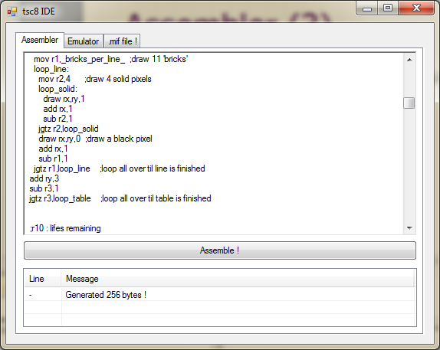
Assembler (3)

Slide 19
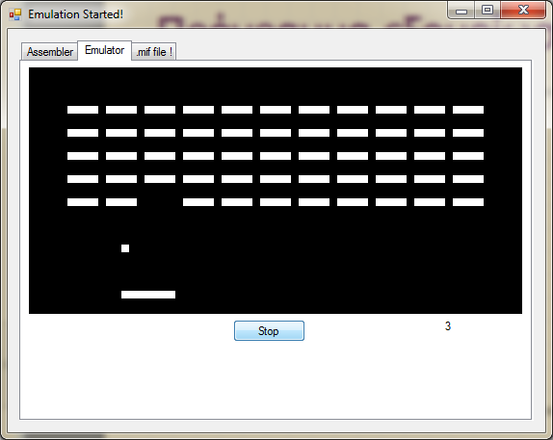
Emulator

Slide 20
That’s it
Questions ?

