Slide 1
Android Security
Techkriti-2019

Slide 2
Outline
Motivation
Android Application
Android Security Architecture
Android Vulnerability
Advanced Threat
Malware Analysis
Hands On

Slide 3
Motivation
Why Mobile Security?
Why Android?
Android Ecosystem

Slide 4
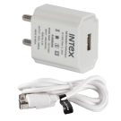







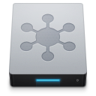



Why Mobile Security?
Technology improvements
User activity
Always on
Valuable data
Multiple Attack Surfaces
Public Place Chargers
WiFi
Mobile apps
Develop, test and deliver safe applications
Web sites
Internet
Secure endpoint device and data
Telecom Provider
Security Gateway
Corporate Intranet & Systems
Achieve Visibility and Enable Adaptive Security
Secure access to enterprise applications and data

Slide 5
Motivation
Why Mobile Security?
Why Android?
Android Ecosystem

Slide 6
1. Almost completely open source
Source: https://giphy.com/gifs/southparkgifs-3o6ZtqprcPDOkDru5W

Slide 7
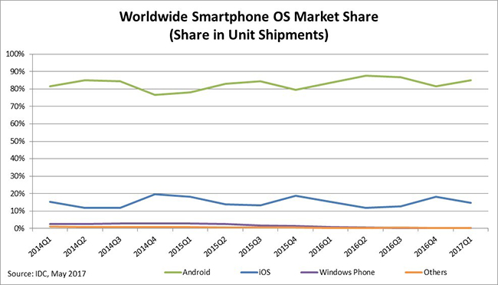
2. The Market Global Smartphone Market Trends
Period | Android | iOS | Windows | Others
Q1 2016 | 83.4% | 15.4% | 0.8% | 0.4%
Q2 2016 | 87.6% | 11.7% | 0.4% | 0.3%
Q3 2016 | 86.6% | 12.5% | 0.3% | 0.4%
Q4 2016 | 81.4% | 18.2% | 0.2% | 0.2%
Q1 2017 | 85% | 14.7% | 0.1% | 0.1%
Source: International Data Corporation (IDC), May 2017

Slide 8
Motivation
Why Mobile Security?
Why Android?
Android Ecosystem

Slide 9









Actors in the Android Ecosystem
Use Tools
Tool chain
(Coredova, App generator, …)
App Developer
Publish app
Publish app
Google Play
Sideloading
Alternate markets
Configure
Third Party app
Online services
Ad Libs
Administrators
Application Framework
Native libs
(C / C++)
Android Runtime
(Dalvik / ART)
Advertisement networks
Linux Kernel (modified)
Platform vendors

Slide 10
Where to improve security & privacy protection?
Tool Chain Provider
Uses tool chains
App developer
Useable Security
3rd party libraries
Includes libraries
Publish App
Application Vetting
Markets
Install
Inline reference monitors
Web Services
Use via internet
Installed Apps
Ad & Analytics Network
Android API
Middleware
Retrofit Android’s Security
Linux API
Linux Kernel
Android Platform

Slide 11
Security Impact of an Actor over others¹
Actor | OS Developer | H/W Vendor | Library Provider | S/W Developer | Toolchain Provider | S/W Publisher | S/W Market | End User
OS Developer | -- | Partial | Full | Full | Partial | Full | Full | Full
H/W Vendor | None | -- | Full | Full | None | None | None | Full
Library Provider | None | None | -- | Full | None | None | None | Full
S/W Developer | None | None | Partial | -- | None | None | None | Full
Toolchain Provider | None | None | None | Full | -- | None | None | Partial
S/W Publisher | None | None | Partial | Partial | None | -- | Partial | Full
S/W Market | None | None | Partial | Partial | None | None | -- | Full
End User | None | None | None | None | None | None | None | --

Slide 12
Motivation: Summary
Feature-rich smartphones and appification have induced security research on various new aspects
Android’s market share has made Android the #1 target for malware authors and makes improved security & privacy mechanisms imperative
Various actors in the ecosystem with (strong) influence on security and privacy

Slide 13
Android Applications

Slide 14
Android Software Stack
Default apps
Third party apps
Contacts
SMS
paytm
linkedin
Application Framework
Native libs
(C / C++)
Android Runtime
(Dalvik / ART)
Linux Kernel (modified)

Slide 15

Application Packages (APK)
APK is simply a packaging format like JAR, ZIP and TAR
Component of Application
Activity
Content Provider
Services
Broadcast Receiver
Native Code (C/C++ shared libraries)
Resources
META-INF
Application Manifest
Classes.dex
Native Libs
Resources
META-INF
Application Manifest

Slide 16
Android Security Architecture
Package Integrity
Sandboxing
Permission and Least Privilege

Slide 17

Package Integrity: Package Manifest
Created with jarsigner
META-INF
Manifest.mf
Cert.sf
Cert.{RSA,DSA}
File
Manifest.mf
Cert.sf
Manifest-Version: 1.0
Built-By: Generated-by-ADT
Created-By: Android Gradle 3.0.1
Name: res/mipmap-hdpi-v4/ic_launcher.png
SHA1-Digest: 2zkIQdtvlXqEHSTVOVuwBQ18aIs=
Signature-Version: 1.0
Created-By: 1.0 (Android)
SHA1-Digest-Manifest: h9xNllN3bQiTJ8RQyPUWBojRKD8=
X-Android-APK-Signed: 2
Name: res/mipmap-hdpi-v4/ic_launcher.png
SHA1-Digest: L8RpX5x8pChJbucqml+hMt9D9CQ=
hash
hash
ic_launcher.png
Certificate
Cert.sf signature
CERT.{RSA,DSA}

Slide 18
Verifying of package manifest
Chain of trust:
PKI
Package certificate in Cert.{RSA,DSA}
Manifest.mf
Cert.sf
Files

Slide 19
Android Security Architecture
Package Integrity
Sandboxing
Permission and Least Privilege

Slide 20

Sandboxing
The application sandbox specifies which system resources the application is allowed to access
An attacker can only perform actions defined in the sandbox

Slide 21



Application Isolation by Sandboxing
Each Application is isolated in its own environment
Applications can access only its own resources
Access to sensitive resources depends on the application’s rights
Sandboxing is enforced by Linux
No rights to “internet”

Slide 22

Application sandbox
Isolation: Each installed App has a separate user ID
Each App lives in its own sandbox
UID A
App Code
(Classes.dex)
JNI
Process boundary
Process boundary
Core libraries
Native Code
(*.so)
UID A
UID B
UID C
App Code
(Classes.dex)
App Code
(Classes.dex)
App Code
(Classes.dex)
JNI
JNI
JNI
Core libraries
Native Code
(*.so)
Core libraries
Native Code
(*.so)
Core libraries
Native Code
(*.so)
syscalls
Kernel
Kernel

Slide 23
Android Security Architecture
Package Integrity
Sandboxing
Permission and Least Privilege

Slide 24
Android Permission System
Access rights in Android’s application framework
Permissions are required to gain access to
System interfaces (Internet, send SMS, etc.)
System resources (logs, battery, etc.)
Sensitive data (SMS, contacts, etc.)
Currently more than 140 default permissions defined in Android
Permissions are assigned to sandbox
Application developers can also define their own permissions

Slide 25

Android Permission: Example
App B
(has permission P)
Service
(Permission P)
App A
App C
(has not permission P)

Slide 26
Permissions’ Protection Level
Normal
Dangerous
Signature
SignatureOrSystem

Slide 27
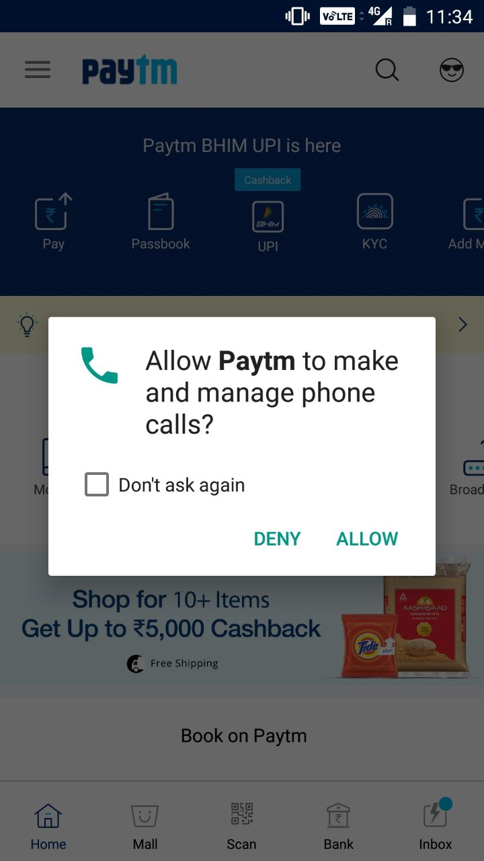
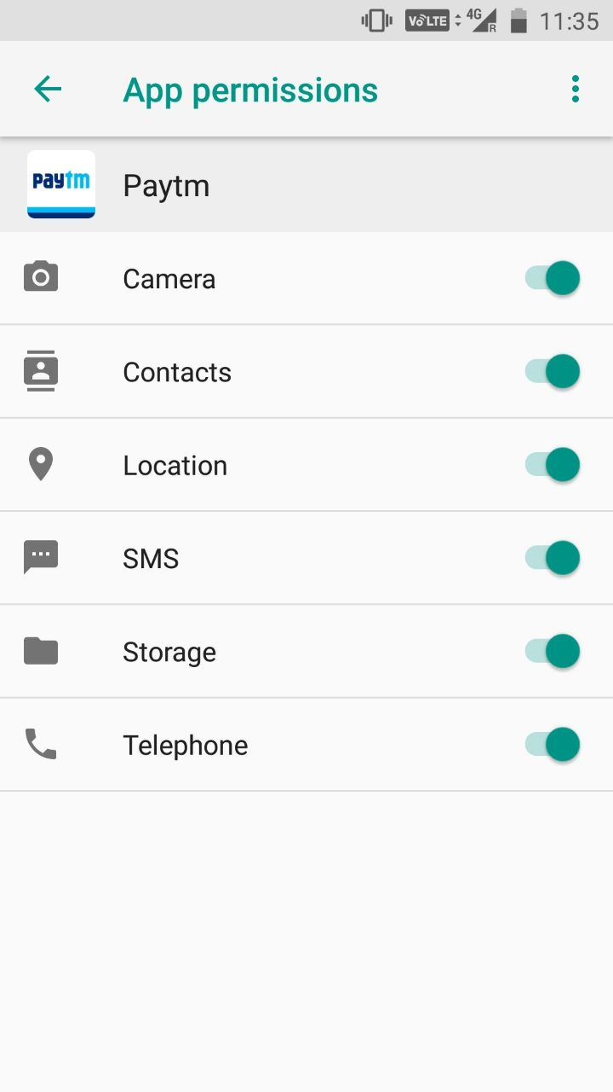

Dynamic Permissions (≥ Android 6.0)
App developers must check if their apps hold required dangerous permission, otherwise request them at runtime
User can grant permissions at runtime and also revoke once granted permissions again
Is the requested permission reasonable?
Should I adjust some permissions?

Slide 28
Android Vulnerabilities
Architecture Based
Software Based
Hardware Based

Slide 29
Vulnerability Classification
Android Vulnerability
Architecture
Software
Hardware
Operating System
Original Equipment Manufacturer (OEM)
Third Party App

Slide 30
Android Vulnerability
Architecture Based
Software Based
Hardware Based

Slide 31


Application-Level Privilege Escalation Attack
+
=
Confused
Deputy
Attack
Malicious App
Confused Deputy App
+
=
Collusion
Attack
Malicious App
Malicious App

Slide 32




Collusion Attack
A)
Malicious App A
(internet)
Malicious App B
(contacts)
Protected Resources
B. 1)
B. 2)
Malicious apps collude in order to merge their respective permissions¹
Android OS
Variants:
Apps communicate directly
Apps communicate via covert² channels in Android

Slide 33
Android Vulnerability
Architecture Based
Software Based
Hardware Based

Slide 34

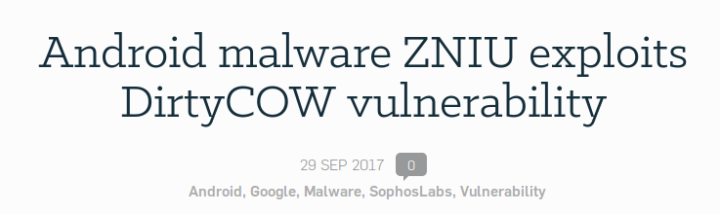
Dirty COW
Existed in the Linux Kernel for 9 years
A local Privilege Escalation Vulnerability
Exploits a race condition in the implementation of the
copy-on-write mechanism
Turns a read-only mapping of a file into a writable mapping
Source: https://nakedsecurity.sophos.com/2017/09/29/android-malware-zniu-exploits-dirtycow-vulnerability/

Slide 35
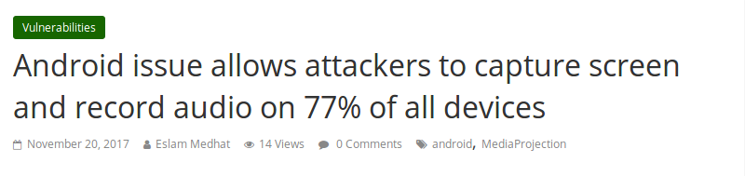
Media Projection Service Issue
Source: https://latesthackingnews.com/2017/11/20/android-issue-allows-attackers-to-capture-screen-and-record-audio-on-77-of-all-devices/

Slide 36


Dynamic Permission¹
Is the context of the permission request better recognizable?
Invisible Permissions: 75.1%
Screen off (60%)
Invisible service (14.4%)
Background app (0.7 %)
Non-indicative indicators: Location icon is visible for only 0.04% of all accesses to location
Around 8 requests/min
Location: 10,960 / day
Reading SMS: 611 / day
Browser history: 19 / day

Slide 37
Over-privileged Apps¹
Many apps request permissions that their functionality does not require
Suspected root cause: API documentation/naming convention
Solution: API Permissions Maps
Can be integrated into lint tools
API₁
Perm₁
API₂
Perm₂
API₃
Perm₃

Slide 38


Confused Deputy Attack
Unprivileged App
Privileged App
Protected Resources
A privileged app is fooled into misusing its privileges on behalf of another (malicious) unprivileged app¹
Example:
Unauthorized phone calls²
Various confused deputies in system apps³

Slide 39









Confused Deputy Introduce by OEMs¹
Several confused deputies found in Samsung devices’ firmware
One deputy running with system privileges provided root shell service to any app
Access to mail account
SMS & MMS
Camera
Internet
Backdoor
Microphone
Contacts
GPS Location
Access to SD card

Slide 40
Android Vulnerability
Architecture Based
Software Based
Hardware Based

Slide 41
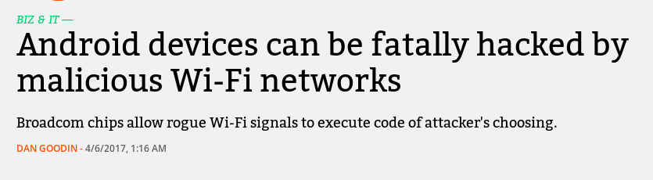
Broadcom Wi-Fi SoC Flaw
Source: https://arstechnica.com/information-technology/2017/04/wide-range-of-android-phones-vulnerable-to-device-hijacks-over-wi-fi/

Slide 42
Advanced Threat

Slide 43
Risk of 3rd Party Libraries
Have to be included in every app package that wants to use the lib
Average 13 libs per app in top 3000 apps on Play¹
Library code, executed within the application process (same UID), inherits the host app’s privileges
no security boundary!
UID A
App Code
+ Library code
JNI
Core libraries
Native Code
syscalls
Kernel

Slide 44
Risk of 3rd Party Libraries^{1,2}
Increase the host app’s attack surface
Compromise the device or violate the user’s privacy
De-anonymization risks through quasi-identifiers
Has access to host app’s local files and external files
Can collect clear picture about the user
Gender, age, browsing history, user trajectories, etc.

Slide 45
Malware Analysis
Analysis Techniques and its Limitations

Slide 46
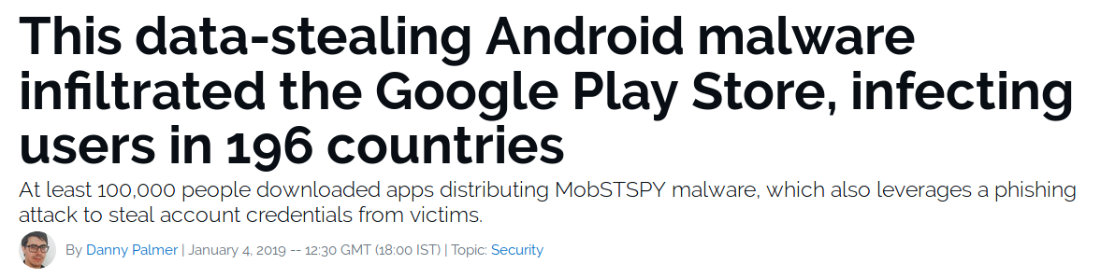
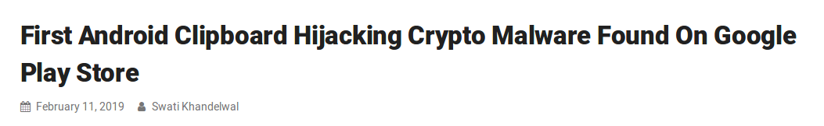
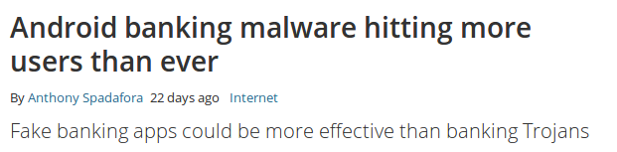
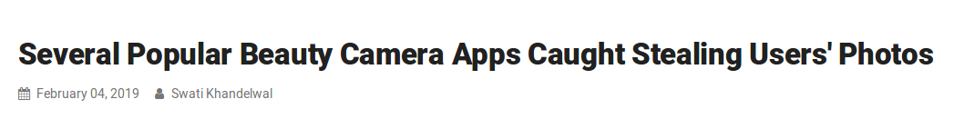
Why Malware Analysis?
Source: https://www.zdnet.com/article/this-data-stealing-android-malware-infiltrated-the-google-play-store-infecting-users-in-196-countries/
Source: https://thehackernews.com/2019/02/android-clickboard-hijacking.html
Source: https://www.techradar.com/news/android-banking-malware-hitting-more-users-than-ever
Source: https://thehackernews.com/2019/02/beauty-camera-android-apps.html

Slide 47
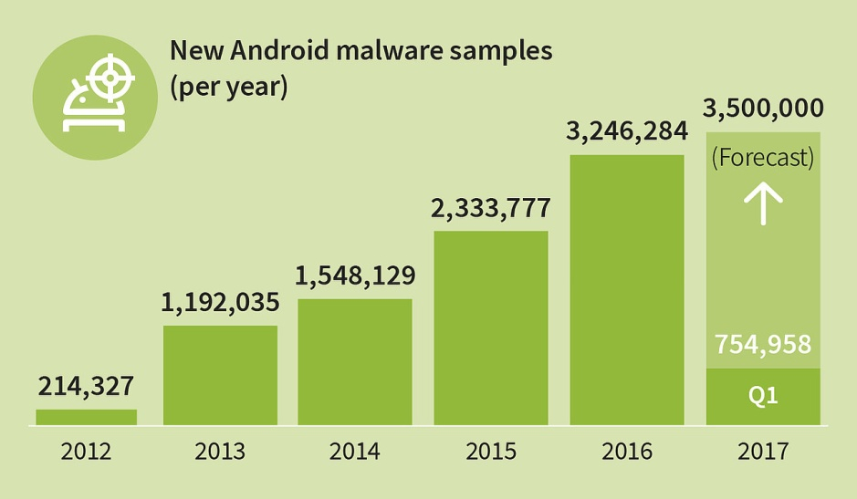
Malware Statistics
Source: https://www.gdatasoftware.com/blog/2017/04/29712-8-400-new-android-malware-samples-every-day

Slide 48
Malware Analysis Techniques
Analysis Technique
Static
Hybrid
Dynamic

Slide 49
Analysis Techniques used in Different Area¹

Slide 50

https://github.com/skmtr1/techkriti-2019-CS-workshop-Android/

Slide 51

Questions..

Slide 52
Thank
You

