Slide 1
Managing working Capital - Cash@Risk
Deloitte

Slide 2
Cash is back as King
When times are rough firm must do everything they can to free up cash.
In a tight recessionary economy tight cash management has special importance.

Slide 3
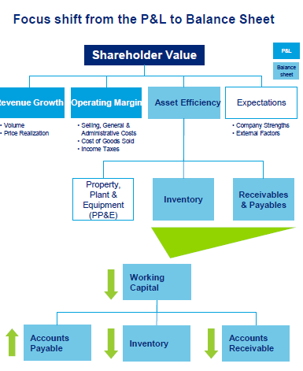

Slide 4
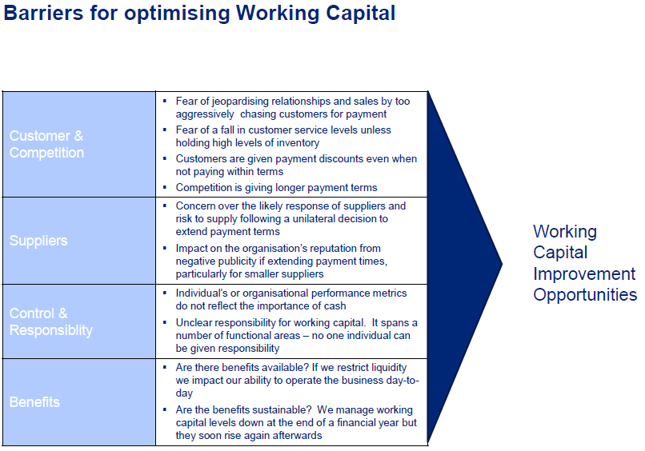

Slide 5
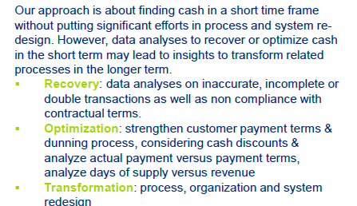

Slide 6
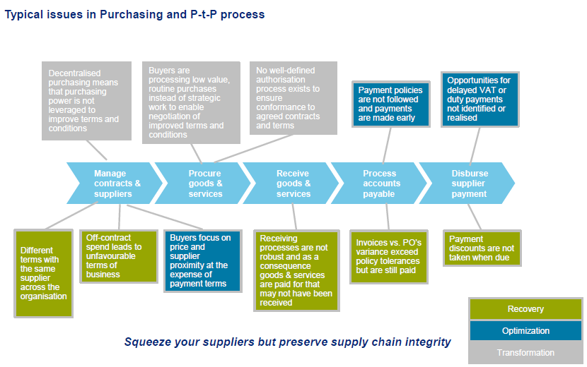

Slide 7
Accounts Payable: Optimization
Increase the accounts payable by analyzing the A/P per supplier compared to its agreed payments terms:
The following actions can be taken –
Payment quality & frequency (Average Payment period)
Payment term negotiation
Evaluation of cash discounts at early payments
Standard Enforcement

Slide 8
Accounts Receivables Optimization
Opportunities to reduce A/R is identified by analyzing the A/R per customer compared to its agreed payment terms. The following actions can be taken :
Billing quality and frequency (Average Collection period)
Dunning process (Methodical Collection process)
Dispute management
Payment term negotiation
Standard Enforcement
Payment term rationalization

Slide 9
