Slide 1
Philtax Service
디자인 시안 반영
2015.03.25.
김인기

Slide 2
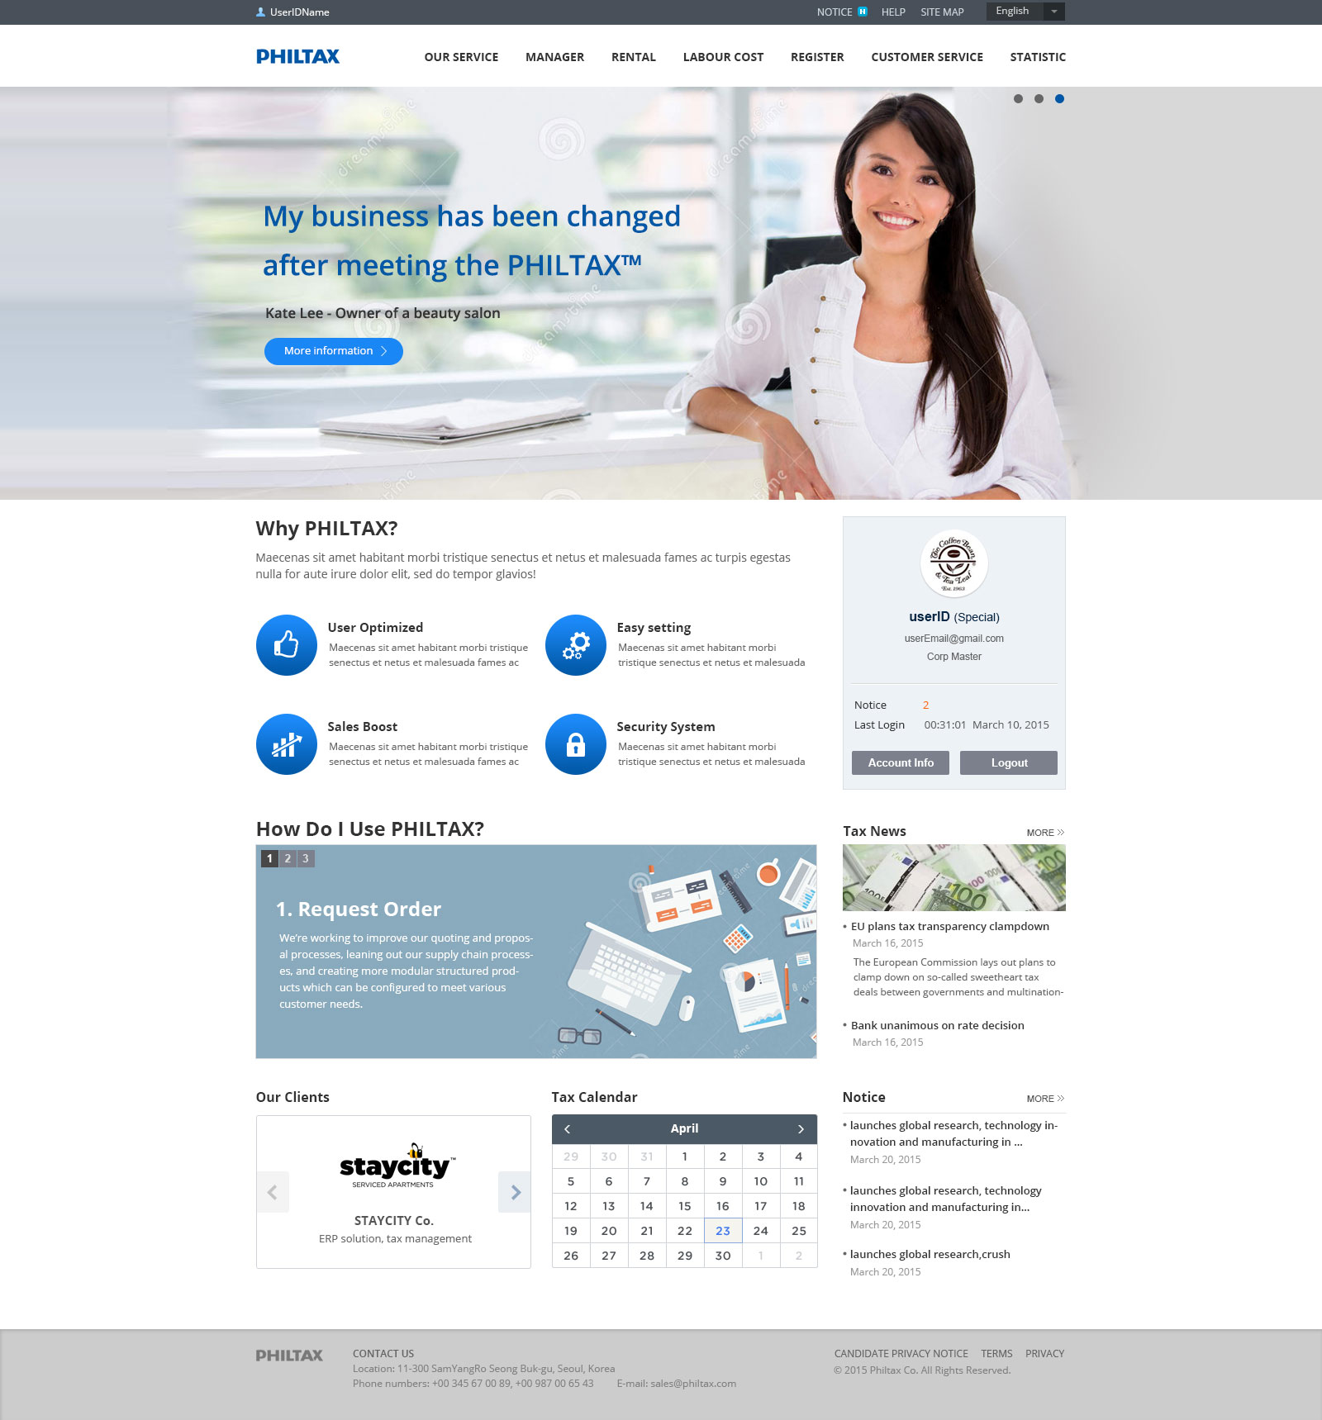
BI 시안 반영
이미지 라이센스 확인 현재 이미지 외 이미지 배경 색 변경 및 확인 필요
사용자 로고 영역은 사각 직사각형 영역으로 설정
정보 컨텐츠 내용 추가

Slide 3

사용자 ID
English ▼
ON
✓
✓
✓
알림(N) | 도움말 | 사이트 맵
1
✓
✓
PHILTAX
서비스 소개
사업자 관리 페이지
임차료
안건비
간편 장부
고객 서비스
통계
메인 이미지
메뉴 영역 ✓ 표시 영역은 로그인 시에만 정보 노출 확인 필요: 이와 관련하여서는 원대표님 번역자료 공유 부탁 드립니다.
메인 이미지 영역
필텍스 차별화 포인트 안내
로그인 정보 표시 미 로그인시에는 로그인 & 회원 가입 유도 컨텐츠 배치(미정)
2
My business has been changed after meeting the PHILTAX
More information >
3
Why PHILTAX?
PHILTAX is the perfect online tax accounting solution for small and midsized businesses.
4
i
EASY ACCOUNTING
Are you an accounting novice? Don't worry!
The program is easy to use for both beginners and experts.
Easily manage invoicing, accounts receivables
and accounts payables with integrated inventory data.
You can quickly generate financial statements
and status reports with real-time data.
More >
i
Payroll Management Software
PHILTAX provides a Payroll module to track employee compensation and to generate payroll. Earnings and deduction vary by each business’s pay structure. PHILTAX can be easily configured to fit perfectly for all businesses. All payroll is integrated with the overtime and leave management for accurate and easy payroll.
More >
User ID (Special)
i
Online Accounting Software
PHILTAX accounting and financials ERP modules help businesses manage A/R, A/P, cost accounting, profit and loss, cash flow projections, and more. While many businesses today have some sort of financial or accounting software available, they still experience problems.
More >
i
Accessibility & Security
PHILTAX is an entirely web-based program that is accessible at anytime and from anywhere!
More >
Notice: 2
New
Account Info
Logout
아래 이어서 계속!!!
아래 이어서 계속!!!

Slide 4

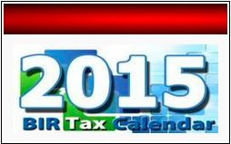

위에 이어서 계속!!!
5
How Do I Use PHILTAX?
9
1
2
3
i
Forms
1. Account FOR $00 PER MONTH
5. 필텍스 사용 안내
6. 세무사 설명 (사업 초기 1명 예상)
7. 무료 체험 & 고객 문의 안내 - 무료 체험(가입): 링크 버튼 - 고객 문의 안내 전화 링크 없음
8. 세무 뉴스 & 공지 사항
9. 빠른 매뉴 및 세무 정보 링크 메뉴 - Forms = 자료실 연동 - Tax Code (신규 링크로 대체)
- 계산기 및 도구: 임차/인건비 계산페이지 이동 또는 세무계산 페이지 링크(추후 협의)
10 TAX Calendar 필리판 BIR사이트 자료 다운로드 제공
11. 배너 광고 적용시 예상 안
서비스를 잘 나타내는 이미지 이미지
Web-based tax accounting Unlimited User IDs
Free system upgrades
Free data security and backups
Withholding e-variation
GST group - forming changing or cancelling
Company tax return 2014
Company tax return instructions 2014
More forms and instructions ►
Learn More >
6
Accountant: Mac Kotecha
More >
Thank you for visiting
Firstly, thank you for visiting our site. I hope you will have been impressed enough to call us on 0208 346 0391 and arrange a no obligation meeting for up to an hour, at our expense!
i
Tax rates and Codes
i
Calculators and tools
7
PRODUCT DEMO
Contact Us 0000-0000
10
i
i
8
PRODUCT DEMO
Contact Us 0000-0000
Tax News
Notice
More >
More >
Tax News (2015.03)
The Fourth Joint Working Group Meeting
Tax News (2015.02)
Income Tax department to closely scrutinise foreign assets held
Tax News (2015.03)
Notice of PHILTAX system checking
When you log in the event of an error
Temporary Suspension of PHILTAX service
Notice of PHILTAX system checking
Notice of PHILTAX system checking
11
Sample

Slide 5







위에 이어서 계속!!!
12
Testimonials
회사명
User Name 1 / 직책
회사명
User Name 2 / 직책
12. 사용자 리뷰 or 파트너사 현황으로 사용 예정
13. 트위터 / 페이스 북등 내부 결정에 따라 추후 진행 부분 확인 필요
I am a small business owner and needed help with personal tax issues as well. This stuff has never come easy to me, I do not like dealing with numbers or taxes let alone the IRS. Alex has been helpful since day one. He handles everything for my business and family. I count on Alex for all the legal yada yada when it comes down to business structure and playing by the rules. Alex provides a great and valuable service at reasonable rates. He makes you feel as if you are his only client which is awesome and saves us time.
As soon as signed up for free I was in Payroll Pie's system processing my office's payroll within minutes. I even completed the entire company payroll of 23 employees within minutes!
회사명
User Name 3 / 직책
회사명
User Name 4 / 직책
As soon as signed up for free I was in Payroll Pie's system processing my office's payroll within minutes. I even completed the entire company payroll of 23 employees within minutes!
My time spent on the company's payroll has just been cut in half and I can access it from anywhere I have an internet connection.
회사명
User Name 5 / 직책
회사명
User Name 6 / 직책
I refer this firm to all my friends and family. After years searching for a reputable and knowledgeable tax and accounting firm, I have found it here. They do all the usual services you would expect and then some. After a recent medical diagnosis, Zach was willing to sit with me and go over my tax implications for ongoing health care costs that were out of pocket. He also explained how the FSA/HSA would or would not benefit me and when a tax break comes into effect. They definitely go above and beyond and are trustworthy and thorough. Highly recommended..
I am a small business owner and needed help with personal tax issues as well. This stuff has never come easy to me, I do not like dealing with numbers or taxes let alone the IRS. Alex has been helpful since day one. He handles everything for my business and family. I count on Alex for all the legal yada yada when it comes down to business structure and playing by the rules. Alex provides a great and valuable service at reasonable rates. He makes you feel as if you are his only client which is awesome and saves us time.
13

