Slide 1
AWS ELB
Load balancing with ELB

Slide 2
ELB
ELB stands for Elastic Load Balancer
Distributes the traffic between EC2 instances associated with it. Detects unhealthy instances and passes traffic only to healthy ones.

Slide 3
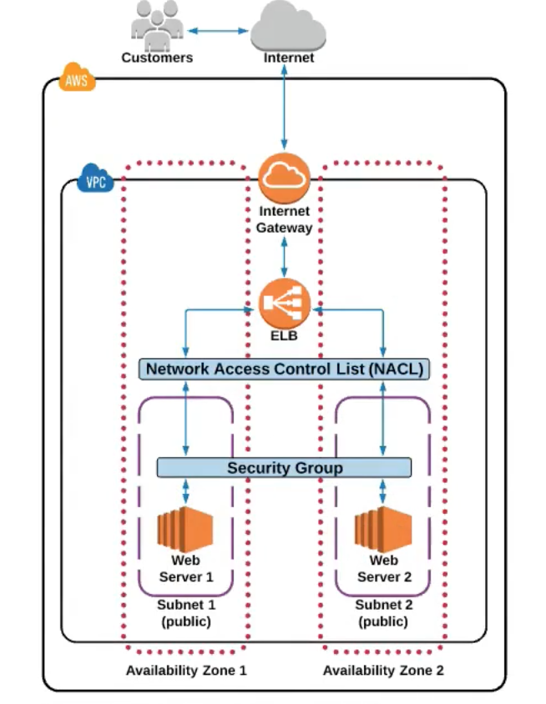
ELB
Understanding the ELB in the VPC

Slide 4
ELB features
ELB supports three types of load balancers:
Application Load Balancers
Network Load Balancers
Classic Load Balancers

Slide 5
ELB pricing
ELB usage is being charged for:
Each hour/partial hour of ELB is running
Each GB of data transferred through the LB
Prices differ depending on region

Slide 6
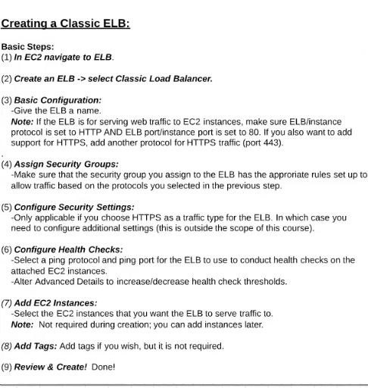
Creating a Classic ELB
(via AWS console)
EC2 – navigate to ELB
Create an ELB – select Classic Load Balancer
Basic configuration:
- give the ELB a name
Assign SG
Configure Security Settings (only if HTTPs is selected)
Configure Health Checks
Add EC2 instances
Add tags

