Slide 1
Ansible

Slide 2
What is Ansible?
Ansible is an open-source tool that can be used for environments managing, configuration, deployment, and orchestration
Runs over ssh
Agentless comparing to Chef/Puppet
Depends on python to be installed on all nodes
Ansible docs:
http://docs.ansible.com/

Slide 3
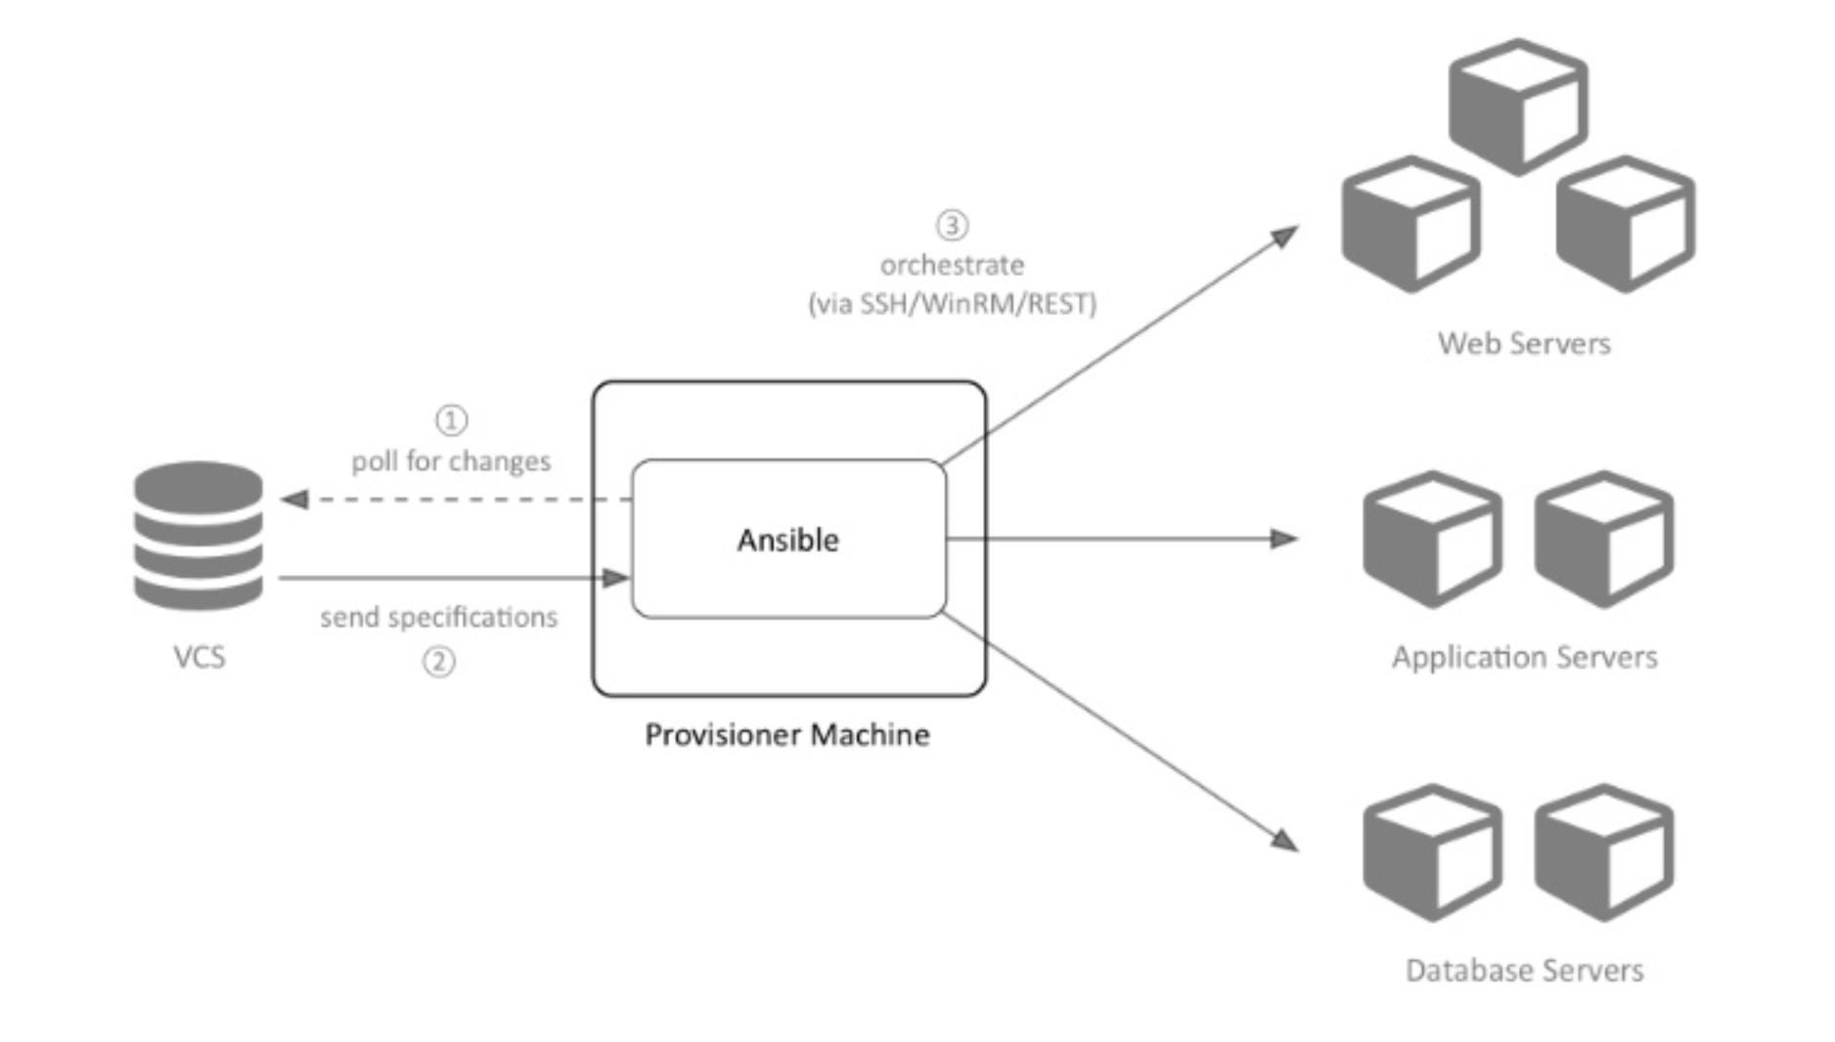
Ansible agentless architecture

Slide 4
Ansible installation
http://docs.ansible.com/ansible/latest/intro_installation.html
http://docs.ansible.com/ansible/latest/intro_getting_started.html
simple configuration:
Create inventory file
2. If needed, specify sudo user in ansible.cfg

Slide 5
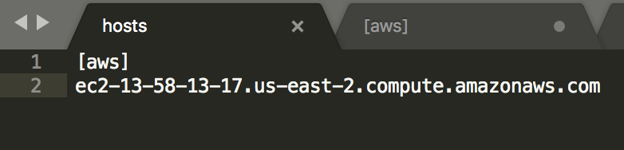
Inventories
Inventories are files specifying the environments to operate with.
Example

Slide 6
Ansible ad-hoc commands examples
Run the action on all servers in 5 parallel forks:
$ ansible aws -a "/sbin/reboot" -f 5
Run the action using privilege escalation:
$ ansible aws -a "/usr/bin/foo" -u username --become-user otheruser [--ask-become-pass]
Copy file:
$ ansible aws -m copy -a "src=/etc/hosts dest=/tmp/hosts”
Restart service:
$ ansible aws -m service -a "name=apache2 state=restarted"
etc

Slide 7
Playbooks
Are the main way of getting things done with Ansible.
Written in YAML, easy to read and maintain
Each playbook has one or multiple plays defined with tasks
Contains variables, tasks, handlers, files, templates, roles
Tasks are defined in module: options format, for example:
tasks:
- name: restart apache2 service: name=apache2 state=restarted enabled=yes
Best practice is to create reusable dynamic playbooks (includes) instead of static (imports)

Slide 8
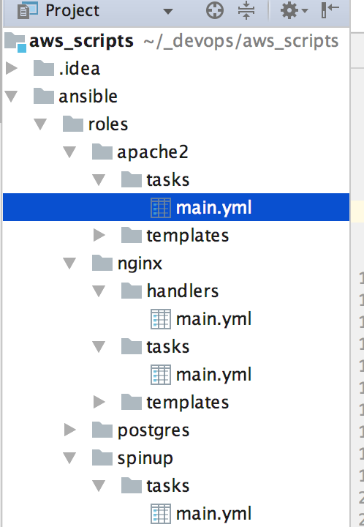
Roles
Roles are the best way of organizing playbooks with loading certain vars_files, tasks, and handlers based on a known file structure.
Roles can be shared and reused
File structure example:

Slide 9
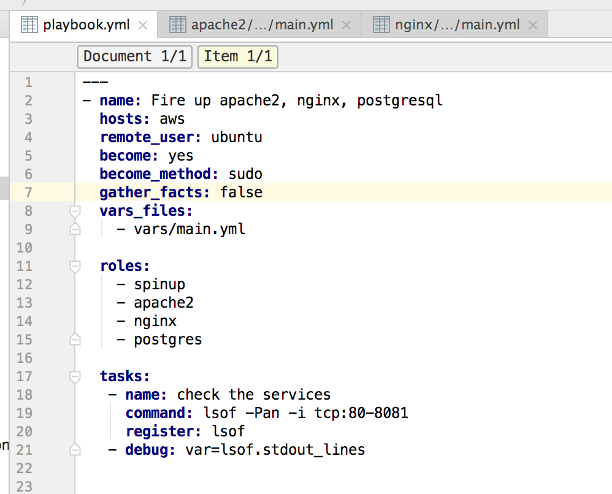
Playbook example using roles

Slide 10
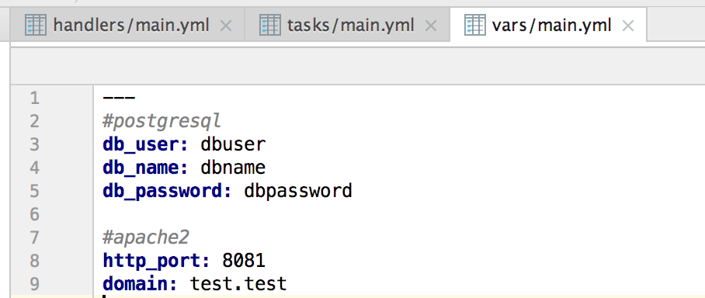
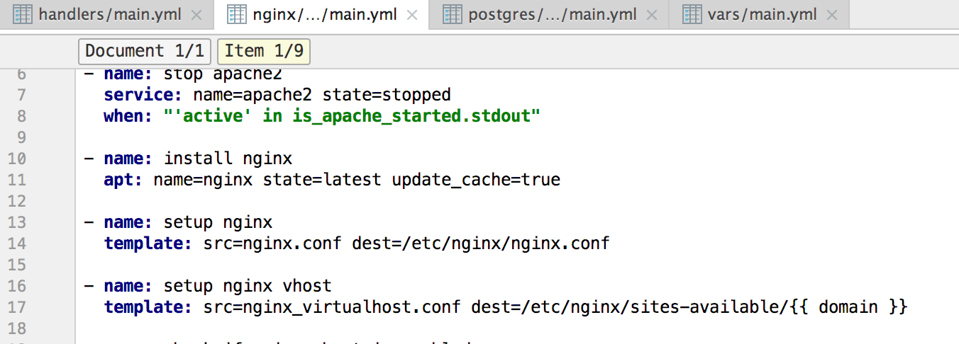
Variables
Having a set of variables defined, it is easy to use variables substitution using Jinja2
Example:
Variables file:
Variables usage:

