Slide 1
AWS VPC
Understanding the main components

Slide 2
VPC
VPC stands for Virtual Private Cloud
Is a private sub-section of AWS that you control, place resources in, add or modify security rules, etc.
In other words, a set of tools and components to build and maintain virtual network in AWS cloud.
- VPC can only belong to one region; limited to 5 per region

Slide 3
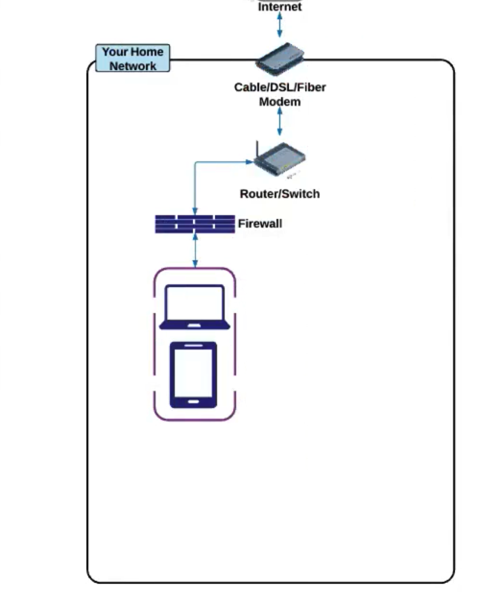
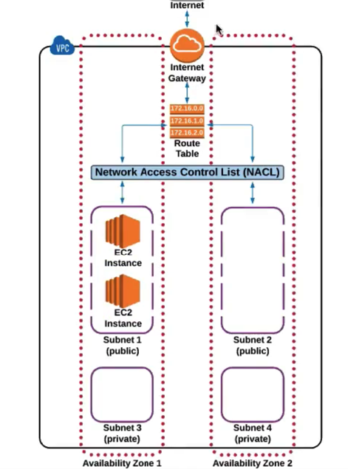
VPC
Understanding the components comparing to home network:
vs

Slide 4
IGW
IGW stands for Internet Gateways
Is a hardware/software combination which allows VPC private network having the route to the internet/ communicating between instances in VPC
Limitations
- 1 attached gateway per VPC
- Gateway cant be detached from VPC if there are any active resources like route tables/subnets etc

Slide 5
RTs
RTs stands for Route Tables
Is a set of rules = routes defining traffic routing to/from/within VPC
Notes
VPC can have multiple active RTs
RT having subnet(s) associated cant be deleted
Main RT cant be deleted, but replaced with custom instead

Slide 6
NACLs
NACL stands for Network Access Control List
Is an optional security level that acts like a firewall and allows controlling incoming/outcoming traffic within VPCs subnets – only on subnet level
Notes
Rules are applied based on rule number, highest is priority
The first rule found is applied immediately, regardless of the next rule
Default NACL allows all traffic to default subnets. Any new created will deny all traffic by default
Subnet can be tied to one NACL at the time

Slide 7
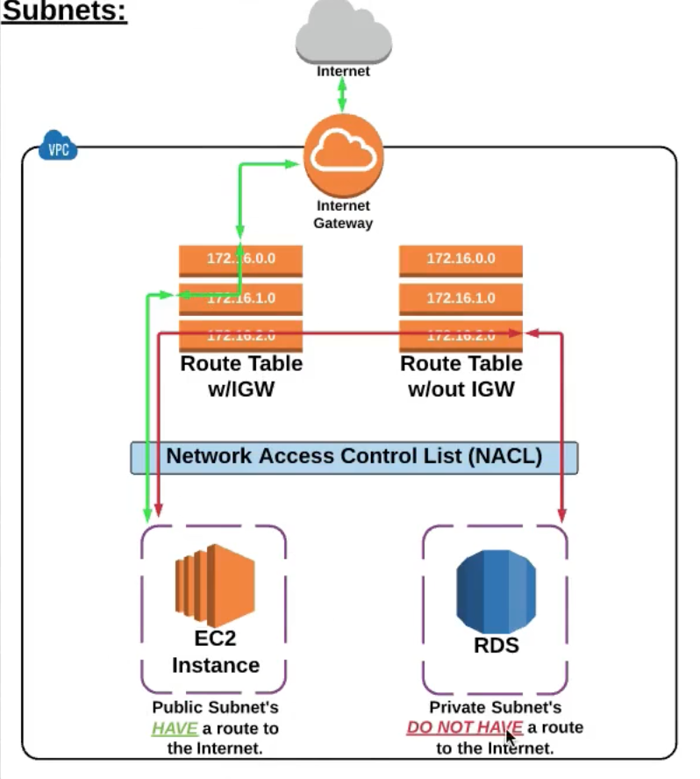
Subnets
Subnet is a subsection of VPC network
When VPC is created, it spans all Availability Zones in the region, meaning one subnet will be created per each zone.
Notes
Subnets must be associated with RT. If subnet is not explicitly associated with a particular route table, the subnet is implicitly associated with the main route table.
Each subnet is located in one specific AZ

Slide 8
Availability Zones
Availability Zones and VPCs:
Any AWS resource shall be placed in a VPC subnet. Any given subnet is located in Availability Zone.
AZ is a distinct location of hardware resources, isolated from other AZ to prevent failures etc.

