Slide 1
Monitoring tools overview

Slide 2
Why in need of monitoring tools?
Find when a service is not available
Understand the reasons of failure
Learn to prevent failures in the future
Find performance issues
Collect the data – logs/ metrics /etc
Get the visual representation of the data/issues/etc
Analyze and forecast infrastructure costs
And so on

Slide 3
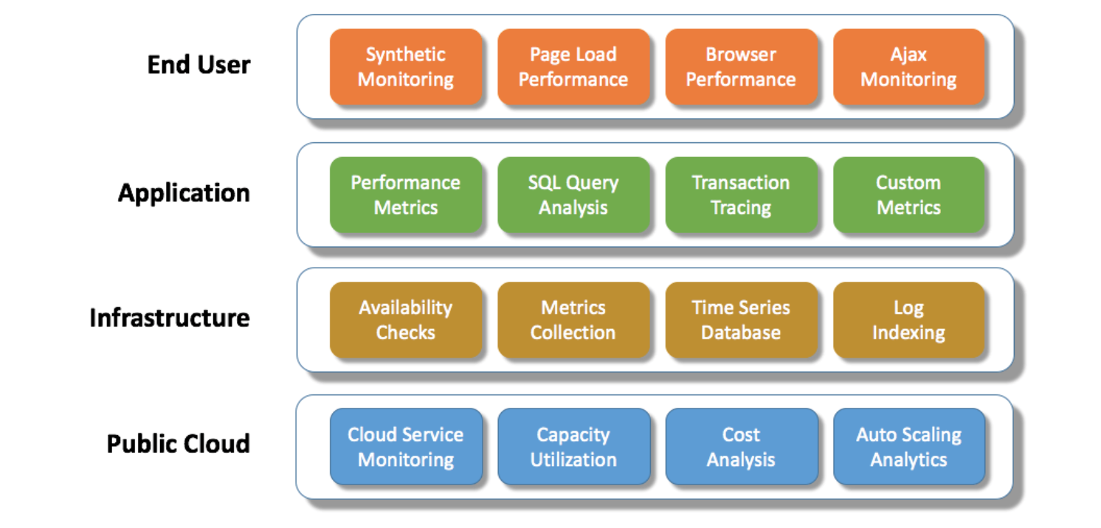
What can be monitored?

Slide 4

Icinga
One of the most widely developed and supported tools
https://www.icinga.com/
Fork of Nagios
User friendly
Open-source
Huge community and documentation
Lots of modules and extensions
Lightweight web interface

Slide 5

Graphite
https://graphiteapp.org/
Accepts any metrics
Stores data in files
Renders on-demand graphs based on the data
Integrates with other tools easily
Tons of UI dashboards: http://graphite.readthedocs.io/en/latest/tools.html#visualization

Slide 6

Nagios
https://www.nagios.org/
Most popular monitoring tool
Monitors everything
Rather complex in configuration, but extremely flexible

Slide 7

Zabbix
https://www.zabbix.com/
Open source
Performance monitoring
Agents for all platforms
Agent-less monitoring
Collection of any data
Graphs and network maps

Slide 8
How the data flow could look like
Apache delivers logs to rsyslog
Rsyslog delivers logs to logstash
Logstash delivers metrics to statsd
Statsd delivers metrics to Graphite
Icinga queries metrics from Graphite

