Slide 1
AWS Route 53

Slide 2
Route 53
Route 53 is where you configure and manage web domains.
Performs three main functions:
Domain registration
DNS service
Health checking
Any combination of these services can be used.

Slide 3
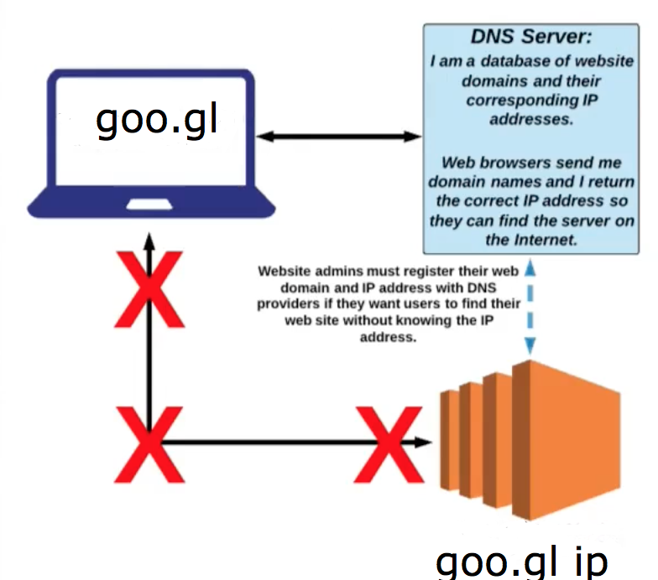
Route 53 as DNS
goo.gl ip address

Slide 4
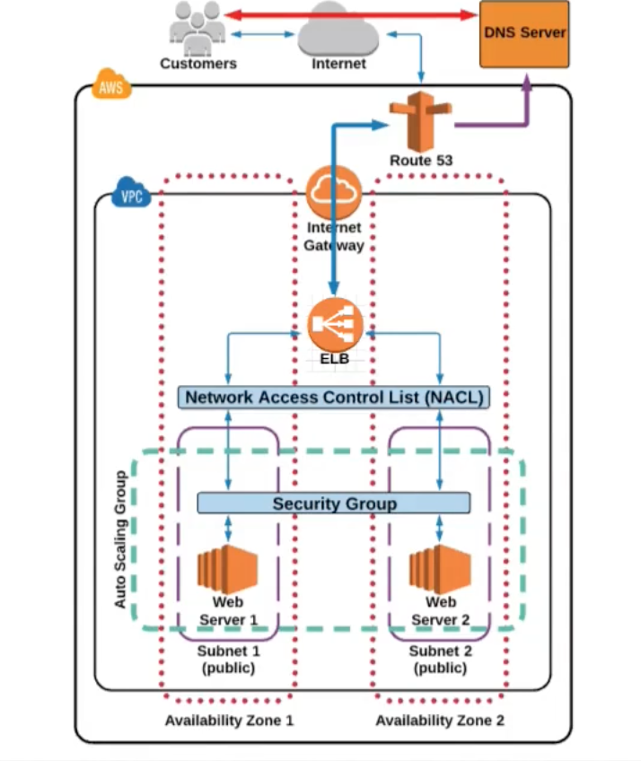
Route 53 in terms of infrastructure

Slide 5
Route 53 domain registration
When you register a domain with Amazon Route 53:
The domain is registered
Hosted zone is created. It has the same name as the domain
A set of four name servers is assigned to the hosted zone
Name servers from the hosted zone are added to the domain.
Domain related data is sent to the registrar.

