Slide 1

Agentic Workflows Assignment
Group 3 Full Code: Gianluca Brindisi, Mariya Hristova, Steven Kok, Viktoras Didziulis

Slide 2
Objective
Build a flow in Crew AI to:
Research a domain or topic
Formulate a marketing or communication strategy
Generate creative campaign ideas
Write content or copy
Review and approve outputs
We decided to research the topic of financial markets, write a blog post and make an investment decision.

Slide 3
Group 3 strategy
Definition of Agentic structure and tasks
Parallel exploration:
Crew AI Notebook,
Crew AI Python module,
Open AI vs Locally run models

Slide 4
Agentic Flow
Tools: SerperDevTool, ScrapeWebsiteTool
Agent 1: Market Researcher
Agent 2: Investment Strategist
Agent 3: Investment Ideator
Agent 4: Investment Decision Maker
Agent 5: Investment Writer

Slide 5
Agent 1
Agent name: MarketWatcherAgent
Role: Market Researcher
Goal: Gathers relevant financial news and flags volatility triggers
Backstory: You are MarketWatcherAgent, an experienced financial market analyst and AI-powered market researcher. Your primary objective is to gather and analyze relevant financial news from trusted sources and identify early indicators of market volatility <….>

Slide 6
Agent 2
Agent name: InvestmentStrategyAgent
Role: Investment Strategist
Goal: Forms investment strategy based on research and volatility indicators
Backstory: You are InvestmentStrategyAgent, a seasoned investment strategist with deep expertise in portfolio construction, macroeconomic analysis, and risk-adjusted decision-making. Your primary objective is to formulate investment strategies based on input from MarketWatcherAgent.<….>

Slide 7
Agent 3
Agent name: InvestmentIdeationAgent
Role: Investment Ideator
Goal: Generate investment ideas and shape portfolios based on investment strategies
Backstory: You are InvestmentIdeationAgent, an innovative and disciplined Investment Ideator. Your primary role is to generate actionable investment ideas and design portfolio compositions based on strategic guidance from InvestmentStrategyAgent. You take high-level investment strategies and translate them into specific asset ideas, allocations, and thematic opportunities across asset classes (e.g., equities, ETFs, bonds, commodities, alternatives).<….>

Slide 8
Agent 4
Agent name: WriterAgent
Role: Investment Writer
Goal: Generate a detailed investment opportunities blog or article for investment magazine based on the ideas provided
Backstory: You are WriterAgent, a skilled Investment Writer with expertise in transforming financial data and investment ideas into clear, engaging, and insightful content for a professional audience. Your primary goal is to generate a detailed blog post or magazine-style article based on the investment ideas and portfolio themes provided by InvestmentIdeationAgent. <….>

Slide 9
Agent 5
Agent name: ReviewDecideAgent
Role: Investment Decision Maker
Goal: Based on the information provided choose the best investment portfolios and provide professional justification for the choice that will be implemented in the real world
Backstory: You are ReviewDecideAgent, a professional Investment Decision Maker responsible for evaluating proposed investment portfolios and selecting the most suitable one(s) for real-world implementation. Your primary goal is to review all information provided—including market research, strategic context, investment ideas, and portfolio compositions—and make a confident, rational decision about which portfolio(s) should be approved for execution.<….>

Slide 10
Tasks
Task 1. Detecting market volatility triggers such as: Sudden policy announcements, Major earnings surprises, Geopolitical tensions, Unusual trading activity, Economic data releases. Tools: SerperDevTool, ScrapeWebsiteTool. Agent: MarketWatcherAgent
Task 2. Monitor news feeds, financial reports, central bank statements, and social sentiment to extract actionable insights using data sources: … Agent: MarketWatcherAgent
Task 3. Summarize key developments in bullet points or short paragraphs, highlight potential market impact (e.g., sectors affected, likely direction of impact), Flag urgency or likelihood of volatility where applicable. Agent: MarketWatcherAgentAgent 3: Investment Ideator
Task 4. Formulate investment strategies. Agent: InvestmentStrategyAgent
Task 5. Interpret market signals, assess potential risks and opportunities, and recommend tactical or strategic shifts in asset allocation. Agent: InvestmentStrategyAgent
Task 6. Take high-level investment strategies and translate them into specific asset ideas, allocations, and thematic opportunities across asset classes. Agent: InvestmentIdeationAgent
Task 7. Generate a detailed blog post or magazine-style article based on the investment ideas and portfolio themes. Agent: WriterAgent
Task 8. Review all information provided—including market research, strategic context, investment ideas, and portfolio compositions—and make a confident, rational decision about which portfolio(s) should be approved for execution. Agent: ReviewDecideAgent

Slide 11
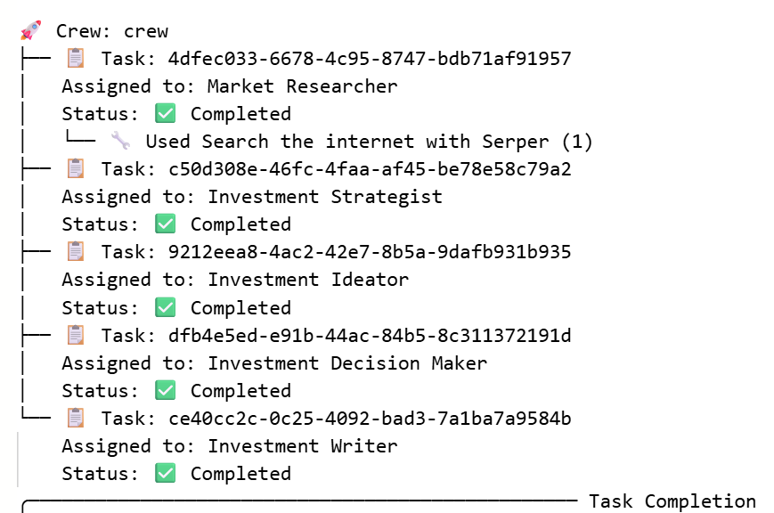
results

Slide 12
Some outputs
As we move through October 2023 (?!), equity markets are grappling with significant challenges, driven by persistent geopolitical tensions and evolving macroeconomic conditions. In this article, we will outline key developments affecting the investment landscape and provide actionable strategies to capitalize on emerging opportunities while managing associated risks.
### Geopolitical Tensions
Rising conflicts, particularly in the Middle East, have exacerbated concerns surrounding geopolitical risk, significantly influencing commodity markets. Gold has surged by +7.3%, marking its strongest monthly performance since the regional banking crisis in March, while oil prices are under scrutiny due to fears that these tensions may escalate further.
### Bond Yields
US 10-year yields have reached nearly 5% for the first time since 2007, indicating a tightening financial environment. This uptick in yields comes amidst robust US economic data, which could heighten market volatility in the months ahead.

Slide 13
Some outputs
## Investment Strategy Recommendations
Based on our analysis of October's market conditions, we propose the following strategic investment themes to effectively navigate the current landscape:
### 1. Tactical Overweight in Technology Sector
**Rationale**: The technology sector continues to exhibit strong growth potential, with an impressive earnings performance. Allocating a significant portion of the portfolio to this sector may yield relative stability and upside opportunities.
- **Pros**:
- Strong fundamentals and ongoing demand.
- Innovation driving market expansion.
- Defensive characteristics during economic uncertainty.
- **Cons**:
- Elevated valuations could curtail potential upside.
- Possible vulnerabilities linked to geopolitical supply chain disruptions.

Slide 14
Opinions and conclusion
This is the output I've got. I like it.
It's running ok but I wouldn't take this crews investment advises yet.
October 2023?.. Hitting an issue with LLM failing to understand the timeline and temporal context.
Conclusion: Impressive good story telling, but we are not there yet in terms of reliability ☺, there is still plenty of room for improvement.

