Slide 1
Capstone Project for Excel
By Saurabh Kolambkar

Slide 2
Problem Statement
Post Graduation Admission
This dataset is created by Mohan S Acharya to estimate chances of post-graduation admission from an Indian perspective.
Our analysis will help us in understand what factors are important in graduate admissions and how these factors are interrelated among themselves.
https://www.kaggle.com/mohansacharya/graduate-admissions

Slide 3
Charts Of Analysis

Slide 6
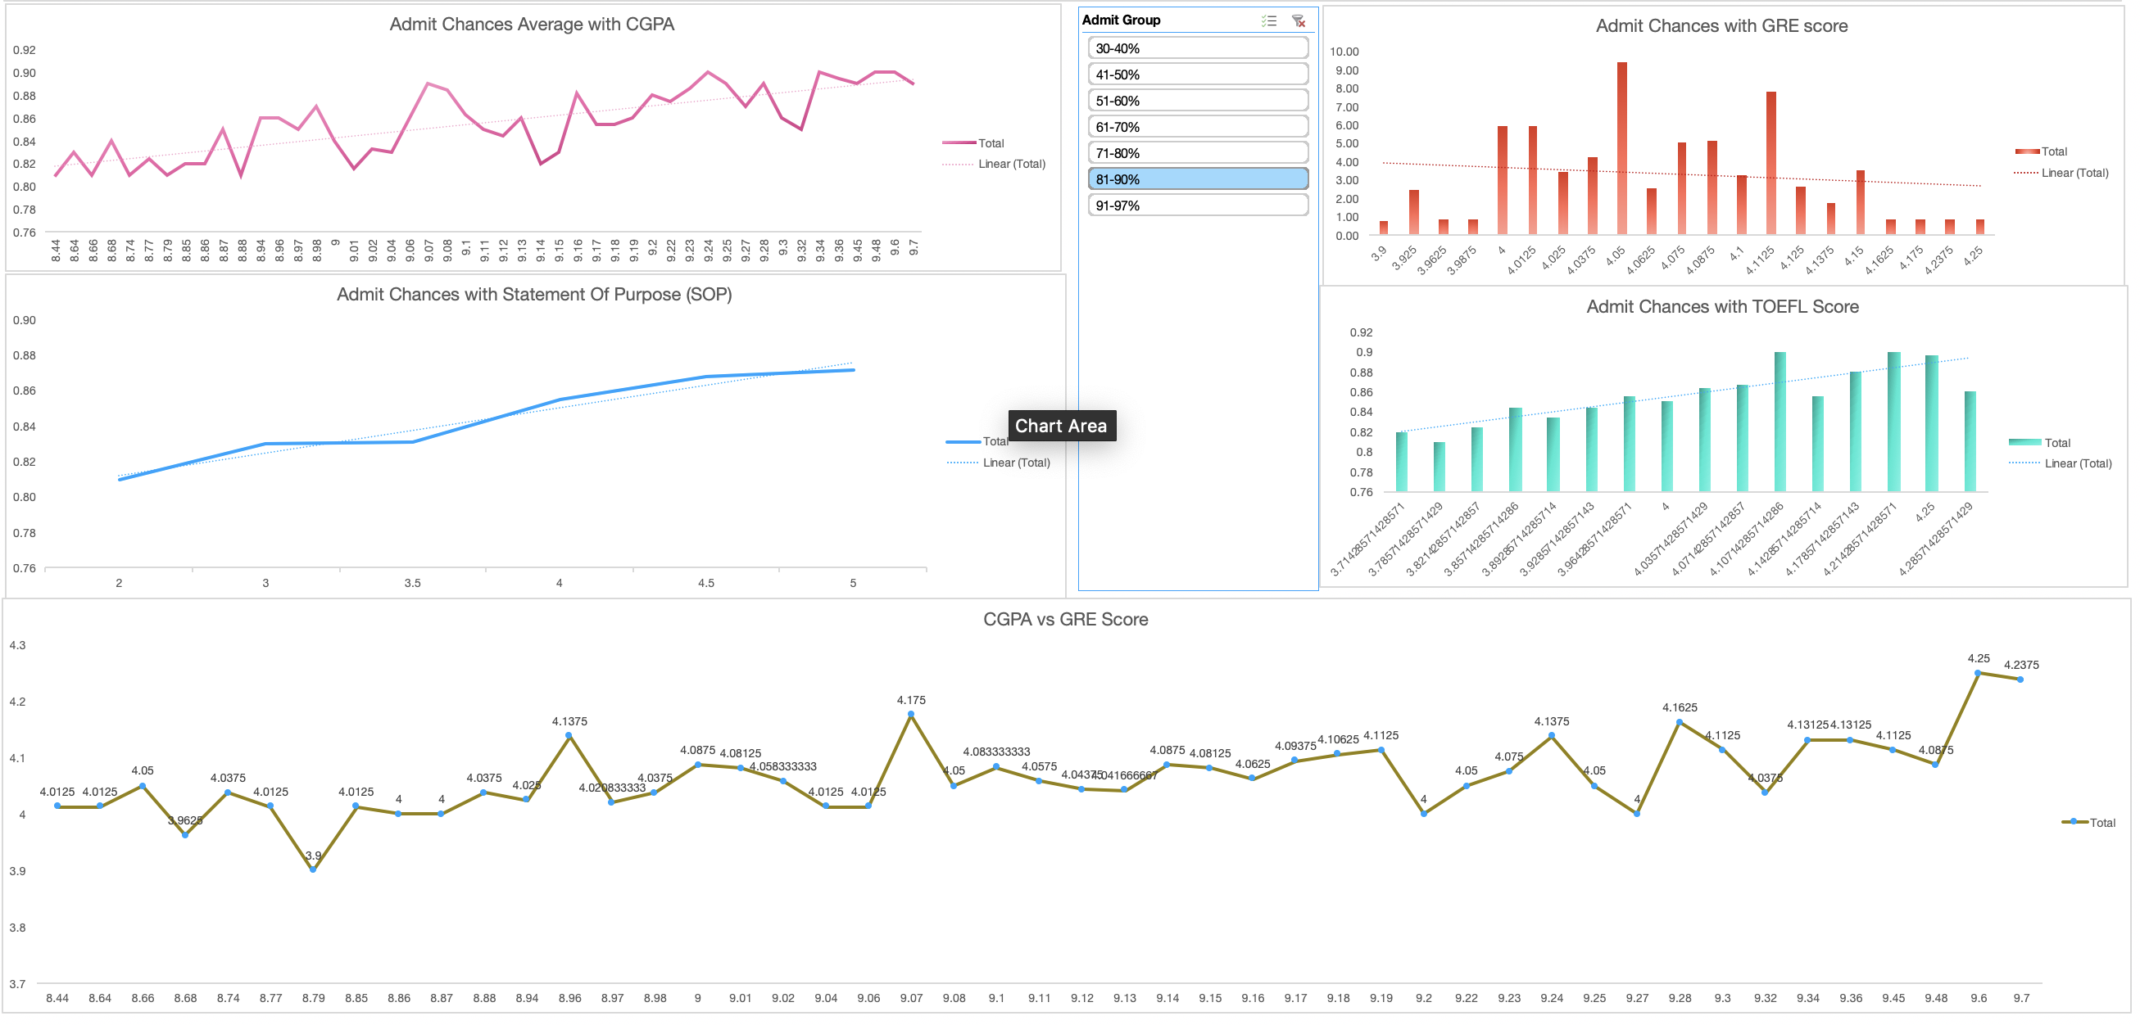

Slide 7
Summary
People with higher GRE Scores also have higher TOEFL Scores which is justified because both TOEFL and GRE have a verbal section which although not similar are relatable but scores in TOEFL are relatively higher.
Although there are exceptions, people with higher CGPA usually have higher GRE scores maybe because they are smart or hard working.
LORs and SOPs seem to have similar approach as per analysis but they don’t tend to be relatively important compared to other factors.
Students from better university tend to have better chances of receiving an admit and also score a bit better CGPA

Slide 8
Conclusion
Your University, GRE score, TOEFL score and CGPA play an important role towards admit for post graduation
Statement of Purpose (SoP) and Letter of Recommendation (LOR) are secondary factors for the admit
Try to work hard for GRE, scoring in GRE is a bit difficult since it is combination of verbal and quands are combined. TOEFL is easier score because it mainly focuses on verbal.
Good CGPA does not determine you would score good in GRE because it requires strong logical reasoning which is not required in university exams (CGPA scores)

