Slide 1
Deep PDE
Leonid Ekimov
Roman Klokov
Ilia Yakubovskiy
October 22, 2015

Slide 2
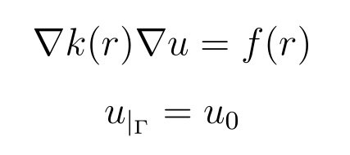
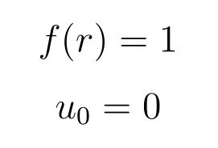
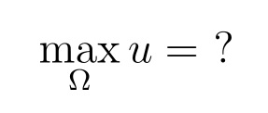
Problem Statement and our Case

Slide 3
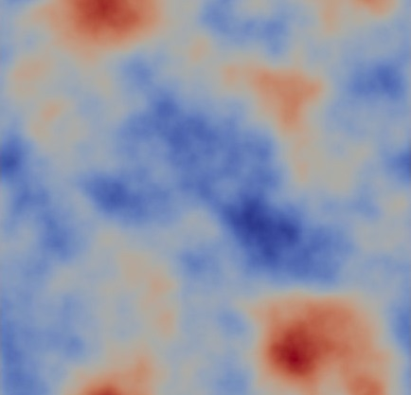
K Field Generation
Gaussian random fields with NIFTY python package

Slide 4
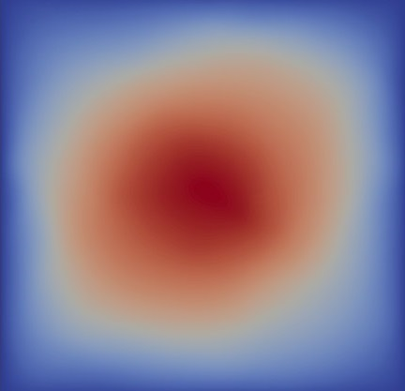
Solving Equation
To solve equation we use Firedrake package.

Slide 5
Input Data Generation
20000 k fields and corresponding maximum solution values splitted into train and test data
Saved in separated hdf5 databases with hdf5 python package

Slide 6
Neural networks
Convolutional neural networks – method of choice
Caffe package can do that!

Slide 7
“Net” 0 (Mean)
Answer = Mean

Slide 8
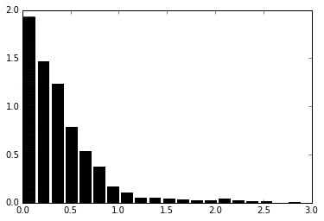
Net 0
Net 0 residuals: L1 norm = 0.095 L2 norm = 0.86

Slide 9
Net 1 (least squares)
Input layer
Inner product (30 outputs)
Inner product (1 output)

Slide 10
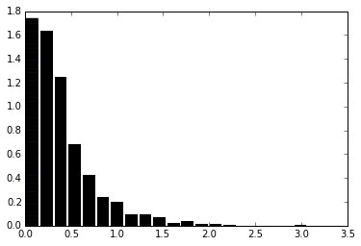
Net 1
Net 1 residuals: L1 norm = 0.395 L2 norm = 0.3

Slide 11
Net 2
Input layer
Convolution (kernel 25 x 25, 40 filters)
Inner product (30 outputs)
ReLU
Inner product (1 output)

Slide 12
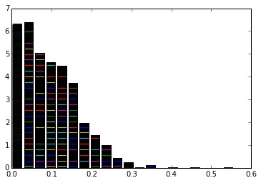
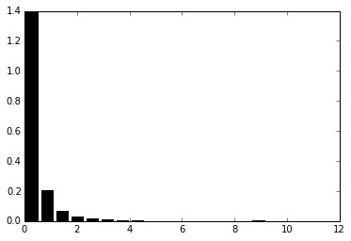
Net 2
Net 2 residuals: L1 norm = 0.09 L2 norm = 0.013

Slide 13
Net 3
Input layer
Convolution (kernel 5 x 5, 20 filters)
Average pooling (kernel 2 x 2)
Convolution (kernel 5 x 5, 50 filters)
Average pooling (kernel 2 x 2)
Inner product (500 outputs)
ReLU
Inner product (20 outputs)
ReLU
Inner product (1 output)

Slide 14
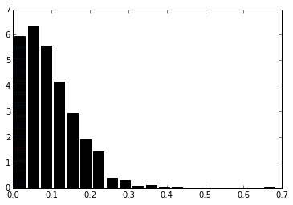
Net 3
Net 3 residuals: L1 norm = 0.095 L2 norm = 0.12

Slide 15
Net 4
Input layer
Convolution (kernel 10 x 10, 40 filters)
Max pooling (kernel 2 x 2)
Convolution (kernel 5 x 5, 30 filters)
Max pooling (kernel 2 x 2)
Inner product (100 outputs)
TanH
Inner product (30 outputs)
ReLU
Inner product (1 output)

Slide 16
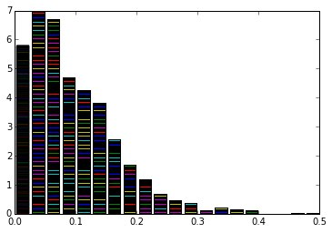
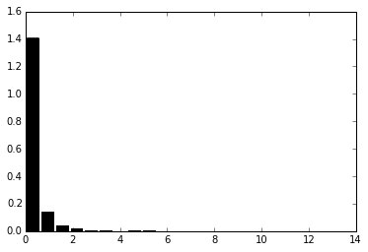
Net 4
Net 4 residuals: L1 norm = 0.096 L2 norm = 0.015

Slide 17
Results Analysis
Overall, the method seems to be feasible
Possibly, the errors are big because of underfitting (lack of computational power led to small learning times)

Slide 18
Remarks
Installation of packages in most cases is not simple
Firedrake package lacks crucial functionality

