Slide 1
Geospatial Data Visualization and Query Interface
-Srujan Kumar Kondi
Notes:
The main objective of this project is to develop an interactive map that users can use to search for specific geographical events based on coordinates. This allows for a visual and intuitive way of exploring data that is otherwise difficult to interpret in tabular or text formats.

Slide 2
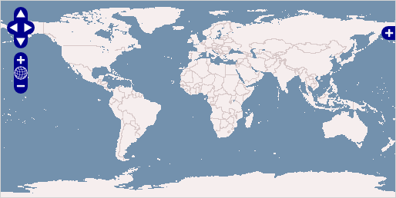
INTRODUCTION
OpenLayers (OL) is employed to create interactive maps on the web. In our project, a map instance is created using OpenLayers with a default view centered at coordinates [0, 0] and zoom level 3.
This map is then populated with two layers: a base layer from OpenStreetMap which is initially invisible, and an aerial imagery layer from Bing Maps which is visible. User interactions with the map, such as clicks, are handled to fetch geographic coordinates, which are then rounded off and used to query PostgreSQL database via backend server.

Slide 3
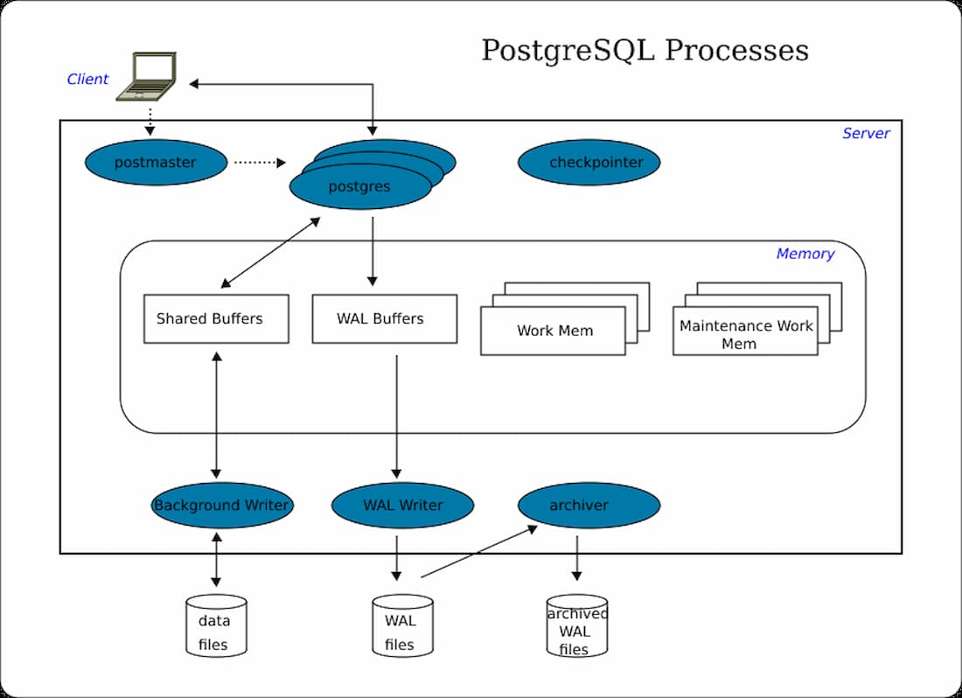
INTRODUCTION
Our project uses PostgreSQL, a robust open-source relational database, to manage geographic data related to storm events. This database is accessed through an Express.js server. The database connection parameters (host, database, user, and password) are defined in server configuration. SQL queries are executed to fetch data based on latitude and longitude, which are passed from the frontend via an HTTP GET request.

Slide 4
HOW DOES THE CONNECTION WORK ?
Frontend Interaction: The user clicks on the map, triggering a function in main.js that captures the coordinates, formats them, and sends a request to the backend.
Backend Processing: The server.js file sets up an Express.js server with a PostgreSQL connection. It defines an endpoint /searchByCoordinates that receives latitude and longitude as query parameters, performs a database query, and returns the results.
Data Fetching and Display: The frontend then receives the data, formats it into a table, and displays it in a popup overlay on the map.

Slide 5
FEATURES AND CAPABILITIES
Interactive Map Navigation: Utilizes OpenLayers for an immersive mapping experience, enabling users to easily navigate, zoom, and click on the map to query geospatial event data in real time.
Dynamic Visualization and Data Layers: Offers dynamic data visualization on the map, including customizable layers and markers, to represent various geospatial events, powered by Bing Maps for detailed imagery.
Efficient Data Querying: Features a responsive backend built with Express.js and PostgreSQL, designed for rapid querying and retrieval of geospatial event data based on user-selected locations.
User-Friendly and Secure: Delivers a seamless and intuitive user experience across different devices, with a focus on data security and privacy, ensuring safe and reliable access to geospatial information
Notes:
The project boasts an interactive map navigation feature that leverages OpenLayers to provide an immersive mapping experience, allowing users to effortlessly navigate, zoom, and interact with the map for real-time querying of geospatial event data.
Additionally, it offers dynamic visualization and data layers with detailed imagery powered by Bing Maps, including customizable layers and markers that accurately represent various geospatial events.
The backend is efficiently designed using Express.js and PostgreSQL, enabling rapid querying and retrieval of data based on user-selected locations.
Furthermore, the platform is crafted to be user-friendly and secure, ensuring a seamless and intuitive user experience across different devices while emphasizing data security and privacy to provide safe and reliable access to geospatial information.

Slide 6
METHODOLOGY
1.Project Initiation and Requirements Gathering:
Identified user needs for geospatial event visualization and interactivity.
2.System Design:
Created a responsive web interface design using OpenLayers for map interactions and architected a RESTful API on the Express.js server for asynchronous data handling.
3.Development:
Coded the frontend for user interactions, including map clicks that trigger data requests.
Developed backend logic to receive coordinates, query the PostgreSQL database, and return results.
4.Integration:
Integrated the interactive map with real-time data retrieval from the backend.
5.Testing:
Tested frontend interactivity and backend response under various scenarios.
Validated the accuracy and performance of geospatial queries and data display.
6.Deployment:
Deployed the application on a server with considerations for scalability and security.

Slide 7
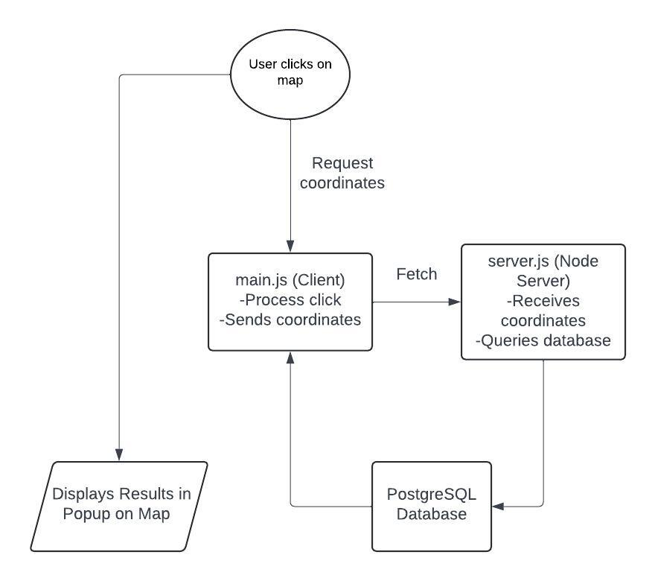
FLOWCHART

Slide 8
IMPLEMENTATION
Map Setup
OpenLayers Map Configuration:
  View: Centered at [0, 0] with zoom level 3, using 'EPSG:4326' projection suitable for latitude and longitude.
  Layers:
    Base Layer: OpenStreetMap tiles, initially hidden.
    Aerial Imagery: Bing Maps satellite layer, visible on load.
Significance:
  Layers allow for switching visual styles and information.
  View settings provide initial user orientation and map interaction controls.

Slide 9
IMPLEMENTATION
Database Configuration
PostgreSQL Schema:
  Typical columns include event_id, latitude, longitude, event_date, and description.
Indices:
  Geographic Indices: Spatial indexing on latitude and longitude for efficient spatial queries.
  B-tree Indices: On event_id and event_date for fast lookups and ordering.
Backend Server Logic
Express.js Setup:
  Utilizes CORS middleware to handle cross-origin requests.
API Endpoints:
  /searchByCoordinates: Returns event data for given geographic coordinates using secure, parameterized SQL queries.
  /test: Confirms CORS functionality and server responsiveness

Slide 10
CHALLENGES AND SOLUTIONS
Issue 1: Handling Asynchronous Requests
Challenge: The primary challenge was managing asynchronous database queries and API responses efficiently. Asynchronous operations are crucial for not blocking the Node.js server's single thread, but they can lead to callback hell if not handled properly.
Solution: Implemented JavaScript's async/await syntax within Express.js routes. This modern feature of ECMAScript simplifies the callback structure and improves code readability and error handling. For instance, asynchronous functions allow server routes to await database responses cleanly before proceeding, thus maintaining a non-blocking flow and clearer code.

Slide 11
CHALLENGES AND SOLUTIONS
Issue 2: Performance Optimization in Spatial Queries
Challenge: Initial implementations of spatial queries on large datasets led to slow response times. Efficient querying of geospatial data is pivotal, especially when interfacing with a frontend application that expects quick load times.
Solution: Spatial Indexing: Implemented GiST (Generalized Search Tree) indices for PostgreSQL spatial data columns (latitude, longitude). GiST indices significantly enhance performance for queries involving spatial operations such as radius searches or nearest neighbor searches.
Query Optimization: Refined SQL queries to reduce the amount of data processed and transferred. For example, using SELECT specific_columns instead of SELECT * to only retrieve necessary data.

Slide 12
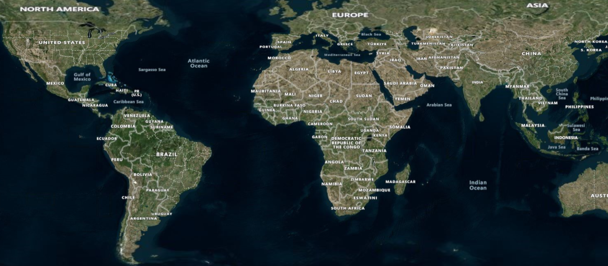
RESULT ANALYSIS
The application displays query results in an intuitive format directly on the map interface, providing users with immediate access to the geospatial event data they've requested. This efficient presentation of information enhances user understanding and facilitates in-depth analysis of the data.

Slide 13
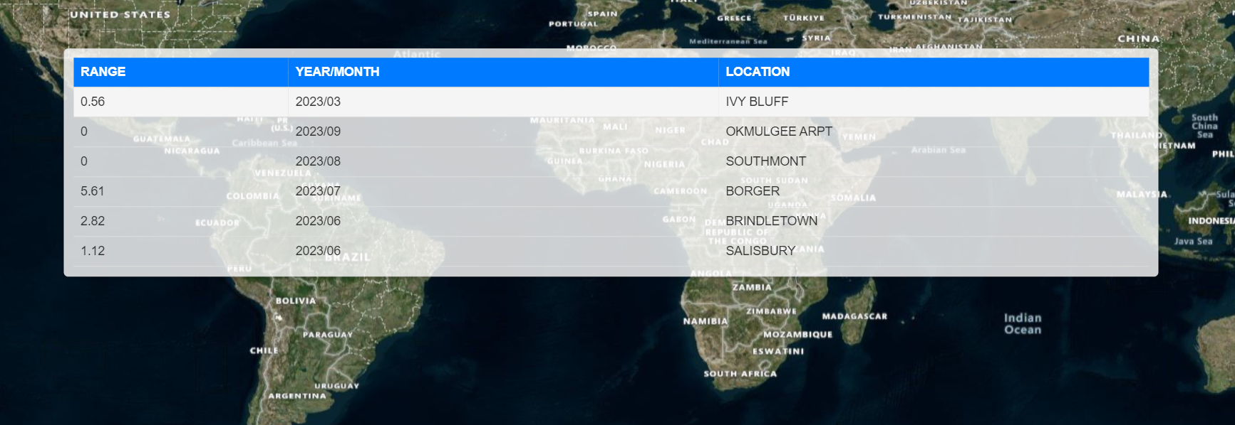
RESULT ANALYSIS

Slide 14
CONCLUSION
Robust Interactive Mapping: Successfully integrated OpenLayers to create a dynamic and interactive mapping application that allows users to visualize geospatial data effectively.
Efficient Data Handling: Optimized PostgreSQL database with spatial indexing to handle complex queries swiftly, ensuring high performance and quick data retrieval.
Advanced Backend Solutions: Developed a scalable and secure backend using Express.js, which efficiently manages asynchronous data flow and protects against common web vulnerabilities.

Slide 15
FUTURE DIRECTIONS
Error Handling: Improve client-side error handling to more gracefully handle issues like network errors or invalid responses.
UI Enhancements: Consider adding more interactive elements to the user interface, such as filters for the type of events displayed or a search box to jump to specific regions.
Performance: For larger datasets, consider implementing server-side pagination or clustering on the map to improve load times and usability.

Slide 16
THANK YOU

