Slide 1
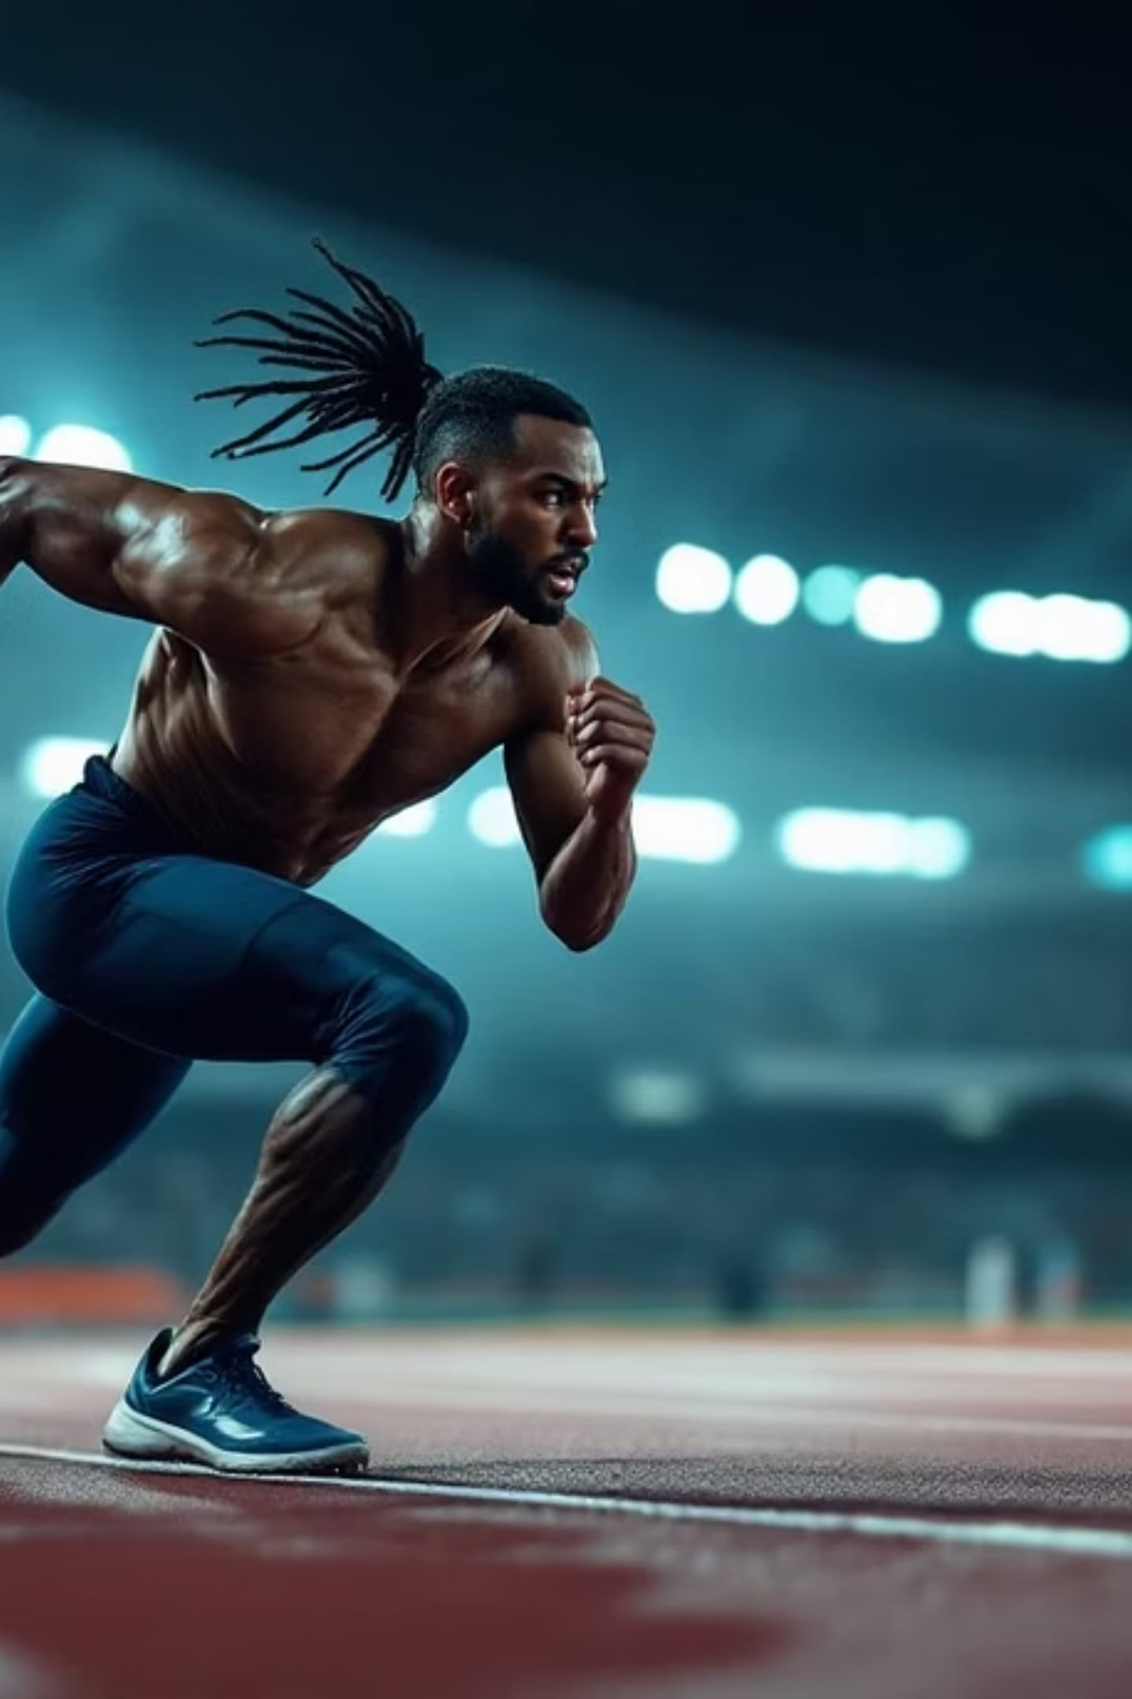
Unleashing Potential
The 6 Pillars of Skill-Related Fitness
What separates good athletes from elite performers — it's not just strength or endurance.

Slide 2
Defining the Performance Edge
Skill-related fitness components are trained motor abilities — not inherited traits — built through targeted practice.
Agility
Balance
Coordination
Power
Reaction Time
Speed

Slide 3

PILLAR 1
Speed
Definition
Performing a movement or covering distance in the shortest possible time
Elite Example
There was an error generating this image
Usain Bolt's 9.58s 100m world record
Test
30m or 40m sprint dash

Slide 4
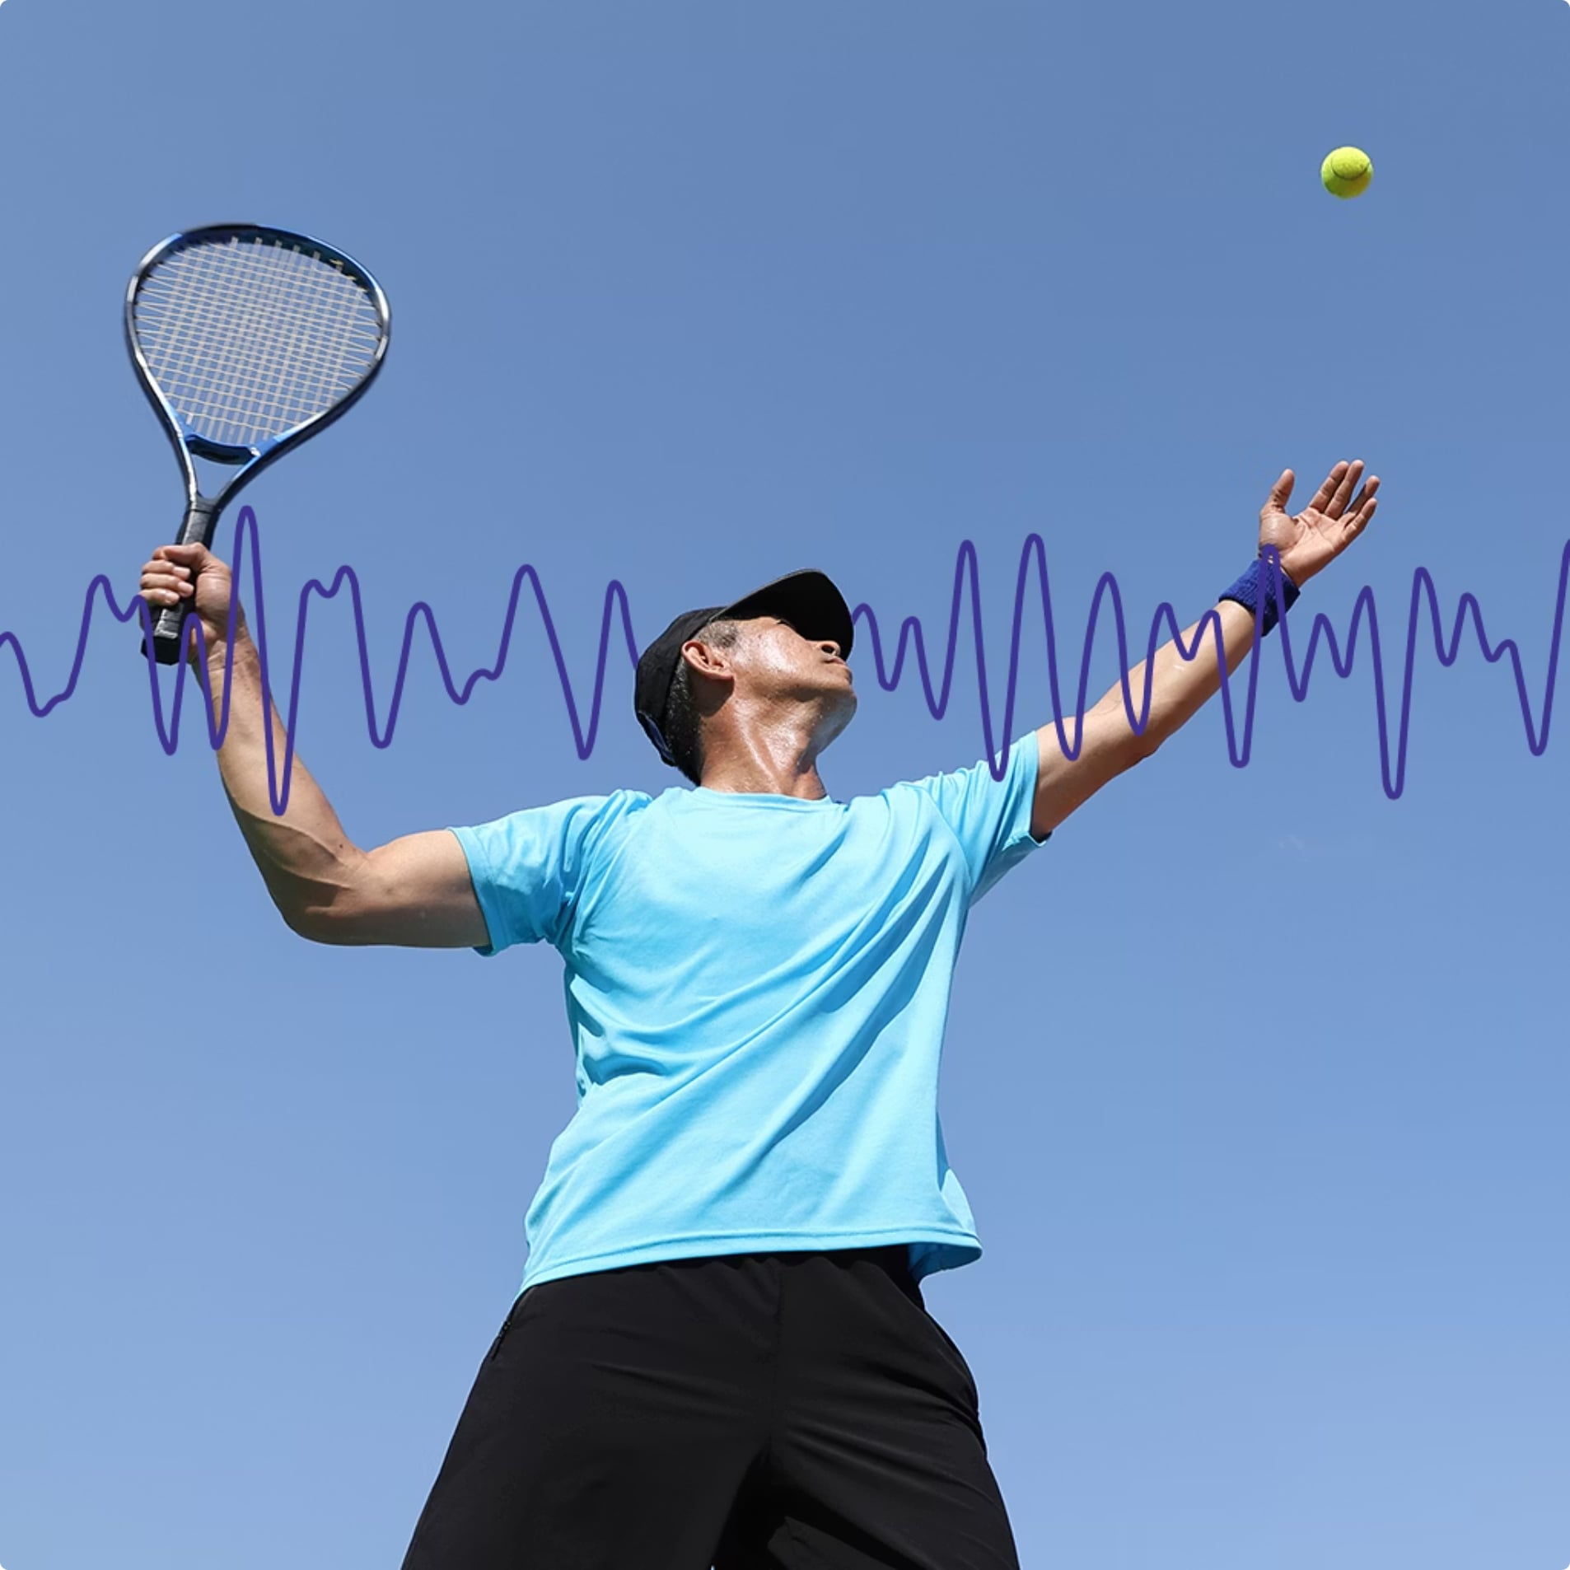
_{PILLAR 2}
_{Coordination}
_{Definition}
Using senses and body parts together for smooth, accurate motor tasks
_{Elite Example}
Tennis player's serve — precise hand-eye synchronization
_{Test}
_{Alternate hand wall-toss test}

Slide 5
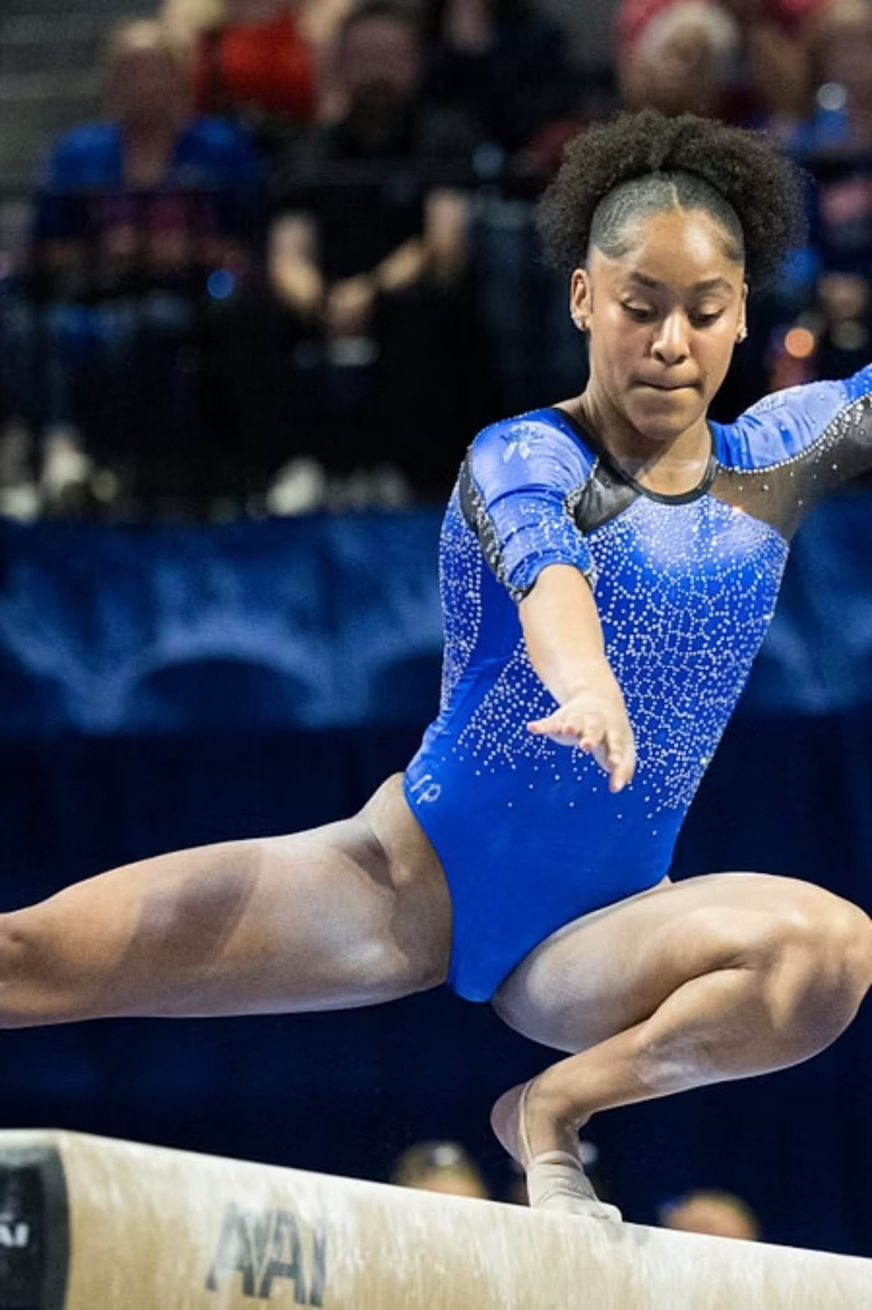

PILLAR 3
Balance
Definition
Maintaining equilibrium — stationary or in motion
Elite Example
Gymnast executing a precise balance beam routine
Test
Stork Balance Stand test

Slide 6
PILLAR 4
Agility
Definition
Rapidly and accurately changing direction at speed
Elite Example
There was an error generating this image
Rugby player stepping past a defender to clear the line
Test
Illinois Agility Run or shuttle runs

Slide 7
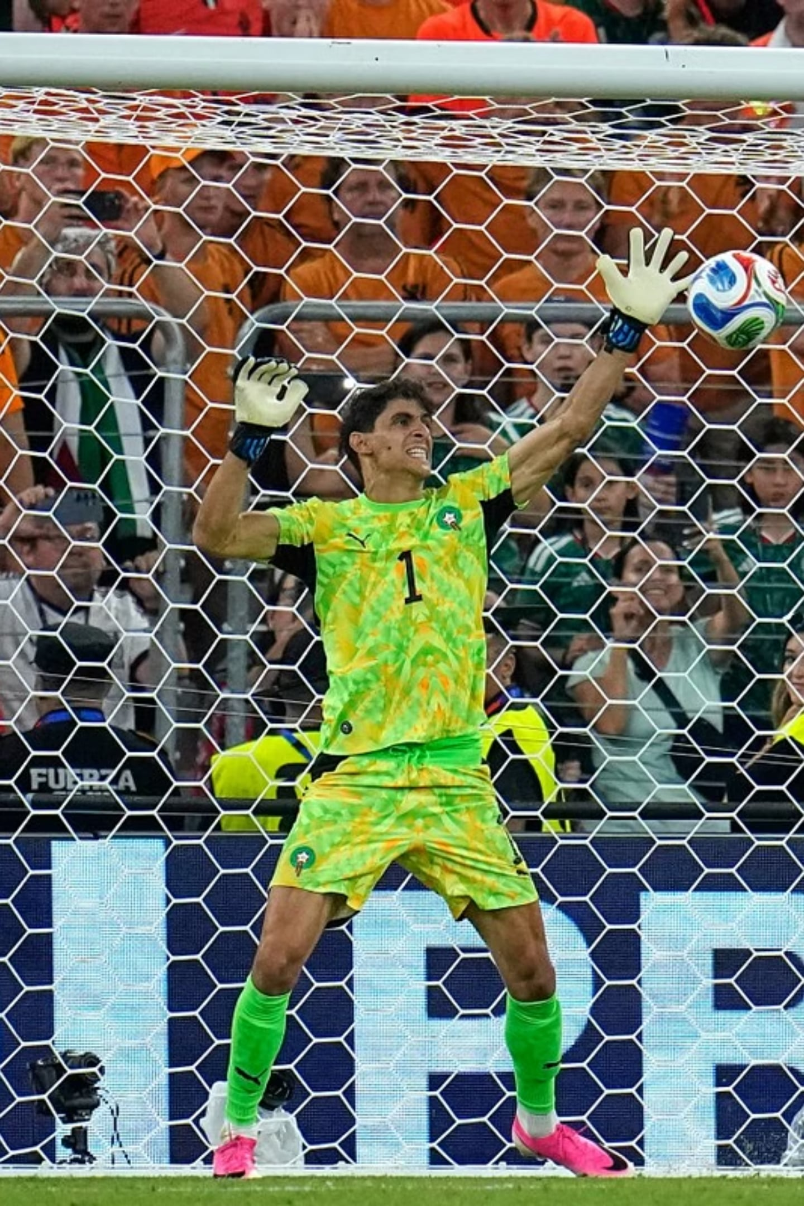
PILLAR 5
Reaction Time
Definition
Elite Example
Time between a stimulus and the initiation of a response
Goalkeeper diving the instant the ball is struck
Test
Ruler Drop test

Slide 8
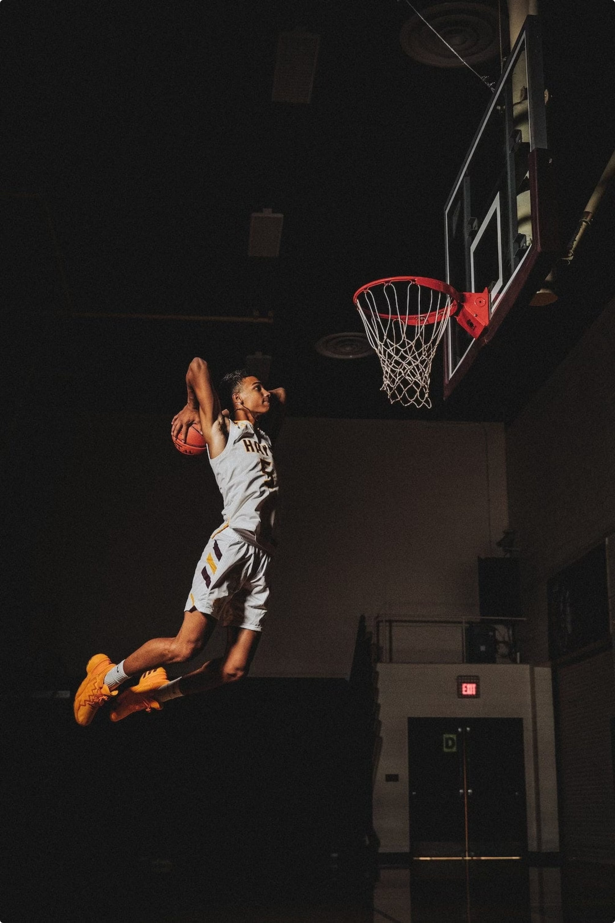
PILLAR 6
Power
Definition
Strength × Speed — explosive energy output
Elite Example
Basketball player's vertical leap to
secure a rebound
Test
Vertical Jump test

Slide 9
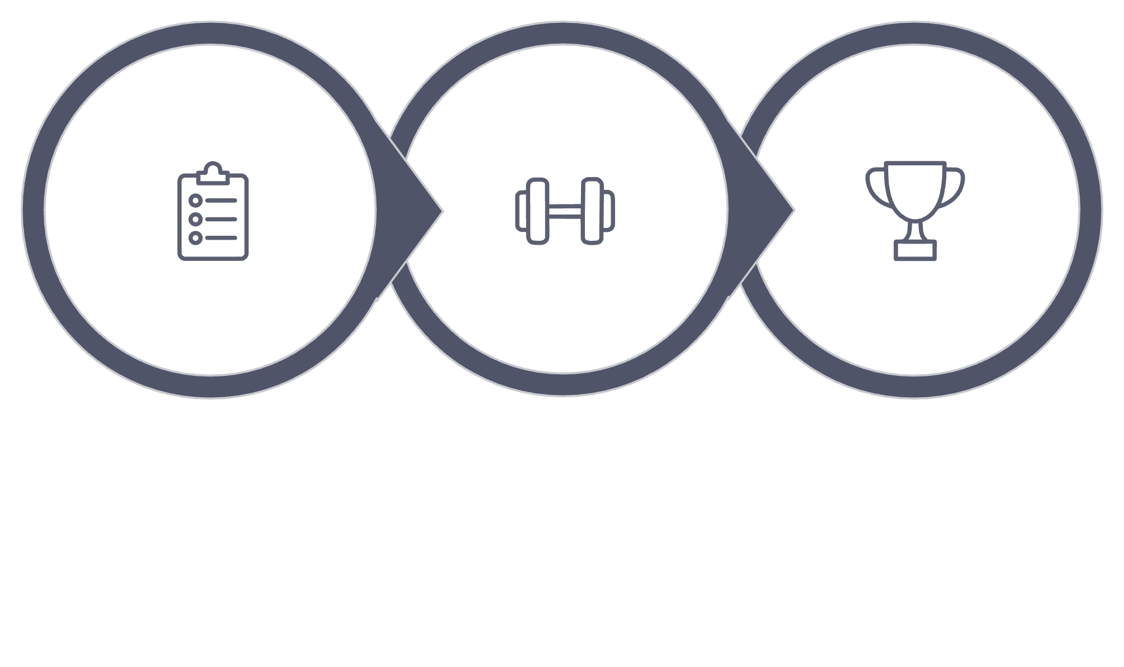
Training for Mastery
Performance is built — not born. These components respond to neurological and physical conditioning.
Assess
Train
Dominate
Success requires a tailored blend of all six components matched to your sport's demands.

Slide 10

Your Competitive Advantage
Assess Your Baseline
Test each component to find your starting point
Train with Intent
Targeted drills transform potential into dominance
Compete at Your Peak
The difference between participation and elite performance

