Slide 1
HitMe

Slide 2
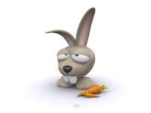
Your time starts now . . .
1:00
Scores
Restart
Quit

