Slide 1




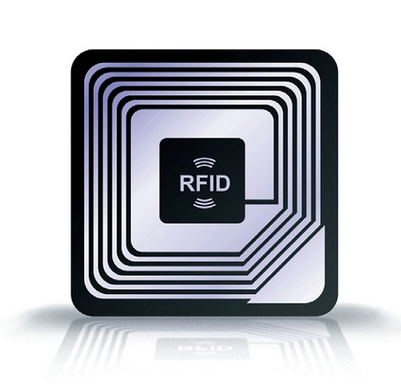
SuperUROP Phase A
Backend to authenticate product messages.
Project proposal of related SuperUROP in Anantha lab.
RFID Reader. Receives messages from chip and forwards them to server for authentication. Displays product's authentication status for user.
Item requiring product validation. Authentication chip designed by Anantha lab.

Slide 2


SuperUROP Phase B (Orange Outline)
Fabricated ASIC
Prototype software model of algorithm
Development of a voice recognition ML algorithm based in homomorphic encryption
Software model of recognition ASIC with benchmarks.
Design Process of the SuperUROP's Homorphically Encrypted Voice Recognition ASIC.

