Slide 1
Speaker Verification
Using Adapted GMM
Presented by CWJ 2000/8/16

Slide 2
Reference
1.Douglas A. Reynolds, Thomas F. Quatieri, Robert B. Dunn,
Speaker Verification Using Adapted Gaussian Mixture Models.
Digital Signal Processing. 10(2000), 19-41.
2.Martin A., Doddington G., Kamm T., Ordowski M., Przybocki M.
The DET curve in assessment of detection task performance.
Eurospeech 97, 1895-1898

Slide 3
Outline
Likelihood Ratio Detector
Alternative Speaker Model
GMM-UBM Verification System
Score Normalization
Introduction to DET curve
Experiment Result

Slide 4
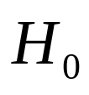

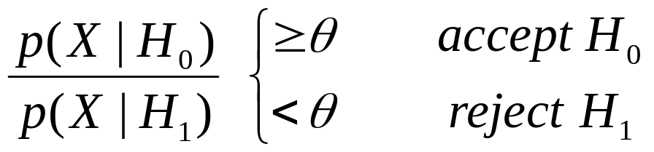
Likelihood Ratio Detector
define:
: observation X is from the hypothesized speaker S
: X is not from the hypothesized speaker S
decision:
take Log:

Slide 5
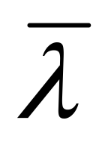
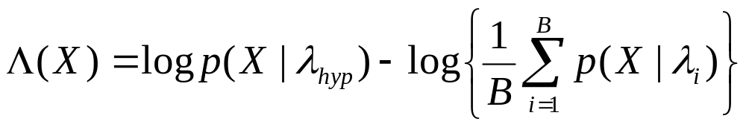
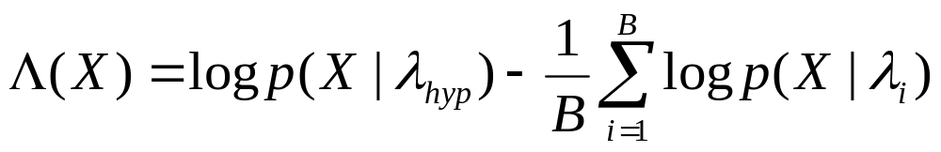
Alternative Speaker Model:
1. Cohort Model :
The model derived from a set of imposters’ models
which are closest to the hypothesized speaker.
likelihood evaluated by arithmetic mean:
likelihood evaluated by geometric mean:

Slide 6
2. World Model :
Given a collection of speech samples from a large
number of speakers is trained to represent the
alternative hypothesis of each speaker.

Slide 7
GMM-UBM Verification System
1.Universal Background Model :
The UBM is a large GMM trained to represent the
speaker-independent distribution of features.
two approaches:
1. Pool all the data to train the UBM via EM
2. Train individual UBMs over the subpopulations in
the data, then combine all of them.

Slide 8
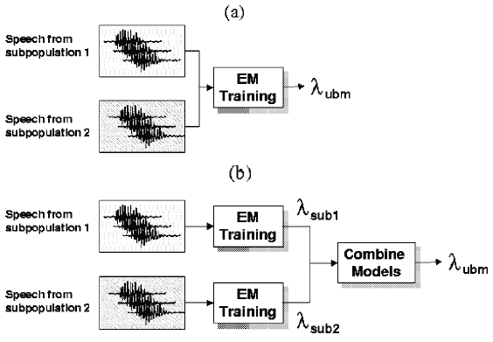

Slide 9
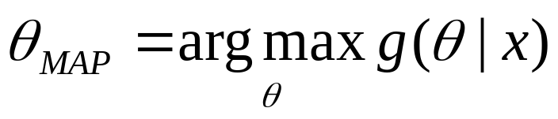
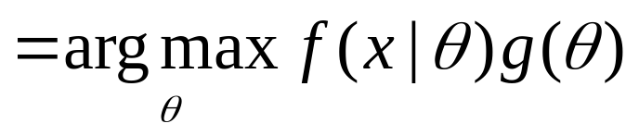
2. Adaptation of Speaker Model
MAP estimation :

Slide 10




Two Steps :
1. Estimates of the sufficient statistics of the speaker’s
training data are computed for each mixture in the
UBM.
=> sufficient statistics for weight,mean,and variance

Slide 11
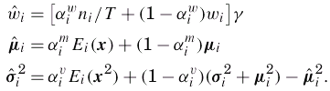

2. The new sufficient statistics are used to update the old UBM sufficient statistics.
The adaptation coefficients control the
balance between old and new estimates for weights,
means, and variances,respectively.

Slide 12

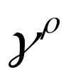
Calculate adaptation coefficient
Where : a fixed relevance factor for parameter ρ
In general MAP, is parameter-dependent.
However, in this paper, the authors use a single
relevance factor for all parameter. i.e. =16

