Slide 1
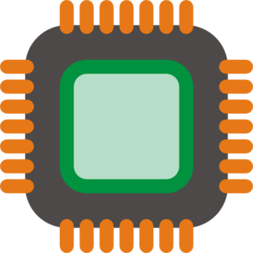



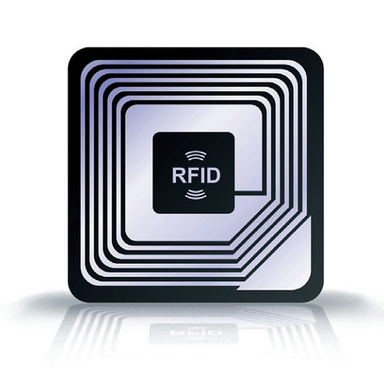
SuperUROP Phase A
Backend to authenticate product messages.
Project proposal of related SuperUROP in Anantha lab.
RFID Reader. Receives messages from chip and forwards them to server for authentication. Displays product's authentication status for user.
Item requiring product validation. Authentication chip designed by Anantha lab.

